Slide 1
New Connectivity for Research and Education Networks
Pacific Islands Research & Education
Networking Workshop
University of Hawaii
Jan. 18, 2013
Steve Blumenthal
VP Strategic Solutions

Slide 2




Company overview
What we do
Building a next-generation satellite constellation: capable of offering our customers connectivity which is better, faster
and more affordable
Initial constellation
of twelve MEO satellites: providing fiber-like latency
Continuous coverage: when one satellite leaves, another satellite takes over without transmission interruption
70+
KA-band beams of 700km diameter: steerable around the globe, each delivering up to 1.2 Gbps
Each beam is connected to a high throughput teleport providing reliable, high-speed internet at a
competitive price
O3b is 100% funded and on schedule for service
launch Oct 2013

Slide 3
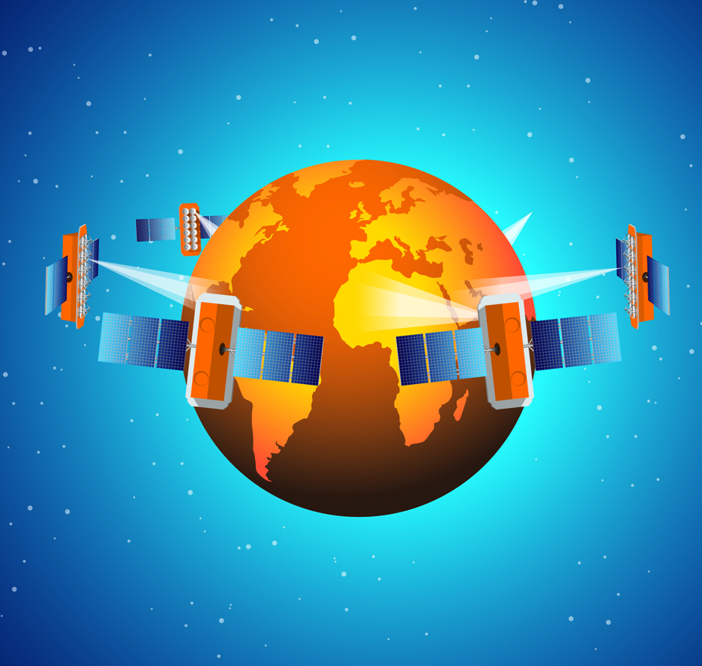







Company overview
Value proposition
MEO: 8,062km altitude
High Bandwidth | Scalable options from 100 Mbps to 1 Gbps
High Speed | 432 MHz steerable beams 6 x faster than 72 MHz Geostationary satellite transponders
Low Latency | Roundtrip latency of 130ms enabling:
 | Faster Interactivity Superior voice quality
Low Cost | Significantly lower cost than Geostationary
Flexibility | Steerable 700km beams can be placed anywhere w/in ±45 degrees of the Equator

Slide 4
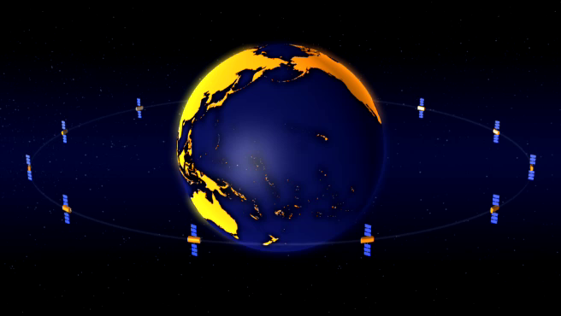
Constellation Animation
O3bEnergy Presentation
Notes:
Animation should be set to play in full screen and loopback automatically and the presentation of how the system works should be complete by the end of the animation but allowing for a few minutes of Q&A before moving on. The audience must grasp how the system works at a high level before progressing with the slides.

Slide 5
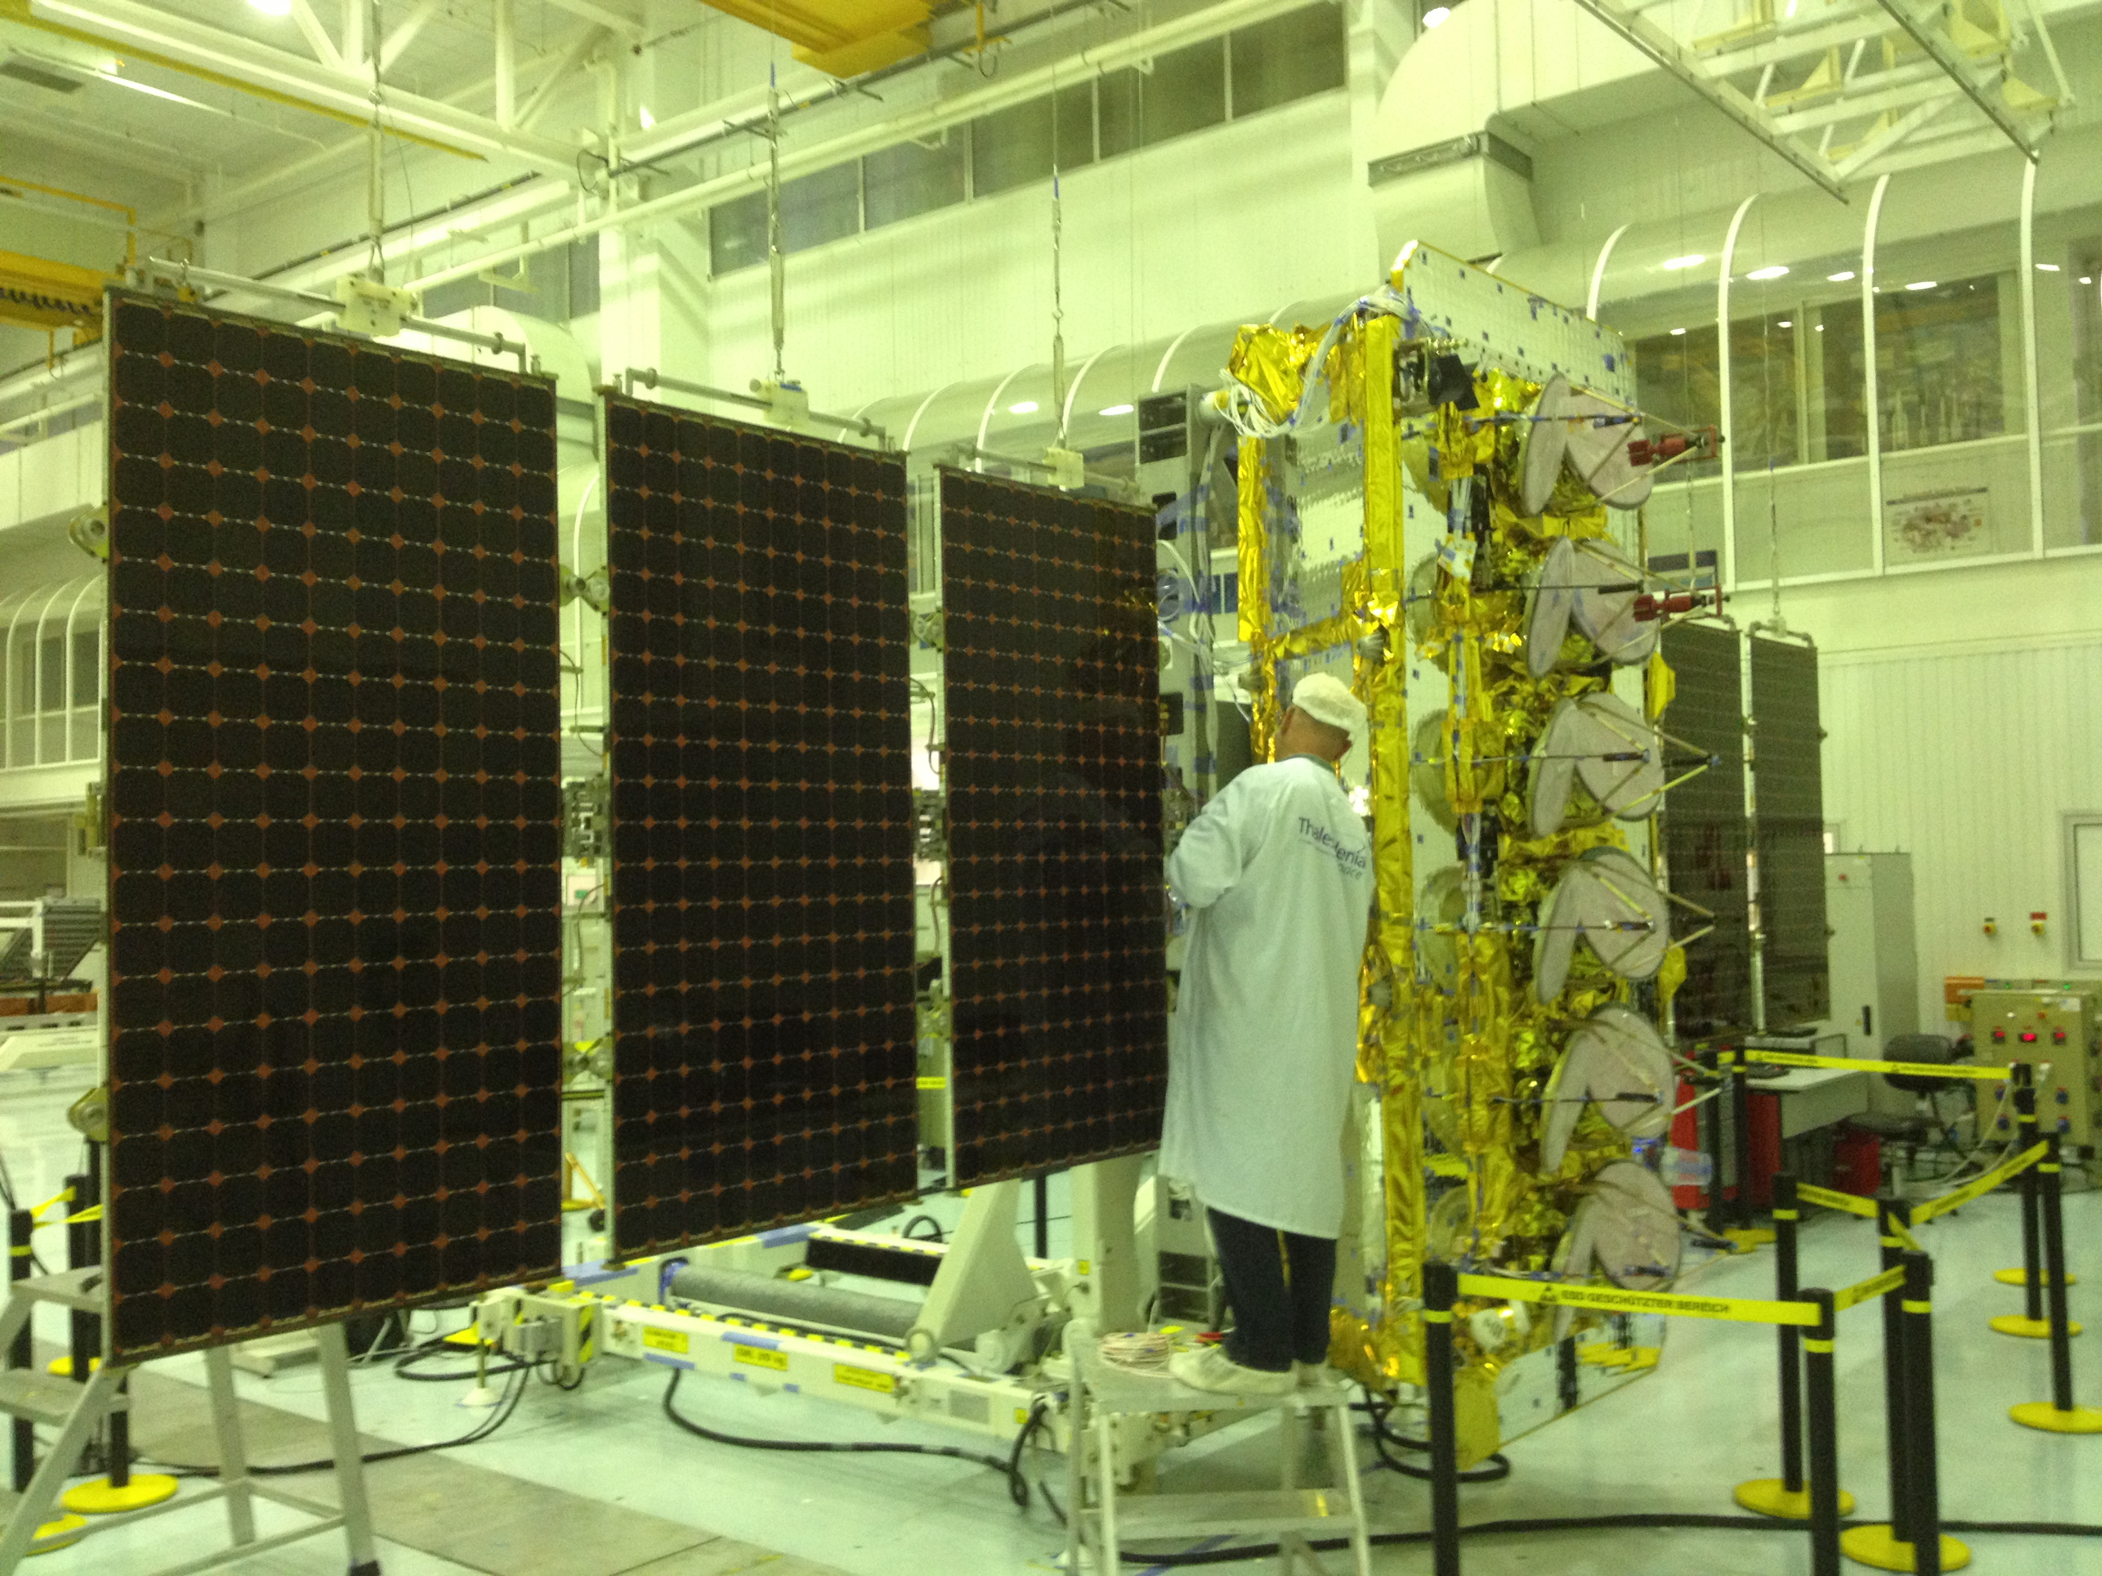
On Track for May 2013 Launch
- 12 Satellites under construction

Slide 6
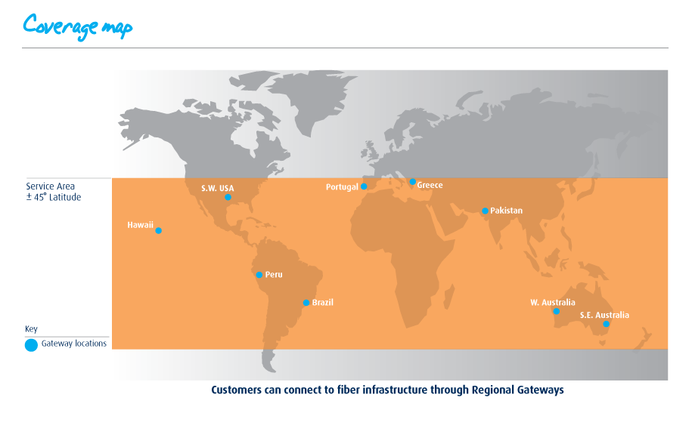
Coverage and Fiber Interconnect at Regional Gateways
Global Coverage anywhere 45°North/South of the equator

Slide 7

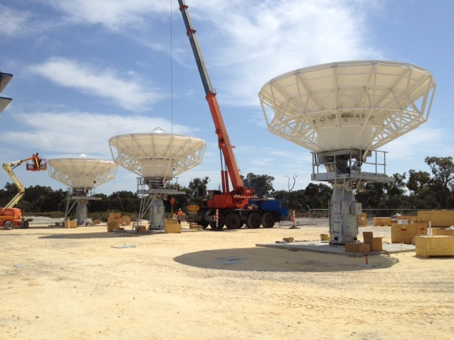
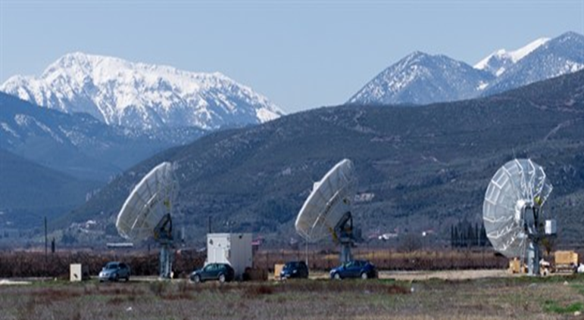

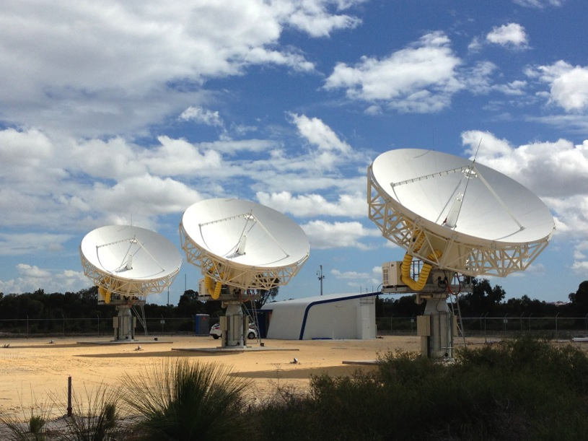


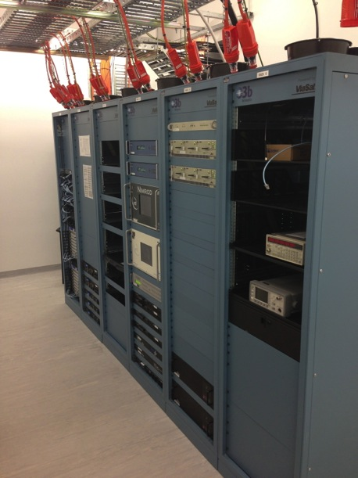
O3b Gateways
Nemea, Greece
Perth, Australia
Haleiwa, Oahu, Hawaii

Slide 8
Terminal Overview
8

Slide 9
O3bTrunk Scalable Bandwidth
Scalable data rates from 100 Mbps – 1 Gbps
  Pay for what you use today
  Buy more capacity to grow as your demand increases
Designed for high speed Internet service with 3:1 ratio of forward to return data rates
Competitively priced
    30% below GEO satellite capacity
 | Forward Data Rate (Mbps) | Return Data Rate (Mbps)
O3bTrunk 100 | 75 | 25
O3bTrunk150 | 115 | 35
O3bTrunk 200 | 150 | 50
O3bTrunk 400 | 300 | 100
O3bTrunk 600 | 450 | 150
O3bTrunk 800 | 600 | 200
O3bTrunk 1G | 750 | 250
9

Slide 10
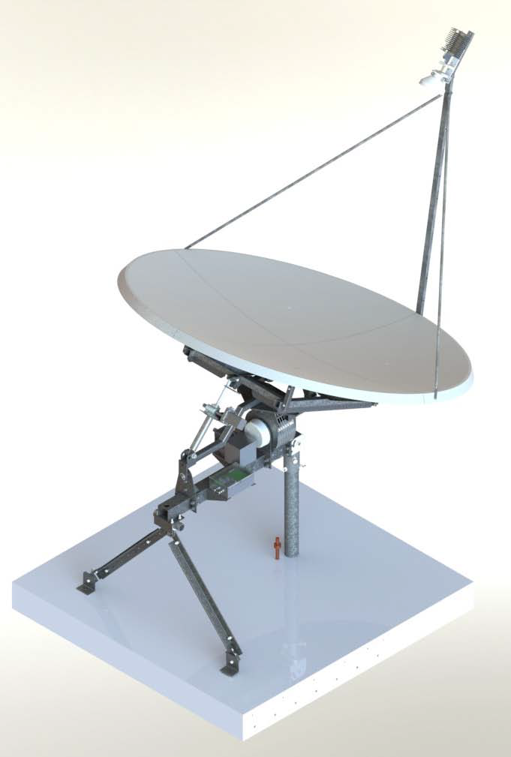
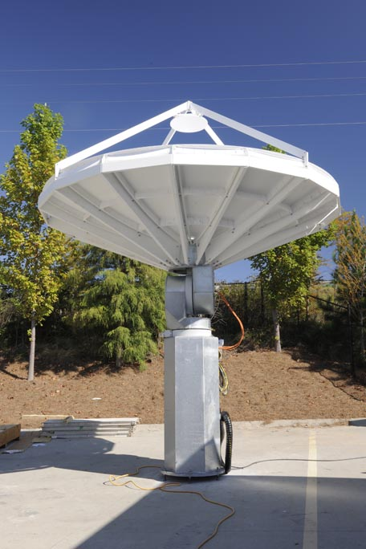
O3b Terminal Range
- Land based
1.8m Antenna
5/10/20W
VSAT Modem
2.4m Antenna
5/10/20/40W
High Data Rate or VSAT Modem
4.5m
40/500/750W
High Data Rate Modem
7.3m
500/750W
High Data Rate Modem
ViaSat
$1.2M
GD Satcom
$400-700k
$60-120k
$35-60k
Terminal Cost
10-50
155
500
Maximum Return Link Capacity (Mbps)
Notes:
10

Slide 11
Terminal Throughput Ranges
Antennas | Power Amplifier | Max. Forward Data Rates | Max. Return Data Rates
Dual 1.8m | 5W | 200 - 400 Mbps | 1-10 Mbps
Dual 1.8m | 10W | 200 - 400 Mbps | 5 – 20 Mbps
Dual 1.8m | 20W | 200 - 400 Mbps | 25 - 50 Mbps
Dual 2.4m | 20W | 300 - 500 Mbps | 50 – 100 Mbps
Dual 2.4m | 40W | 300 - 500 Mbps | 80 - 160 Mbps
Dual 4.5m | 40W | 450 - 750 Mbps | 150 - 470 Mbps
Dual 4.5m | 500W | 450 - 750 Mbps | 400 - 600 Mbps
Dual 7.3m | 500W | 500 – 750 Mbps | 500 – 750 Mbps

Slide 12
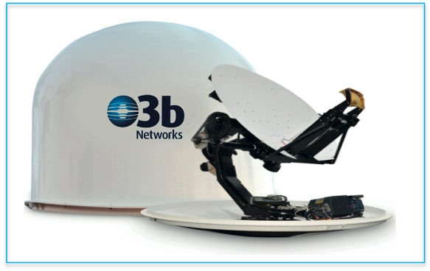
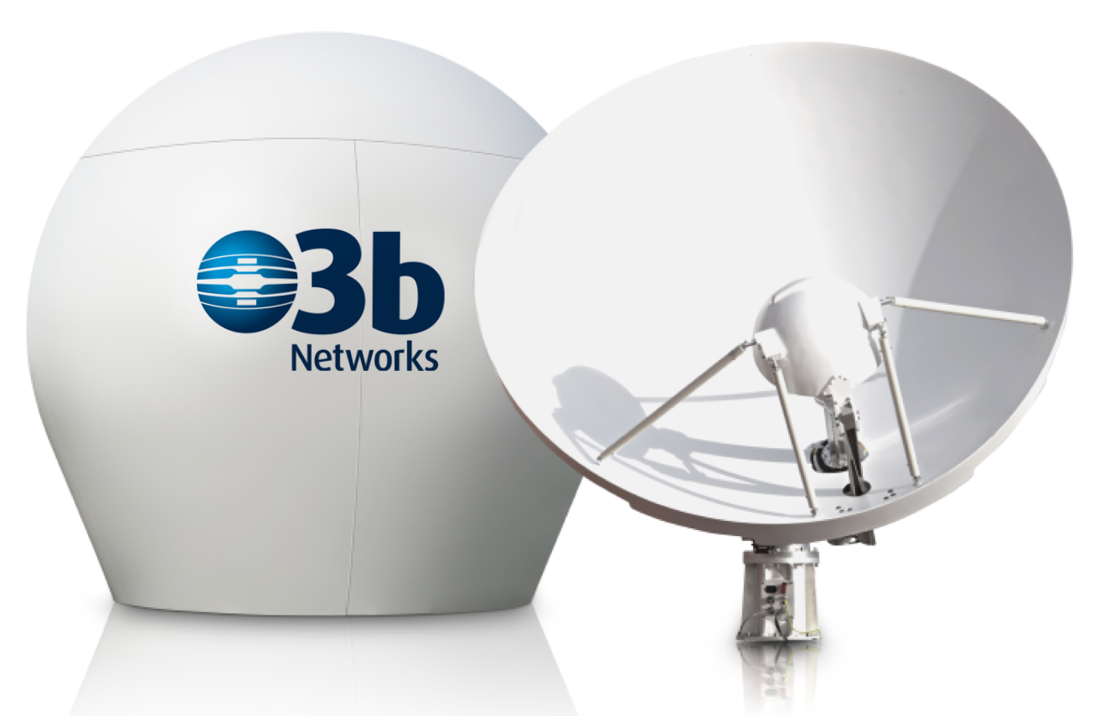
Shipboard Stabilized
Ka Band Terminals
1.2m and 2.2m Stabilized Terminals:
Dual tracking antennas provide seamless handover at end of pass and in case of blockage if together they can see 360 degrees
2.7m Radome for 2.2m Antenna
System | Size | Data Rates | Optional BUC’s
O3b 1.2m | 1.2m | 5 – 200 Mbps | 5W / 10W / 20W
O3b 2.2m | 2.2m | 100 – 350 Mbps | 20W / 40W
12
12

Slide 13
Stablized Terminal
- Throughput Ranges
Antennas | Power Amplifier | Typical Forward Data Rates | Typical Return Data Rates
Dual 1.2m | 5W | 100 - 200 Mbps | 1-5 Mbps
Dual 1.2m | 10W | 100 - 200 Mbps | 5 – 10 Mbps
Dual 1.2m | 20W | 100 - 200 Mbps | 10 - 25 Mbps
Dual 2.2m | 10W | 200 - 350 Mbps | 10 – 25 Mbps
Dual 2.2m | 20W | 200 - 350 Mbps | 35 - 75 Mbps
Dual 2.2m | 40W | 200 - 350 Mbps | 100 – 150 Mbps
13

Slide 14
O3b Pacific Regions
14

Slide 15
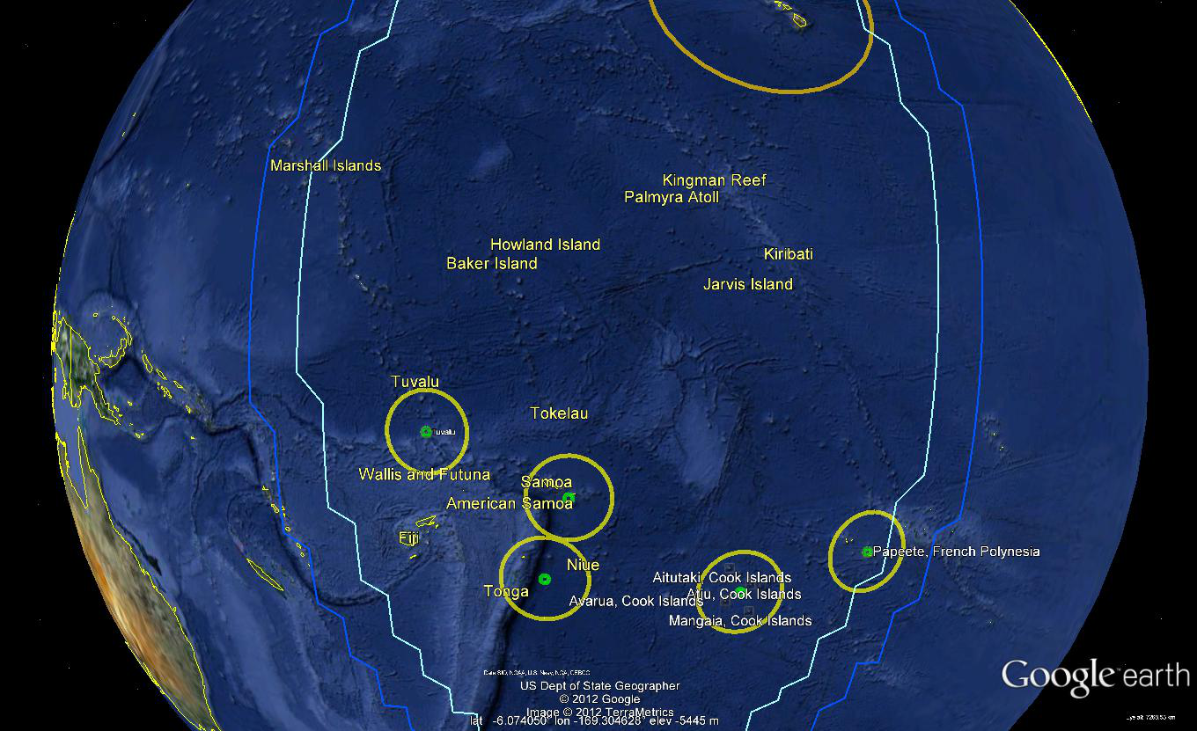
Region 5B – Homed to Hawaii Gateway
16 Nov 2012

Slide 16
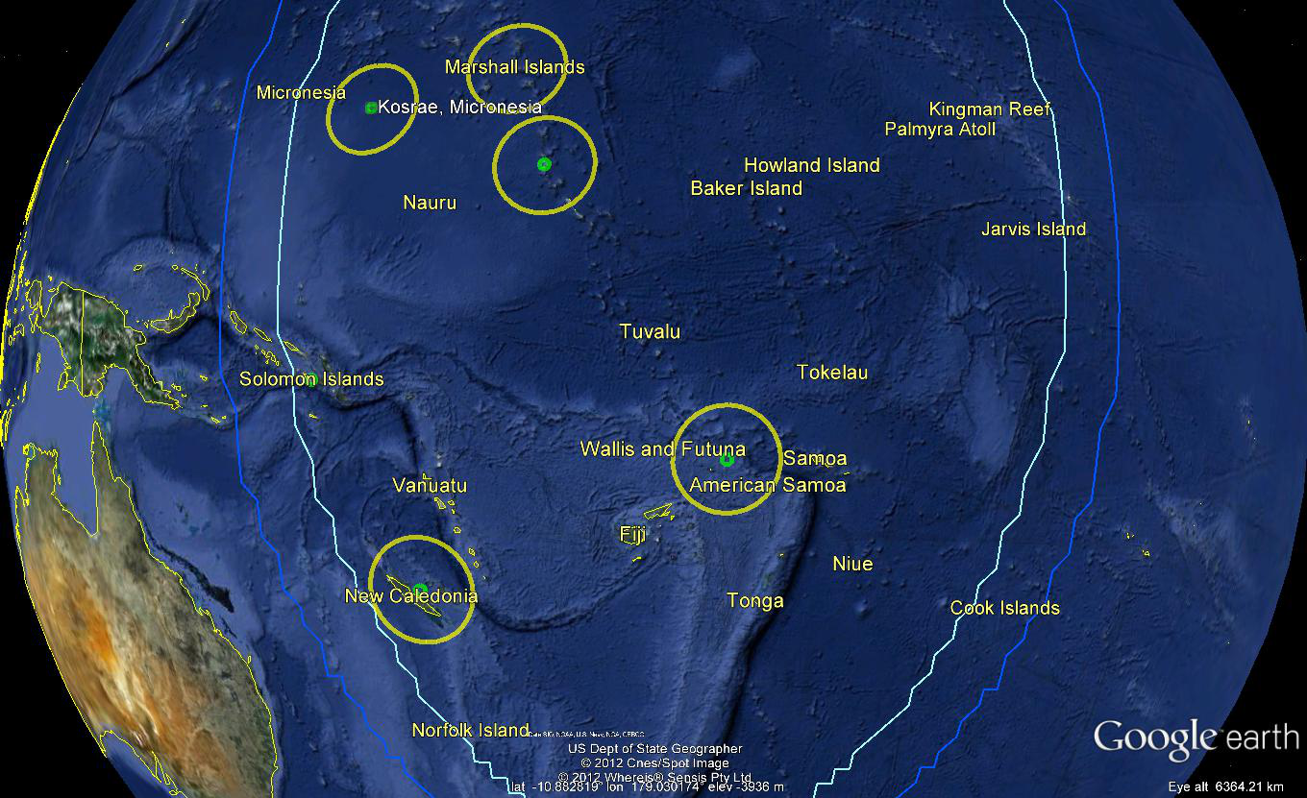
Region 5A – Homed to Hawaii Gateway
16 Nov 2012

Slide 17
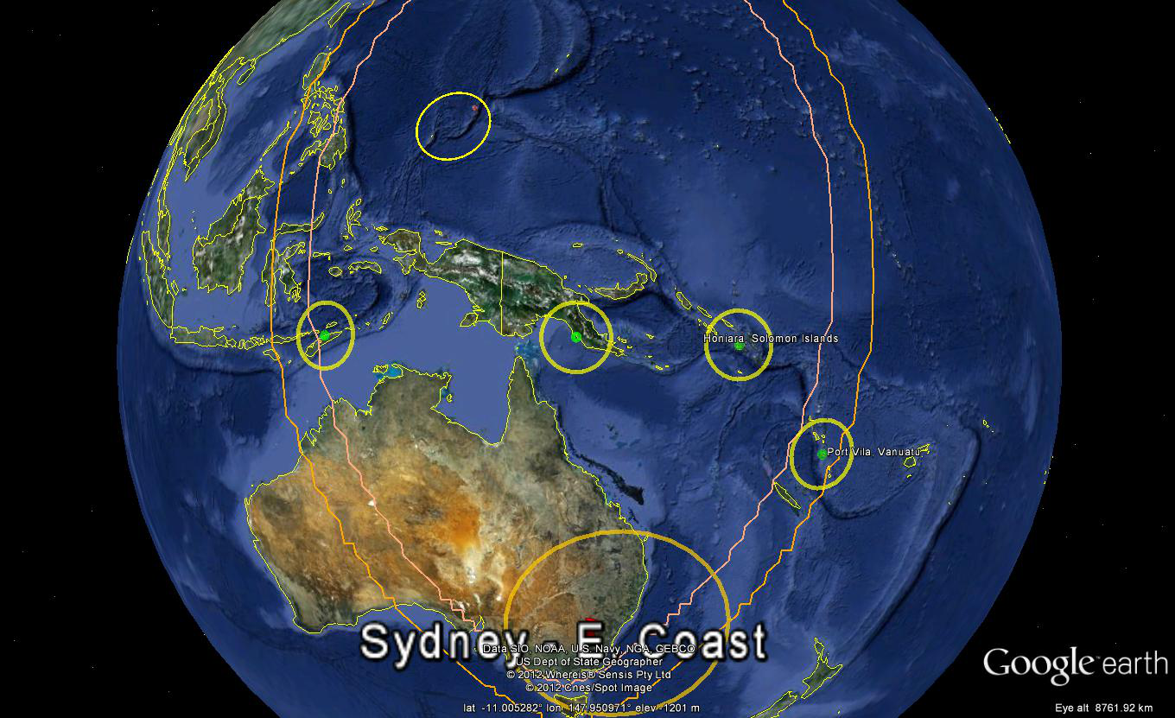
Region 4B – Homed to East Australia
Gateway
16 Nov 2012

Slide 18
NSF Use Options
18

Slide 19
NSF Use Options
NSF uses additional capacity in locations where O3b has already sold a beam
  USP Campuses
  Papua New Guinea
NSF purchases a new beam for a fixed location with enough demand to justify cost
  Galapagos Islands
NSF purchases a steerable beam that can be time-shared by multiple research vessels within a region

Slide 20
Current and Potential Coverage of
USP Campuses
 | USP CAMPUSES
Alafua Campus Campus Director, The University of the South Pacific Private Bag, Apia, Samoa | Emalus Campus The Senior Assistant, Registrar, The University of the South Pacific, PMB 9072, Port Vila, Vanuatu | Laucala Campus Student Academic Services, The University of the South Pacific, Suva, Fiji Islands
USP Cook Islands Campus PO Box 130, Rarotonga, Cook Islands | Labasa Campus Private Mail Bag, Labasa, Fiji | Lautoka Campus Private Mail Bag, Lautoka, Fiji
USP Kiribati Campus PO Box 59, Bairiki, Tarawa, Kiribati | USP Marshall Islands Campus PO Box 3537, Majuro, Marshall Islands | USP Nauru Campus Private Bag, Post Office. Republic of Nauru
USP Niue Campus PO Box 31, Alofi, Niue. | Solomon Islands Campus PO Box 460, Honiara, Solomon Islands. | USP Tokelau Campus c/- Student Academic Services, Alafua Campus, Samoa.
USP Tonga Campus PO Box 278, Nuku'alofa, Tonga | USP Tuvalu Campus PO Box 21, Funafuti, Tuvalu
Already O3b
Customer
Near-Term
Prospect
Longer-Term
Prospect

Slide 21
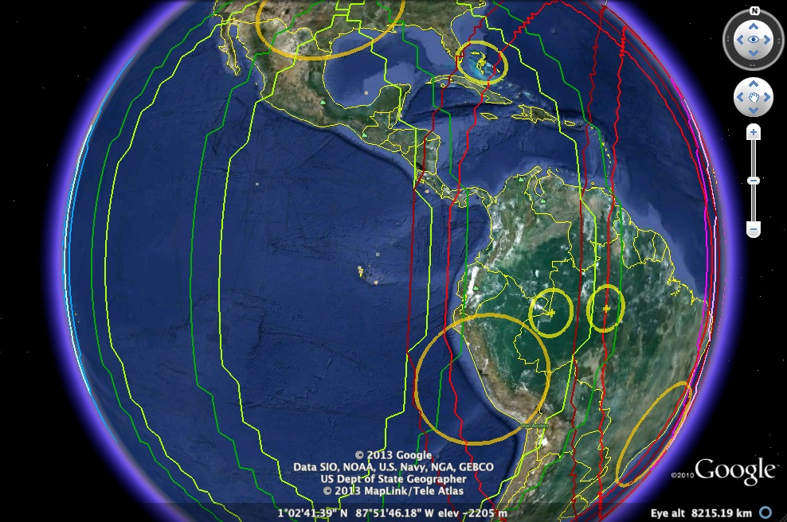
Galapagos Beam
Homed to SW US Gateway

Slide 22
Galapagos Islands Coverage
Single beam covers Galapagos Islands
Finding sufficient use between commercial and research users to justify a full beam
  Need minimum usage of 100 x 50 Mbps to bring down the cost per Mbps
  Looking for sale of additional capacity to tourism industry

Slide 23

Scalable & Cost-Effective Bandwidth
Shared or whole beams
  Scalable data rates from
  50 Mbps – 500 Mbps
  Steerable/tracking option for whole beam purchase
Designed for high speed Internet service with 3:1 ratio of FWD to RTN data rates
Ship Terminals sized to data requirements
 | Forward Data Rate (Mbps) | Return Data Rate (Mbps)
O3bMaritime 50 | 38 | 12
O3bMaritime 100 | 75 | 25
O3bMaritime 150 | 115 | 35
O3bMaritime 200 | 150 | 50
O3bMaritime 400 | 300 | 100
O3bMaritime 500 | 350 | 150
23

Slide 24
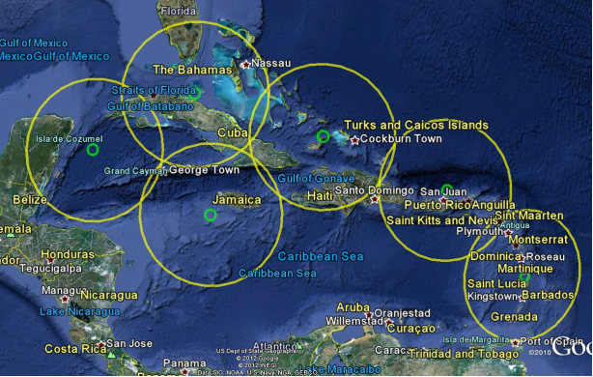
Caribbean Beam Cruise Ship Coverage

Slide 25
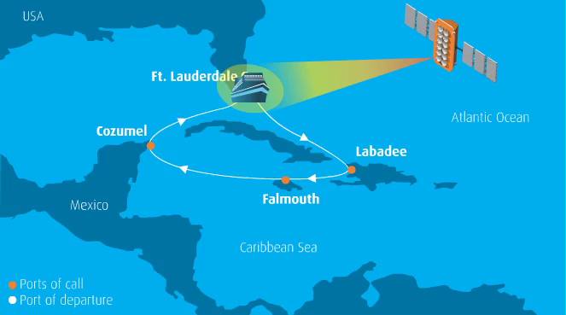
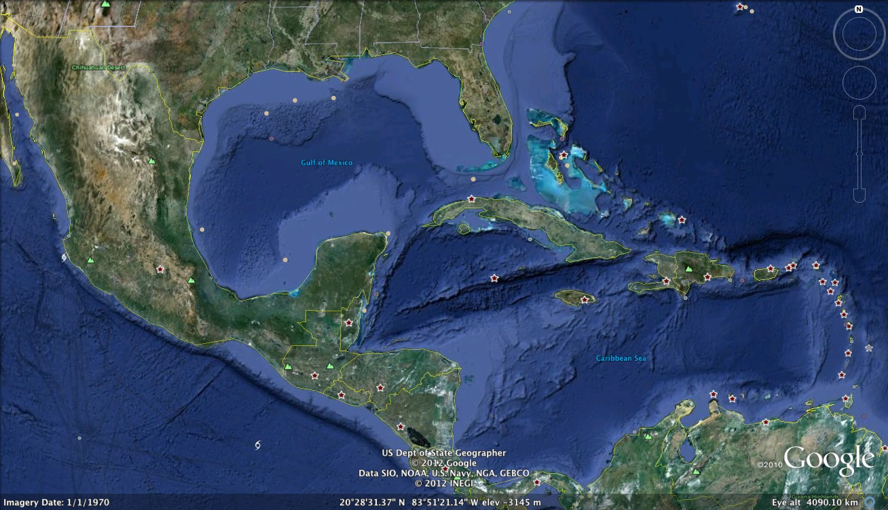
Real-Time Ship Tracking
Royal Caribbean
O3b satellite beams will follow ship’s movement
Beam tracking updates in real-time
  O3b maintains ship within beam center
  Ship provides heading/lat/long updates in real time intervals to NOC
Real-Time Ship Track Monitoring
Via O3b Customer Portal
Ft Lauderdale
Cozumel
Labadee
Falmouth
Notes:
Add new flash animation that came from Merchant

Slide 26
Research Vessels
NSF purchases a single beam in Region 5 homed to Hawaii Gateway.
With the 1.2m antenna, beam can deliver
  up to 200 Mbps in the forward direction
  Up to 25 Mbps in the return direction
Beam can be used by multiple ships in region, either serially or by hopping around region as required
Beam can be programmed to follow research vessel on it’s cruise

Slide 27
Other Topics
How will capacity be contracted for?
  Contract length?
If equipment is required, how will it be purchased?
How will the satellite terminal equipment be installed, tested, and operated?

Slide 28
New Opportunities for Research and Education Networks
High bandwidth at lower cost per Mbps to underserved locations
Fiber-like low latency
  Supports voice, video conferencing, and other real-time traffic
  Faster response for interactive Web 2.0 and other business applications
  Faster downloads of web content
  Less congestion and retransmissions
Beams can be repointed on short notice and can track moving terminals

Slide 29
Notes:
29

