Slide 1

Nagios
APRICOT 2009
22 February 2009
Hervey Allen

Slide 2
Introduction
A key measurement tool for actively monitoring availability of devices and services.
Possible the most used open source network monitoring software.
Has a web interface.
  Uses CGIs written in C for faster response and scalability.
Can support up to thousands of devices and services.

Slide 3
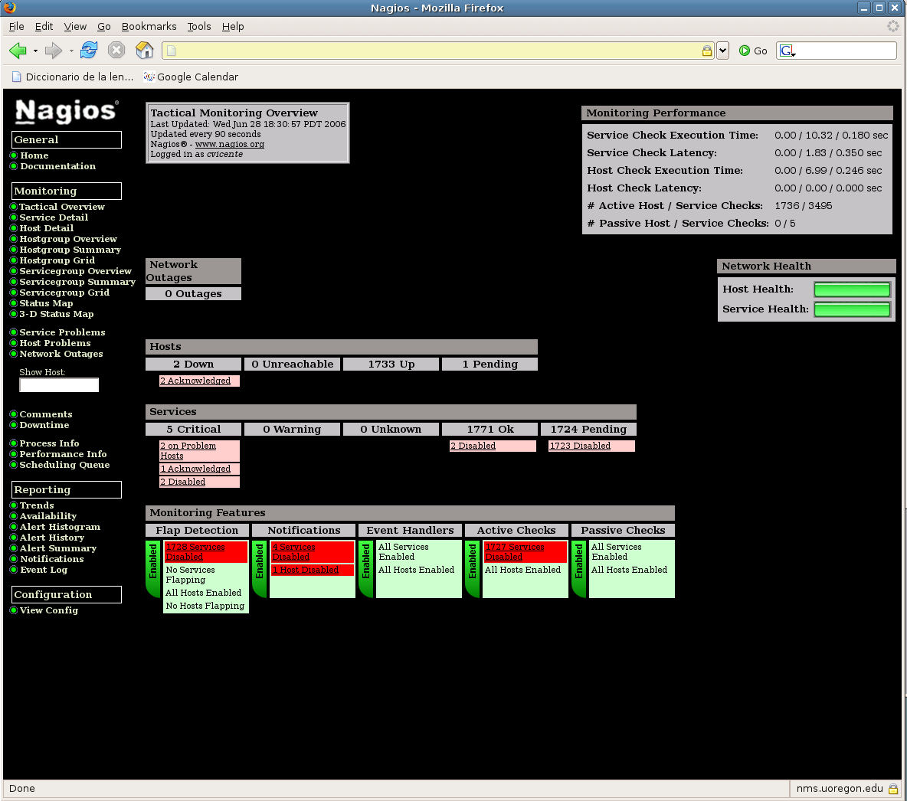

Slide 4
Features
Verification of availability is delegated to plugins:
  The product's architecture is simple enough that writing new plugins is fairly easy in the language of your choice.
  There are many, many plugins available.
Nagios uses parallel checking and forking.
  Version 3 of Nagions does this better.

Slide 5
Features cont.
Has intelligent checking capabilities. Attempts to distribute the server load of running Nagios (for larger sites) and the load placed on devices being checked.
Configuration is done in simple, plain text files, but that can contain much detail and are based on templates.
Nagios reads it's configuration from an entire directory. You decide how to define individual files.

Slide 6
Yet More Features...
Utilizes topology to determine dependencies.
  Nagios differentiates between what is down vs. what is not available. This way it avoids running unnecessary checks.
Nagios allows you to define how you send notifications based on combinations of:
  Contacts and lists of contacts
  Devices and groups of devices
  Services and groups of services
  Defined hours by persons or groups.
  The state of a service.

Slide 7
And, even more...
Service state:
When configuration a service you have the following notification options:
  d: DOWN: The service is down (not available)
  u: UNREACHABLE: When the host is not visible
  r: RECOVERY: (OK) Host is coming back up
  f: FLAPPING: When a host first starts or stops or it's state is undetermined.
  n: NONE: Don't send any notifications

Slide 8
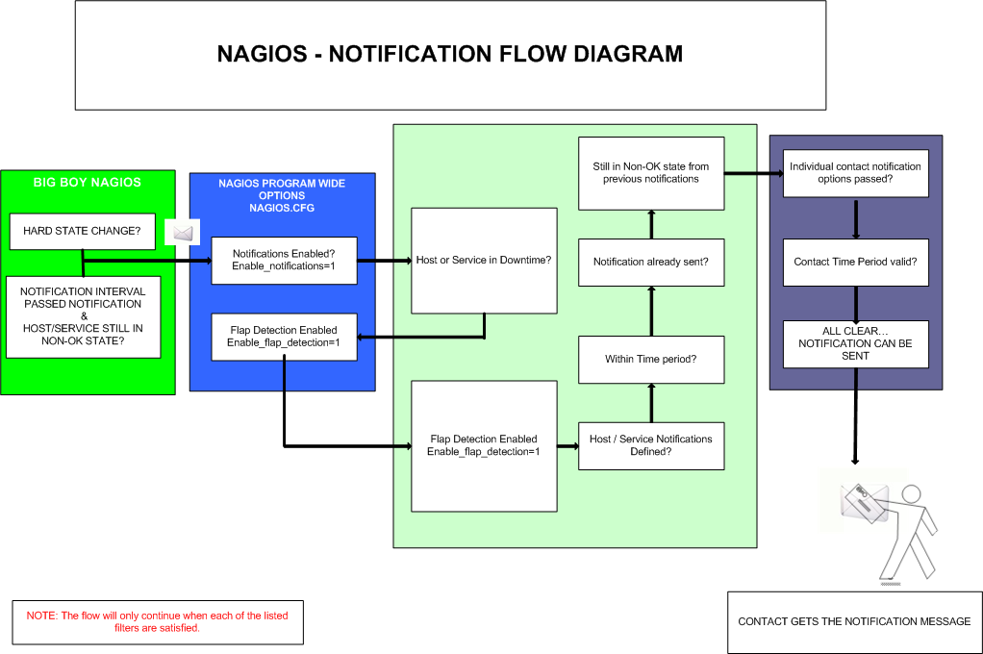

Slide 9
Features, features, features
Allows you to acknowledge an event.
  A user can add comments via the GUI
You can define maintenance periods
  By device or a group of devices
Maintains availability statistics.
Can detect flapping and suppress additional notificaitons.
Allows for multiple notification methods such as:
  e-mail, pager, SMS, winpopup, audio, etc...
Allows you to define notification levels. Critical feature.

Slide 10
How Checks Work
A node/host/device consists of one or more service checks (PING, HTTP, MYSQL, SSH, etc)‏
Periodically Nagios checks each service for each node and determines if state has changed. State changes are:
  CRITICAL
  WARNING
  UNKNOWN
For each state change you can assign:
  Notification options (as mentioned before)
  Event handlers

Slide 11
How Checks Work
Parameters
  Normal checking interval
  Re-check interval
  Maximum number of checks.
  Period for each check
Node checks only happen when on services respond (assuming you've configured this).
  A node can be:
    DOWN
    UNREACHABLE

Slide 12
How Checks Work
In this manner it can take some time before a host change's its state to “down” as Nagios first does a service check and then a node check.
By default Nagios does a node check 3 times before it will change the nodes state to down.
You can, of course, change all this.

Slide 13
The Concept of “Parents”
Nodes can have parents.
  For example, the parent of a PC connected to a switch would be the switch.
  This allows us to specify the network dependencies that exist between machines, switches, routers, etc.
  This avoids having Nagios send alarms when a parent does not respond.
  A node can have multiple parents.

Slide 14
The Idea of Network Viewpoint
Where you locate your Nagios server will determine your point of view of the network.
Nagios allows for parallel Nagios boxes that run at other locations on a network.
Often it makes sense to place your Nagios server nearer the border of your network vs. in the core.

Slide 15
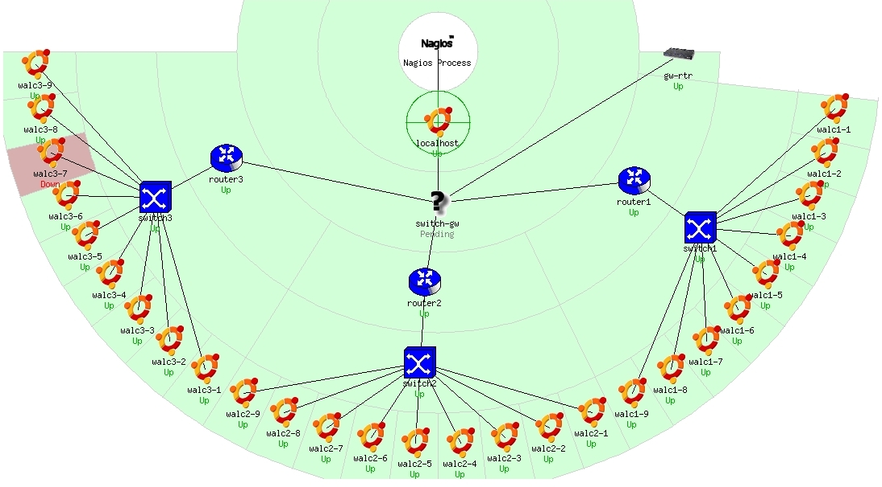
Network Viewpoint

Slide 16
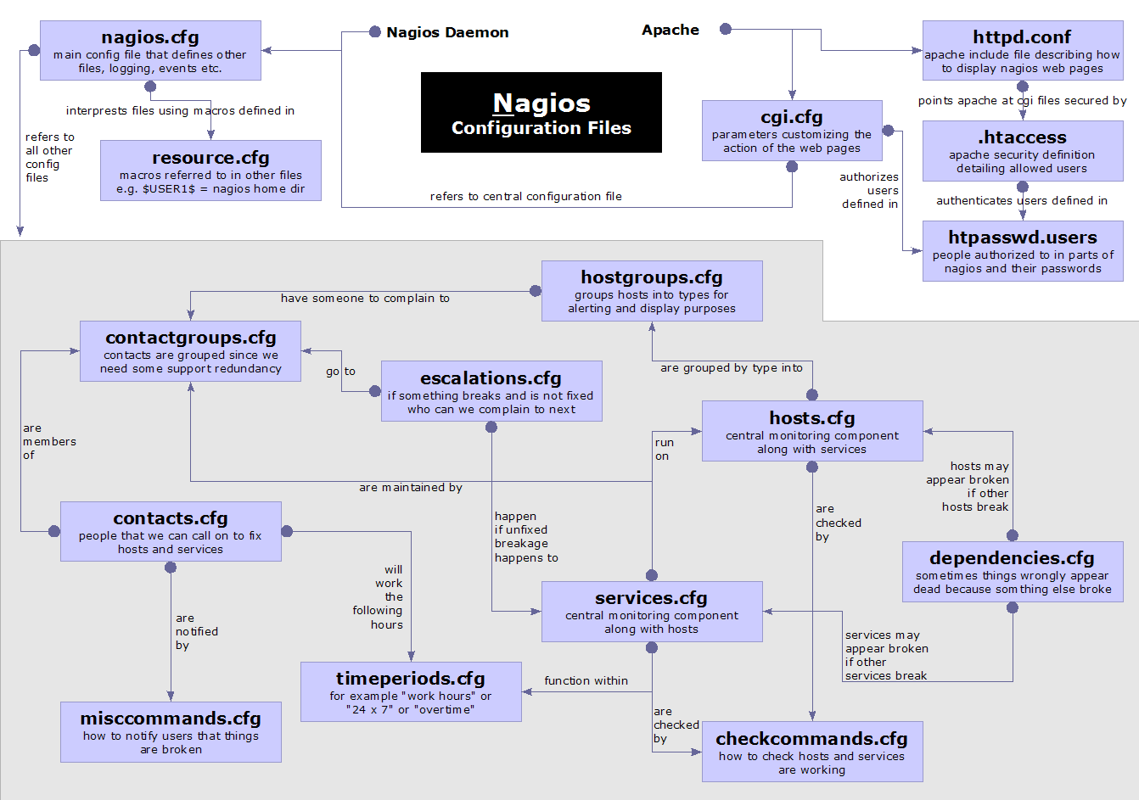
Nagios Configuration Files

Slide 17
Configuration Files
Located in /etc/nagios3/
Important files include:
  cgi.cfg Controls the web interface and
  security options.
  commands.cfg The commands that Nagios uses
  for notifications.
  nagios.cfg Main configuration file.
  conf.d/* All other configuration goes here!

Slide 18
Configuration Files
Under conf.d/* (sample only)
contacts_nagios3.cfg users and groups
generic-host_nagios2.cfg default host template‏
generic-service_nagios2.cfg default service template
hostgroups_nagios2.cfg groups of nodes
services_nagios2.cfg what services to check
timeperiods_nagios2.cfg when to check and who
to notifiy

Slide 19
Configuration Files
Under conf.d some other possible configfiles:
host-gateway.cfg Default route definition
extinfo.cfg Additional node information
servicegroups.cfig Groups of nodes and services
localhost.cfg Define the Nagios server itself
pcs .cfg Sample definition of PCs (hosts)
switches.cfg Definitions of switches (hosts)
routers.cfg Definitions of routers (hosts)

Slide 20
Plugin Configuration
The Nagios package in Ubuntu comes with a bunch of pre-installed plugins:
apt.cfg breeze.cfg dhcp.cfg disk-smb.cfg disk.cfg dns.cfg dummy.cfg flexlm.cfg fping.cfg ftp.cfg games.cfg hppjd.cfg http.cfg ifstatus.cfg ldap.cfg load.cfg mail.cfg mrtg.cfg mysql.cfg netware.cfg news.cfg nt.cfg ntp.cfg pgsql.cfg ping.cfg procs.cfg radius.cfg real.cfg rpc-nfs.cfg snmp.cfg ssh.cfg tcp_udp.cfg telnet.cfg users.cfg vsz.cfg

Slide 21
Main Configuration Details
Global settings
File: /etc/nagios2/nagios.cfg
    Says where other configuration files are.
    General Nagios behavior:
      For large installations you should tune the installation via this file.
        See: Tunning Nagios for Maximum Performance http://nagios.sourceforge.net/docs/2_0/tuning.html

Slide 22
CGI Configuration
Archivo: /etc/nagios3/cgi.cfg
  You can change the CGI directory if you wish
  Authentication and authorization for Nagios use.
      Activate authentication via Apache's .htpasswd mechanism, or using RADIUS or LDAP.
      Users can be assigned rights via the following variables:
        authorized_for_system_information
        authorized_for_configuration_information
        authorized_for_system_commands
        authorized_for_all_services
        authorized_for_all_hosts
        authorized_for_all_service_commands
        authorized_for_all_host_commands

Slide 23
Time Periods
This defines the base periods that control checks, notifications, etc.
  Defaults: 24 x 7
  Could adjust as needed, such as work week only.
  Could adjust a new time period for “outside of regular hours”, etc.
# '24x7'
define timeperiod{
timeperiod_name 24x7
alias 24 Hours A Day, 7 Days A Week
sunday 00:00-24:00
monday 00:00-24:00
tuesday 00:00-24:00
wednesday 00:00-24:00
thursday 00:00-24:00
friday 00:00-24:00
saturday 00:00-24:00
}

Slide 24
Configuring Service/Host Checks
Define how you are going to test a service.
# 'check-host-alive' command definition
define command{
command_name check-host-alive
command_line $USER1$/check_ping -H $HOSTADDRESS$ -w 2000.0,60% -c 5000.0,100% -p 1 -t 5
}
Located in /etc/nagios-plugins/config, then adjust in /etc/nagios3/conf.d/services_nagios2.cfg

Slide 25
Notification Commands
Allows you to utilize any command you wish. We'll do this for our generating tickets in RT.
# 'notify-by-email' command definition
define command{
command_name notify-by-email
command_line /usr/bin/printf "%b" "Service: $SERVICEDESC$\nHost: $HOSTNAME$\nIn: $HOSTALIAS$\nAddress: $HOSTADDRESS$\nState: $SERVICESTATE$\nInfo: $SERVICEOUTPUT$\nDate: $SHORTDATETIME$" | /bin/mail -s '$NOTIFICATIONTYPE$: $HOSTNAME$/$SERVICEDESC$ is $SERVICESTATE$' $CONTACTEMAIL$
}
From: nagios@nms.localdomain
To: grupo-redes@localdomain
Subject: Host DOWN alert for switch1!
Date: Thu, 29 Jun 2006 15:13:30 -0700
Host: switch1
In: Core_Switches
State: DOWN
Address: 111.222.333.444
Date/Time: 06-29-2006 15:13:30
Info: CRITICAL - Plugin timed out after 6 seconds

Slide 26
Nodes and Services Configuration
Based on templates
  This saves lots of time avoiding repetition
  Similar to Object Oriented programming
Create default templates with default parameters for a:
  generic node
  generic service
  generic contact

Slide 27
Generic Node Configuration
define host{
name generic-host
notifications_enabled 1
event_handler_enabled 1
flap_detection_enabled 1
process_perf_data 1
retain_status_information 1
retain_nonstatus_information 1
check_command check-host-alive
max_check_attempts 5
notification_interval 60
notification_period 24x7
notification_options d,r
contact_groups nobody
register 0
}

Slide 28
Individual Node Configuration
define host{
use generic-host
host_name switch1
alias Core_switches
address 192.168.1.2
parents router1
contact_groups switch_group
}

Slide 29
Generic Service Configuration
define service{
name generic-service
active_checks_enabled 1
passive_checks_enabled 1
parallelize_check 1
obsess_over_service 1
check_freshness 0
notifications_enabled 1
event_handler_enabled 1
flap_detection_enabled 1
process_perf_data 1
retain_status_information 1
retain_nonstatus_information 1
is_volatile 0
check_period 24x7
max_check_attempts 5
normal_check_interval 5
retry_check_interval 1
notification_interval 60
notification_period 24x7
notification_options c,r
register 0
}

Slide 30
Individual Service Configuration
define service{
host_name switch1
use generic-service
service_description PING
check_command check-host-alive
max_check_attempts 5
normal_check_interval 5
notification_options c,r,f
contact_groups switch-group
}

Slide 31
Automation
To maintain large configurations by hand becomes tiresome.
  It's better to simplify and automate using scripts.
    http://ns.uoregon.edu/~cvicente/download/nagios-config-scripts.tar.gz
    Or, export device (node) information from tools like Netdot, netdisco, OpenNMS, etc.

Slide 32
Beeper/SMS Messages
It's important to integrate Nagios with something available outside of work
  Problems occur after hours... (unfair, but true)
A critical item to remember: an SMS or message system should be independent from your network.
  You can utilize a modem and a telephone line
  Packages like sendpage or qpage can help.

Slide 33
Some References
http://www.nagios.org: Nagios web site
http://sourceforge.net/projects/nagiosplug: Nagios plugins site
Nagios. System and Network Monitoring by Wolfgang Barth. Good book onNagios
http://www.nagiosexchange.org: Unofficial Nagios plugin site
http://www.debianhelp.co.uk/nagios.htm: A Debian tutorial on Nagios
http://www.nagios.com/: Commercial Nagios support
And, the O'Reilly book you received in class!

Slide 34
Reference Slides
Dhruba Raj
Bhandari, CCNA
Additions by Phil Regnauld
bhandari.dhruba@scp.com.np

Slide 35
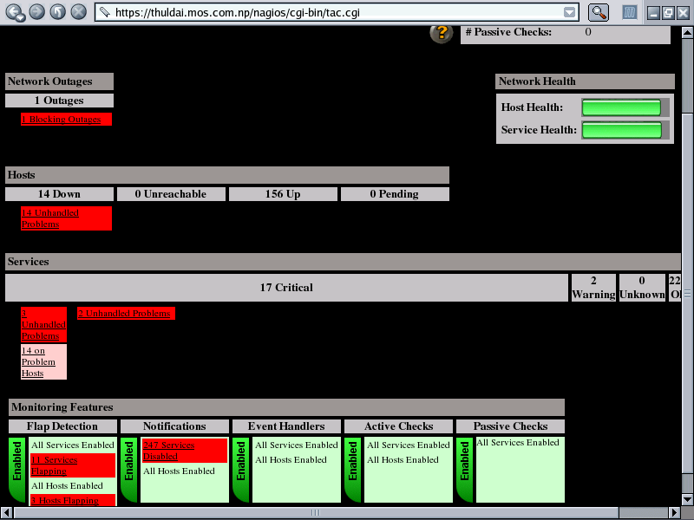
Nagios – Vista General (Tactical Overview)‏

Slide 36
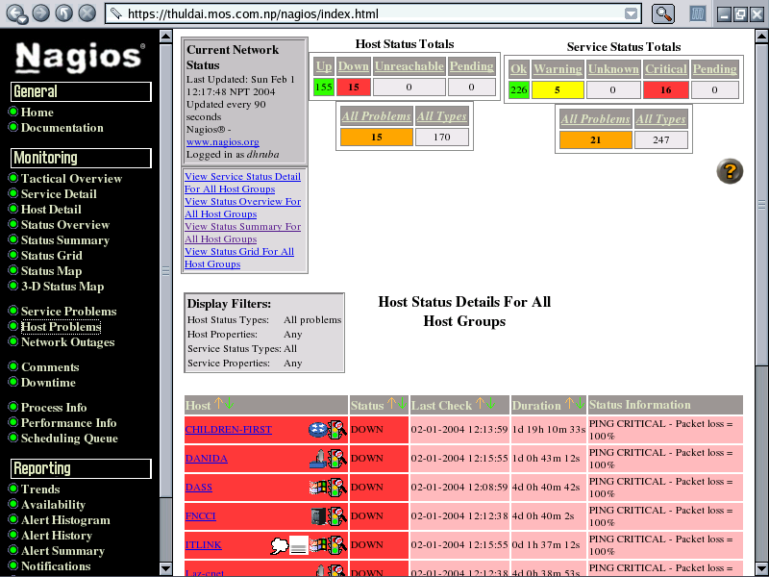
  Pantalla de Status Detail

Slide 37
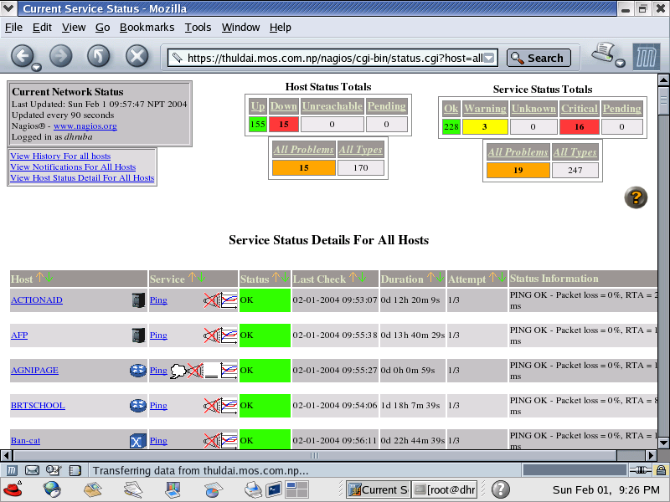
Pantalla de Service Detail

Slide 38
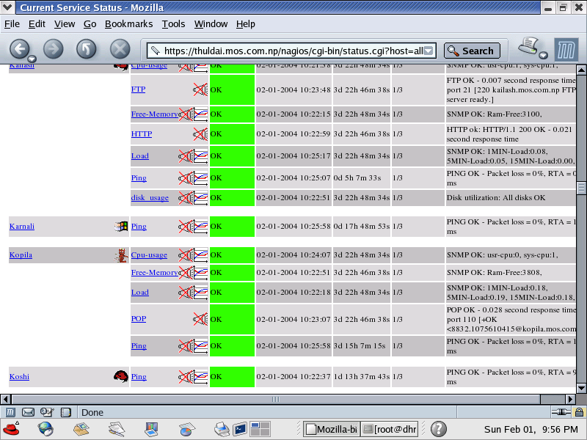
Tipos de Servicios

Slide 39
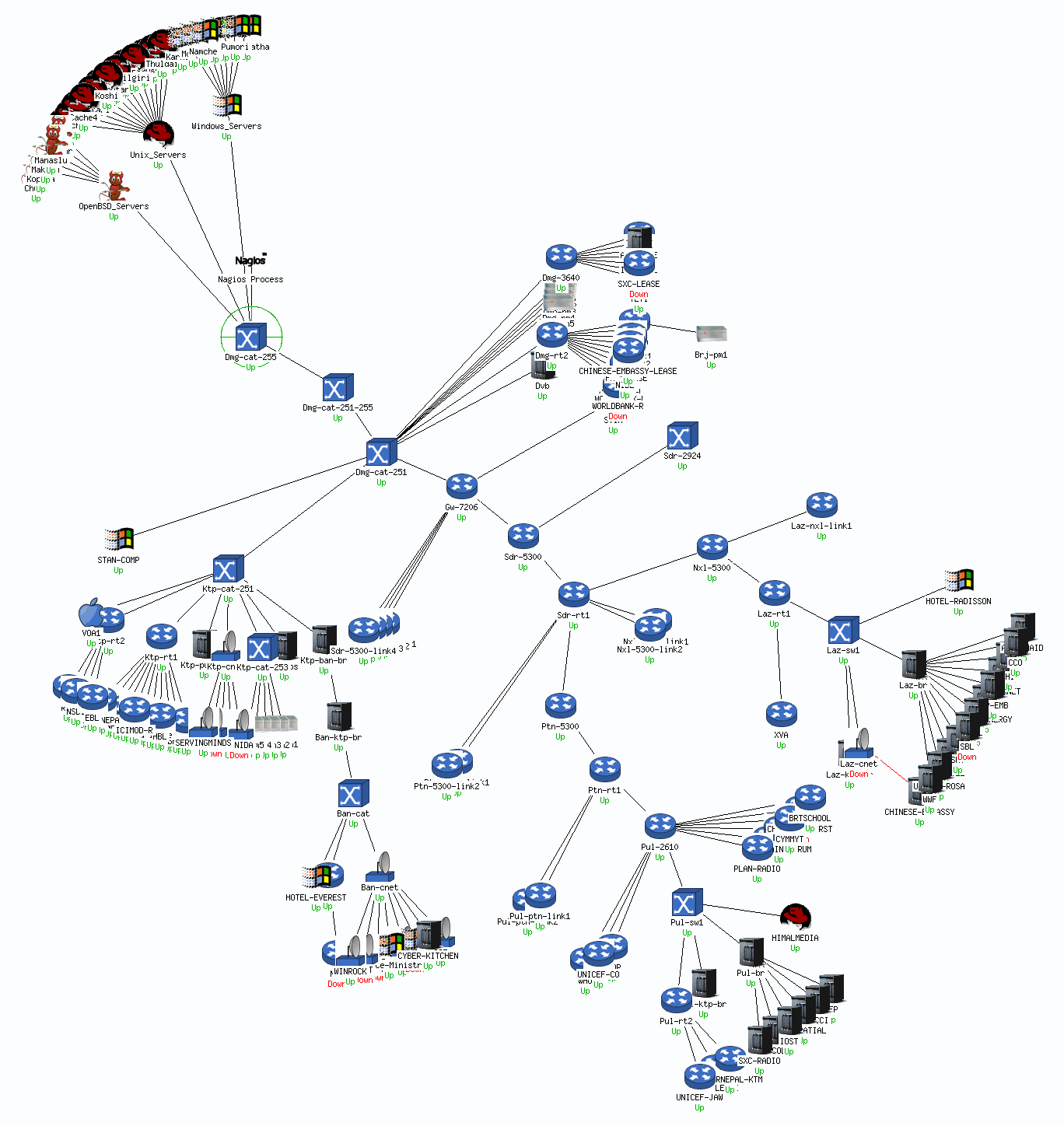
Muestra de una Mapa de Estatus

Slide 40
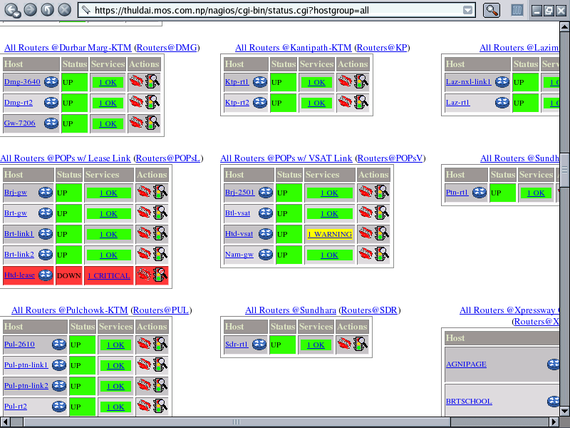
Vista General de Estatus (Status Overview)‏

Slide 41
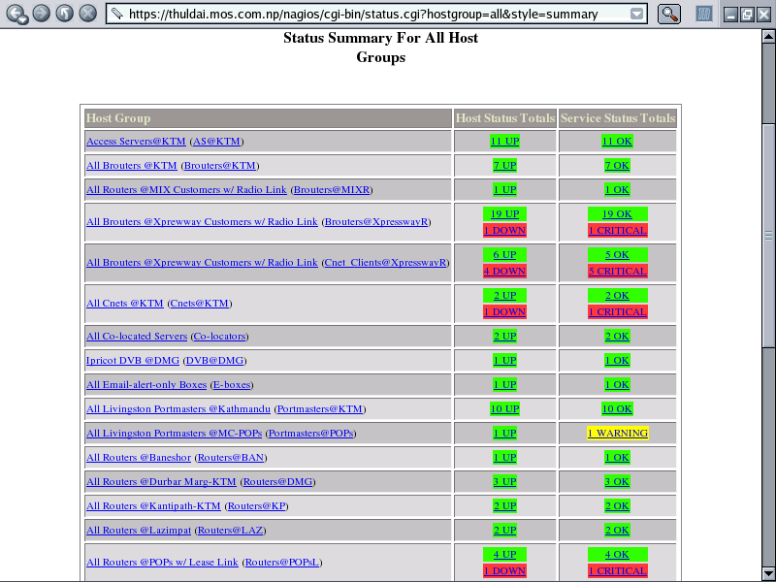
Vista Sumaria de Hostgroups

Slide 42
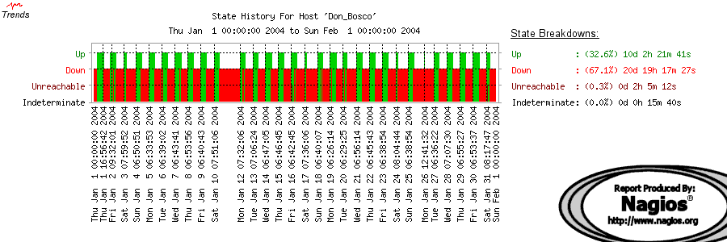
Historia o Tendencias de Hosts

Slide 43
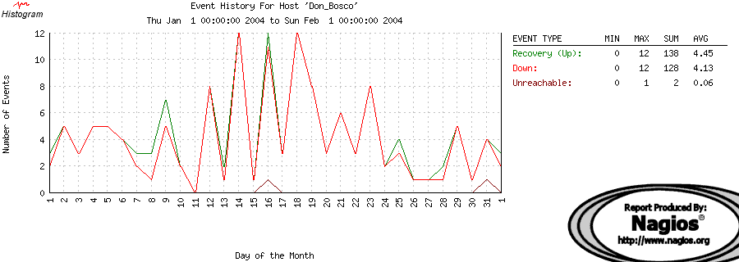
Histogram de un Host

Slide 44
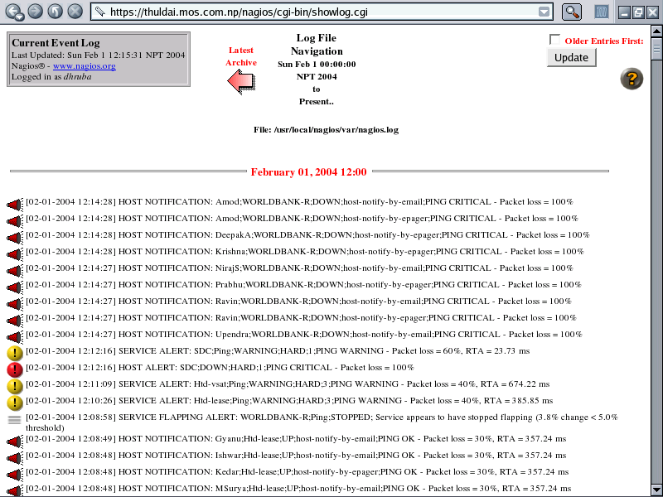
Event Logs

Slide 45
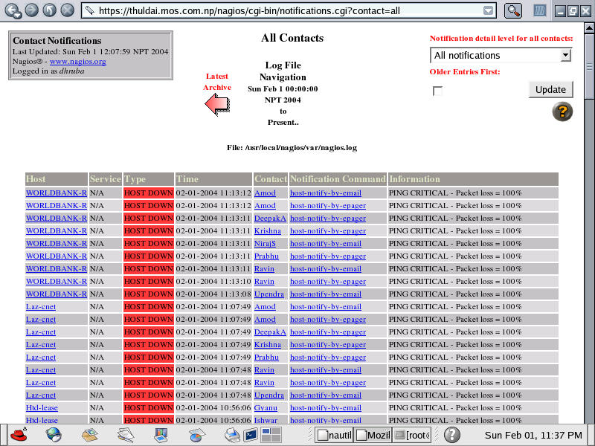
Quien Recibe Notificationes

