Slide 1

DSpace Structure basics
8/8/2012
Catherine Flynn-Purvis Karen Estlund
Scholar’s Bank Coordinator Head of Digital Library Services
cflynn@uoregon.edu kestlund@uoregon.edu

Slide 2
Structure of DSpace
Communities
  Sub-communities (optional)
    Collections
      Titles
        Files
  Collections
    Titles
      Files
Collections are required to add items!
Terms can be localized for your needs:
  For example:
    Community = Dépôt
    Collection = Thème
  Change terms in messages.xml file

Slide 3
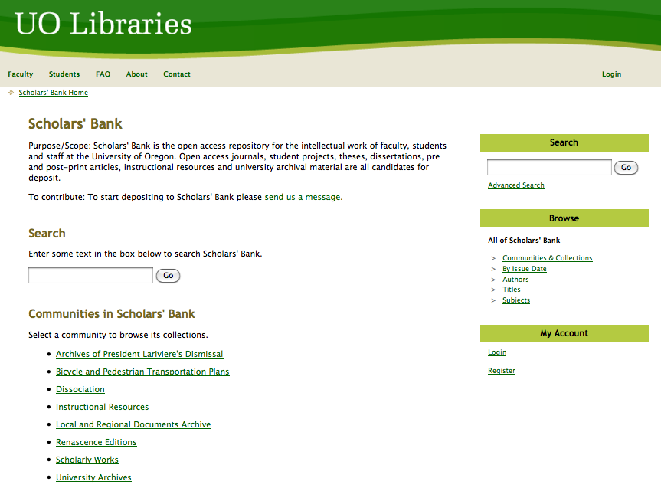
Top-level Organization: Communities
“Top-level” communities are displayed on the home page

Slide 4
Further thematic or grouping categorization: sub-communities
When more organizational structure is desired, sub-communities can be used. The nomenclature is a little misleading, because they’re all still just communities.
The following example from Scholars’ Bank illustrates sub-communities within the “University Archives” community

Slide 5
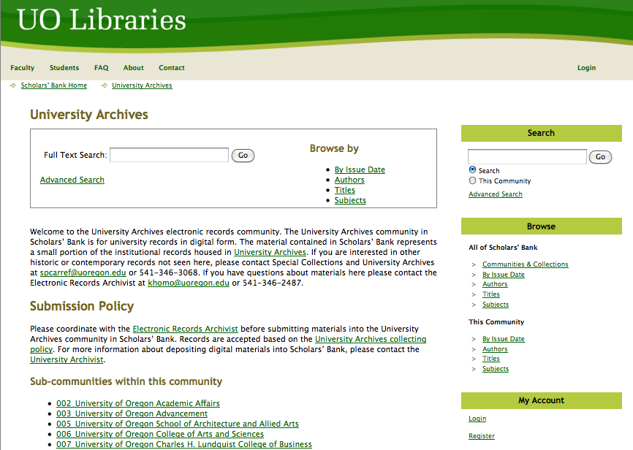

Slide 6
Where Items Go: the “Collection”
A DSpace collection is a group of items that are grouped together
In a collection, you can determine:
  Who can submit to a collection
  The review process
  Who is allowed to see the collection
  The input-forms for a collection

Slide 7
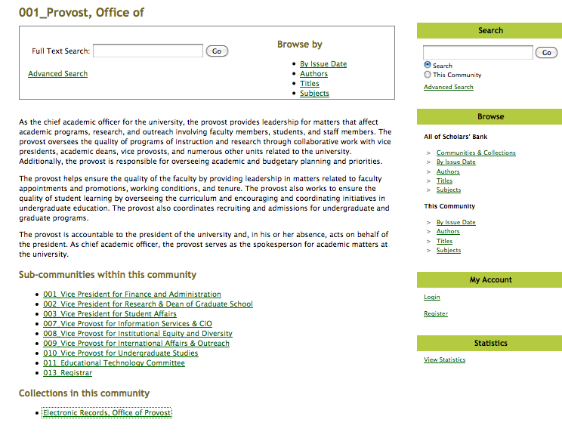
Collections within Communities

Slide 8
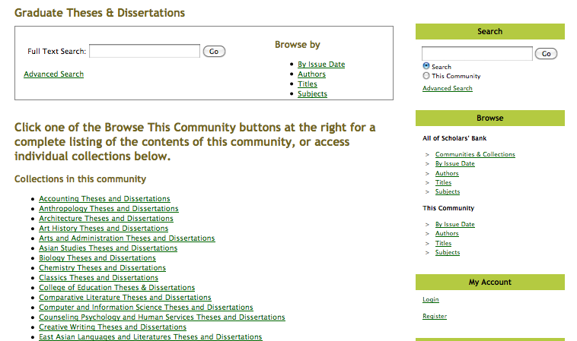

Slide 9
Individual Titles/Items within Collections
Items can be part of multiple collections by using the “Item Mapper” tool
Items can have multiple files associated with them
Item level records can have a persistent URL (handle)
Items can have access controls for who can view and also be have an embargo
Notes:
Finally, we arrive at the collection level, where the items reside together. Notice the hierarchy of collections and sub-collections at the top of the screen.

Slide 10
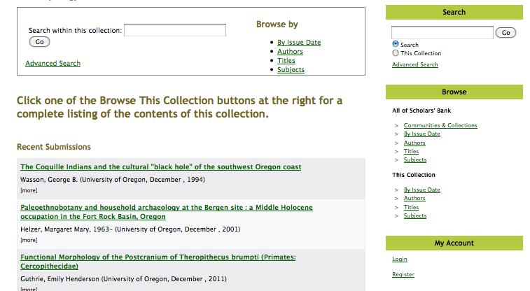

Slide 11
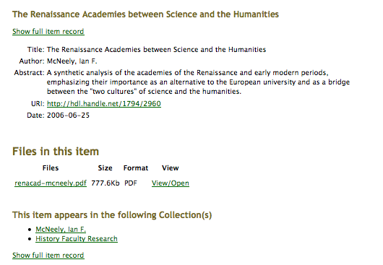

Slide 12

Individual files make up items
Associate file types can be identified by the system if entered in the Format Registry
Associated files can have a “Description” to help the user identify the files

Slide 13
