Slide 1
Education and Research Networks: The case of USPNet Presentation to the Pacific Islands Research & Education Networking Workshop, 18 January 2013
Professor Rajesh Chandra
Vice-Chancellor and President
www.usp.ac.fj

Slide 2
Presentation Outline
ICTs as Central to Our Future/ Dramatically Changing World
ICTs in the Pacific Islands
ICT a Key Priority of the new USP Strategic Plan 2013-2018
USP as a ICT Pioneer in the Pacific and a Demonstrator
From USPNet to a Knowledge Hub
Other Major Developments on the Horizon
Conclusions

Slide 3
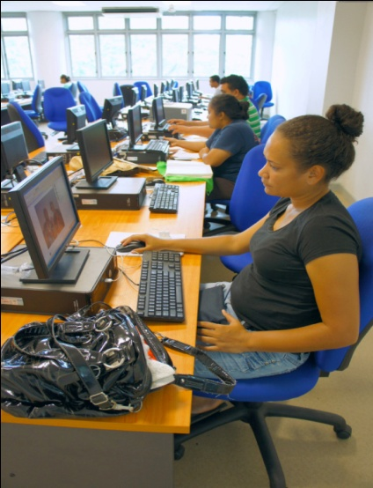
The Knowledge Economy and Higher Education
Knowledge society now dominates international competitiveness and long-term sustainability
PICs need more knowledge-based industries, which are dependent on ICT development and a highly educated and skilled workforce
All existing industries can become more efficient and competitive with ICTs
“The trend towards a knowledge-based economy has emphasized the importance of universities as repositories of valuable human capital. In particular, the accelerating shift to high technology and information technology economy requires sustained human resource development and training.. (2011, ICT for Higher Education: Case Studies from Asia and the Pacific, UNESCO).

Slide 4
Access for who and why?
“Helping developing countries build their citizens' access to the Internet is akin to giving them a tool that boosts their chances of achieving sustainable economic growth…The Internet offers a lot of potential and opportunities for sustainable development”.
(Director of the Division for Public Administration and Development Management of the UN Department of Economic and Social Affairs (DESA), Haiyan Qian.)
Source: http://allafrica.com/stories/201211110249.html

Slide 5
Importance of ICTs in the Pacific Islands
Apart from the obvious importance of ICTs in a knowledge society, ICTs are especially important to the PICs because:
Scattered islands and populations
Isolation from main centres of production and consumption
Accessing international markets and investment
Meeting MDG goals, especially in education and health
Potentially opening up possibilities of participating in the global system without moving from their countries through telework
Leveling the playing field

Slide 6
Asia-Pacific: Where we stand

Slide 7
Overall Low Level of ICT Development: USP member Countries
USP Member Countries | Fixed Telephone subscriptions per 100 inhabitants | Mobile cellular subscriptions per 100 inhabitants | Percentage of Individuals using the Internet | Fixed Internet subscriptions per 100 inhabitants
 | 2010 | 2010 | 2010 | 2010
Cook Islands | 35.63 | 38.46 | 35.71
Fiji | 15.09 | 81.09 | 14.82 | 4.53
Kiribati | 4.12 | 10.05 | 9
Marshall Islands | 8.14 | 7.03
Nauru | 0 | 60.46 | 6
Niue | 68.12
Samoa | 19.28 | 91.43 | 7
Solomon Islands | 1.56 | 5.57 | 5
Tokelau | 26.43
Tonga | 29.79 | 52.18 | 12
Tuvalu | 16.49 | 25.44 | 25
Vanuatu | 2.09 | 119.05 | 8
Source: ITU - http://www.itu.int/ITU-D/ict/statistics/ (Accessed 15 February 2012)

Slide 8
Infrastructure and markets still major problems
Optic fibre is still not available other than to Fiji, PNG, French and former American Territories : major handicap
Tonga plans to have connection to Southern Cross through Fintel by mid-2013
Solomon Islands, Samoa and Vanuatu actively looking at fibre with World Bank/ADB assistance
O3B initiative, but yet to operationalize

Slide 9
Institutional Arrangements and Markets Still Weak
Many countries still not liberalizing fully: inability to see national “good”
Institutional arrangements e.g. policy frameworks, regulatory and pricing mechanisms weak
Human resources weak in leading ICT reform and development

Slide 10
Despite shortcomings, Some Positive Indicators
Pacific Islands Regional Digital Strategy
SPC and USP collaborating with countries to implement it
Some good practice, such as Fiji’s recent reforms and achievements; Vanuatu’s e-Governance network; Chief Information Officer
Full liberalization of the telecommunications market
Commerce Commission
National Bandwidth Plan
e-Commerce; e-Governance
USP is a demonstrator of a complete and successful ICT system that is being further improved

Slide 11
Not enough and not fast enough?
In terms of the speed with which other countries are moving, the movement in PICs in ICT development is not enough and not fast enough
When you have a lot of catching-up to do, you need to move fast
Also, not many demonstrators of complete ICT systems/models in our region

Slide 12
ICT a Key Priority of the new USP Strategic Plan 2013-2018
Use state-of-the-art ICT facilities to deliver high quality education
Lead ICT developments in the region to help all regional economies to take advantage of ICTs
Provide innovative, sustainable ICT solutions adapted to the demographic and spatial nature of the Pacific region.

Slide 13
USPNet: Early Pioneer
USPNet founded by USP in 1972 with audio conference via shared PeaceSat using applications technology satellite (ATS-1)
Progressive upgrade by leased circuits into Cook Islands, Solomon Islands, Tonga, Vanuatu and Lautoka completed by 1997
For audio conference tutorials
For data network
Major upgrades in 2000, 2005 and 2011

Slide 14
Recent Upgrade and New Capacities of USPNet
USPNet was fundamentally changed and upgraded in 2011 – to 11 MHz (C-band)
Satellite system changed from Gillat to iDirect giving greater flexibility and quality control
Dual bands-original C-Band system complemented by new Ku-Band that we needed for further expanding our reach – 7 MHZ
Voice and video system changed from Click and Talk to REACT allowing videoconferencing with all our campuses simultaneously

Slide 15
What is USPNet?
One of the largest private educational telecommunications systems in the world based on a VSAT system owned and operated by the USP through educational licenses from member countries covering 12 countries, 14 campuses and 33 million km²
Integrates all technologies: satellite, marine cable, PCs, high speed document readers, telephones, faxes, advanced control software, and various e-learning software such as Moodle

Slide 16
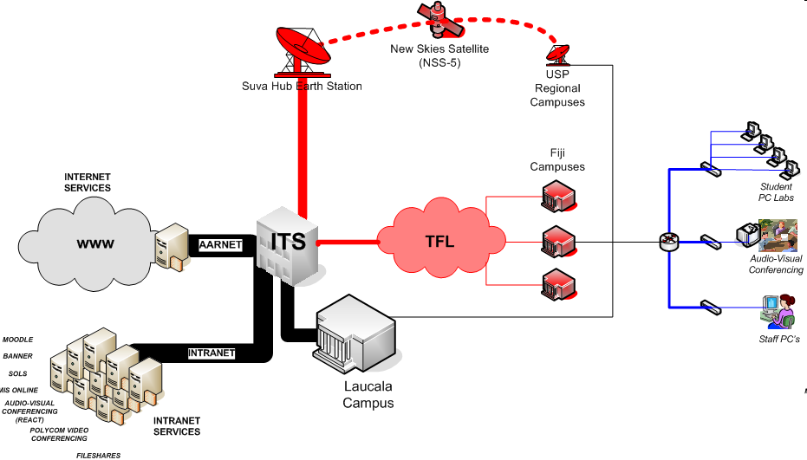

USP IT Infrastructure
Information Technology Services @ USP

Slide 17
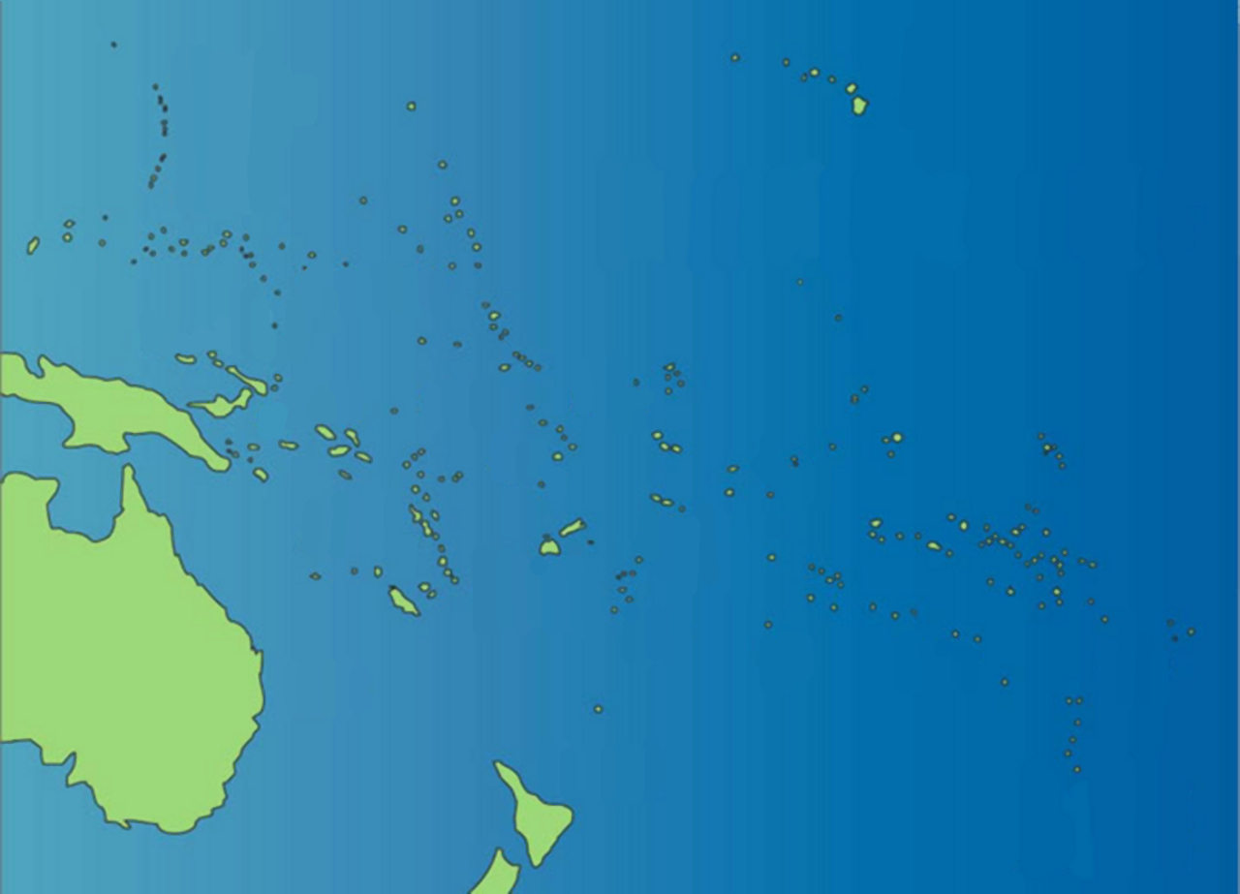


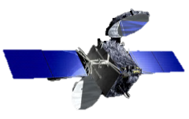




Ku-band Communication Satellite (IS-18)
C-band Communication Satellite (NSS-9)
Hawaii
Guam
Marshall Islands
Palau
Federated States
of Micronesia
Nauru
Papua New Guinea
Kiribati
Tokelau
Solomon
Islands
Tuvalu
Samoa
Vanuatu
Fiji
Tonga
Cook
Islands
Australia
Niue
USPNet
The University of the South Pacific
Satellite Communication Network
New Zealand

Slide 18
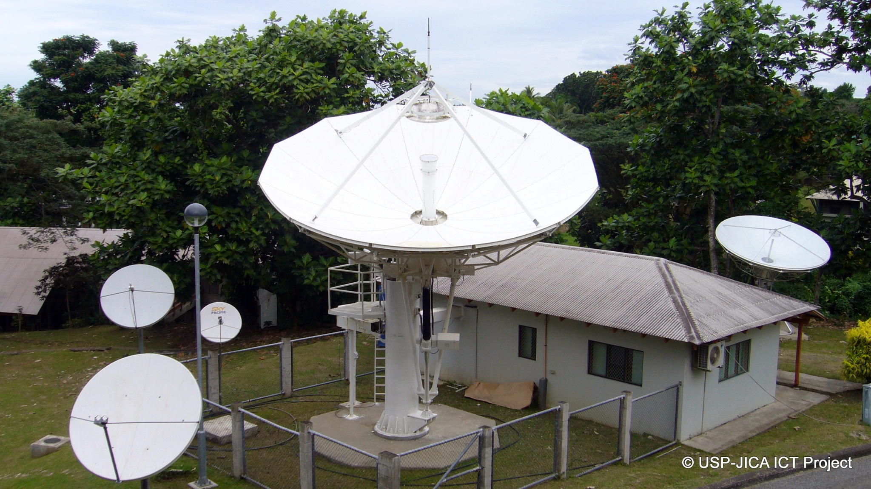
USPNet Hub
at Laucala Campus

Slide 19
USP ICT Overall
3500 PCs and n-Computing around the 14 campuses and centres
250 Servers
23,000 (approx) Student User accounts
2000 (approx) Staff accounts
Current Student per PCs ratio 12:1
23,000 simultaneous web connections a day, 30,000 email messages a day (staff)
5 km of fibre on Laucala and 2 km at Emalus and Alafua
Private network that links 12 countries over an area of about 33 million square Km
USP is possibly the best demonstration for the region of what can be done with ICT and how to do it

Slide 20
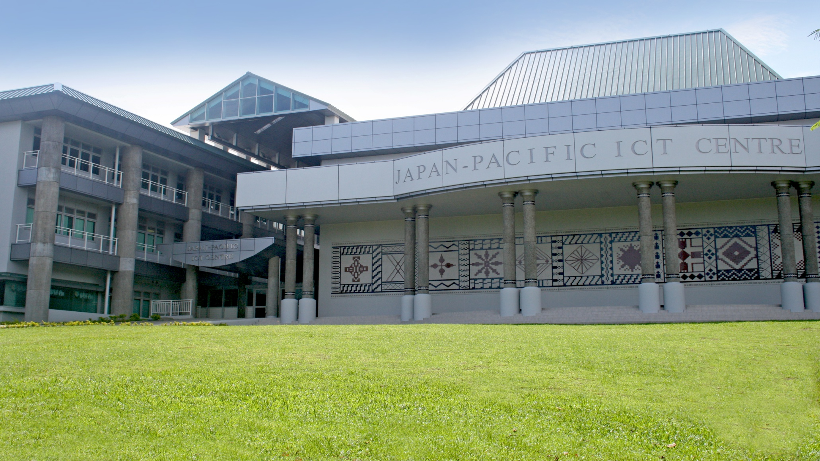
Japan-Pacific ICT Centre, USP

Slide 21
Independent Internet and STM4 Capacity
Partnership with AARNET since March 2005 and now strengthened
STM upgraded to STM4 in late 2011, can be scaled up to STM16 easily if needed
New deregulated market offers greater opportunity to deploy the new capacities much better
USP willing to make capacity available to related stakeholders including CROP agencies, tertiary institutions, and Ministries of Education

Slide 22
Knowledge Hub at a Glance
Global Internet Users
National Academic and Knowledge Networks
Library
Faculties/CFDL Print/Mixed Mode and On-line courses
Clearing House for Open Source Software
USP Hub: USPNet/Internet Gateway
Ministries of Education
ITS
School of Computing and Information Sciences
Other
Knowledge Networks
Japan-Pacific ICT Centre
Natural Disaster Network

Slide 23
So What is the Plan?
A Knowledge Hub exists already in terms of the concentration of knowledge, infrastructure to make it available on-line, and the ability to create content as well as help the region
But the dots have not been connected effectively, so the emphasis will be to link these; expand knowledge concentration; make it available to others EASILY, and to be inclusive in our approach

Slide 24
USP Represents a Large Telecommunications System
USP’s student enrolment is larger than the total populations of a number of its member states such as Cook Islands, Niue, Tokelau and Tuvalu
USPNet is larger than the telecoms of many member countries
USP is the domain name administrator for Fiji
USP internet gateway is same size as Telecom Fiji, the main internet provider in Fiji
The area covered is exceptionally large

Slide 25
REGIONAL RESEARCH NETWORKS
A dialogue was hosted at USP 5-7 November 2012, funded by The Technical Centre for Agricultural and Rural Cooperation (CTA) and UNESCO to discuss a regional universities network to support knowledge creation and sharing in science, technology and innovation (ST&I)
The dialogue was attended by 30 participants including Vice Chancellors and Heads of sections from universities in PNG (6), Fiji (3), the French Territories (2) and Samoa (1) as well as advisors and experts from research institutes, CROP agencies and government bodies
The result was an agreement to form a working group to establish the Modus Operandi for a Pacific Islands Universities Research Network (PIURN), with the Secretariat hosted by USP for 3 years in the first instance
PIURN is aimed at enhancing collaboration between the network of universities involved and will help foster research links and strengthen ST&I policy development across the region

Slide 26
Other Developments
EU/ACP commissioned study into possible knowledge network for the Pacific Islands
Prof David Lassner NSF Study of Pacific networks
Australian Tertiary Sector Strategy Pacific Academic Broadband initiative

Slide 27
Other Developments
Hawaiki proposal on the table
Need for progress on the core cable and due diligence before the Islands commit?
ADB and WB are now major financiers of cable development
Pacific Islands Forum Leaders’ request for update from SPC/USP on marine cable options

Slide 28
Need for Co-ordination
Need to collaborate/co-ordinate among the main proposed developments
Avoid duplication
Need for cost-effectiveness and sustainability: too many examples of aid funded projects languishing after funding ends
USP committed and willing to work together, protecting the independence of its network given that it is the University’s bread and butter system

Slide 29
Conclusions
ICTs are critically important to the Pacific Is.
USP represents an excellent ICT model and demonstrator
USPNet and regional campuses offer an excellent backbone for a R&E network for the (South Pacific) region
USP is open to making available its USPNet to perform important regional functions, such as knowledge network, disaster management, and for the dissemination of best practice/expertise

