Slide 1
Ubuntunet Alliance – update on network operations
Joe Kimaili
Ubuntunet Alliance

Slide 2
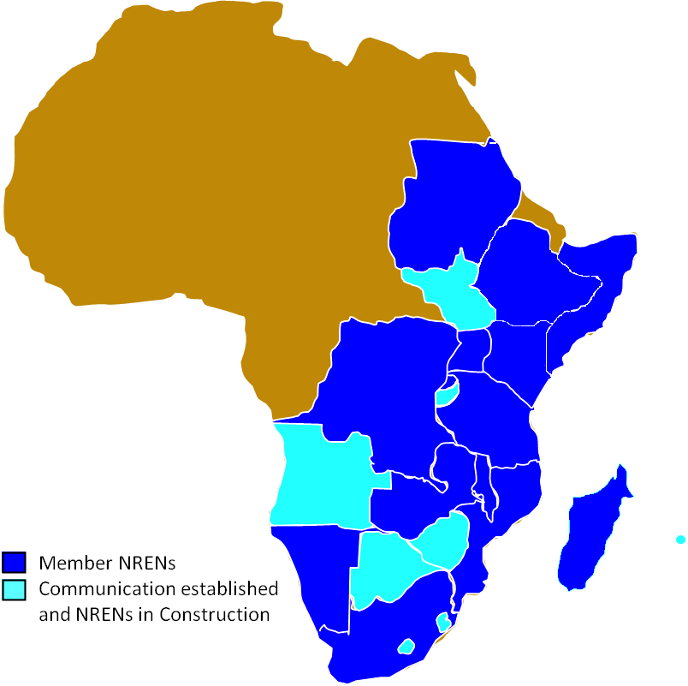
What is Ubuntunet Alliance?
The regional Research and
Education Network of ESA region
Member NRENs from 14 countries
Eb@le, DRC
EthERNet, Ethiopia
iRENALA, Madagascar
KENET, Kenya
MAREN, Malawi
MoRENet, Mozambique
XNet, Namibia
RwEdNet, Rwanda
SomaliREN, Somalia
SudREN, Sudan
Southern Sudan (de facto)
TENET, South Africa
TERNET, Tanzania
RENU, Uganda
ZAMREN, Zambia

Slide 3
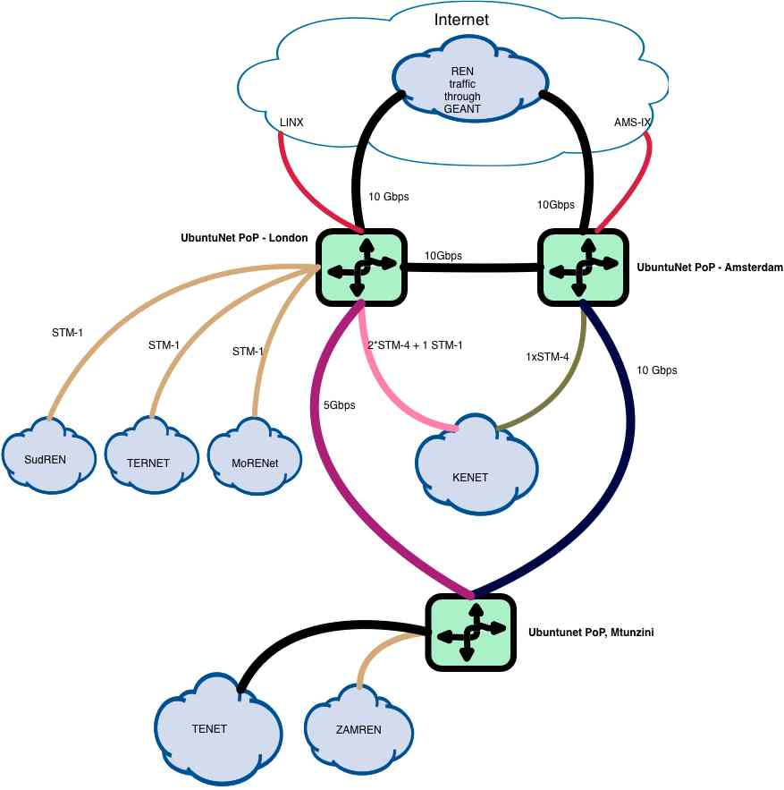
Current network operations
3 POPs
2 Links from Mtunzini PoP to Europe
All traffic exchanged in Europe

Slide 4
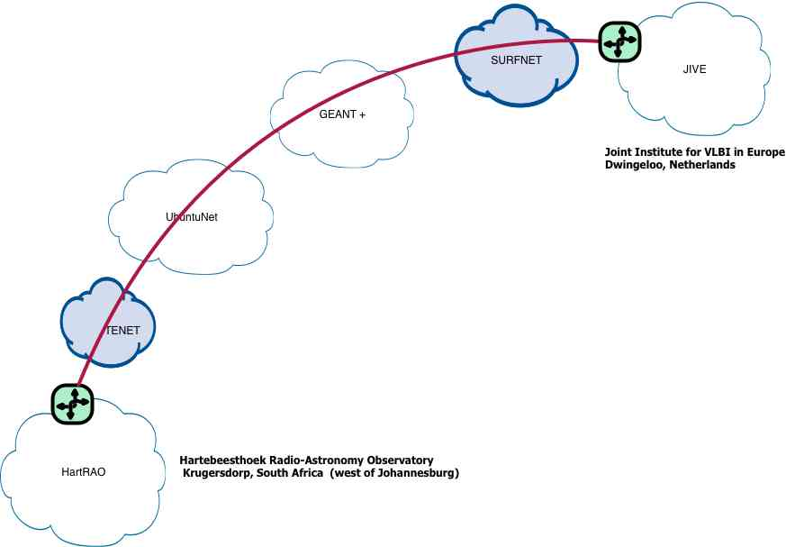
Current network operations – Light paths
One light-path currently operational
Between HartRAO and Jive
Transfer of e-VLBI data from the observatory in HartRAO to JIVE in real time
2 Gbps capacity
Notes:
Radio telescope

Slide 5
AfricaConnect – Keeping African traffic Local
Project to Implement UbuntuNet (the network)
Interconnect NREN networks within the Alliance
Connect to GÉANT and the rest of REN community through UbuntuNet PoPs in Europe
Budget - € 14.75 M for 4 years.
Aims to;
Foster the development of cooperative research programmes (EU-Africa)
Stimulate research activities in the region and build co-operation with researchers in the rest of the world;
Support NREN staff capacity building

Slide 6
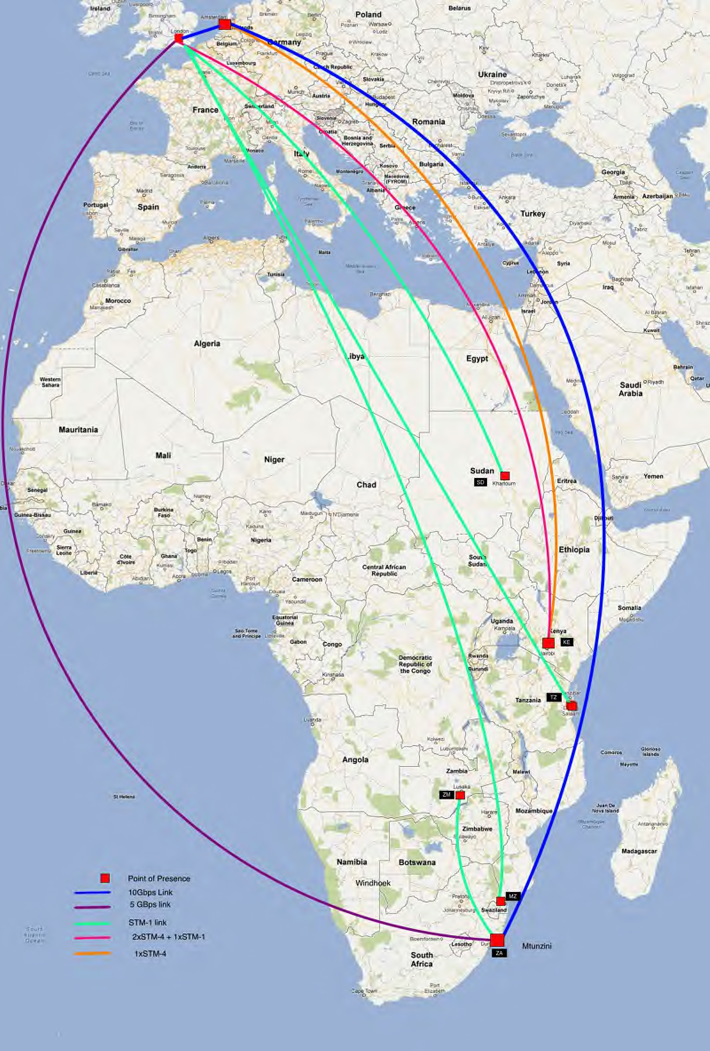
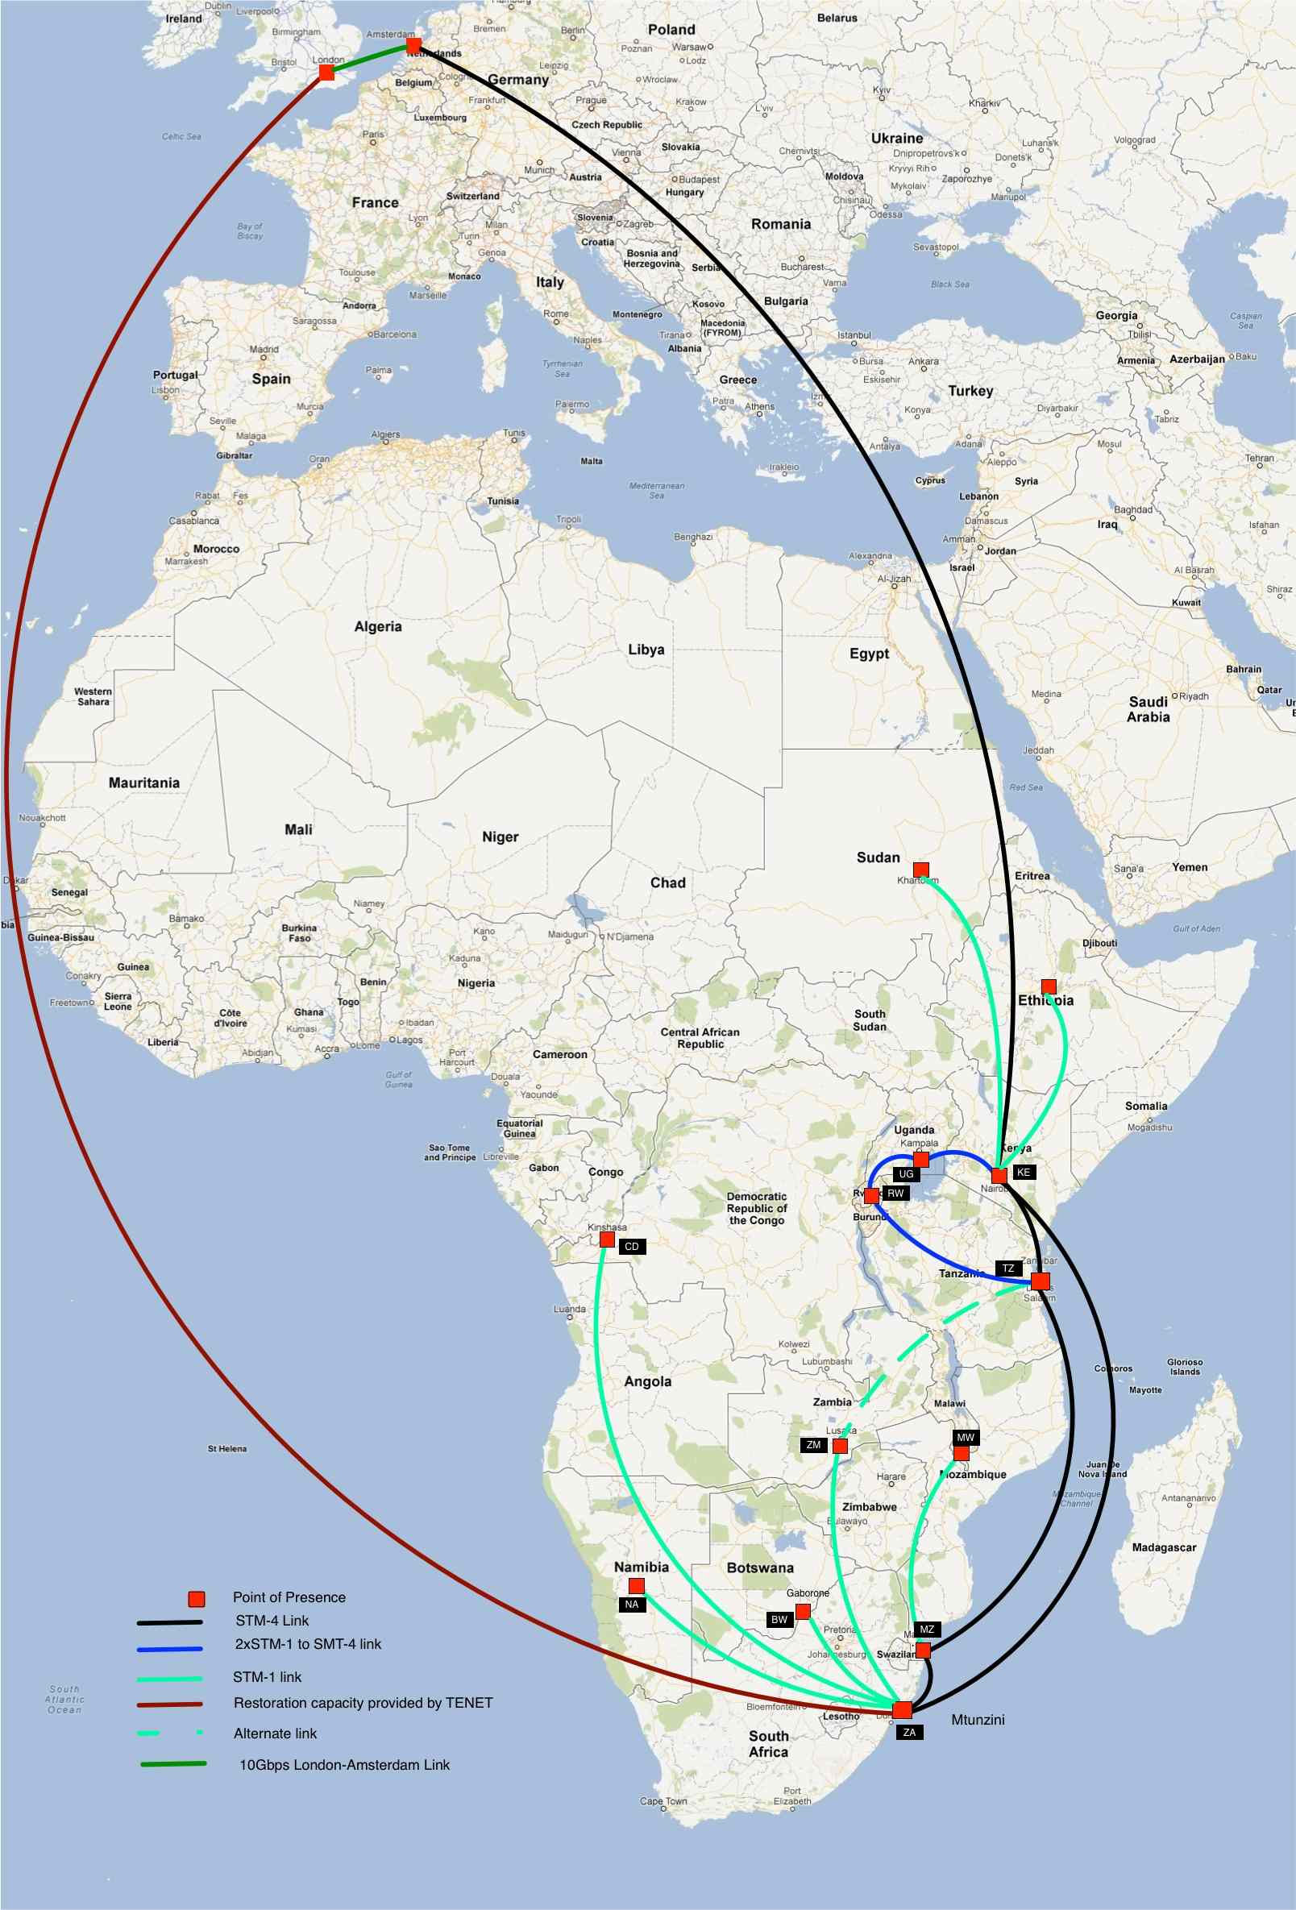
AfricaConnect – Keeping African traffic Local

Slide 7
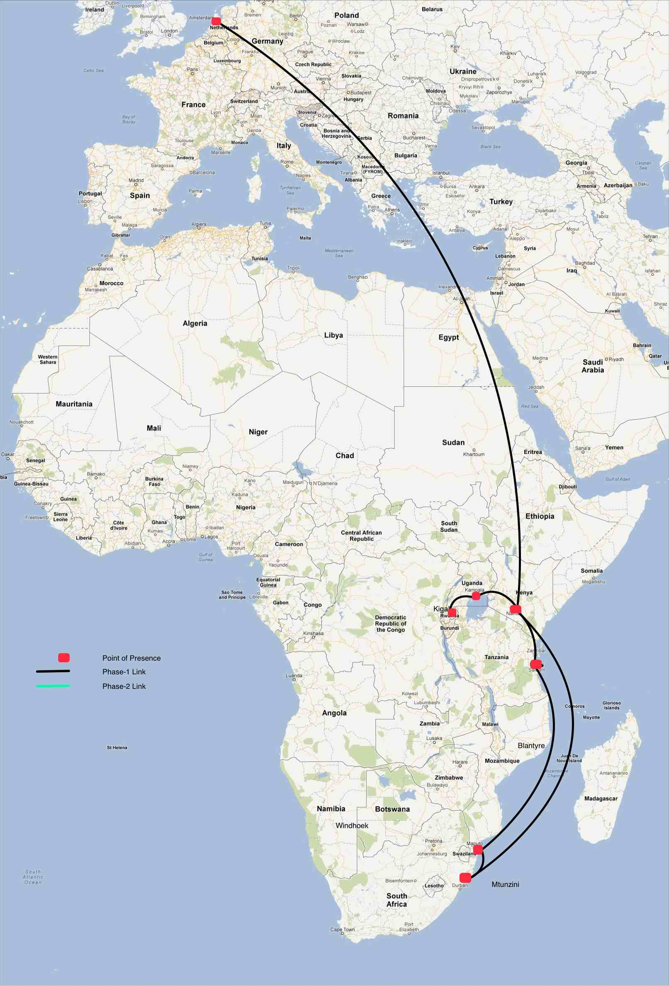
AfricaConnect – progress
Phase one
Contracts awarded
Phase two:
ITT issued.
Phases 3&4:
Addis Ababa, Khartoum

Slide 8
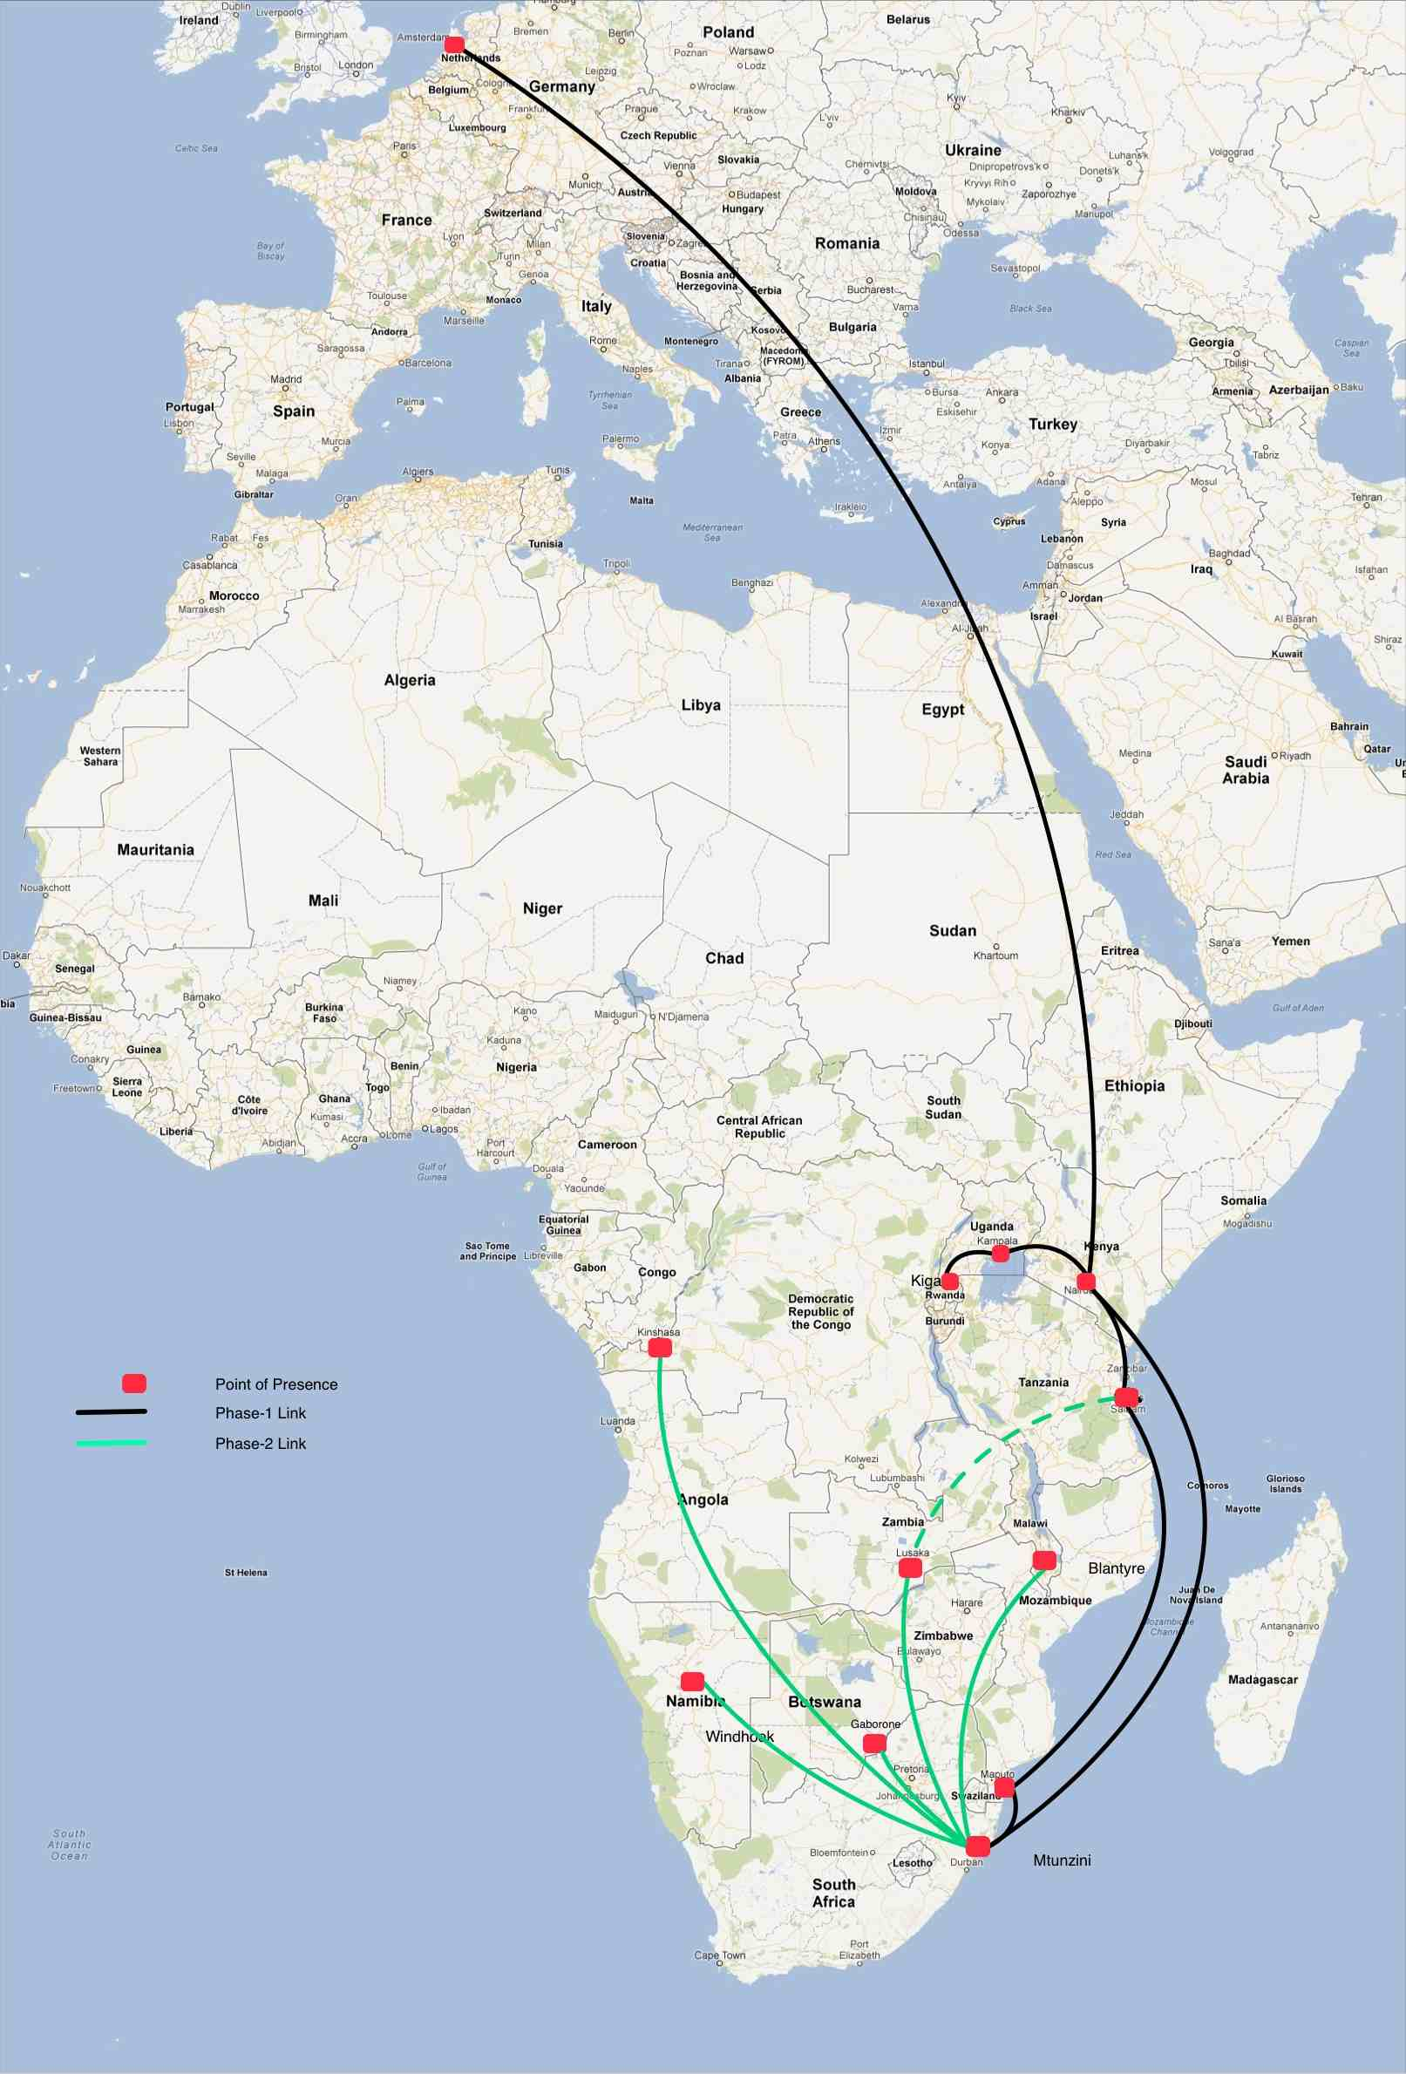
AfricaConnect – progress
Phase one
Contracts awarded
Phase two:
ITT issued.
Phases 3&4:
Addis Ababa, Khartoum

Slide 9
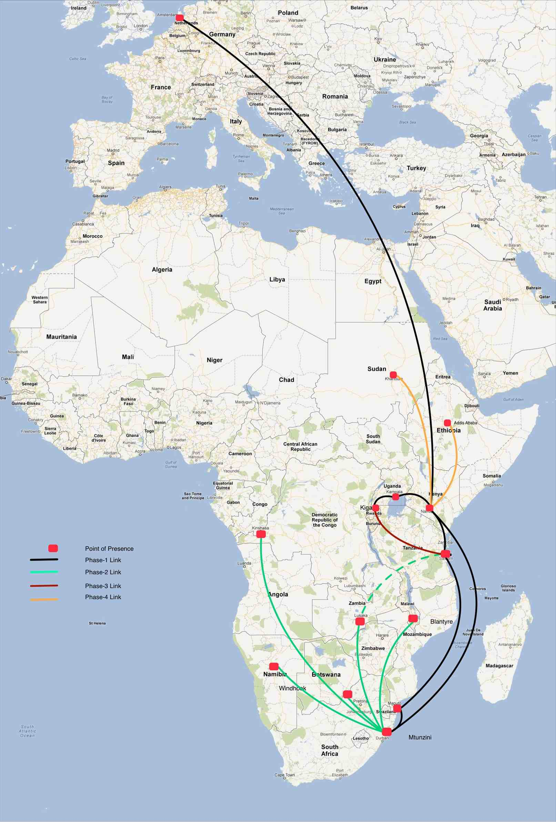
AfricaConnect – progress
Phase one
Contracts awarded
Phase two:
ITT issued.
Phases 3&4:
Addis Ababa, Khartoum

Slide 10
E-infrastructure initiatives
Ubuntunet Alliance is a partner in the e-infrastructures for Africa (eI4Africa) (www.eI4Africa.eu)
an FP7 project funded by the European commission aimed at promoting e-infrastructures in Africa.
Promote Euro-Africa collaborative research on e-infrastructures and their applications
Develop a science gateway (http://sgw.africa-grid.org), and use it to demonstrate applications to researchers and policy makers.
NRENs have just completed the implementation of Certificate Authorities for authentication.
In readiness for infrastructure under AfricaConnect.
The Alliance is also a partner in the CHAIN-REDS project (www.chain-project.eu)
Interoperability of grid infrastructure to allow virtual research communities to access worldwide e-resources.
ERINA4Africa collaboration (www.erina4africa.eu)
Providing policy makers with information on existing e-infrastructures in Africa.

Slide 11
Capacity building for Engineers
The Alliance recognizes the general lack of human resource capacity in the region
able to plan, implement and operate advanced data networks
The alliance has put in place a capacity building program incorporating:
Training workshops
Secondment of expert personnel
Attachment of Engineers from Alliance NRENs
Scholarships to attend workshops- mainly to AfNOG
NREN twinning

Slide 12
Capacity building for Engineers - Partners
Network startup Resource Center (NSRC)
Support for 3 years starting November 2012
Provide trainers for workshop events (NREN and campus level)
Provide training kits
Establishment of online training Labs
Support for trainees to attend workshops
Direct Engineering support for Campuses
Support to attend conference events including Internet 2
Two events carried out so far, a total of 33 engineers trained on Advanced Routing techniques
3 more events planned for this year, including the deployment of an online LAB

Slide 13
Capacity building for Engineers - Partners
AfricaConnect project
Support for trainees to attend workshops organized by the Alliance in collaboration with NSRC and AfNOG
Support to attend conference events e.g TNC
International Network for the Availability of Scientific Publications (INASP)
Support for 5 years starting January 2013 for select countries in the Alliance region
Will support training workshops in collaboration with NSRC and AfNOG
Support for campus network Audit and interventions in collaboration with NSRC
Support for Attachments and secondments under the twinning program.
Internet Society (ISOC)
Has collaborated with the Alliance since 2009
Provides trainers for workshops in collaboration with NSRC

Slide 14
Special thanks to our Friends:
AUC, AAU, PHEA, IDRC, FRENIA (ANDREW MELLON), USAID, IEEAF, EUC, TERENA, DANTE, AAU, Cisco, NSRC, INASP
And many more

Slide 15
Thank you

