Slide 1

Research and Education Network In Africa – The KENET Story
Kennedy Aseda Josphat Karanja
kaseda@kenet.or.ke jkaranja@kenet.or.ke

Slide 2

Is a Leading Tourist Destination?

Slide 3
Contents
Who is KENET?
The journey in the last 13 years
Current Status
Regional Partnership
International Collaboration and Partnerships
Future Possibilities
Q & A

Slide 4
KENET Background
Founded in 1999 and is licensed as a private networks operator since 2002 (www.kenet.or.ke)
Alternative Network Facilities Network Operator
KENET recognized by ICANN and AfriNIC as an NREN and allocated AS# and IP block (v4 and v6 on behalf of education community of Kenya)
KENET governed by a Trust Deed with following objects:
Cost-effective bandwidth, Sharing of resources for learning and research, Promote collaboration in higher education
Board of Trustees
Membership organization (closed network for members only)

Slide 5
Governance
Board of Trustees
Five (5) Vice Chancellors of founding universities
Three (3) representative of Government, Industry Regulator and Research Institutes.
Management Board
Five representative of the founding universities
Three representatives of senior faculty, private (rural) universities and Research Institutes.
Secretariat
Executive Director
16 techies – Electrical Engineering and Computer Science
Three (3) finance
Four (4) Graduate Trainees

Slide 6
KENET Member Categories - 78
Institutional Category | Number of institutions | Comments
Public Universities | 16 | All public universities
Private Universities | 21 | All chartered universities members
University colleges | 10 | Most university colleges are members
University campuses | 1 | Moi University, School of Medicine
Research institutes | 8 | ILRI, ICRAF, KEMRI, KEFRI,KARI, KIRDI, ICIPE, BSC
Libraries | 1 | KNLS – joined in 2009
Colleges | 10 | Mostly Government colleges
Other related institutions Government Affiliates | 9 | CHE, HELB, KIE, TSC , KSMS, KIA, KDLC, KNEC
Technical Institutes | 2 | Machakos Technical Training Institute

Slide 7

KENET Spheres Of Influence
Campus Networks
National Network via KIXP
Backbone Networks
Server Rooms
PC to Student ratio
Automation
Directory Services
Capacity Building
Telcos
NOFBI
Leased Lines
Owned Fiber
PoPs
Data Centers
Capacity Building
Network Availability
Shared Services
KENET
Global Internet Community
Research and Education Community
International Capacity – IRUs
Peering –
Redundancy
Content – Google, Akamai
Peering – Research Networks
Regional Connectivity
Redundancy
Collaboration and Twinning
ADVOCACY AND POLICY INFLUENCE
RESEARCH ON E-READINESS
INFRASTRUCTURE

Slide 8
Local & International Connectivity
National Cnnectivity
Peer at the Kenyan Exchange
1Gbps port to KIXP
10Gbps core network
Provides cheap and very fast throughput
Local traffic not affected by undersea fiber faults
Very low congestion
International Connectivity – 1.95Gbps
2xSTM4 IRU Capacity (TEAMS/SMW4) to London
1xSTM4 IRU Capacity (SEACOM) to London
1xSTM4 IRU Capacity (SEACOM) to Amsterdam
Regional Connectivity – Expected Mid 2013
AfricaConnect, Ubuntunet Alliance

Slide 9
KENET Rapid Growth in Connected Campuses (Serving more than 300,000 students)
KDN fiber-underground (Primary)
FON dark fiber-underground
.
Jamii fiber -overhead(Backup)
Lokichoggio
Ethiopia
KENET POP
Mandera
Lodwar
POP | Number of Campuses Connected
Nairobi POP | 62
Kisumu POP | 15
Mombasa POP | 9
Eldoret POP | 13
Nakuru POP | 10
Meru POP | 11
Total Campuses connected | 120
Total Student Population | 300,000 (approx)
Moyale
577
Marsabit
Project
912
Marsabit
Wajiir
Kitale
Uganda
Meru
POP
Somalia
__
Eldoret
POP
Weybuye
Eldoret
Nyahururu
Nanyuki
70
Kakamega
Nakuru
POP
Isielo
129
Nakuru
Nyeri
Meru
350KM
318
Kisumu
POP
Kisumu
Embu
400KM
150KM
Muranga
350KM
321
Garissa
Kericho
Thika
Mwingi
Kisii
Bomet
Nairobi
USIU
POP
Tala
Kitui
Rongo
400KM
UoN
POP
159
Isebania
Narok
Kaljiado
159
500KM
Garsen
500KM
Italian Space Agency -Luigi Broglio Space Centre- Malindi
Namanga
Malindi
Mombasa
POP
INDIAN OCEAN
Kilifi
Mombasa
Tanzania

Slide 10
Bandwidth Distribution Network
Infrastructure Type | Number of links | Capacity of links (Mbps)
KENET Owned Fiber | 10 | 25,000
Commercial fiber leased lines | 90 | 2,281
KENET Owned Radios | 12 | 382
Commercial radio leased lines | 29 | 286
Total | 141 | 27,949

Slide 11
Price per Mb/s at Member Institution the Key Competitive Advantage

Slide 12
Services To Members
Advocacy
Vice Chancellors’ and ICT Directors forum
Influence budgets, ICT Directors’ position
International bandwidth
1.95 Gb/s Capacity on TEAMS and SEACOM cables
Local connectivity
High capacity, low congestion links
70 % of links on fiber
Highly skilled technical staff
Training services, technical support to members
Shared Services
Video Conferencing, IP Management
Domain and web hosting
Co-location
Storage & virtual servers

Slide 13
Services To Members Contd..
Eduroam
5 Universities already running Eduroam
5 more universities by May 30th 2013
Total of 25 by December 2013
Certificates & Federated Services
CA & idF projects ongoing with eI4Africa (ei4africa.eu)
Measurement Lab
Internet Measurements
Internet Research

Slide 14
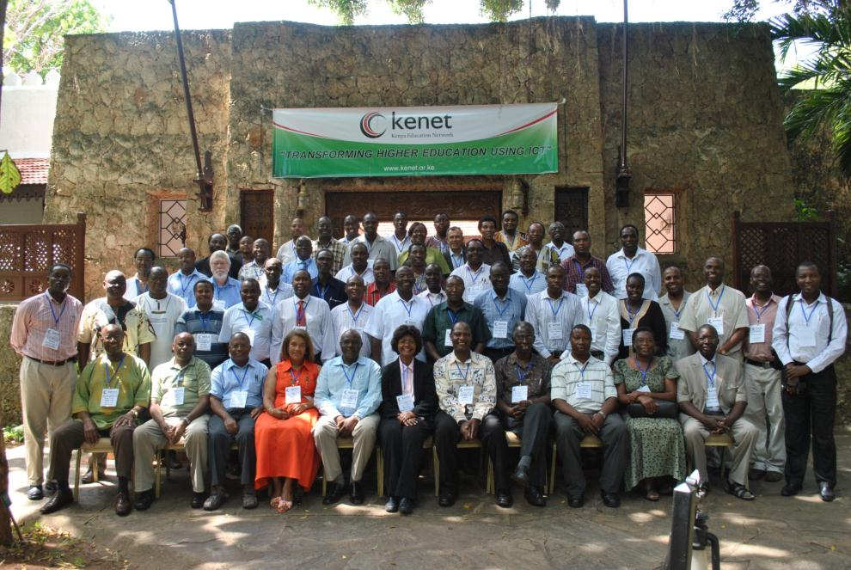
Community Growth Vice Chancellors’ Forum (Annual)

Slide 15
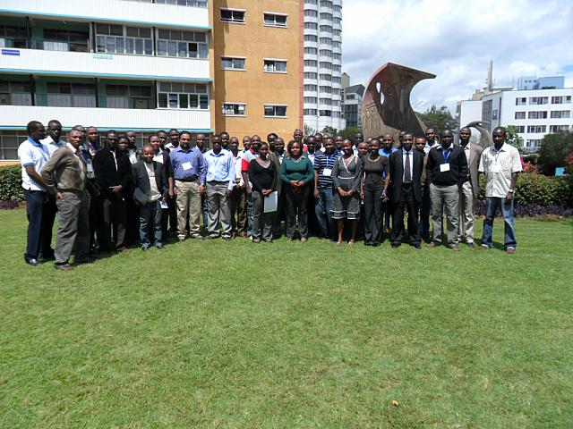
System Administrator’s Training

Slide 16
Partnerships – Helping Hands!
Kenya ICT Board and CCK, MoHEST and MoIC
LOCAL OPERATORS – KDN, Jamii, Safaricom, Telkom, SEACOM
ISOC, AfNOG – Capacity Building
IBM (Pro bono Consultancy work) and research lab!
DFN ( German NREN) for Capacity Building and NREN business models
Network Startup Resource Center / University of Oregon : Capacity Building
Google : Infrastructure grants, Cache, donated switches, Open access Internet measurement labs
TENET : International NOC services and NREN business models
EU and AU – AfricaConnect Project

Slide 17
Key Achievements So Far
More than 120 campuses connected in 4 years
Distributing more than 1.95 Gbps of international bandwidth
Distributing 600Mbps from local content cache
10 Gbps fiber dark fiber ring connected key sites in Nairobi
Commissioned in 2012.
Development of 2 data centers
Shared services, colocation
Partnership with local operators and leased line providers
KDN, FON, JTL, Safaricom,Telkom Kenya and Access Kenya
Collaboration with other NRENs,
Ubuntunet Alliance, Internet 2, DFN, International Universities and Research Bodies
International Collaboration and Partnership
Google implementation partner, IBM research lab, NSRC for capacity building
High Speed network
http://www.itnewsafrica.com/2012/04/africas-top-ten-countries-with-fastest-internet-speeds/
Generates > 600 Mbps of Google/You tube traffic

Slide 18
FUTURE PLANS
Core Network Expansion
Additional 800Km dark fiber lit at 10Gbps
Access Network Expansion - Ongoing
27 Campuses to be integrated to 1Gbps KENET owned last mile fiber
Additional 200Km of KENET fiber
Campus Wireless - Ongoing
Addition of wireless networks in 10 more campuses
Eduroam Service
Certificates & Federated Services – Ongoing
Training Lab
Physical Lab – Networks & Systems Administration

Slide 19
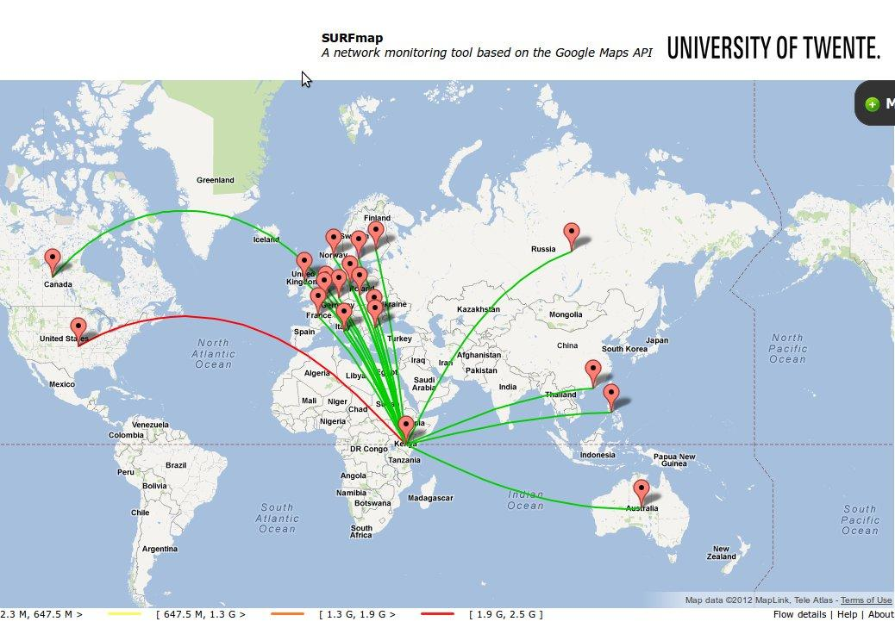

Traffic Patterns – AfricaConnect

Slide 20
Q&A

