Slide 1
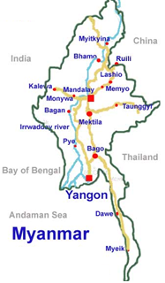

Myanmar Networking Update
University of Computer Studies, Yangon

Slide 2

Agenda
ICT Educational Organization Structure
Current ICT Infrastructure
Current state of University Teaching
Research & Development
Developments in progress for enhancing campus
Establishing National Research and Education Network

Slide 3
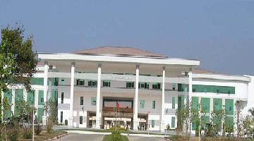
ICT Educational Organization Structure
MOST
University
of Technology
University
of Computer Studies
MCIT
IT Training Centers
Top Level Management
MOE
Universities
(Art & Science)
University of Economic
…
…
We are here
UCSY
MOE – Ministry of Education
MOST – Ministry of Science & Technology
MCIT - Ministry of Communication & Information Technology

Slide 4
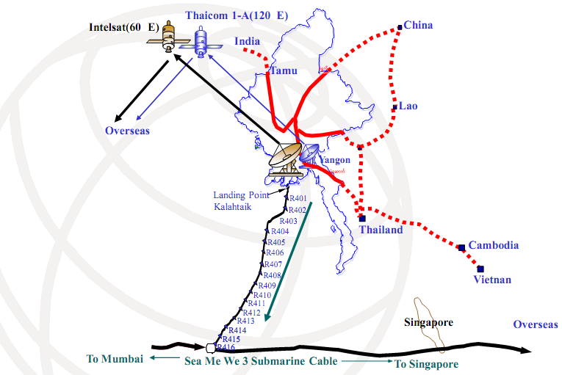
Border Link Communication Network Diagram
Notes:
Sea-Me-WE 3 - South East Asia- Middle East-Western Europe 3
underwater cable system and satellite communication system and cross-border transmission link system have been built.
In the regions with difficulty in the installation of fiber and microwave systems, VSAT, IPSTAR and I-Direct systems have been built.
Plans are also underway to be able to link with SEA-ME-WE-4, Asia, Europe under water cable. It will be linked to SEA-ME-WE-4 via Bangladesh which is the nearest country. After completion of the project, it can communicate with other countries included in SEA-ME-WE-4 cyber link via fiber cable.
Fiber-to-the-Home (FTTH) Service, one of the high standard communication technologies, was launched in Yangon and Mandalay in December 2010

Slide 5
Current ICT Infrastructure
Internet Service Provider (ISP)
  Myanmar Posts and Telecoms (MPT)
  Yatanarpon ISP
  National backbone : Fiber link between major cities
Narrowband Access
  Dial-up, Access kit
Broadband Access
  ADSL, Wi-Max, Optical Fibre, Satellite (ipStar, Thaicom5, VENASAT)

Slide 6
Cyber Security
mmCert : under Ministry of Communications and Information Technology
Myanmar Computer Emergency Response Team
a single point of contact for dealing with cyber security incident in Myanmar
works to increase public awareness in security
supports technical advisories in our community
http://www.mmcert.org.mm/

Slide 7
Teaching Methodology
  → Change Theoretical Oriented approach to Practical Oriented approach
  Apply Public, Private and Partnership approach
  Join with industrial sector (both national companies and international companies)
Notes:
such as NTT Data, Japan

Slide 8





Languages used in Study
All Textbooks and References are written in English
Native Language is only spoken in detail explanation during lecture time
Reports, Seminars, Assignments are conducted in English

Slide 9
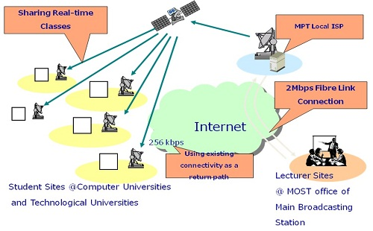

Distance Learning
Online Teaching and Learning System among Computer Universities
Web-based Teaching System in Yangon University
Use 4Mbps Fibre Line from MPT
All universities use 256Kbps ipStar Link from MPT
Use Streaming server to transmit the lecture and streaming media player to receive the lecture
iPSTAR
Notes:
three components: lecturer sites, a gateway site, and student sites
Lecturer sites can be built anywhere as long as the network bandwidth is sufficient to carry lecture video and audio to the gateway site.
The gateway site is located in Keio University, Shonan Fujisawa Campus, the location of the AI3 C-band hub station.
Students sites are located in Asia, within the footprint of the JCSAT-3 satellite used by AI3 Project.
-have Receive Only earth stations to receive data transmitted to the AI3 Unidirectional Link
-have Internet connections, such as 128kbps leased-line
-while the existing Internet connections enable real-time interactions between lecturers and students
-have mirror servers. Students can watch lecture archives from local servers.

Slide 10

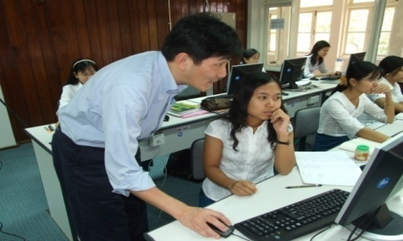
ICT Training Centers under the Ministry of Science and Technology
Information and Communication Technology Training Institute
- established in 2006
- joint with JICA, Japan
India-Myanmar Center for Enhancement of IT Skills
  - established in 2008
  - joint with India Government

Slide 11
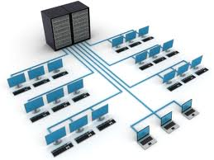
Network Status at Computer Universities
UCSY has 2 dedicated line from MPT
  Fiber Optic, E1 connection, Wi-Max connection
UCSM
  ipSTAR Satellite Connection, Fiber Optic
All universities have internet access through
  ipStar Satellite Communication
No intranet connection between all computer universities

Slide 12
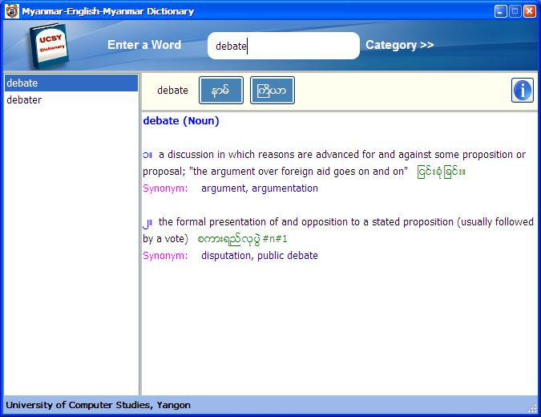
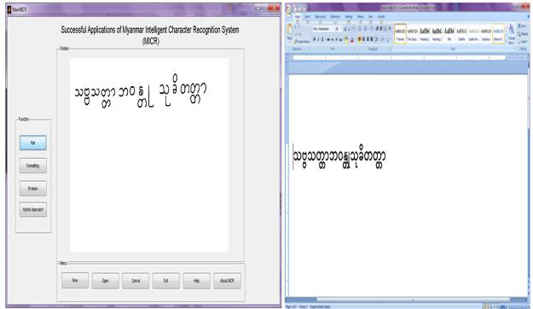
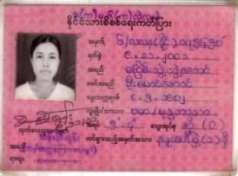

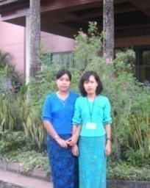



Research and Development in UCSY
Natural Language Processing
  Myanmar-English Myanmar Bilingual Dictionary
  English-Myanmar Machine Translation System
  http://www.nlpresearch-ucsy.edu.mm
Image Processing
  Myanmar Intelligent Character Recognition (MICR) and Myanmar Voice Mixer (MVM) System
  Automatic Identification System of Myanmar National Registration Card (NRC) Holder based on Biometric Information

Slide 13
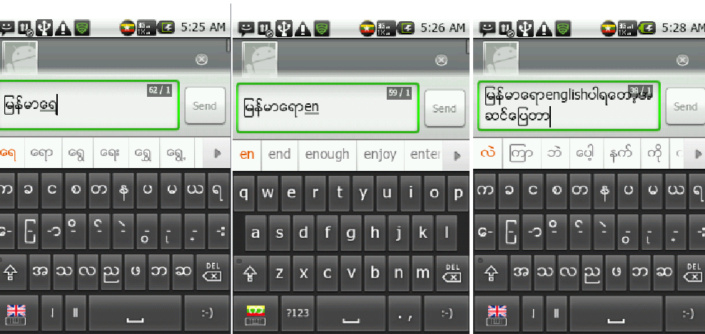
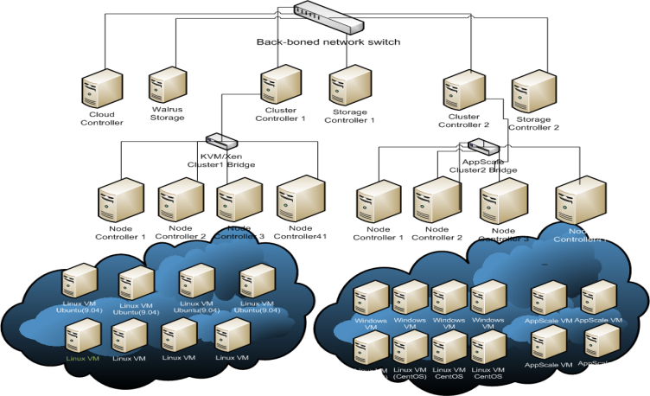



Research and Development in UCSY
Mobile Computing
  iTextmm (Myanmar Text Input for Mobile Phone)
  Context-Related Access Control Mechanism
  Context aware Location-based Service
  http://www.ucsy.edu.mm
Virtualization and Cloud Computing
  UCSY Private Cloud System (Open Source)
Open source Web portal

Slide 14
Developments in progress for enhancing campuses
International Co-operations
Future International Co-operations
Expectations

Slide 15
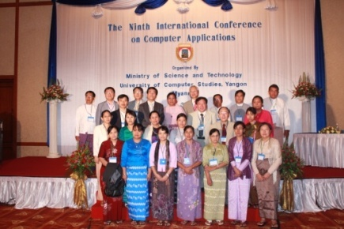
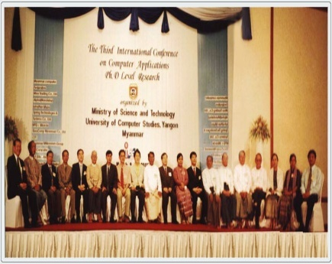
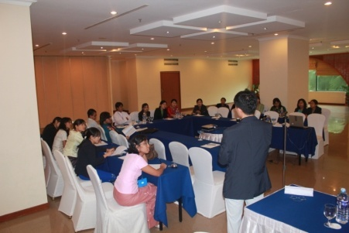
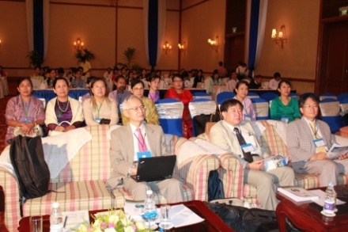
International Cooperation Activities and Events
International Conferences on Computer Applications (ICCA)

Slide 16


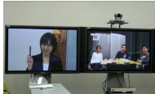
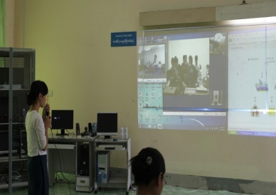
International Cooperation Projects
School on Internet Asia (SOI Asia) Project
  develops distant learning applications for the advanced usage of the Internet as a tool of higher education.
Asian Internet Interconnection Initiatives (AI3) Project
  joined together with KEIO University, other Asian partner universities and UCSY
  aims to research and develop the Internet technologies
  2011 AI3/SOI Asia Autumn joint Meeting is held at UCSY in the last November.

Slide 17
International Cooperation Project
SEACOOP Project
  Supporting policy dialogues and strengthening cooperation between Europe and Southeast Asia in ICT
  Recent Activities
    The 6th SEACOOP Cooperation Forum on ICT Research and ICT for Development is successfully celebrated at Myanmar on October 25, 2011.
    A TEIN3 workshop organized by UCSY and DANTE under the aegis of MOST and EU to connect the REN community to the World on May 2012.

Slide 18


One Day in Asia Event
http://connect-asia.org/

Slide 19
International Cooperation
UCSY join to Network-based ASEAN Language Translation for Public Service Project proponent by NECTEC, Thailand.
National Advance IPv6 Centre, University Sains Malaysia offers UCSY to carry out research collaborations concerning IPV6, next generation internet technology.
Scholarship Program and Training of Trainers (TOT) Program by Nippon Telegraph and Telephone (NTT) Data Corporation, Japan.
Notes:
National Advance IPv6 Centre is a premier centre in the area of Next Generation Internet, serving as the National Centre for IPv6 research, human resource development and monitoring of IPv6 development for Malaysia
In view of the overlap and synergy of the research and development goals between USM and UCSY, it is the intention of USM (working through various relevant experts available from NAv6) and UCSY to carry out collaboration efforts and to this end they are desirous of setting out their understanding in relation to such collaboration;

Slide 20
Future International Cooperation
Translation post-editing system for multilingual information access and language learning, Linton University College, Legenda Education Group, Malaysia.
UCSY is trying to join to the TEIN3 / TEIN4 network to support researches and development in Myanmar and to enhance international cooperation

Slide 21
First Step to Enhance Campus Networks
Cooperation with National Startup Resource Center (NSRC), University of Oregon, USA
Upcoming event on 2013 March
  Technical assistance & Group Workshop Program for participants from all Universities in Myanmar
  Objectives
To develop the human network
To provide direct engineering assistance in the physical development of campus networks
To improve network access and infrastructure

Slide 22
Expectation
To build advanced research center with the initial guidance of knowledgeable and skilled experts from developed countries
To setup campus networks in Universities and improve internet access connection.
To implement Cyber Security and Forensic Computer Crime Investigation Laboratory as security is an important issue in ICT environment

Slide 23
Establishing Myanmar NREN
Motivate Universities to participate in Myanmar NREN by sharing knowledge and technology such as providing training and awareness workshop
Need a good coordination and collaboration among Universities and research organizations
Support IT & develop campus network for research and education activities

Slide 24
Thank you

