Slide 1
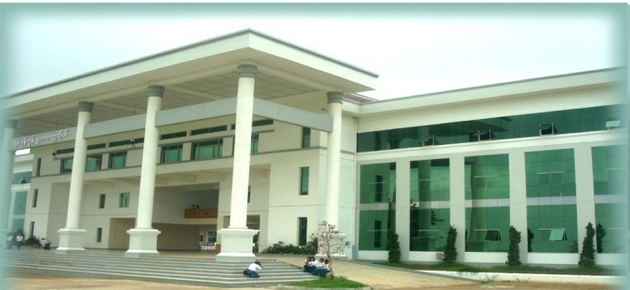

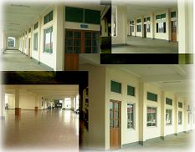
Current ICT Status and Trend in Myanmar

Slide 2
Outlines
Current ICT Infrastructure
ICT Trends in Myanmar
Analysis of ICT environment of Myanmar
E-government activities of Ministry of Science and Technology (MOST)
Network Status at Computer Universities in Myanmar
Research and Education Network of Myanmar

Slide 3
Current ICT Infrastructure
two types of Internet access
narrowband access
broadband access.
For narrowband access,
dial-up access and access kit which makes full use of copper network of Myanmar Posts and Telecommunications (MPT).
For broadband access,
ADSL which uses copper line,
WiMAX uses wireless link for fixed and mobile access,
Satellite link which uses ipStar, Thaicom5, VENASAT
Fibre which uses optical fibre.
10531km and 619km are under construction and 1747km needs to be connected more.
The domestic bandwidth is currently 20Gbps and the international bandwidth is 10 Gbps.

Slide 4
Cross-border Fiber Optic Link

Slide 5
Subscriber Networks in Myanmar
Technology | Ratio (%)
Dial up (<56 kbps) | 39.9 %
ADSL (256 Kbps – 20 Mbps) | 45.7%
FTTx | 1.2 %
Satellite/ iPSTAR | 8.8 %
BWLL | 1.8 %
Wireless B.B (WiMAX) | 1.8 %
E1 | 0.5 %
SUM | 100 %
85 % of user connect to the Internet via Dial up or ADSL

Slide 6
Long Term Vision of Myanmar ICT Plan
Socio-Economic Development through Knowledge-based Society
Objectives of Myanmar ICT Plan
Enhance the ability of citizens to utilize ICT
Strengthening national competitiveness by promoting informatization
Facilitate economic growth by promoting the ICT industry and establishing information infrastructure
Realize good governance and Clean government through ICT

Slide 7
Vision & Objectives in 2015
Establishing Foundation towards Knowledge-based Society
Competitive Industry
Socio-economic Development
Reliable Infrastructure
Efficient Government
Enhancement of ICT Infrastructure
Efficient Competition Structure
Demand based Promotion Policy
Extension of ICT Applications
Strong political commitment, Public & private cooperation & collaboration, Competition and liberalization, Domestic and foreign investment, Support program, Good governance, Effective utilization of resources
Source: Jong Sou Park, Myanmar ICT Master Plan, SEACOOP Conference, Oct 25th 2011

Slide 8
Major Sectors in Myanmar ICT Vision
Infrastructure Building
Legal Framework
ICT Human Resource Development
ICT Infrastructure
Industry Promotion
Standards
Liberalization
ICT industry
Utilization
E-society
ICT Utilization
E-Government
E-Commerce
E-Education

Slide 9
Analysis of Myanmar ICT Environment
Strength | Weakness
- High demand in ICT services - High profitability of mobile industry - The government’s high interest - Increase in well-educated human resources - Relatively cheap labor cost | Limited and unstable telecom infrastructure Weak ICT industry base Strong regulation imposed on most of industry sectors Mismatch of ICT manpower supply and demand Public’s lack of ICT knowledge
Opportunity | Threat
New administration with new ICT policy direction Improving international cooperation environment Regional cooperation with ASEAN, China, India Strong determination on informatization Increasing demand of ICT outsourcing | Intense competition from neighboring countries Instability and low efficiency in macro economy Weak financial industry base and structure Brain drain of ICT human resources

Slide 10
Vision & Objectives of ICT Infrastructure
Vision
Construct a reliable ICT environment to facilitate industrial base and to strengthen ICT utilization capability
Achieve 30 mil subscriber by 2015 in mobile industry
Objectives
To achieve 50% of teledensity by 2015
To strengthen ICT security and public safety
To construct proactive ICT infrastructure
To establish efficient migration strategy for network operator

Slide 11
Analysis in Infrastructure Sector
Strength | Weakness
The Government’s high interest in ICT development Strong consensus on ICT infra build up Fast increase in demand on mobile service High return of telecom business | Limited and unstable infrastructure Too many outdated telecom network systems Lack of national informatization strategy Mismatch of ICT manpower supply and demand
Opportunity | Threat
New administration with new ICT policy direction Improving international cooperation environment Strong needs for telecom infrastructure Dynamism of ICT industry environment | Instability and low efficiency of macro economy Weak financial base and structure Limited foreign investment Lack of skilled professionals

Slide 12
e-Government Activities
in Ministry of Science and Technology , Myanmar
No. | Current e-government Status at ministry | Planned Activities
1 | Ministry has nine departments. No online e-service is used for office work such as distributing documents among departments Only DTVE use own domain for e-mail service to deliver office documents to its sub departments: universities, colleges, high schools which locate across country All other departments use fax and mailing for office work | Ministry plans to promote office work using online services for ministry level To distribute and exchange office documents among departments and its sub organizations (universities, colleges, high schools and etc.) Documents exchange system among departments and its sub organizations which locate at different regions Staffs data management system for ministry and all departments and its sub organizations.
2 | Website for ministry and departments: Ministry has own website created using free open source software “joomla” (http://www.most.gov.mm) All departments information are described in ministry website All universities, colleges, high schools information are described under ministry link (http://www.most.gov.mm/ucsm, http://www.most.gov.mm/mtu, http://www.most.gov.mm/ytu, http://www.most.gov.mm/maeu, and etc.) but They do not have own domain web site Some university has their own domain website (UCSY) (http://www.ucsy.edu.mm) Website only provides information and provides no online service for users. | Promote website Promote website that offers services to public users and students such as (1) commenting on ministry’s activities (2) providing important information for users (3) interactive service for users Build own domain websites for some universities (YTU, MTU, MAEU, Pyay TU, COE universities)

Slide 13
No | Current e-gov Status at ministry | Planned Activities
3 | e-service Job Matching Information System (JMIS) is already established online for students who graduated from ICT training center (Hlaing), yangon. (http://www.jobsearch-ict.net.mm) | e-service Want to promote more e-services for students and public users (1) online student registration system (2) online e-library to share among universities, colleges, institutes and high schools
4 | Basic computer training For office staffs, ministry offers three months training for office work using office software such as Microsoft word, excels, power point and internet usage every year
5 | Cyber learning University of Technology (Yatanarpone Cyber City) (UT(YCC)), locates at upper Myanmar - Pyin Oo Lwin, has cyber studio to broadcast lectures (established by CLMV project from KOREA) Only two universities have been tested to receive lectures but still not enough bandwidth problem | Cyber learning Ministry plans to connect UT(YCC) and other universities under MOST for promoting the e-learning system All receiving universities need high bandwidth internet connection and multi-media class rooms
Source: E-Government Training Action Plan, MOST, Myanmar, KOICA, Korea, Dec 17, 2012

Slide 14
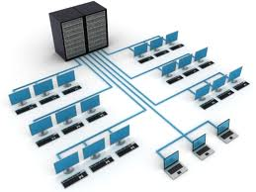
Network Status at Computer Universities
UCSY has 3 dedicated line from MPT
Fiber Optic E1 connection, Wi-Max connection, ipSTAR
UCSM
ipSTAR Satellite Connection, Fiber Optic
All universities have internet access through
ipStar Satellite Communication
No intranet connection between all computer universities

Slide 15
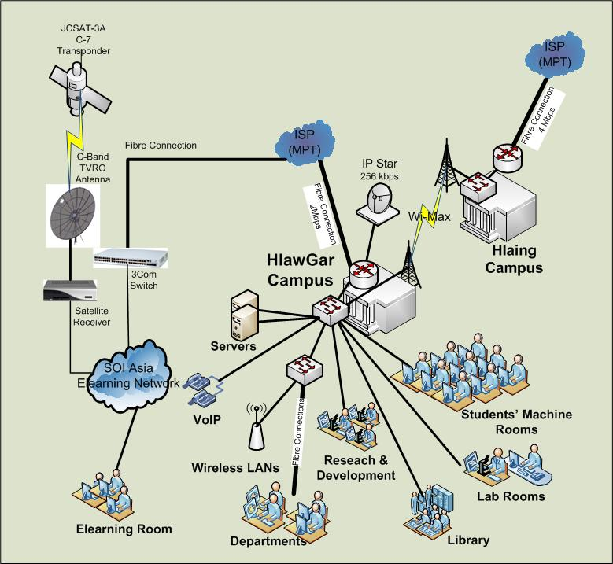
Backbone Infrastructure Network in UCSY

Slide 16
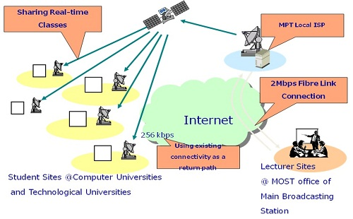
Distance Learning among Universities
Online Teaching and Learning System
Use 4Mbps Fibre Line from MPT
All universities use 256Kbps ipStar Link from MPT
Use Streaming server to transmit the lecture and streaming media player to receive the lecture

Slide 17
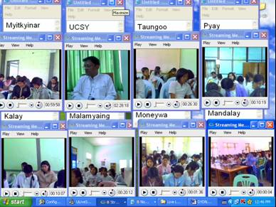
Limitation of Distance Learning
Software-based video sharing – Streaming Server
Maximum 15 Universities can join at the time of broadcasting.
Discussion is done through mail and chat.
Because of low bandwidth, frequent disconnection occurs using ipSTAR connection.

Slide 18
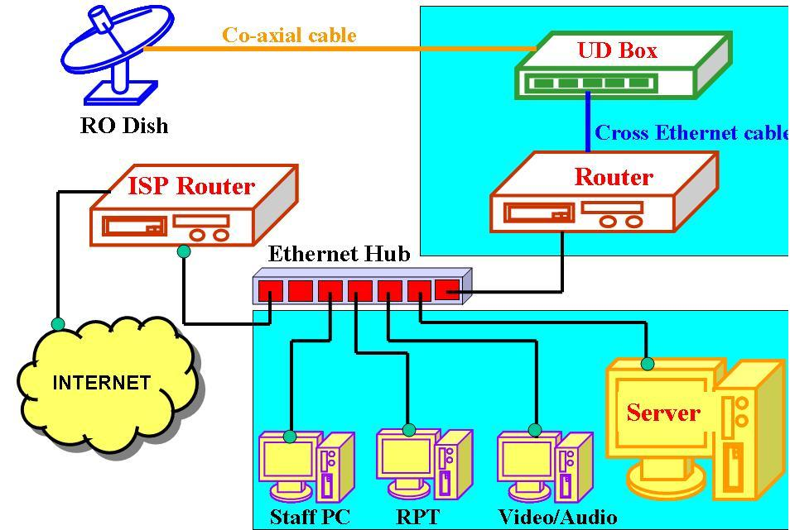
International Cooperation in Educational Network
AI3/SOI membership in SOI-Asia R&D network
E-Learning System
Uni-directional receive only side

Slide 19
Cooperation with Network Startup Resource Center (NSRC), University of Oregon
On 2013 February 28 - March 03
Technical assistance to UCSY network engineers
On 2013 March 04 - 08
Group Workshop Program for participants from all Universities in Myanmar
Objectives
To develop the human network
To provide direct engineering assistance in the physical development of campus networks
To improve network access and infrastructure

Slide 20
Building Myanmar REN
UCSY is trying to join the TEIN3/4 network to support research and development in Myanmar.
UCSY is established National Advance IPv6 Centre collaborated with University Sains, Malaysia to carry out research collaboration concerning IPv6, next generation Internet Technology.
Some human resources from UCSY is sent to the TEIN3 training program to get knowledge in research and education networking technology.
Need a good coordination and collaboration between different organizations and institutes under control of different ministries.
Need also the global collaboration that can support network development for research and education activities,
Need technology and knowledge transfer through training programs and research collaborations.

Slide 21
Thank You Very Much

