Slide 1
Day 4-2 Inter-Network Cooperation
Cooperation and Coordination
community, sharing,
incident response, trust

Slide 2
cooperation and coordination
to keep the Internet working
- we are relying on each other
it’s good to know
- community
- point of contact

Slide 3
NOGs
Network Operations Group is an open forum
- technology discussions
- sharing operational best practices
- compare experience
- peering coordination
- establishing personal relationships

Slide 4
medium for NOGs
mailing-list
- anyone can subscribe
- traffic depends on events and topics
in-person meeting
- participation fee varies, and costs of transports, accommodations
- high value

Slide 5
NANOG
North American Network Operators’ Group
- evolved from the NSFNET "Regional-Techs" meetings in 1994
- Three meetings each year
NANOG57, Feb 2013, Orland
NANOG58, Jun 2013, New Orleans
NANOG59, Oct 2013, Phoenix

Slide 6
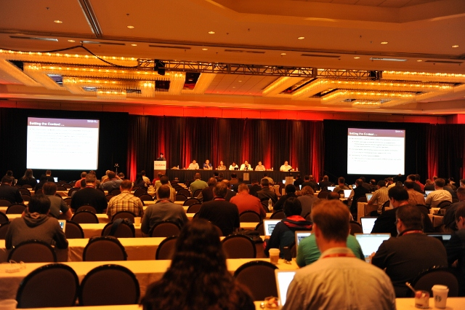
https://www.nanog.org/
- program
1 day tutorial
3 days plenary
- about 500 attendees
from Asia and Europe as well

Slide 7
AfNOG
The African Network Operators’ Group
- also called ‘Africa Internet Summit’
- established in 2000
- co-located with Af* meetings
- held annually in spring
AfNOG-14/Afrinic-18, Jun 2013, Lusaka, Zambia

Slide 8
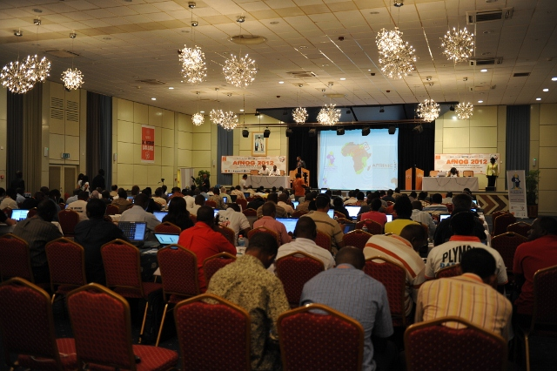
https://www.afnog.org/
- program
5 days workshop
5 days conference and tutorial
2 days AfriNIC meeting
- about 150 attendees

Slide 9
APRICOT
Asia and Pacific Operations Conference
- established in 1996
- co-located with AP* meetings
- held annually on the last week of Feb
APRICOT2013, Singapore
APRICOT2014, Bangkok
APRICOT2015, Fukuoka

Slide 10
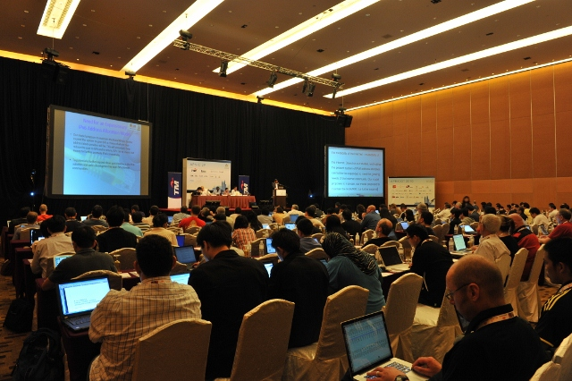
http://www.apricot.net/
- program
5 days workshop
4 days conference and tutorial
1 day APNIC member meeting
- about 600 attendees

Slide 11
SANOG
South Asian Network Operators Group
- established in 2003
- Two meeting each year
SANOG21, Jan 2013, Cox’s Bazar
SANOG22, Jul/Aug 2013, Mumbai

Slide 12
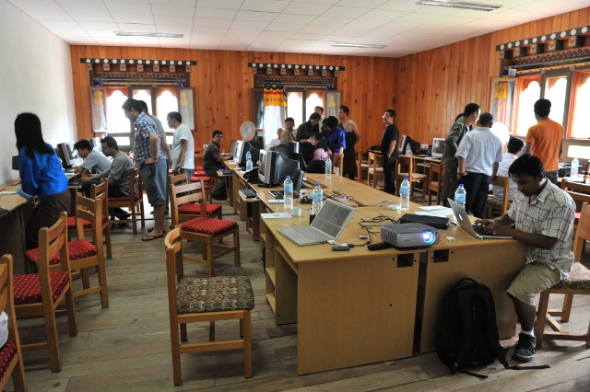
http://www.sanog.org/
program
- 5 days workshop
- 1 day tutorial
- 1 day conference
about 250 attendees

Slide 13
JANOG
Japan Network Operators’ Group
- established in 1997
local language community - Japanese
- Two meetings each year
JANOG31, Jan 2013, Tokyo
JANOG32, Jul 2013, TBD

Slide 14

http://www.janog.gr.jp/
- program
2 days plenary
- about 400 attendees

Slide 15
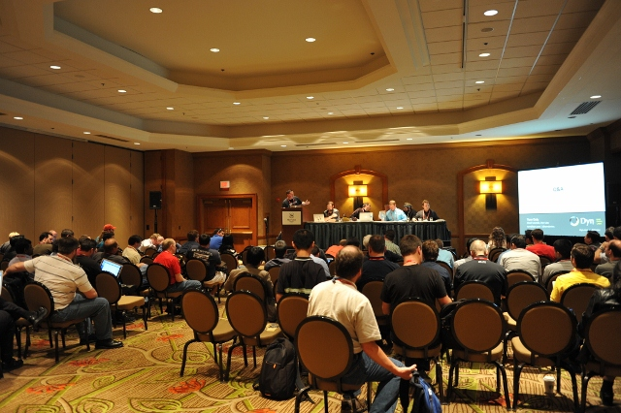
BoFs
birds of a feather(BoF) is a small meeting focused on a specific topic
- security, peering, and so on
usually scheduled in advance, sometimes organized on demand

Slide 16

coffee breaks and social events
to expand relationships
- business and personal
to start/manage a project
- a face-to-face meeting help to step forward things

Slide 17
NOG operation
independent
- forms a committee to lead the NOG
support from cross industry
- Service Providers
- Research and Academics
- Vendors
- ISOC, NSRC, APNIC, APIA

Slide 18
other upcoming events
upcoming network-related education or training events
- http://ws.edu.isoc.org/calendar/

Slide 19
CSIRT
Computer Security Incident Response Team(CSIRT) provides the incident handling service for its constituency
- may offer other related services as well
The first CSIRT - CERT/CC was created in 1988 in response to the Morris worm incident

Slide 20
computer security incident
Any real or suspected adverse event
examples:
- attacks to/from your network
- compromised host
- account/information theft
- spam or IT policy violation

Slide 21
needs for response
to limit the damage
to lower the cost of recovery
an effective response benefits for organizations
- motivation to have a CSIRT in your organization

Slide 22
The incident handling service
- a single point of contact to receive incident reports
- provides response and support to the report
- announcement to disclose information about specific attack/incident
- feedback to the report/request

Slide 23
building your CSIRT
mission statement
- what/how to do
constituency
- for whom
structure
- budget, position within organization
relationship with other CSIRTs

Slide 24
CSIRT types
National CISRTs
- a national point of contact to coordinate an incident handling, reduce the number of security incidents in that country
ISP/xSP CSIRTs
- provide a secure environment for their customer, and provide response to their customers for security incidents

Slide 25
CSIRT types
Vendors CSIRTs
- improve the security of their products
Enterprise CSIRTs
- improve the security of their corporation’s infrastructure, and provide on-site response for security incidents

Slide 26
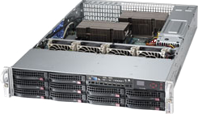

Point of Contact
National CSIRT
CSIRT
constituency

