Slide 1
Introduction & Motivation
Event
Presenter, Organization, Email
Date
This document is a result of work by the perfSONAR Project (http://www.perfsonar.net) and is licensed under CC BY-SA 4.0 (https://creativecommons.org/licenses/by-sa/4.0/).

Slide 2
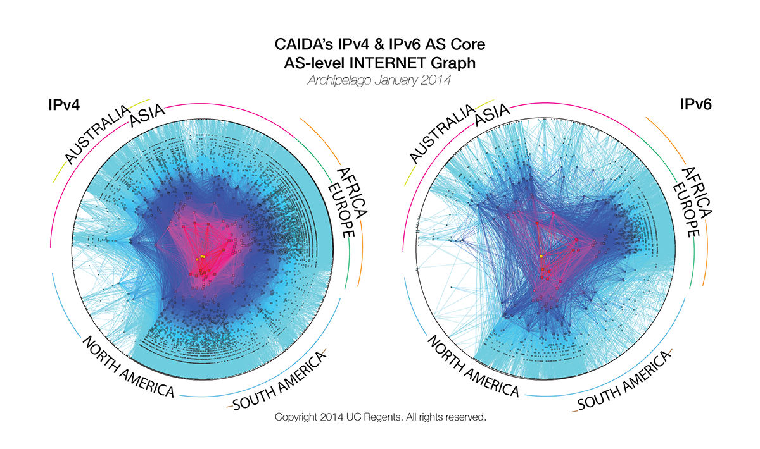
Problem Statement
The global Research & Education network ecosystem is comprised of hundreds of international, national, regional and local-scale networks.
Notes:
Make the point that the complexity of the network is too much for anyone to grasp – and with the complexity we need tools/methods to bite off smaller parts of the problem

Slide 3
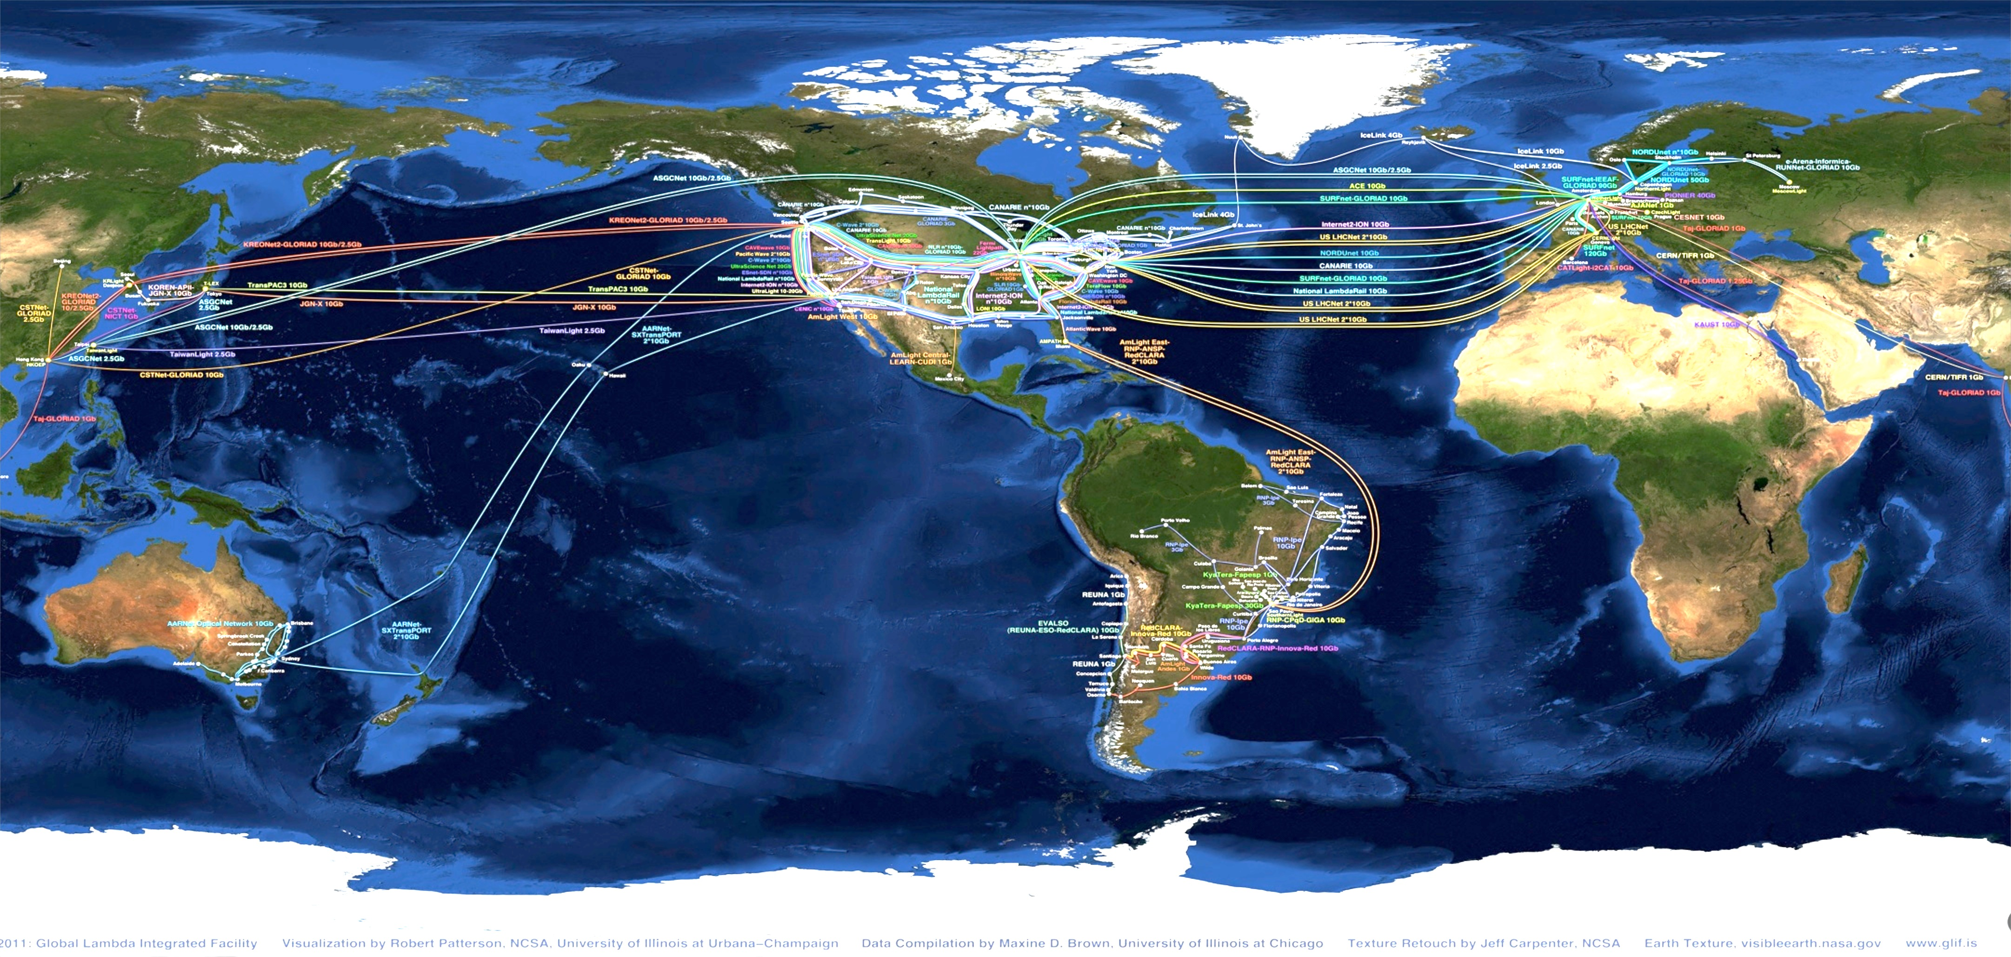
Problem Statement
While these networks all interconnect, each network is owned and operated by separate organizations (called “domains”) with different policies, customers, funding models, hardware, bandwidth and configurations.
Notes:
MAP is courtesy of the GLIF
perfSONAR is designed to be multi-domain, so drive home the fact that all transfers are multi-domain

Slide 4
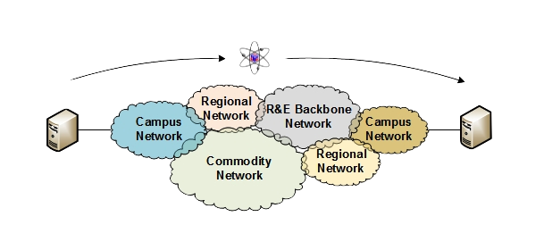
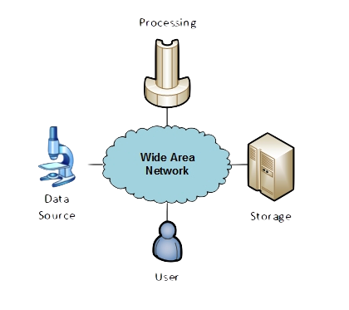
The R&E Community
The global Research & Education network ecosystem is comprised of hundreds of international, national, regional and local-scale resources – each independently owned and operated.
This complex, heterogeneous set of networks must operate seamlessly from “end to end” to support science and research collaborations that are distributed globally.
Data mobility is required; there is no liquid market for HPC resources (people use what they can get – DOE, XSEDE, NOAA, etc. etc.)
To stay competitive, we must learn the use patterns, and support them
This may mean making sure your network, and the networks of others, are functional
Notes:
Getting into the end to end argument – we can’t just ensure things work locally.

Slide 5
Understanding Data Trends
http://www.es.net/science-engagement/science-requirements-reviews/
Notes:
This comes from ESnet requirements review data (starting in 2007). Smaller collaborations produce less data than larger ones, but their numbers are greater. Across the board increases as instrumentation, processing, storage, becomes better/more widely available.

Slide 6
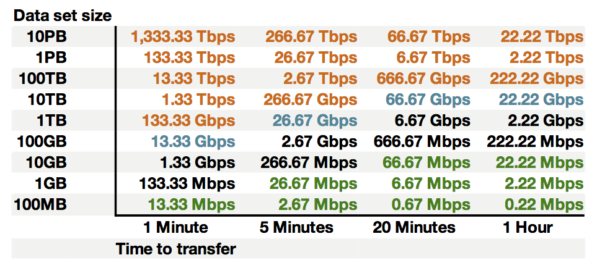
Sample Data Transfer Rates
This table available at:
http://fasterdata.es.net/home/requirements-and-expectations
Notes:
Read this chart as:
If you have ‘green’ connectivity (e.g. < 100Mbps), it will take you about 20 minutes to transfer 10G. That same amount of data can be sent in 1 minute with 1Gbps of connectivity, or 100x that amount with around 10Gbps.
Basically send the message that capacity does matter – the flip side is that we need to be sure its really working at those speeds (and free of defects)

Slide 7
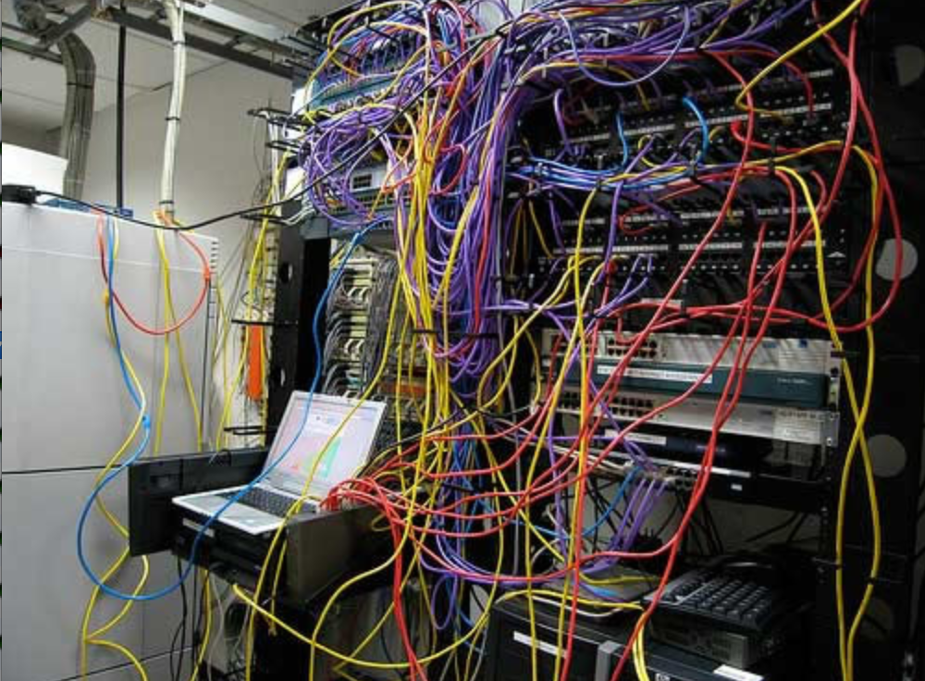
Challenges to Network Adoption
Causes of performance issues are complicated for users.
Lack of communication and collaboration between the CIO’s office and researchers on campus.
Lack of IT expertise within a science collaboration or experimental facility
User’s performance expectations are low (“The network is too slow”, “I tried it and it didn’t work”).
Cultural change is hard (“we’ve always shipped disks!”).
Scientists want to do science not IT support
The Capability Gap
Notes:
Reasons why it is hard for users to embrace networks – its challenging to get things working.

Slide 8

Lets Talk Performance …
"In any large system, there is always something broken.”
Jon Postel
Modern networks are occasionally designed to be one-size-fits-most
e.g. if you have ever heard the phrase “converged network”, the design is to facilitate CIA (Confidentiality, Integrity, Availability)
This is not bad for protecting the HVAC system from hackers.
Its all TCP
Bulk data movement is a common thread (move the data from the microscope, to the storage, to the processing, to the people – and they are all sitting in different facilities)
This fails when TCP suffers due to path problems (ANYWHERE in the path)
its easier to work with TCP than to fix it (20+ years of trying…)
TCP suffers the most from unpredictability; Packet loss/delays are the enemy
Small buffers on the network gear and hosts
Incorrect application choice
Packet disruption caused by overzealous security
Congestion from herds of mice
It all starts with knowing your users, and knowing your network
Notes:
Why is it a challenge? It’s the complexity, and it’s the tools.
We basically need to accommodate TCP to do anything useful.

Slide 9

Where Are The Problems?
Congested or faulty links between domains
Latency dependant problems inside domains with small RTT
Source
Campus
Backbone
Destination
Campus
S
D
NREN
Regional
Congested intra- campus links
Notes:
Isolating problems is challenging – consider the following sets of domains. If things are ‘slow’, it could be anything (or multiple things)
We need something that examines the entire path, and pulls out trouble

Slide 10
Local Testing Will Not Find Everything
Performance is poor when RTT exceeds ~10 ms
Performance is good when RTT is < ~10 ms
Source
Campus
R&E
Backbone
Destination
Campus
S
D
Switch with small buffers
Regional
Regional
Notes:
The magic buffer zone – if we are < 10ms, we often don’t see problems. Throughput still works well because TCP can perform well over short distances with lots of loss.
As we get further out, we notice the pain.
This leads to some false diagnostics at times – e.g. if we have a problem locally, but we only see it when we go far away, its tempting to say the problem is out there, far away. See the switch with small buffers locally as the example.

Slide 11
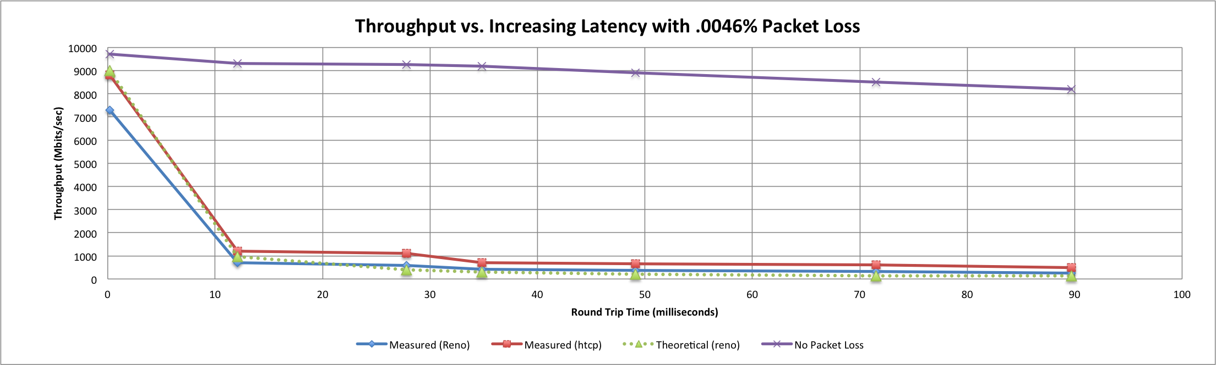
Soft Failures Cause Packet Loss and Degraded TCP Performance
Local
(LAN)
With loss, high performance beyond metro distances is essentially impossible
International
Metro Area
Regional
Continental
Measured (TCP Reno)
Measured (HTCP)
Theoretical (TCP Reno)
Measured (no loss)
Notes:
TCP works well over short distances (e.g. 1% packet loss on the LAN will produce high throughput).
The further out you get the more pronounced the problems will be as the algorithms cope with retransmissions.

Slide 12
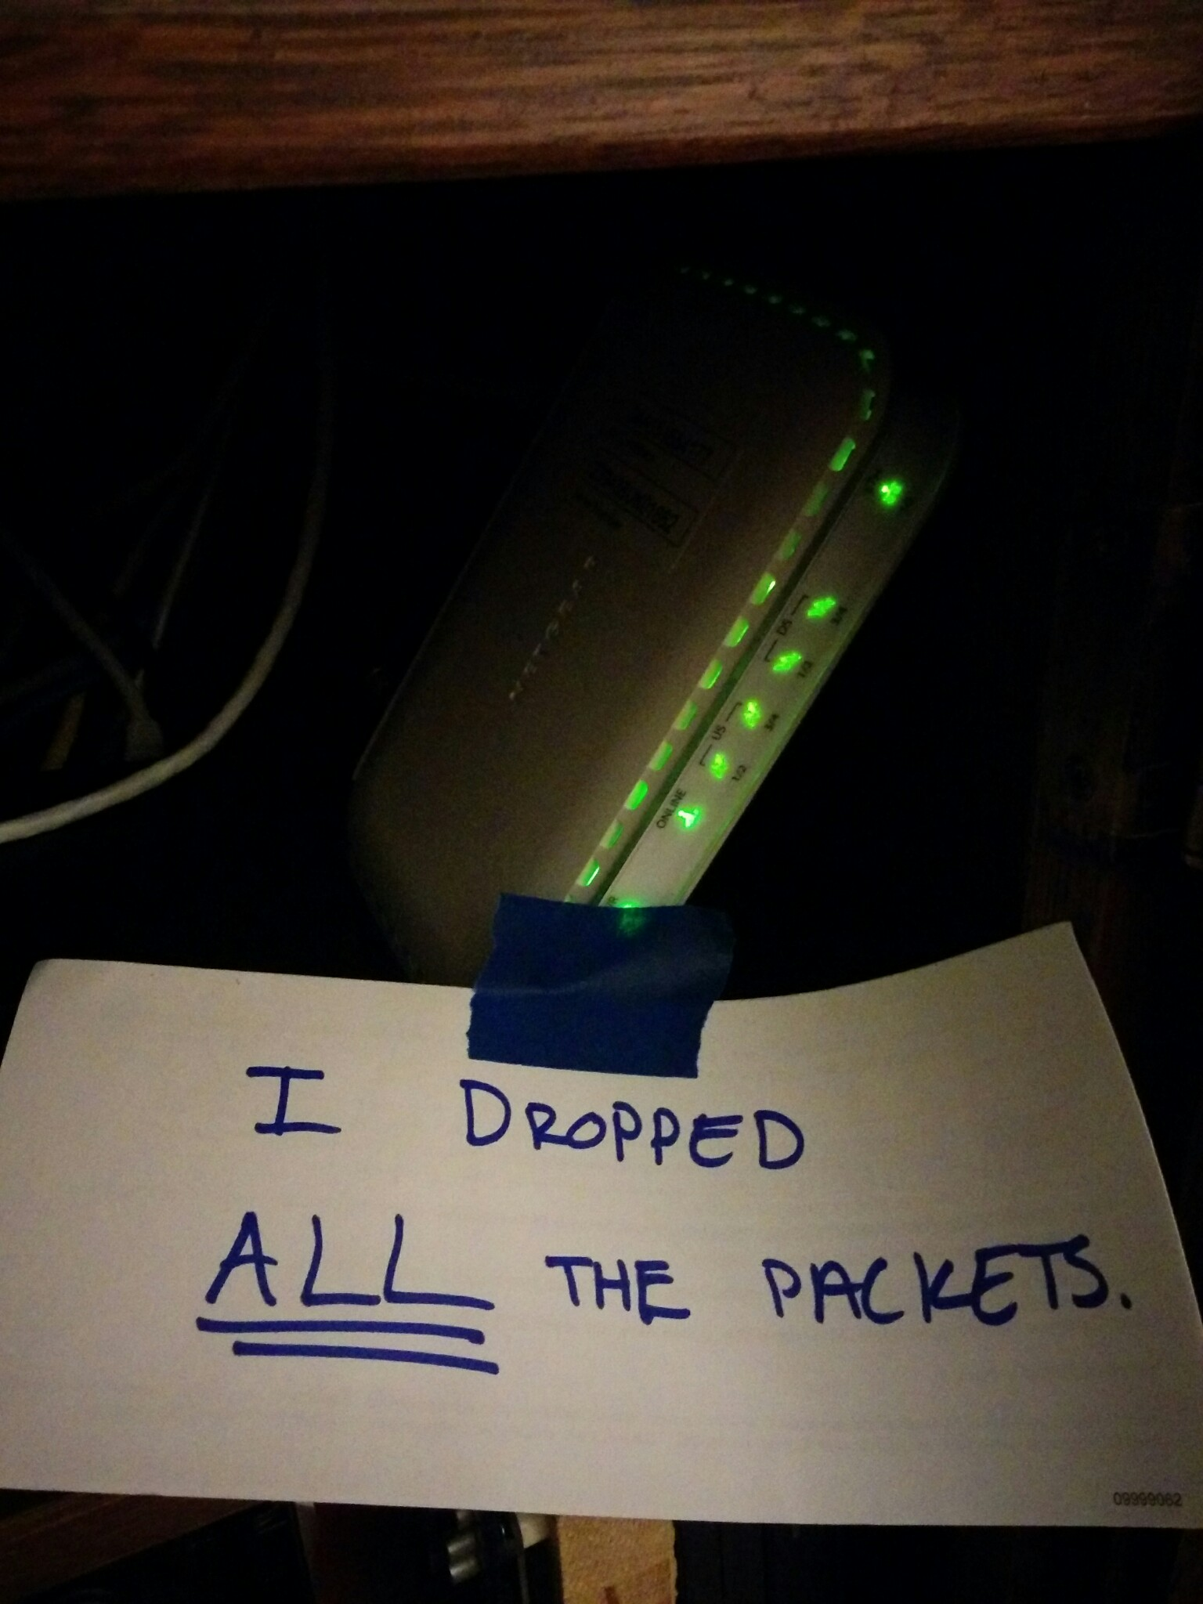
Soft Network Failures
Soft failures are where basic connectivity functions, but high performance is not possible.
TCP was intentionally designed to hide all transmission errors from the user:
“As long as the TCPs continue to function properly and the internet system does not become completely partitioned, no transmission errors will affect the users.” (From IEN 129, RFC 716)
Some soft failures only affect high bandwidth long RTT flows.
Hard failures are easy to detect & fix
soft failures can lie hidden for years!
One network problem can often mask others
Notes:
Introduce the soft network failure – not a loss of connectivity. This is what perfSONAR is designed to find since they are challenging to see unless you are testing end to end over a large distance.

Slide 13
Problem Statement: Hard vs. Soft Failures
“Hard failures” are the kind of problems every organization understands
Fiber cut
Power failure takes down routers
Hardware ceases to function
Classic monitoring systems are good at alerting hard failures
i.e., NOC sees something turn red on their screen
Engineers paged by monitoring systems
“Soft failures” are different and often go undetected
Basic connectivity (ping, traceroute, web pages, email) works
Performance is just poor
How much should we care about soft failures?
Notes:
Answer: we need to care *a lot* about soft failures – see next

Slide 14
Causes of Packet Loss
Network Congestion
Easy to confirm via SNMP, easy to fix with $$
This is not a ‘soft failure’, but just a network capacity issue
Often people assume congestion is the issue when it fact it is not.
Under-buffered switch dropping packets
Hard to confirm
Under-powered firewall dropping packets
Hard to confirm
Dirty fibers or connectors, failing optics/light levels
Sometimes easy to confirm by looking at error counters in the routers
Overloaded or slow receive host dropping packets
Easy to confirm by looking at CPU load on the host

Slide 15
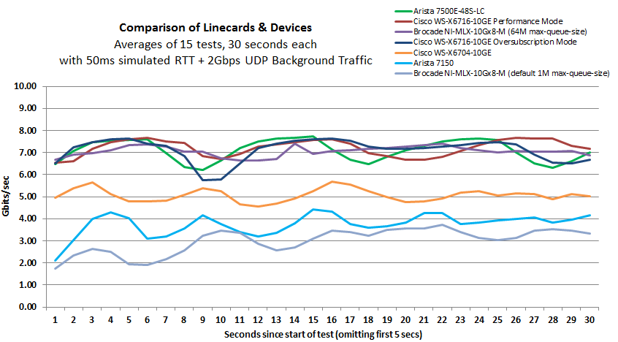
Under-buffered Switches are probably our biggest problem today
Notes:
Testing done by Michael Smitasin , LBL
1 10G TCP flow competing with 2GB background UDP

Slide 16

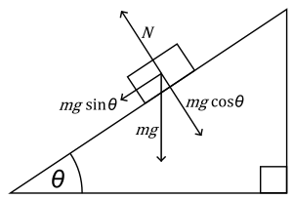
The Science DMZ in 1 Slide
Consists of four key components, all required:
“Friction free” network path
Highly capable network devices (wire-speed, deep queues)
Virtual circuit connectivity option
Security policy and enforcement specific to science workflows
Located at or near site perimeter if possible
Dedicated, high-performance Data Transfer Nodes (DTNs)
Hardware, operating system, libraries all optimized for transfer
Includes optimized data transfer tools such as Globus and GridFTP
Performance measurement/test node
perfSONAR
Education & Engagement w/ End Users
Details at http://fasterdata.es.net/science-dmz/
© 2013 Globus
© 2013 Wikipedia

Slide 17
The Abstract Science DMZ
Notes:
Simple DMZ design. Things to note:
- not ‘lack of security’, security still is *very* important. It is targeted toward a use case, not a blanket policy
- The DTN is a dedicated machine tuned for 1 job and 1 job only – moving data. Use it to handle the WAN portion of the flow. If someone needs to pull data into the enterprise, the short RTT will help the packet loss caused by the firewall. Treat the DTN as a ‘cache’
- perfSONAR on the outside. Prevents measurement traffic from perturbing things. If you have science stuff inside of the firewall, you need one there too.

Slide 18
But … It’s Not Just the Network
Perhaps you are saying to yourself “I have no control over parts of my campus, let alone the 5 networks that sit between me and my collaborators”
Significant gains are possible in isolated areas of the OSI Stack
Things “you” control:
Choice of data movement applications (say no to SCP and RSYNC)
Configuration of local gear (hosts, network devices)
Placement and configuration of diagnostic tools, e.g. perfSONAR
Use of the diagnostic tools
Things that need some help:
Configuration of remote gear
Addressing issues when the diagnostic tools alarm
Getting someone to “care”
Notes:
Don’t stop at network architecture, fix other stuff too

Slide 19
Network Monitoring
All networks do some form monitoring.
Addresses needs of local staff for understanding state of the network
Would this information be useful to external users?
Can these tools function on a multi-domain basis?
Beyond passive methods, there are active tools.
E.g. often we want a ‘throughput’ number. Can we automate that idea?
Wouldn’t it be nice to get some sort of plot of performance over the course of a day? Week? Year? Multiple endpoints?
perfSONAR = Measurement Middleware
Notes:
Everyone does it – but not everyone monitors end to end
perfSONAR is nothing earth shattering, it’s a way to share measurements and make it easy to deploy/figure out what is going on

Slide 20
perfSONAR
All the previous Science DMZ network diagrams have little perfSONAR boxes everywhere
The reason for this is that consistent behavior requires correctness
Correctness requires the ability to find and fix problems
You can’t fix what you can’t find
You can’t find what you can’t see
perfSONAR lets you see
Especially important when deploying high performance services
If there is a problem with the infrastructure, need to fix it
If the problem is not with your stuff, need to prove it
Many players in an end to end path
Ability to show correct behavior aids in problem localization
Notes:
perfSONAR = visbibility

Slide 21
What is perfSONAR?
perfSONAR is a tool to:
Set network performance expectations
Find network problems (“soft failures”)
Help fix these problems
All in multi-domain environments
These problems are all harder when multiple networks are involved
perfSONAR is provides a standard way to publish active and passive monitoring data
This data is interesting to network researchers as well as network operators
Notes:
Enables Federation
Service oriented
Designed with ‘multi-domain’ in mind
Brings together useful tools to address different needs
Several active and passive tools
Interface to configure regular testing
Diagnostic tools ready with ‘0 configuration’
Easy to install, easy to use
ISO image can be burned to CD/USB key
‘Wizard’ interface for configuration
Encouraging people to deploy ‘known good’ measurement points near domain boundaries
“known good” = hosts that are well configured, enough memory and CPU to drive the network, proper TCP tuning, clean path, etc.
Community Adoption
Over 1300 instances seen world wide
40+ countries
100s of domains

Slide 22
perfSONAR History
perfSONAR can trace its origin to the Internet2 “End 2 End performance Initiative” from the year 2000.
What has changed since 2000?
The Good News:
TCP is much less fragile; Cubic is the default CC alg, autotuning is and larger TCP buffers are everywhere
Reliable parallel transfers via tools like Globus Online
High-performance UDP-based commercial tools like Aspera
The Bad News:
The wizard gap is still large
Jumbo frame use is still small
Under-buffered and switches and routers are still common
Under-powered/misconfigured firewalls are common
Soft failures still go undetected for months
User performance expectations are still too low
Notes:
Improvements in 15 years since the idea came about – but lots of room to grow

Slide 23
Simulating Performance
It’s infeasible to perform at-scale data movement all the time – as we see in other forms of science, we need to rely on simulations
Network performance comes down to a couple of key metrics:
Throughput (e.g. “how much can I get out of the network”)
Latency (time it takes to get to/from a destination)
Packet loss/duplication/ordering (for some sampling of packets, do they all make it to the other side without serious abnormalities occurring?)
Network utilization (the opposite of “throughput” for a moment in time)
We can get many of these from a selection of active and passive measurement tools – enter the perfSONAR Toolkit
Notes:
Idea – we are measuring performance by testing what is possible. If OWAMP runs stable and loss free, video will work out ok. If throughput is stable and high, bulk data movement should work on the network (does not test disk)

Slide 24
perfSONAR Toolkit
The “perfSONAR Toolkit” is an open source implementation and packaging of the perfSONAR measurement infrastructure and protocols
http://www.perfsonar.net
All components are available as RPMs, and bundled as a CentOS 6-based “netinstall”
perfSONAR tools are much more accurate if run on a dedicated perfSONAR host, not on the DTN
Very easy to install and configure
Usually takes less than 30 minutes
Notes:
Install via the ISO – RPMs if you don’t want to do that

Slide 25
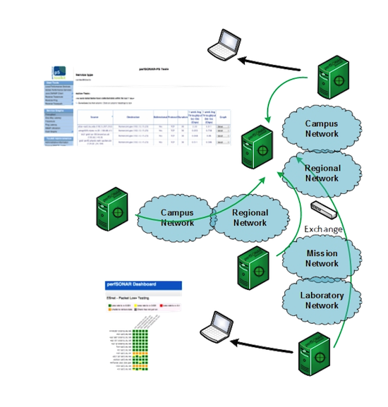
Toolkit “Beacon” Use Case
The general use case is to establish some set of tests to other locations/facilities
To answer the what/why questions:
Regular testing with select tools helps to establish patterns – how much bandwidth we would see during the course of the day – or when packet loss appears
We do this to ‘points of interest’ to see how well a real activity (e.g. Globus transfer) would do.
If performance is ‘bad’, don’t expect much from the data movement tool
Notes:
General use case – make the tools available and let people test against you

Slide 26
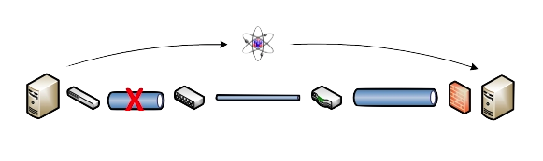
Benefits: Finding the needle in the haystack
Above all, perfSONAR allows you to maintain a healthy, high-performing network because it helps identify the “soft failures” in the network path.
Classical monitoring systems have limitations
Performance problems are often only visible at the ends
Individual network components (e.g. routers) have no knowledge of end host state
perfSONAR tests the network in ways that classical monitoring systems do not
More perfSONAR distributions equal better network visibility.
Notes:
Metcalf law argument – only useful because people are using it

Slide 27
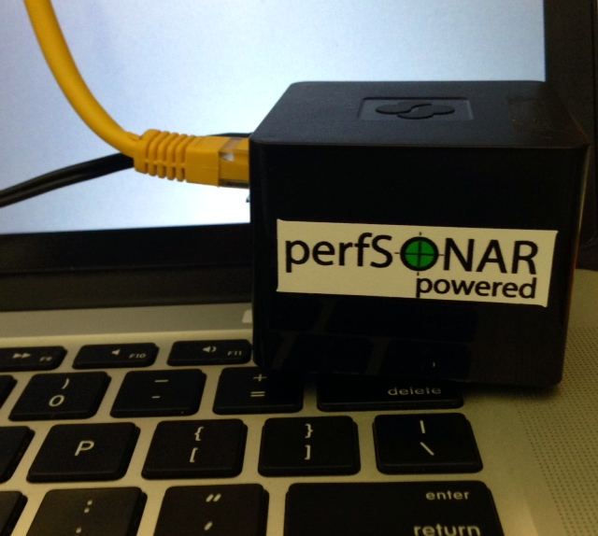
New explorations
Cheap ARM-based perfSONAR nodes
e.g.: Cubox (“perfCUBE”) $120
Several organizations have begun playing with these
TCP max = 350Mbps
owamp works well
ARM RPMs for Fedora20 at: http://downloads.es.net/pub/perfsonar/cubox/
Notes:
Emerging work to make the nodes smaller

Slide 28
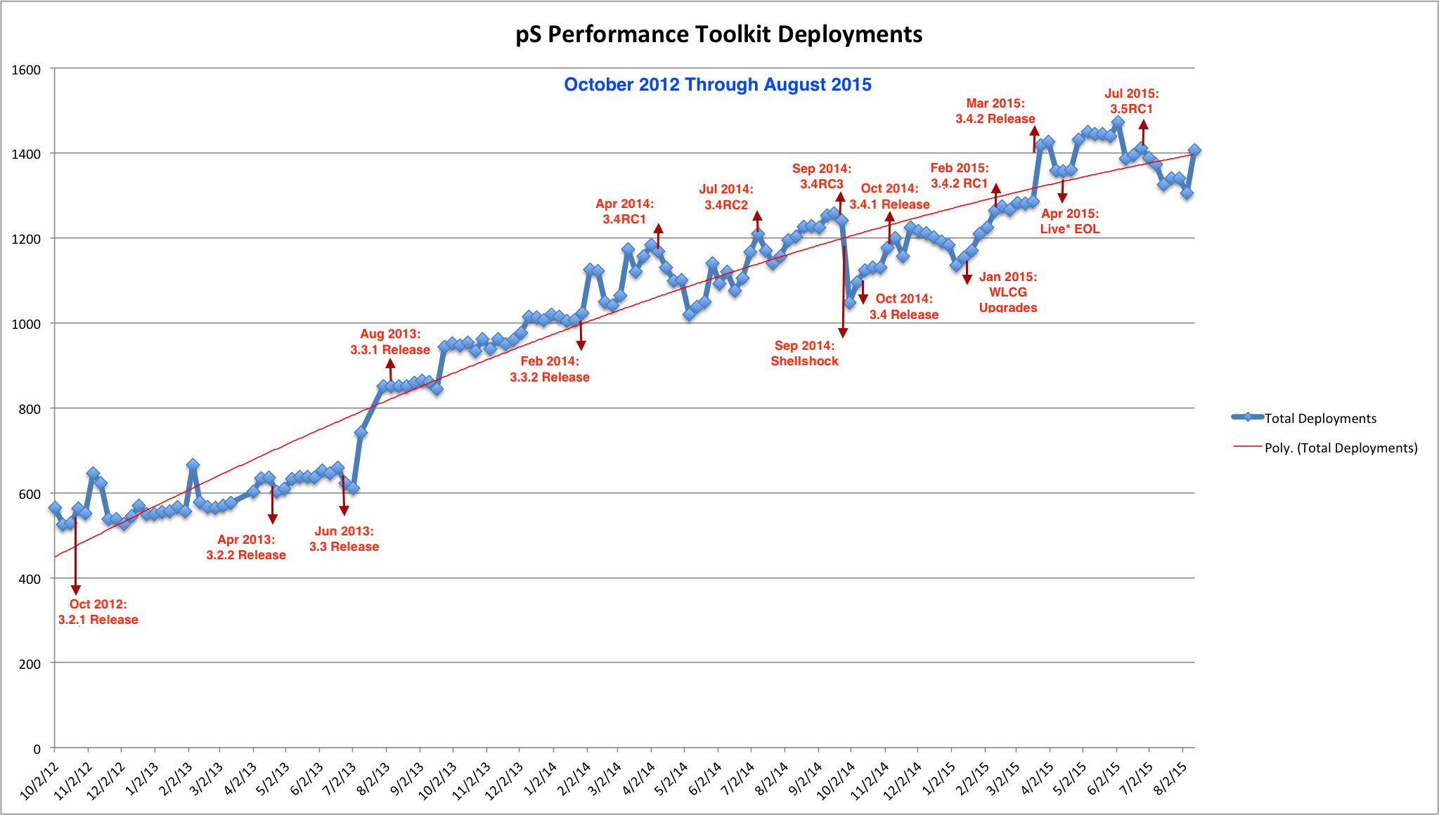
Deployment By The Numbers
Last updated August 2015. Adoption trend increases with each release. CC-NIE and innovation platform helped as well.
Notes:
Updated in 2/2015, steady growth curve with some dips.

Slide 29
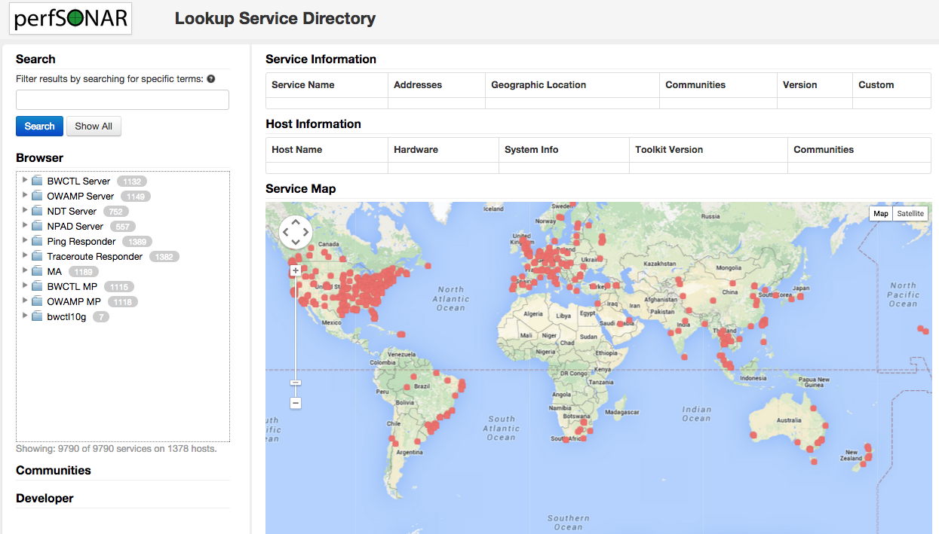
http://stats.es.net/ServicesDirectory/
Notes:
View public instances

Slide 30
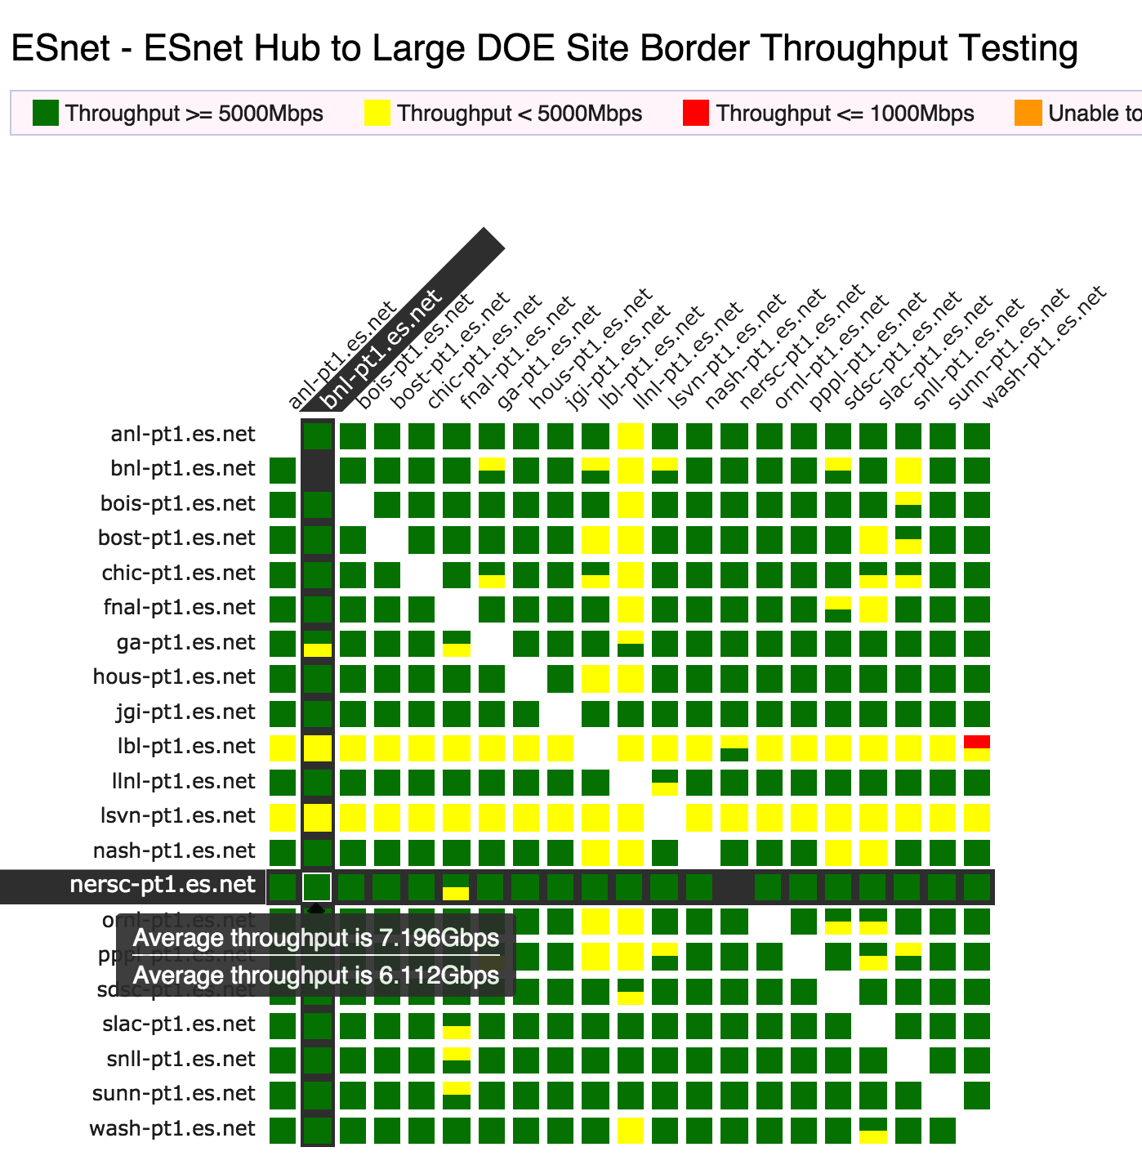
perfSONAR Dashboard: Raising Expectations and improving network visibility
Status at-a-glance
Packet loss
Throughput
Correctness
Current live instances at http://pas.net.internet2.edu/
http://ps-dashboard.es.net/
Drill-down capabilities:
Test history between hosts
Ability to correlate with other events
Very valuable for fault localization and isolation
Notes:
Dashboards – requires coordination of testing

Slide 31

Benefit: Active and Growing Community
Active email lists and forums provide:
Instant access to advice and expertise from the community.
Ability to share metrics, experience and findings with others to help debug issues on a global scale.
Joining the community automatically increases the reach and power of perfSONAR
The more endpoints means exponentially more ways to test and discover issues, compare metrics

Slide 32
perfSONAR Community
The perfSONAR collaboration is working to build a strong user community to support the use and development of the software.
perfSONAR Mailing Lists
Announcement Lists:
https://mail.internet2.edu/wws/subrequest/perfsonar-announce
Users List:
https://mail.internet2.edu/wws/subrequest/perfsonar-users

Slide 33

Resources
perfSONAR website
http://www.perfsonar.net/
perfSONAR Toolkit Manual
http://docs.perfsonar.net/
perfSONAR mailing lists
http://www.perfsonar.net/about/getting-help/
perfSONAR directory
http://stats.es.net/ServicesDirectory/
FasterData Knowledgebase
http://fasterdata.es.net/

Slide 34
Introduction & Motivation
Event
Presenter, Organization, Email
Date
This document is a result of work by the perfSONAR Project (http://www.perfsonar.net) and is licensed under CC BY-SA 4.0 (https://creativecommons.org/licenses/by-sa/4.0/).

