Slide 1
Local Deployment
Event
Presenter, Organization, Email
Date
This document is a result of work by the perfSONAR Project (http://www.perfsonar.net) and is licensed under CC BY-SA 4.0 (https://creativecommons.org/licenses/by-sa/4.0/).

Slide 2
Outline
a
Notes:
Soft failures are everywhere – and they may hide other soft failures

Slide 3
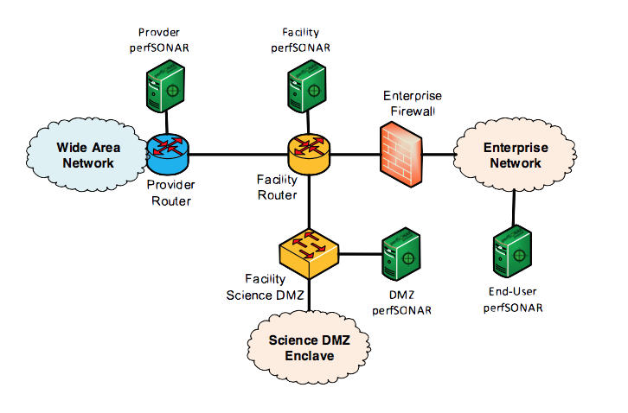
Notes:
Soft failures are everywhere – and they may hide other soft failures

Slide 4
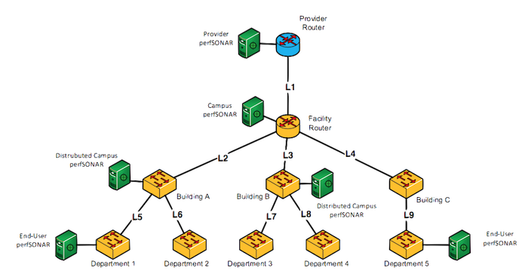
Notes:
Soft failures are everywhere – and they may hide other soft failures

Slide 5
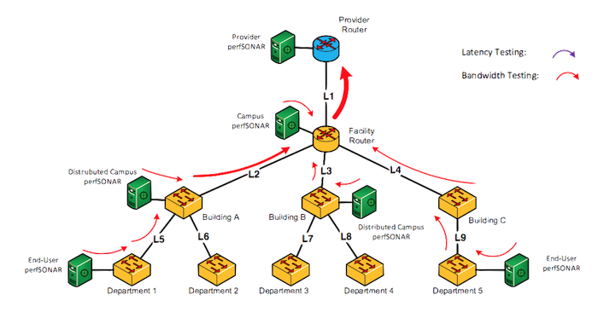
Notes:
Soft failures are everywhere – and they may hide other soft failures

Slide 6
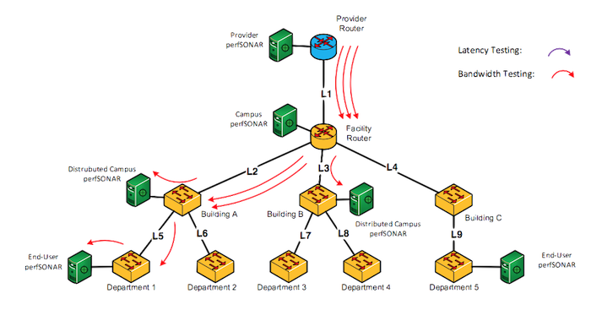
Notes:
Soft failures are everywhere – and they may hide other soft failures

Slide 7
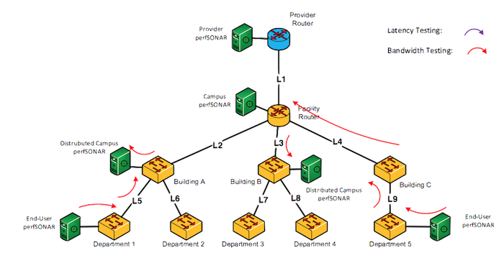
Notes:
Soft failures are everywhere – and they may hide other soft failures

Slide 8
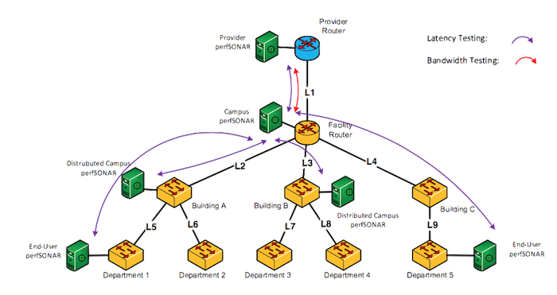
Notes:
Soft failures are everywhere – and they may hide other soft failures

Slide 9
Local Deployment
Event
Presenter, Organization, Email
Date
This document is a result of work by the perfSONAR Project (http://www.perfsonar.net) and is licensed under CC BY-SA 4.0 (https://creativecommons.org/licenses/by-sa/4.0/).

