Slide 1
Node Maintenance: Security & Operational Concerns
Event
Presenter, Organization, Email
Date
This document is a result of work by the perfSONAR Project (http://www.perfsonar.net) and is licensed under CC BY-SA 4.0 (https://creativecommons.org/licenses/by-sa/4.0/).

Slide 2
Outline
Introduction & Overview
Security
Software Updates & Accounting
User Accounts & Machine Access
Physical Security
Service Audit
Firewalls & IDSs
Logging
Operational Concerns
Backups & Disk Maintenance
Regular Monitoring Solutions
Remote Management Verification
Auditing User Accounts
perfSONAR Specific Concerns
Conclusions

Slide 3

Introduction
The perfSONAR Toolkit should be treated the same as any other unprotected host in your infrastructure
E.g. it should receive the same care and attention from the server team as something like the mail or DNS server
Those that forgot they had one, were shellshock’ed, and may be upset about that experience
There are many tools out there that can ease the burden, there is no replacement for a human regularly checking

Slide 4
Introduction
Recommendations for deployment often mean allowing this resource to live in the cold dark internet, to allow for a clean view of pure network performance
This doesn’t mean we don’t want to forget about security or maintenance – in fact we need to be careful to implement adequate, intelligent, and performance focused countermeasures where we can
The following sections outline some of the items that should be examined on a semi-regular basis.
N.B. All of these are ‘typical’ recommendations that are SOP for Linux servers, apply this knowledge elsewhere if need be.
Some are specific to perfSONAR

Slide 5
perfSONAR Risk
Since perfSONAR hosts are usually fast, well connected hosts, the main risk is that someone will get on and use the host for a DDOS attack
If this happens, WE ALL SUFFER!
perfSONAR nodes will get taken down, making the perfSONAR ecosystem less useful
Data on the host is not particularly valuable.

Slide 6
Part 1: Security

Slide 7
Outline
Introduction & Overview
Security
Firewalls & IDSs
Logging
Software Updates & Accounting
User Accounts & Machine Access
Physical Security
Service Audit
Operational Concerns
Backups & Disk Maintenance
Regular Monitoring Solutions
Remote Management Verification
Auditing User Accounts
perfSONAR Specific Concerns
Conclusions

Slide 8
Firewalls
Firewalls have a role in the enterprise network
They protect against the unknown – they are designed to protect the network from bad things getting in, and private things from getting out.
*IFF* you have scientific resources behind a firewall (e.g. you aren’t using the Science DMZ paradigm yet) should you also place a perfSONAR host behind a firewall
This will give the perfSONAR host the same ‘view’ of what is going on
If performance is bad, you may want to consider a comparison with a perfSONAR host directly outside of the firewall, and testing to the same things.
Notes:
We can’t tell you to run or not run a firewall – this is up to you and your security officer. Do note that if your users are behind a firewall – your perfSONAR node should be as well to ‘experience’ the same pain

Slide 9
Access Control Lists (ACLs)
You can use router or host ACLs to control who can run tests to/from your perfSONAR host
This can be used to reduce the DDOS risk
BUT: restricting access makes your host less useful!
Detecting the DDOS using via traffic monitoring or an Intrusion Detection System is a much better solution
The perfSONAR Toolkit features IPTables rules for all essential services – this can be considered a host-based firewall
More information here: http://www.perfsonar.net/deploy/security-considerations/
The administrator has the ability to add/delete rules, see this documentation page for more details: http://docs.perfsonar.net/manage_security.html
Notes:
Similar to fireawalls – set the pS node to be the same as what the user’s are experiencing.
Note that if you wall off your pS nodes from the world, they are less useful.

Slide 10
Intrusion Detection
There are numerous solutions in the IDS space (host based, appliance based, external server based).
All have positives and negatives
Typically the use of external systems should start as a conversation between you and your security people.
Host based IDSs are software packages that can be installed on the perfSONAR node – we will talk about some here.
The perfSONAR toolkit comes with Fail2ban (http://www.fail2ban.org/wiki/index.php/Main_Page)
This software is designed to parse logs (apache, ssh access, etc.) and look for behavior consistent with attack vectors.
For example, a brute force SSH attempt from a host will result in several log messages in the secure log – fail2ban can detect this
When it finds behavior (normally with a couple of minute delay) it will send an email alert, and can be configured to block the host using IPTables or TCPWrappers
Notes:
If your side is runnning Bro, etc, that will work for pS too. There are host based IDSs that work well.

Slide 11
Intrusion Detection
Other Options:
Denyhosts - http://denyhosts.sourceforge.net
Similar to fail2ban, relies on scripts to parse logs and insert rules when bad behavior is detected
OSSEC - http://www.ossec.net
Client/Server based system that can be used to watch multiple hosts.
Detects bad behavior from log files, can also be used to watch for anomalies such as disk failure, user behavior, interface promiscuousness, and installation of software.
Snort - https://www.snort.org
System capable of real time analysis and prevention of attack vectors through the use of heuristics
There are many more pay and free options in this space, look around and choose what makes you comfortable.

Slide 12

Rootkit Detection
There are two solutions that are typically used to search a host for infections (e.g. ‘rootkits’)
These are ‘last resort’ tools normally
Remember that a skilled cracker (e.g. not a script kiddie) will cover their tracks – making a rootkit detector required to determine damage
If you have a fear that you were compromised, or just want to run one of these scanners in the background and have it mail you periodic reports, they can provide useful information:
http://rkhunter.sourceforge.net
http://www.chkrootkit.org
Notes:
This normally not a concern – pS nodes aren’t typically rooted. IF you have a concern, run one of these mitigations.

Slide 13
Logging
Central logging helps you pull all the data from the perfSONAR node to some other location for analysis
Helps track faults
Helps watch for mischief
There are also numerous solutions in the central logging space.
Many are free, some are not
Some have GUIs and can aggregate lots of hosts
Shop around and test things out – some have features you may never need. Sometimes just setting up ‘syslog-ng’ and forwarding to a central host is sufficient
Some options:
http://logstash.net
http://www.elasticsearch.org/overview/kibana/
https://www.graylog2.org
Notes:
Everyone should be doing logging anyway, just treat the pS node the same way

Slide 14
Host Security

Slide 15
Securing your perfSONAR host
The following slides are some well known techniques for making a Linux host more secure
Some of these are already configured if you do a ‘toolkit’ install, and some are under consideration for the next release
These slides are just a quick overview of things to consider

Slide 16
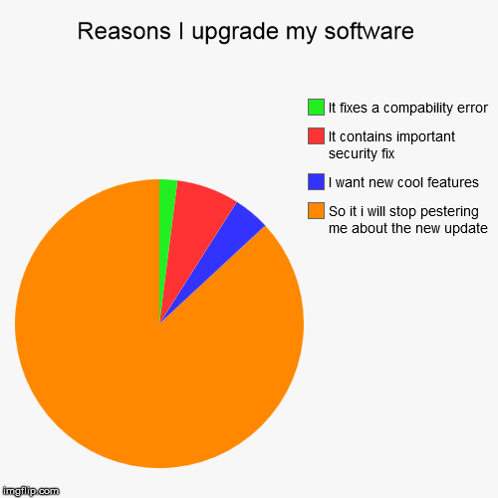
Software Updates
The perfSONAR toolkit is built on CentOS Linux version 6
CentOS uses the ‘yum’ package management system for software version control
Typically you can just run ‘yum update’ (with root permissions) to bring the system up to date. Do this frequently.
Notes:
Use the automated method to ‘help’ you, but its not a panacea. Still need to maintain your node on a regular basis

Slide 17
Software Updates
With the release of perfSONAR Toolkit v 3.4, we have an auto-update feature now available:
http://docs.perfsonar.net/manage_update.html#automatic-updates
Auto-updates will pull down packages from upstream, nightly, to ensure the system stays up to date.
Obligatory Pro/Con Discussion:
Auto-updates are one factor in host security, they are not a panacea. They are also not an excuse to ignore the server exists.
Some updates (e.g. kernels) would need a reboot
Pulling down updates immediately can sometimes lead to situations where things break (e.g. CentOS or perfSONAR broke something upstream).

Slide 18
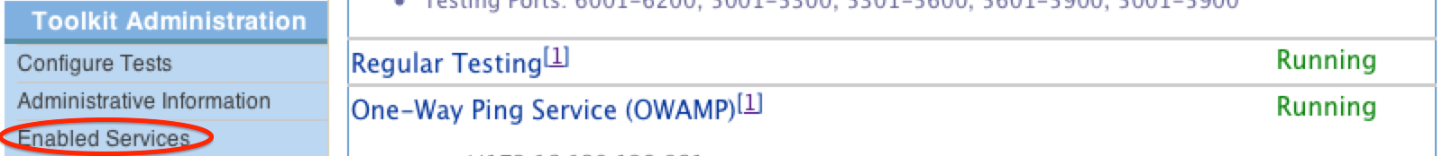
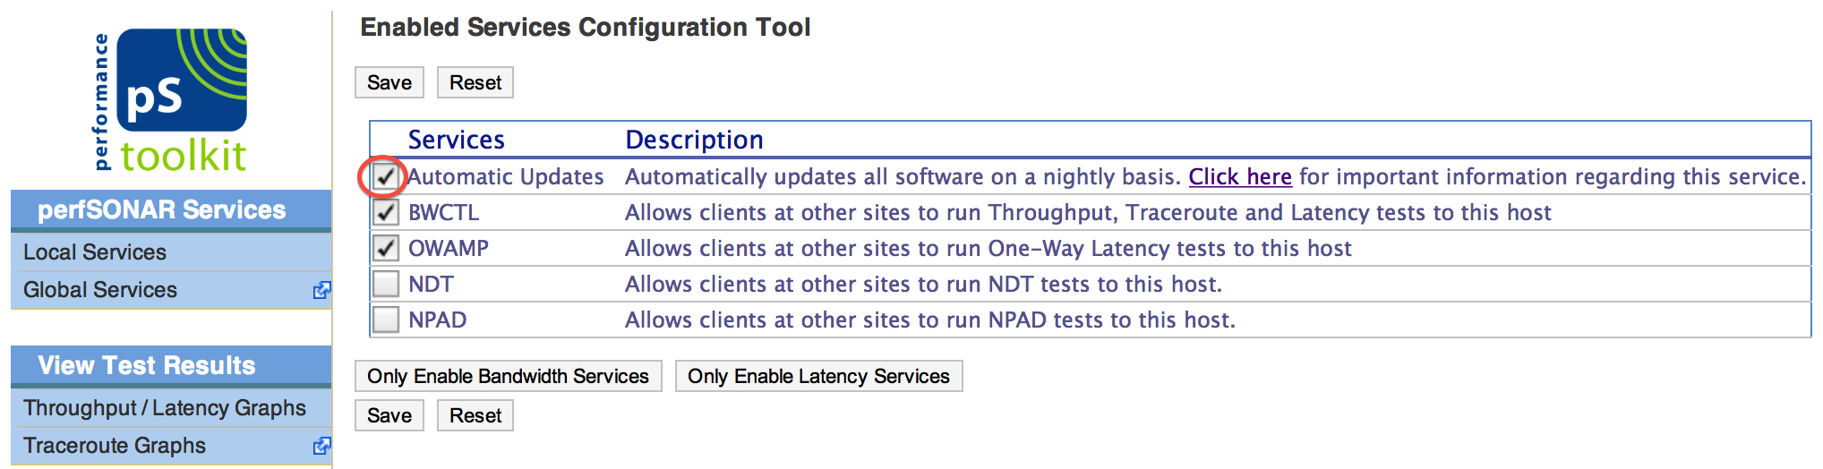
Updates
Automatic updates via ‘Enabled Services’:
Note – this is not the end all solution, but it will grab critical things as they come in.
© 2015, http://www.perfsonar.net
August 24, 2015
18

Slide 19
Software Auditing
The perfSONAR Toolkit installs only packages that are required for perfSONAR
a minimal Linux install plus network monitoring tools
Some sites may decide they don’t need all of these features – if this is the case it may be worthwhile to conduct a software audit
yum list installed
yum remove packageName
Note that yum can process dependencies too – if you notice that removing something you don’t think is necessary will delete things that are necessary, rethink that choice ☺
For example, you don’t intend to use XWindows on the server, remove it:
yum groupremove "X Window System”
Notes:
Something you wouldn’t do regularly – but just in case.

Slide 20
Software Auditing
Disable unwanted SUID and SGID binaries – this prevents misuse if a bug crops up down the road:
#See all set user id files:
find / -perm +4000
# See all group id files
find / -perm +2000
# Or combine both in a single command
find / \( -perm -4000 -o -perm -2000 \) -print
find / -path -prune -o -type f -perm +6000 –ls
Stomp out world-writable files (especially if they shouldn’t be). Investigate each positive hit on a case by case basis:
find /dir -xdev -type d \( -perm -0002 -a ! -perm -1000 \) –print
Discovery any noowner/nogroup files (also a case by case investigation)
find /dir -xdev \( -nouser -o -nogroup \) -print
Notes:
Something you wouldn’t do regularly – but just in case.

Slide 21
Tightening the Kernel
There are settings that can be applied to the /etc/sysctl.conf file that can help to tighten the machine (after applying, run ‘sysctl –p’ as root):
# Turn on execshield
kernel.exec-shield=1
kernel.randomize_va_space=1
# Enable IP spoofing protection
net.ipv4.conf.all.rp_filter=1
# Ignoring broadcasts request
net.ipv4.icmp_echo_ignore_broadcasts=1
net.ipv4.icmp_ignore_bogus_error_messages=1
# Make sure spoofed packets get logged
net.ipv4.conf.all.log_martians = 1
# Disable IP source routing
net.ipv4.conf.all.accept_source_route=0
SELINUX is disabled by default on perfSONAR Toolkit hosts. For those that want to enable this, there are options in /etc/selinux/config (N.B. permissive is better to test with, to see the warnings and change behaviors):
# enforcing - SELinux security policy is enforced.
# permissive - SELinux prints warnings instead of enforcing.
# disabled - SELinux is fully disabled.
Notes:
Something you wouldn’t do regularly – but just in case.

Slide 22
Networking
If you have no intention of using IPv6 on your host … disable it.
You really should configure IPv6, as there are some V6 only perfSONAR hosts
But from a security standpoint an unused (but open) service may cause problems in the future.
E.g.: forget to to update ip6tables when updating iptables
E.g.: if there is some bug with the RHEL IPv6 neighbor discovery tooling, etc.
To disable IPv6:
Disable in the interface:
in /etc/sysconfig/network : NETWORKING_IPV6=no
in /etc/sysconfig/network-scripts/ifcfg-eth0 : IPV6INIT=”no”
Set this in rc.local (so that it gets started on boot):
echo 1 > /proc/sys/net/ipv6/conf/eth1/disable_ipv6
OR add this to /etc/sysctl.conf and run ‘sysctl –p’ as root
net.ipv6.conf.all.disable_ipv6 = 1
net.ipv6.conf.default.disable_ipv6 = 1
Notes:
Something you wouldn’t do regularly – but just in case.

Slide 23
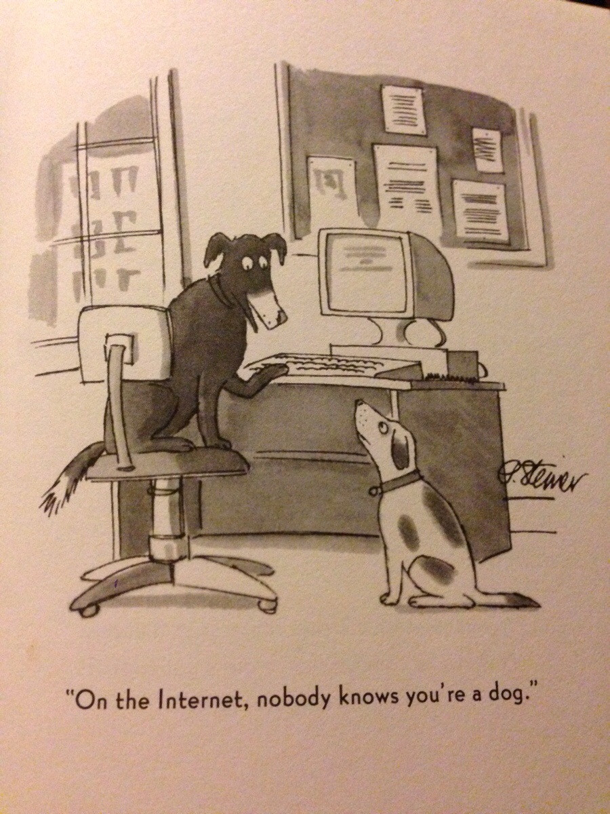
User Accounts
perfSONAR can be used in three main ways:
Users can view results via the web-based interface. Typically an administrator will have to configure the tests on the machine
External users can invoke tests against a perfSONAR machine to the measurement daemons
Those with shell accounts can log in, and perform tests/administer the machine (depending on permissions)
Of these, granting shell access to the machine is the riskiest to deal with
Some questions to consider when granting a shell account to someone:
What are they going to use it for?
Will they be an admin, or just a user?
Are they a trusted user at the institution?
Is the host linked to any other critical institutional resources?
Notes:
This is something you should do from time to time, especially if you are granting accounts.

Slide 24
Admin Accounts
For those that do get a shell account, consider some of the following precautions:
Enforce login via SSH only (see next section)
If you are using passwords, consider precautions on aging (see chage), complexity (see pam), reuse (see pam), and locking accounts on multiple failures (see faillog)
The admin of the machine should do periodic checks to be sure there are no empty passwords on the system:
awk -F: '($2 == "") {print}' /etc/shadow
And lock them down, if there are any:
passwd -l accountName
Lastly, verify that there are not any non-root accounts with UID set to 0:
awk -F: '($3 == "0") {print}' /etc/passwd
The only output from this command should be for the ‘root’ user. If there are others, delete the accounts or verify they should have permission.
Notes:
Typical approach is to not grant many admin accounts.

Slide 25
Use of sudo
The perfSONAR Toolkit also features the sudo tool that allows someone with ‘administrator’ privileges (set up when accounts are created) to invoke root level access
By default we allow people in the ‘wheel’ group the ability to run sudo
Some changes can be made to secure this greater in the /etc/sudoers file:
Require password with each command
Change ALL=(ALL) NOPASSWD: ALL to be ALL=(ALL): ALL
Limit the commands that can be run via sudo (see file for details)
Notes:
Something you wouldn’t do regularly – but just in case.

Slide 26
Centralized Authentication
If you site already uses this on servers, it can be extended to the perfSONAR Toolkit as well (its just Linux after all …)
Typical auth systems are LDAP or Kerberos
Follow the instructions for setting up this type of system, and finding the correct packages. These documents will be better than what perfSONAR can produce.
Note – this is non-standard, but can be done if your site has policies that govern the use of this type of system.
Notes:
If you know how this works, you probably don’t need our help. IF you don’t know what this is, you may not want to implement it.

Slide 27
Tightening Machine Access
SSH should be the only login protocol that is running.
There are some basic SSH protections worth considering:
Disable root login in /etc/ssh/sshd_config (restart the service after doing this)
PermitRootLogin no
Allow specific users in /etc/ssh/sshd_config (restart the service after doing this)
AllowUsers alice bob
Disable old protocols /etc/ssh/sshd_config (restart the service after doing this)
Protocol 2
It is also possible to run SSH on a non-standard port:
Port 2345
Note that if you take this step, ensure that selinux knows about the change (see semanage) and that the proper port is open in IPTables (if you are using it).
Notes:
Something you wouldn’t do regularly – but just in case.

Slide 28
Tightening Machine Access
SSH Throttling can be installed into IPTables to prevent brute force attacks:
# Throttling of SSH
-A INPUT -p tcp --dport 22 --syn -m limit --limit 1/m --limit-burst 3 -j ACCEPT
-A INPUT -p tcp --dport 22 --syn -j DROP
If there are concerns about the use of passwords, you can require public key authentication.
This will require all users to generate a public/private key pair and authenticate to the machine in this manner.
The following change can be made to /etc/ssh/sshd_config (restart the service after doing this)
# Disable password authentication forcing use of keys
PasswordAuthentication no
Lastly, you can limit the exposure of SSH (via IPTables) to ranges of hosts
Allow only specific subnets to access or a ‘bastion’ host
Notes:
Something you wouldn’t do regularly – but just in case.

Slide 29

Physical Security
Lets say your server is in a bad neighborhood, it makes sense to protect the physical access.
Configure the BIOS to prevent booting from external devices (e.g. USB, CD, etc.)
Set the BIOS bootloader password
If the server is set up for serial access, don’t leave root logged into the console (no-brainer …)
Notes:
Something you wouldn’t do regularly – but just in case.

Slide 30
Auditing Services
The default settings for the perfSONAR Toolkit will only enable essential services.
If you are interested in disabling services you have no intention of using, try the following:
chkconfig --list | grep '3:on’
To disable service, enter:
service serviceName stop
chkconfig serviceName off
Similarly, you can view the services that are in a listening state on the host like this:
netstat –tulpn
Also can use netmap, from an external host:
nmap -sT -O localhost
nmap -sT -O server.example.com
Notes:
Something you wouldn’t do regularly – but just in case.

Slide 31
Security Scanning
The use of a vulnerability scanner on a regular basis is an important tool.
By doing this, you can see if there are any exposed risks via the software on your machine
perfSONAR runs a scan with each major release for default settings – the use of other tools or modifications may change the risk vectors for a machine.
There are lots of scanners, two popular ones:
http://www.tenable.com/products/nessus
http://www-03.ibm.com/software/products/en/appscan
In the general case, any similar implementation will do the same thing – generate a report of categorized warnings for a given vulnerability set.
Notes:
Something you wouldn’t do regularly – but just in case.

Slide 32
Part 2: Operational Concerns

Slide 33
Outline
Introduction & Overview
Security
Firewalls & IDSs
Logging
Software Updates & Accounting
User Accounts & Machine Access
Physical Security
Service Audit
Operational Concerns
Backups & Disk Maintenance
Regular Monitoring Solutions
Remote Management Verification
Auditing User Accounts
perfSONAR Specific Concerns
Conclusions
Notes:
Issues are

Slide 34
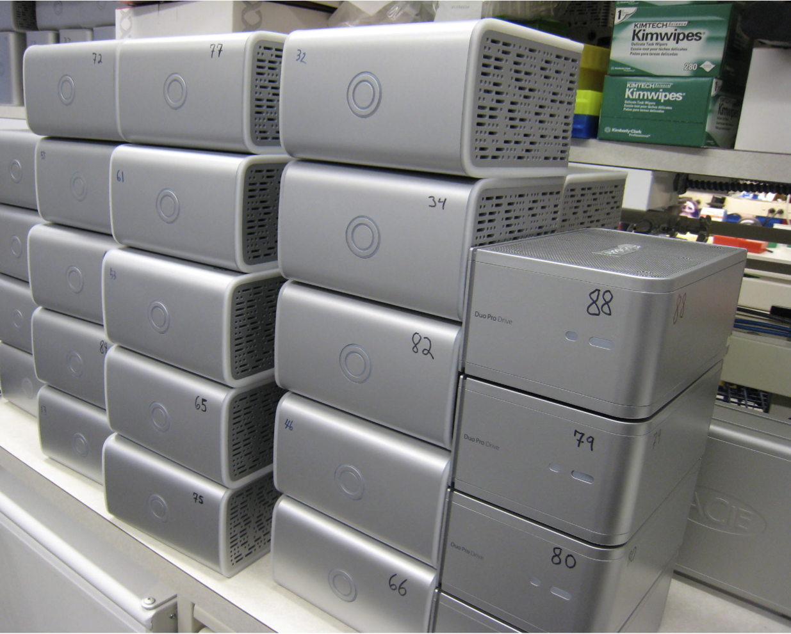
Backups
If you want to use your perfSONAR host to track historical results, regular backups are a good idea.
Can use a cloud/local solution that mirrors the entire system (lots of things out there that do this – Google it)
Can back up just the essential configurations and data
To back up perfSONAR configurations:
/opt/perfsonar_ps/toolkit/etc/*
/opt/perfsonar_ps/regular_testing/etc/*
/opt/perfsonar_ps/ls_registration_daemon/etc/*
/opt/perfsonar_ps/mesh_config/etc/*
/etc
To back up perfSONAR data:
The pg_dump tool can dump the metadata database from postgresql
The nodetool tool can dump the database from cassandra
Notes:
If you are treating your node as a ‘pet’ you may want to do this. If you aren’t, don’t worry about backups

Slide 35
Disk Maintenance
Use the nagios disk space tool to make sure your disk is not full
The df tool can be used to tell you the usage of a disk/partition:
[root@localhost ~]# df –h
Filesystem Size Used Avail Use% Mounted on
/dev/mapper/VolGroup-lv_root 50G 3.1G 44G 7% /
/dev/mapper/VolGroup-lv_home 176G 36G 132G 22% /home
The du tool can tell you usage of a directory:
[root@localhost ~]# du -sh /home/psadmin
21M /home/psadmin
Performing a fsck on a regular basis will also help to clean file system problems.
perfSONAR servers can exhaust log file space, particularly if they are testing against many hosts that are not responding
Clean out /var/log perodically or set log rotation limits if there are concerns about disk space
Notes:
Something you wouldn’t do regularly – but just in case.

Slide 36
Regular Monitoring
Most facilities will employ active monitoring for network devices
Tests to check network connectivity, service availability
Emails when active tests show a warning or critical alarm situation
Too many solutions in this space to enumerate. Some have more features than others (nicer GUI, configurable alarms, etc.)
NAGIOS (http://www.nagios.org) is one of the most commonly use solutions that many
NAGIOS is typically configured to watch servers and test against a ‘template’ of basic needs
Can be configured to watch more specific services and health (e.g. disk usage, number of processes running).
There are plugins written for NAGIOS that can be used to monitor specific services. These will be discussed later on.
Notes:
Take the time to get this set up – if you are not doing it already

Slide 37

Server Specific Monitoring Software
Some servers come with tools for health monitoring
Sometimes installed in a special partition on the stock configuration
These can be used to expose data (e.g. disk health, temperature, etc.) via systems like SNMP
If this is an option, consider having your SNMP solution (CACTI, MRTG, Cricket, etc.) monitor the perfSONAR server as well.
Can be used to alert on failures
Notes:
Also something that if you are doing enterprise – should be set up already.

Slide 38
Remote Management Verification
If your site relies on remote access to servers in the event of a network failure, check that the backup procedures work periodically.
E.g. if you have serial access enabled through a backup server, run an automated or manual test
If you have a DRAC or similar remote access card, be sure it is working
Notes:
Something you wouldn’t do regularly – but just in case.

Slide 39
Auditing User Accounts
perfSONAR can be used without giving out shell accounts (e.g. many tools are web based).
Some questions to consider when granting a shell account to someone:
What are they going to use it for?
Will they be an admin, or just a user?
Are they a trusted user at the institution?
Is the host linked to any other critical institutional resources?
If many people have shell access to the perfSONAR machine, consider a routine audit of accounts
Remove old ones that no longer need access
Force password changes (if password login is being used)
Notes:
Something you wouldn’t do regularly – but just in case.

Slide 40
perfSONAR Specific Concerns
perfSONAR Plugins for NAGIOS are available:
https://code.google.com/p/perfsonar-ps/source/browse/perfSONAR_PS-Nagios/doc/README.txt
Requires an already functional NAGIOS instance, and then
yum install perfSONAR_PS-Nagios
Purpose:
NAGIOS can be used to call the plugins to retrieve data from perfSONAR services
Throughput from a given test, packet loss, etc.
NAGIOS configuration can be altered to warn on certain thresholds
Regular NAGIOS plugins can be used to make TCP connections to ports on perfSONAR services to check reachability (e.g. BWCTL/OWAMP control port, HTTP server, etc.)
Notes:
Only applies if you are running nagios or similar.

Slide 41
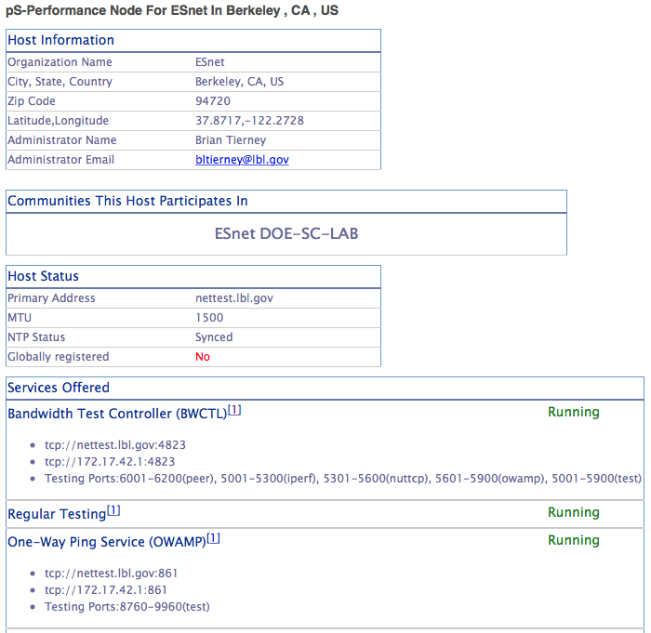
perfSONAR Specific Concerns
Check the home page for ‘status’:
Is the host information filled in?
Are the services that should be running, in the running state?
Has the host been globally registered?
In most cases these will not change, unless the host is in need of maintenance
Notes:
Issues are

Slide 42
Outline
Introduction & Overview
Security
Software Updates & Accounting
User Accounts & Machine Access
Physical Security
Service Audit
Firewalls & IDSs
Logging
Operational Concerns
Backups & Disk Maintenance
Regular Monitoring Solutions
Remote Management Verification
Auditing User Accounts
perfSONAR Specific Concerns
Conclusions
Notes:
Issues are

Slide 43
Conclusions
A perfSONAR server should not require much care and feeding
Yum auto-updates help a lot, but need to make sure they are set them up correctly
General server best practices are sufficient
Use external monitoring when you can to watch for bad behaviors
Security is only as advanced as you are willing to make it.
Use of external tools, or the audits that you perform, can be a strong defense.
If no effort is put in, be prepared to treat the machine as disposable (e.g. do you want ‘pets’ or do you want ‘cattle’)
In the disposable case – you certainly don’t want to integrate the machine into your environment very tightly
There is no magic pill in this space
If someone wants to get in, odds are they have a lot more resources than you do to make it so
perfSONAR nodes are public and have been compromised before
Spend some time talking to the right people at your campus about expectations and realities, and then make a plan.
Notes:
Issues are

Slide 44
Node Maintenance: Security & Operational Concerns
Event
Presenter, Organization, Email
Date
This document is a result of work by the perfSONAR Project (http://www.perfsonar.net) and is licensed under CC BY-SA 4.0 (https://creativecommons.org/licenses/by-sa/4.0/).

