Slide 1
Use Cases & Success Stories
KENET Workshop
NSRC/IU
September 2015
This document is a result of work by the perfSONAR Project (http://www.perfsonar.net) and is licensed under CC BY-SA 4.0 (https://creativecommons.org/licenses/by-sa/4.0/).

Slide 2

Success Stories
#1 Failing Optic(s)
#2 Brown University Firewall
#3 Penn State University Firewall
#4 Host Tuning
#5 Bottleneck Link
#6 R&E vs. Commodity Routing
#7 Extreme Upstream Packet loss
#8 Fiber Cut
#9 Buffer Tuning
#10 BGP Peering Migration
#11 Monitoring TA Performance
#12 Changing Regular Test Parameters
#13 MTU Changes (short & longer RTT)
#14 Speed Mismatch (e.g. not a ‘problem’)

Slide 3
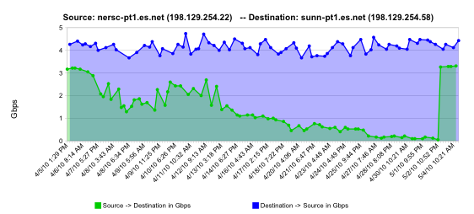
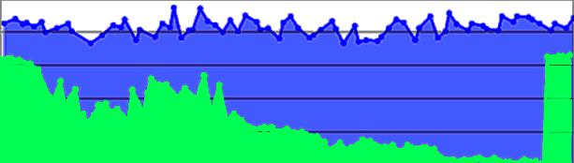
Success Stories - #1 Failing Optic(s)
First example –featuring a backbone network
Similar to frog boiling, hard alarms don’t notice gradual failure
normal performance
Gb/s
degrading performance
repair
one month
Notes:
Observed on ESnet
Slow burn of failure – note that if you look at a small window you wouldn’t have noticed this
Eventually triggered a hard alarm (and was repaired)

Slide 4
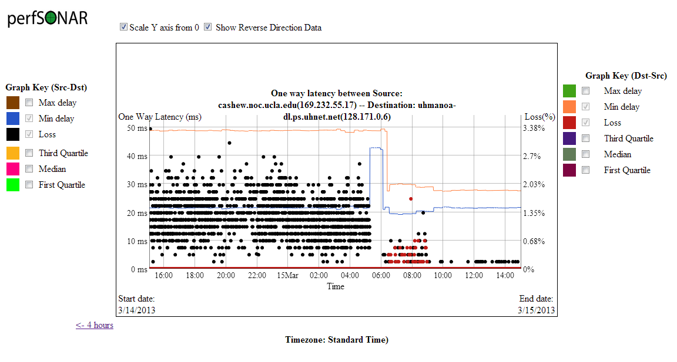
Success Stories - #1 Failing Optic(s) ex 2
Adding an Attenuator to a Noisy (discovered via OWAMP) Link
Notes:
Failing attenuator somewhere in the path (layer 2)

Slide 5
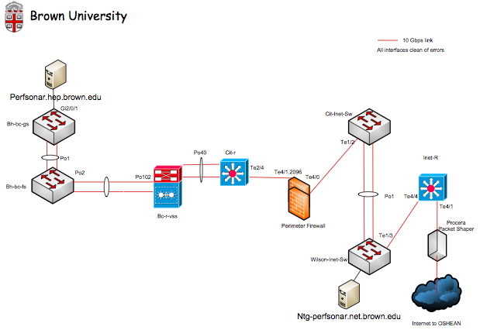
Success Stories - #2 Brown University
Notes:
Note: all links 10G, perfsonar hosts only 1G – this is fine though. 2 pS nodes, one in the physics area, one not (outside of firewall)

Slide 6
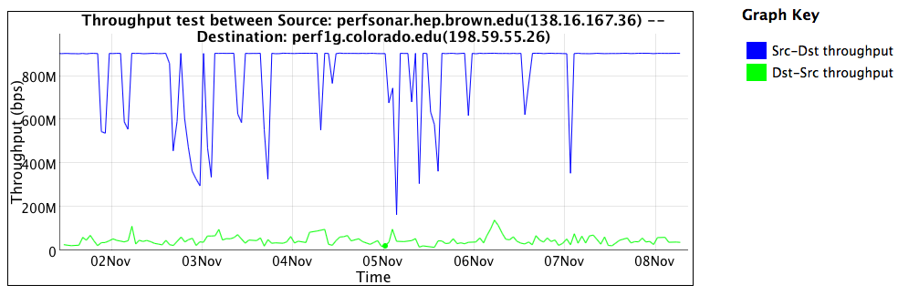
Success Stories - #2 Brown University Example
Results to host behind the firewall:
Notes:
Through the firewall – the ‘inbound’ traffic (green) is poor. Why? There is a slowdown due to the processing of packets. Even if there is state maintained for the flow, there is a processing and queuing delay we must suffer with.
Outbound traffic doesn’t have this issue

Slide 7
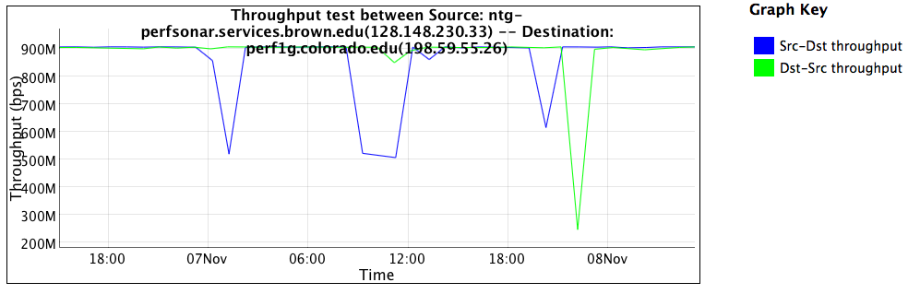
Success Stories - #2 Brown University Example
In front of the firewall:
Notes:
Outside of the firewall (the difference of 3 hops really) doesn’t see the problems.

Slide 8
Success Stories - #2 TCP Dynamics
Want more proof – lets look at a measurement tool through the firewall.
Measurement tools emulate a well behaved application
‘Outbound’, not filtered:
nuttcp -T 10 -i 1 -p 10200 bwctl.newy.net.internet2.edu
92.3750 MB / 1.00 sec = 774.3069 Mbps 0 retrans
111.8750 MB / 1.00 sec = 938.2879 Mbps 0 retrans
111.8750 MB / 1.00 sec = 938.3019 Mbps 0 retrans
111.7500 MB / 1.00 sec = 938.1606 Mbps 0 retrans
111.8750 MB / 1.00 sec = 938.3198 Mbps 0 retrans
111.8750 MB / 1.00 sec = 938.2653 Mbps 0 retrans
111.8750 MB / 1.00 sec = 938.1931 Mbps 0 retrans
111.9375 MB / 1.00 sec = 938.4808 Mbps 0 retrans
111.6875 MB / 1.00 sec = 937.6941 Mbps 0 retrans
111.8750 MB / 1.00 sec = 938.3610 Mbps 0 retrans
1107.9867 MB / 10.13 sec = 917.2914 Mbps 13 %TX 11 %RX 0 retrans 8.38 msRTT
Notes:
No RTR for outbound (non filtered) traffic

Slide 9
Success Stories - #2 TCP Dynamics Through Firewall
‘Inbound’, filtered:
nuttcp -r -T 10 -i 1 -p 10200 bwctl.newy.net.internet2.edu
4.5625 MB / 1.00 sec = 38.1995 Mbps 13 retrans
4.8750 MB / 1.00 sec = 40.8956 Mbps 4 retrans
4.8750 MB / 1.00 sec = 40.8954 Mbps 6 retrans
6.4375 MB / 1.00 sec = 54.0024 Mbps 9 retrans
5.7500 MB / 1.00 sec = 48.2310 Mbps 8 retrans
5.8750 MB / 1.00 sec = 49.2880 Mbps 5 retrans
6.3125 MB / 1.00 sec = 52.9006 Mbps 3 retrans
5.3125 MB / 1.00 sec = 44.5653 Mbps 7 retrans
4.3125 MB / 1.00 sec = 36.2108 Mbps 7 retrans
5.1875 MB / 1.00 sec = 43.5186 Mbps 8 retrans
53.7519 MB / 10.07 sec = 44.7577 Mbps 0 %TX 1 %RX 70 retrans 8.29 msRTT
Notes:
Retransmissions in the inbound case through the firewall. Is this loss? Could be. Is it delayed packets that cause TCP to time out? More likely. The firewall probably isn’t dropping traffic completely, its just spending so much time categorizing it.

Slide 10
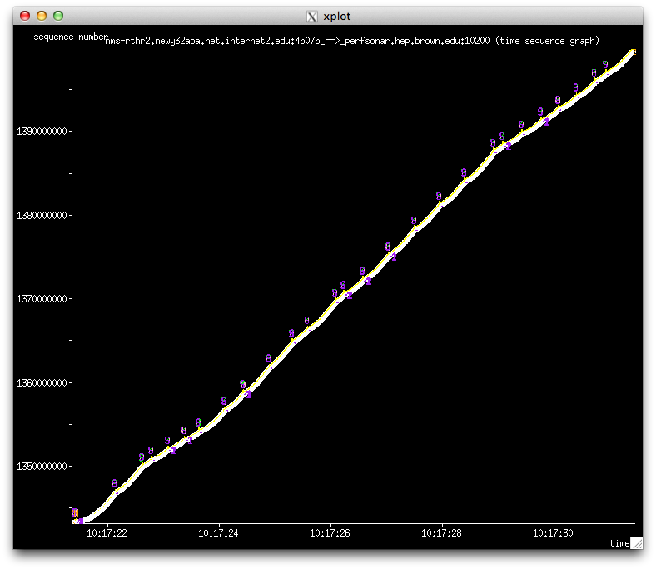
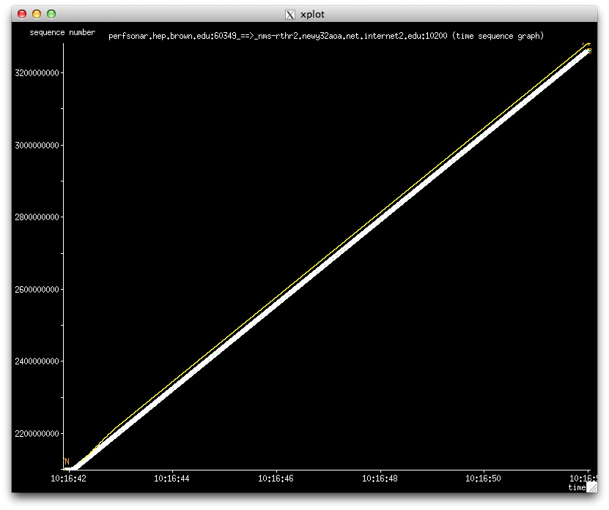
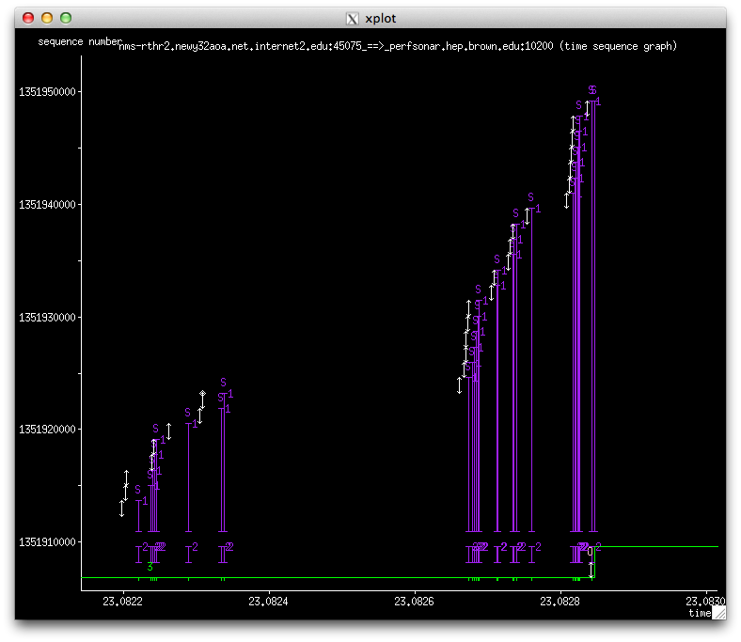
Success Stories - #2 tcptrace output: with and without a firewall
firewall
No firewall
Notes:
TCP trace – the purple = SACK/RTR blocks. We see this 2-3 times per second for a 10 second test.

Slide 11
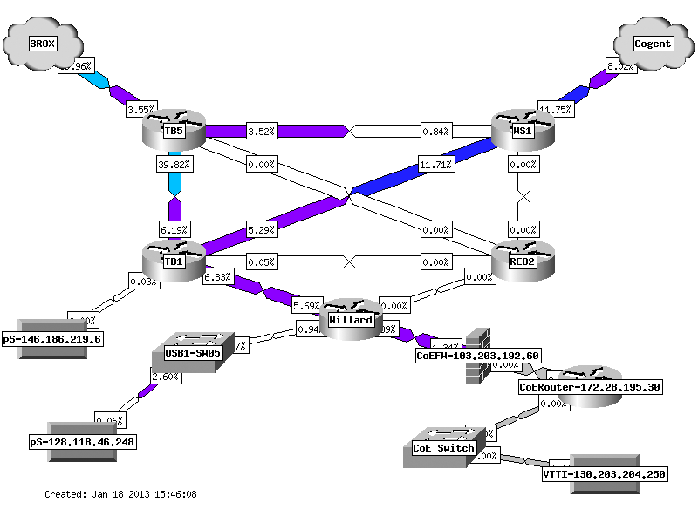
Success Stories - #3 PSU
PSU = Firewalls for some. The college of engineering has one, central IT does not
Notes:
Note that there is not a border firewall, but there is a department firewall.

Slide 12
Success Stories - #3 PSU
Initial Report from network users: performance poor both directions
Outbound and inbound (normal issue is inbound through protection mechanisms)
From previous diagram – CoE firewalll was tested
Machine outside/inside of firewall. Test to point 10ms away (Internet2 Washington)
Low, but no retransmissions?
jzurawski@ssstatecollege:~> nuttcp -T 30 -i 1 -p 5679 -P 5678 64.57.16.22
5.8125 MB / 1.00 sec = 48.7565 Mbps 0 retrans
6.1875 MB / 1.00 sec = 51.8886 Mbps 0 retrans
…
6.1250 MB / 1.00 sec = 51.3957 Mbps 0 retrans
6.1250 MB / 1.00 sec = 51.3927 Mbps 0 retrans
184.3515 MB / 30.17 sec = 51.2573 Mbps 0 %TX 1 %RX 0 retrans 9.85 msRTT
Notes:
This isn’t the same as in the previous case – we don’t see RTR at all.
This isn’t the same issue

Slide 13
Success Stories - #3 PSU
Observation: net.ipv4.tcp_window_scaling did not seem to be working
64K of buffer is default. Over a 10ms path, this means we can hope to see only 50Mbps of throughput:
BDP (50 Mbit/sec, 10.0 ms) = 0.06 Mbyte
Implication: something in the path was not respecting the specification in RFC 1323, and was not allowing TCP window to grow
TCP window of 64 KByte and RTT of 1.0 ms <= 500.00 Mbit/sec.
TCP window of 64 KByte and RTT of 5.0 ms <= 100.00 Mbit/sec.
TCP window of 64 KByte and RTT of 10.0 ms <= 50.00 Mbit/sec.
TCP window of 64 KByte and RTT of 50.0 ms <= 10.00 Mbit/sec.
Reading documentation for firewall:
TCP flow sequence checking was enabled
What would happen if this was turn off (both directions?
Notes:
What could it be? Have to do some math. If we look at the observation, it looks like a buffer problem. If we scale out the math, we should be seeing these expectations.

Slide 14
Success Stories - #3 PSU
jzurawski@ssstatecollege:~> nuttcp -T 30 -i 1 -p 5679 -P 5678 64.57.16.22
55.6875 MB / 1.00 sec = 467.0481 Mbps 0 retrans
74.3750 MB / 1.00 sec = 623.5704 Mbps 0 retrans
87.4375 MB / 1.00 sec = 733.4004 Mbps 0 retrans
…
91.7500 MB / 1.00 sec = 770.0544 Mbps 0 retrans
88.6875 MB / 1.00 sec = 743.5676 Mbps 28 retrans
69.0625 MB / 1.00 sec = 578.9509 Mbps 0 retrans
2300.8495 MB / 30.17 sec = 639.7338 Mbps 4 %TX 17 %RX 730 retrans 9.88 msRTT
Notes:
After the change to the firewall – better performance.

Slide 15
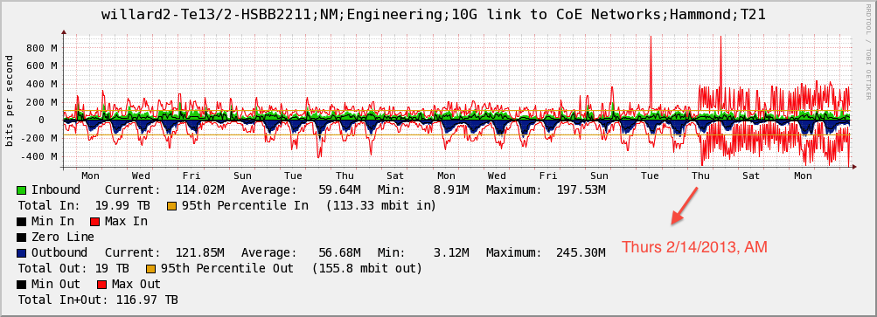
Success Stories - #3 PSU
Was this impacting people? Oh yes it was:
Notes:
Lots of pent-up demand

Slide 16
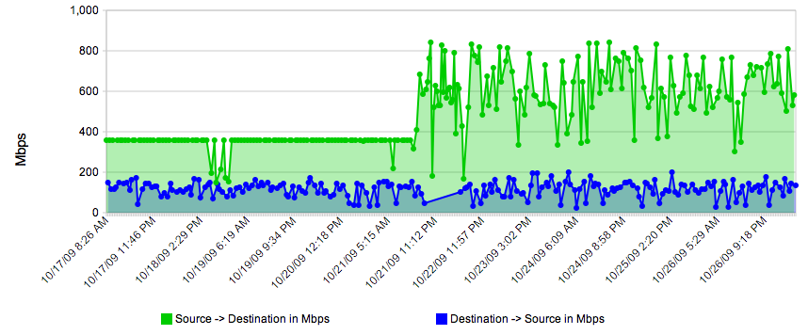
Success Stories - #4 Host Tuning
Simple example – play with the settings in /etc/sysctl.conf when running some BWCTL tests.
See if you can pick out when we raised the memory for the TCP window (ignore the blue – this is a known firewall)
Notes:
IF you don’t tune your host, you will max out performance
Blue = firewall, just ignore that

Slide 17
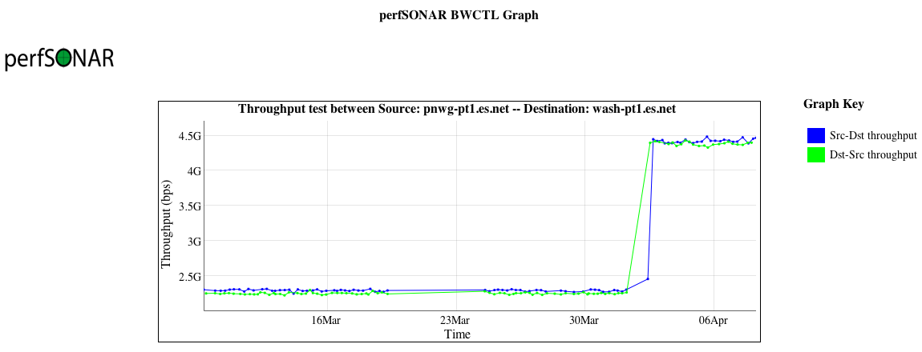
Success Stories - #4 Host Tuning
Another example – long path (~70ms), single stream TCP, 10G cards, tuned hosts
Why the nearly 2x uptick? Adjusted net.ipv4.tcp_rmem/wmem maximums (used in auto tuning) to 64M instead of 16M.
As the path length/throughput expectation increases, this is a good idea. There are limits (e.g. beware of buffer bloat on short RTTs)
Notes:
Better view of increasing the max window size

Slide 18
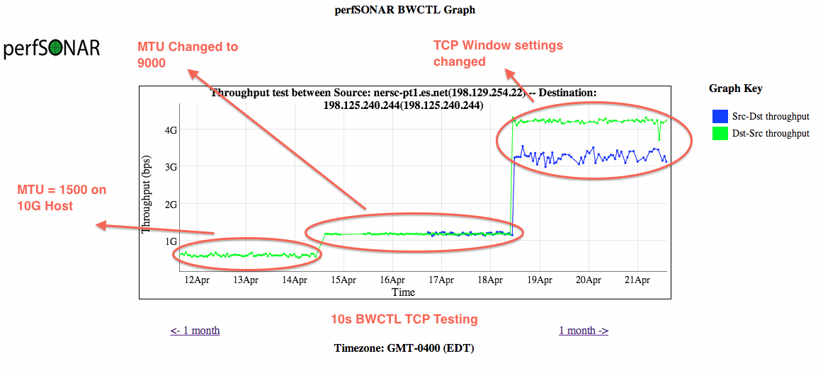
Success Stories - #4 Host Tuning
A more complete view – showing the role of MTUs and host tuning (e.g. ‘its all related’):
Notes:
Normal, 9000 MTU, and increased window. This is what all science hosts need to have applied

Slide 19
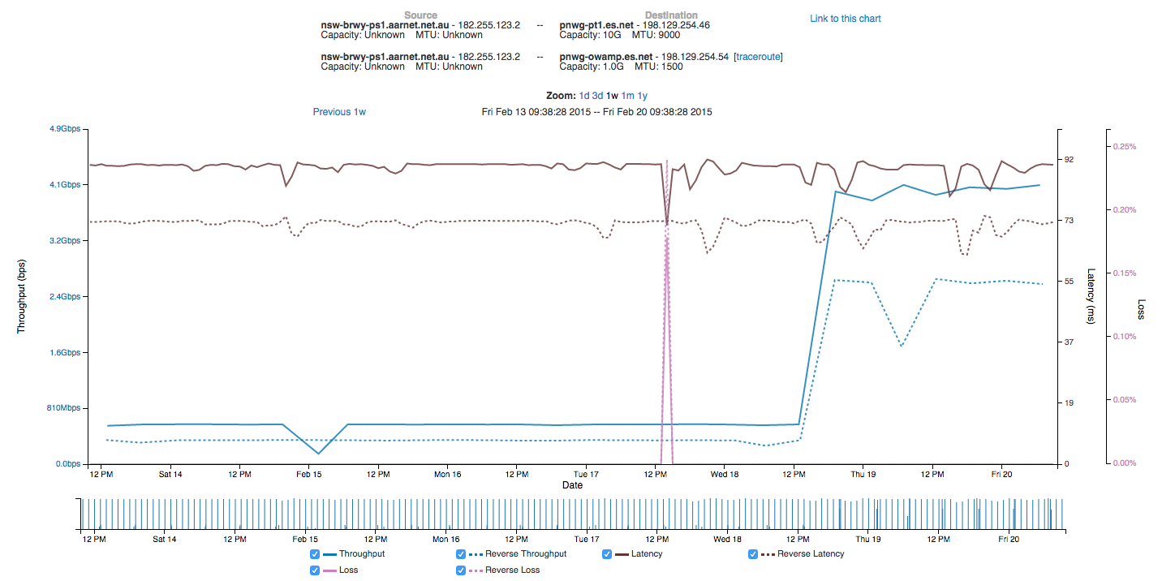
Success Stories - #4 Host Tuning
Notes:
Normal, 9000 MTU, and increased window. This is what all science hosts need to have applied

Slide 20
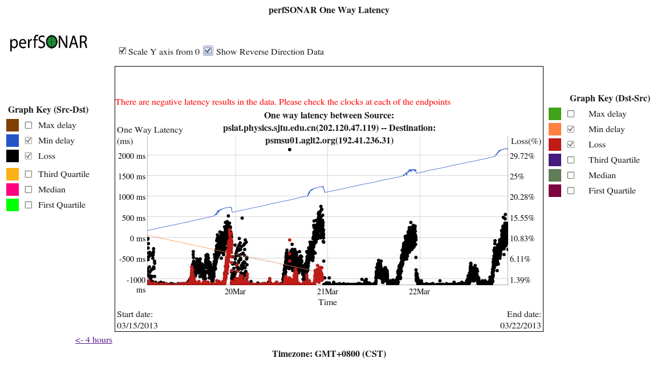
Success Stories - #5 Bottleneck Link
OWAMP used in a campus with too many users and not enough network (ignore the latency lines – NTP was hurting too)
Notes:
Seen on a campus in China – there is not enough capacity which causes congestion (and loss)

Slide 21
Success Stories - #6 R&E vs. Commodity Routing
Some campuses don’t need to be told that the R&E path is ‘better’, others need to figure it out on their own.
BWCTL results between PSU and Vanderbilt (science driver was genomics)
Normally low results over the course of the day. ‘spikes’ at night.
Traceoutes:
PSU -> Cogent -> Century Link -> Vanderbilt
Vanderbilt -> SOX -> NLR (dated) -> 3ROX -> PSU
Asymmetry is not bad by itself, unless …
Notes:
If you maintain multiple peerings, you will need to set localprefs to make sure your traffic engineering works the way you want it to. Otherwise, if you just trust BGP to use shortest path, you may get odd results.

Slide 22
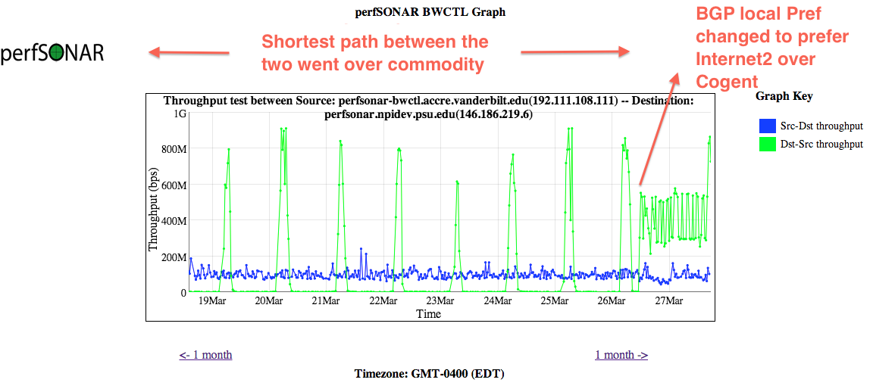
Success Stories - #6 R&E vs. Commodity Routing
Letting BGP ‘figure it out’ can sometimes lead to issues.
Yes, shortest path is a good metric in the commercial world.
R&E should always be preferred to commodity when available
Managing local prefs can be a ‘pain’ for those that are not used to it. The end result is hard to argue with
The ‘blue’ line? Over NLR in the dying days – and the Cisco 650x in that region was known to have a bad card/optic that was never replaced (e.g. packet loss all over the place)
Notes:
Once the change was applied to trust a localpref, we see immediate increase in performance.

Slide 23
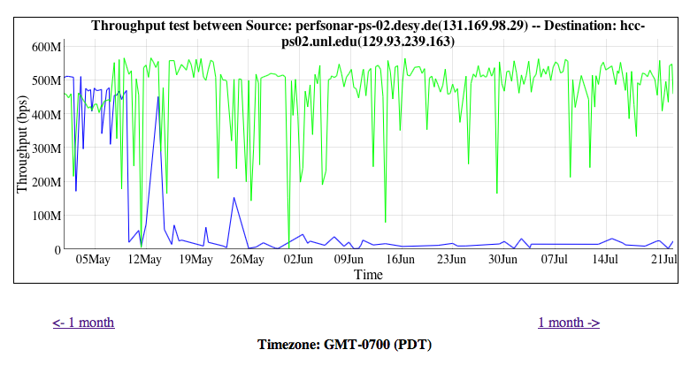
Success Stories - #6 R&E vs. other R&E
Sometimes things break on R&E too, here is UNL to DESY (Germany), first over Internet2 then over ‘LHCONE’
Takeaway – there was something wrong with LHCONE …
Notes:
Real problem on the LHCONE network – it was worse than the best effort IP

Slide 24
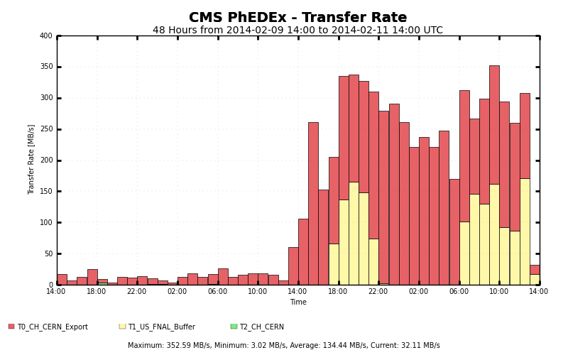
Success Stories - #6 R&E vs. other R&E
Same situation, different location (this time Vanderbilt). This is a PhEDEx (e.g. data movement) graph that shows the transfer rate with LHCONE, and then when Vanderbilt went back to regular Internet2:
Notes:
Same story – bad performance = bad results in real data movement. Switched away from LHCONE and things got better (until LHCONE was fixed)

Slide 25
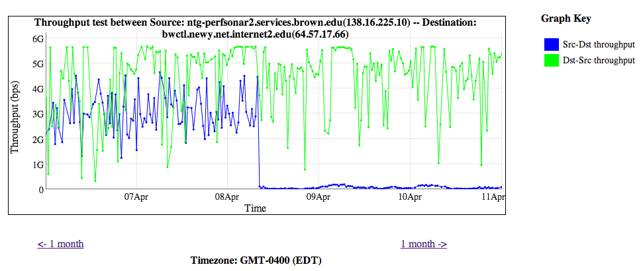
Success Stories - #7 Upstream Packet Loss
Sometimes its not your fault – this is why monitoring your provider is a good idea:
Drastic drop in BWCTL normally has a reason …
Notes:
IF you do have alarming working, this would have caused an alarm. Drop in throughput, caused by upstream packet loss

Slide 26
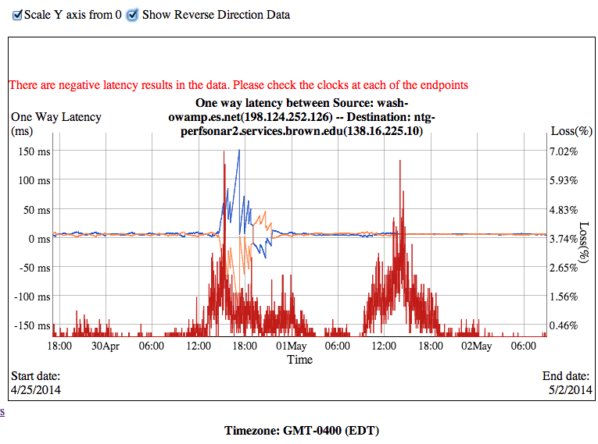
Success Stories - #7 Upstream Packet Loss
Spikes of packet loss, almost always during business hours
Function of the load on the line/time of day
This was traced to regional network
Notes:
.0046% packet loss is bad, this hit close to 7% at points of the day.

Slide 27
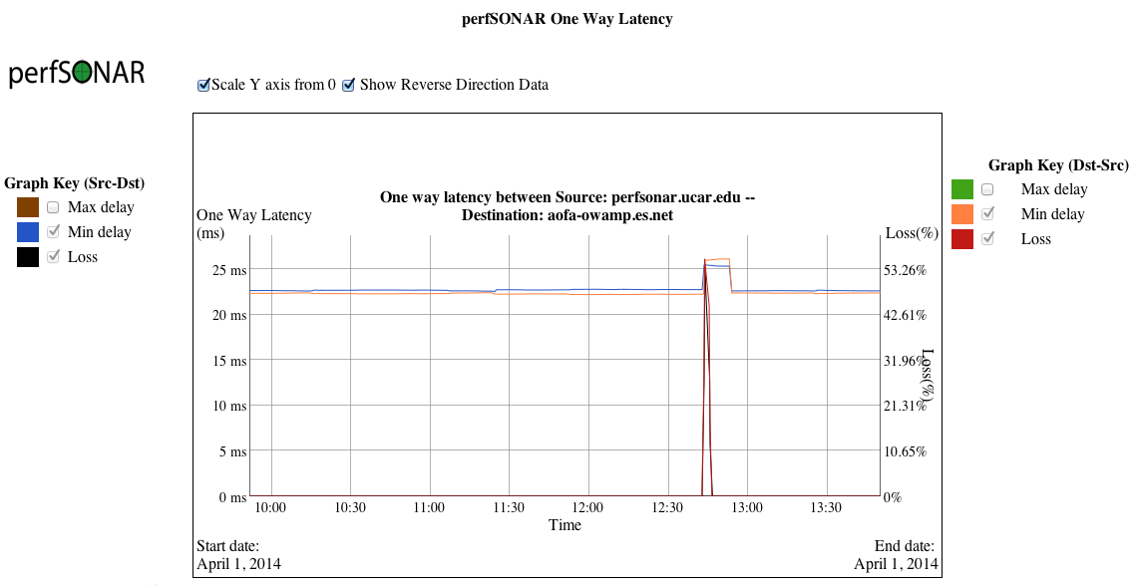
Success Stories - #8 Fiber Cut
Not that perfSONAR couldn’t help fix this (that’s up to your local DOT and provider …), but it does have an interesting signature in terms of loss and latency:
Notes:
Very clear signature of a fiber cut – loss spike, re-route, and then another re-route

Slide 28
#9 Buffer Tuning Experiment
TCP Test flows, 50ms path
30 Second test, 2 TCP streams
Buffer Size | Packets Dropped | TCP Throughput
120 MB | 0 | 8Gbps
60 MB | 0 | 8Gbps
36 MB | 200 | 2Gbps
24 MB | 205 | 2Gbps
12 MB | 204 | 2Gbps
6 MB | 207 | 2Gbps
2Gbps UDP background data
Modify this egress buffer size
Notes:
Experiment done to figure out the ‘sweet spot’ for buffering. ‘Buffer Bloat’ is not typically a problem in R&E networks, so more is better. If there is not enough buffer, all flows will suffer.

Slide 29
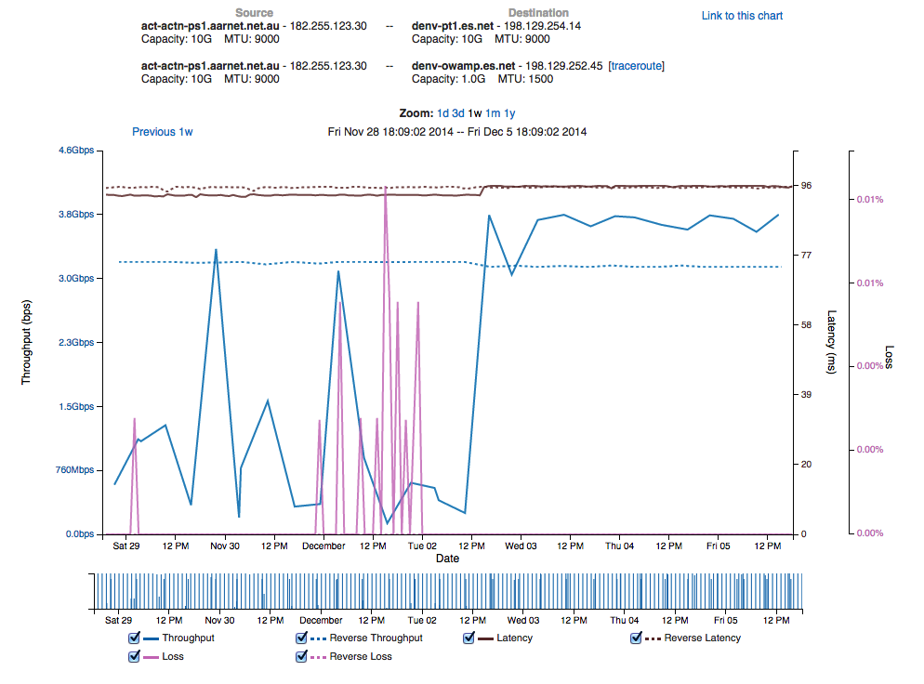
#10 BGP Peering Migration
Peering moved from 10G link to 100G link
Latency change shows path change
Notes:
BGP peering swap from a congested 10G peering to a slightly further away 100G peering

Slide 30
#10 BGP Peering Migration
Performance increases
Performance stabilizes
Notes:
BGP peering swap from a congested 10G peering to a slightly further away 100G peering

Slide 31
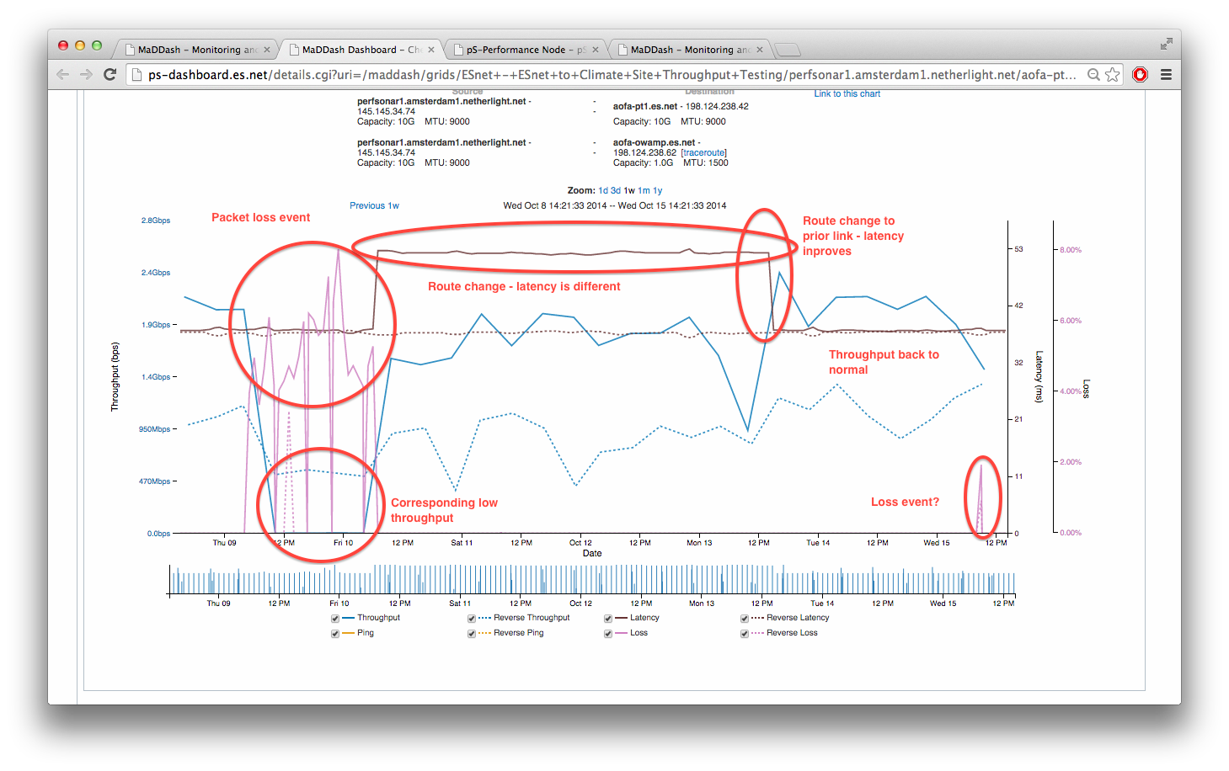
#11 Monitoring TA Links
Notes:
Watching loss, route changes, and repair on a TA link (100G)

Slide 32
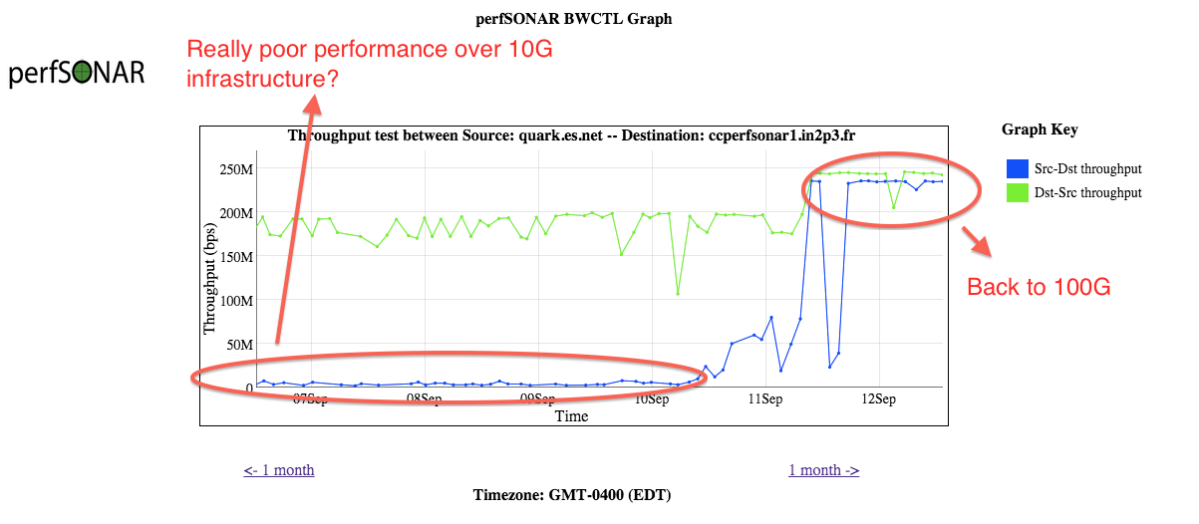
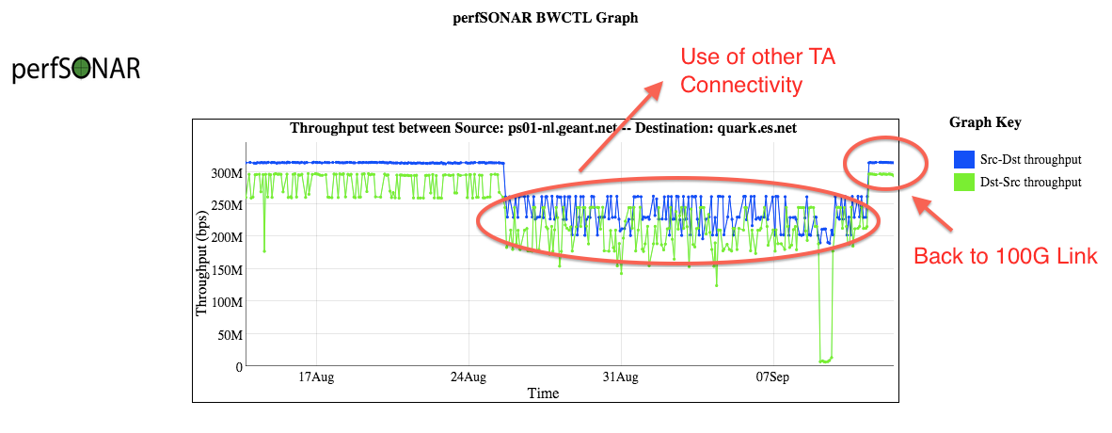
#11 Monitoring TA Links
Notes:
More TA updates. Moving to 100G in the first, failover to 10G in the 2nd

Slide 33
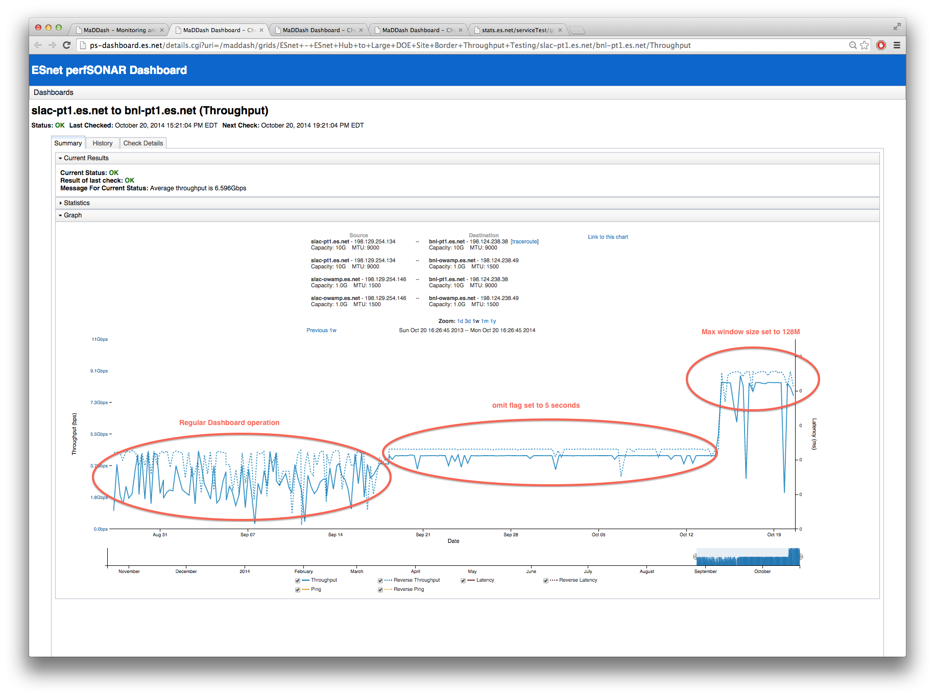
#12 Testing Parameter Adjustments
Notes:
WE made some changes to our dashboard – this catalogs the experience we had.

Slide 34
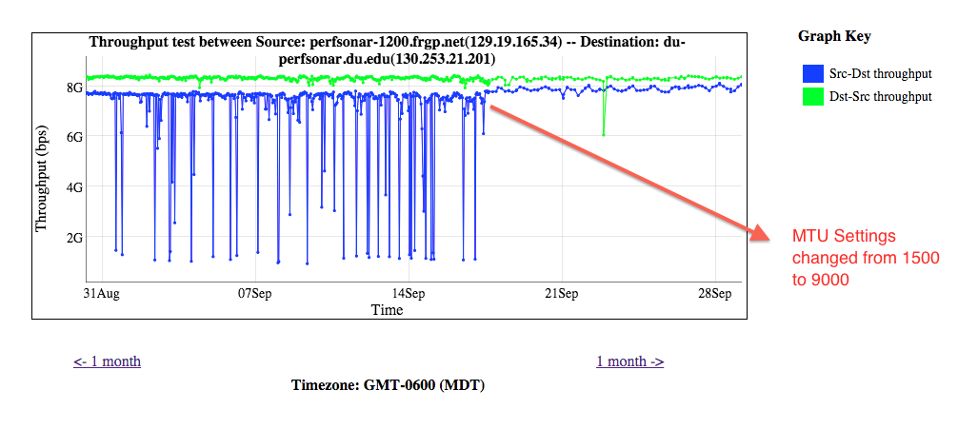
#13 MTU Changes (Short RTT)
Notes:
MTU things matter – and in this case even though things were close there was a deep variation in performance

Slide 35
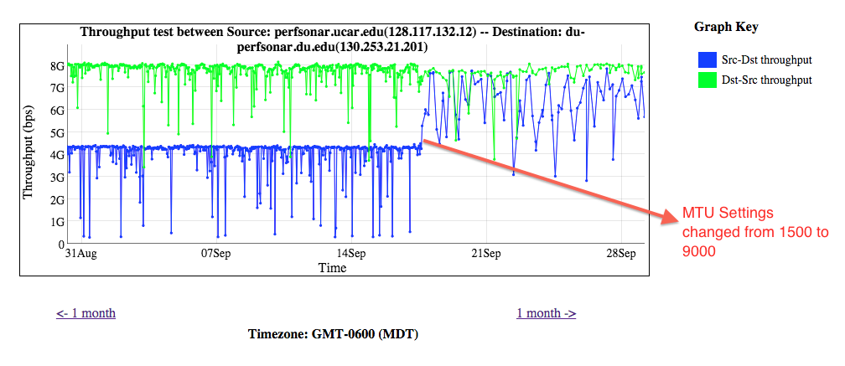
#13 MTU Changes (Longer RTT)
Notes:
MTU things matter – and in this case even though things were close there was a deep variation in performance

Slide 36
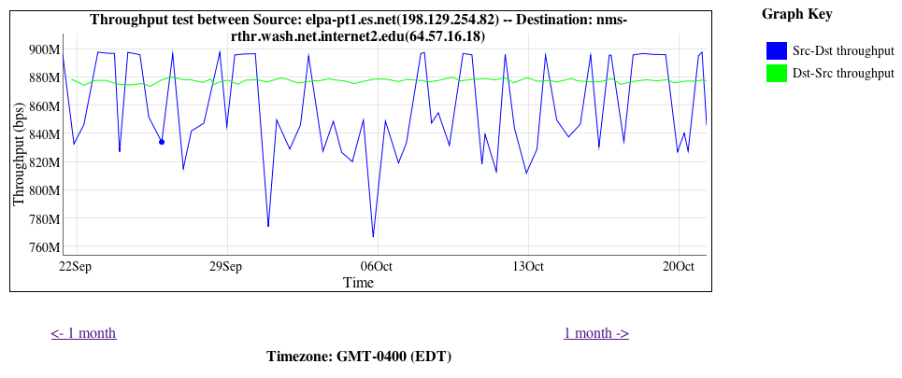
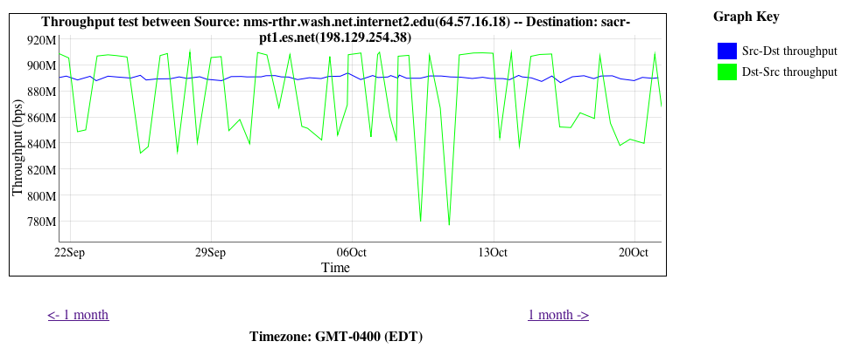
#14 Speed Mismatch
http://fasterdata.es.net/performance-testing/troubleshooting/interface-speed-mismatch/
http://fasterdata.es.net/performance-testing/evaluating-network-performance/impedence-mismatch/
Notes:
Speedmismatch may look like a ‘problem’, but this is expected behavior unless you have deep buffers.

Slide 37
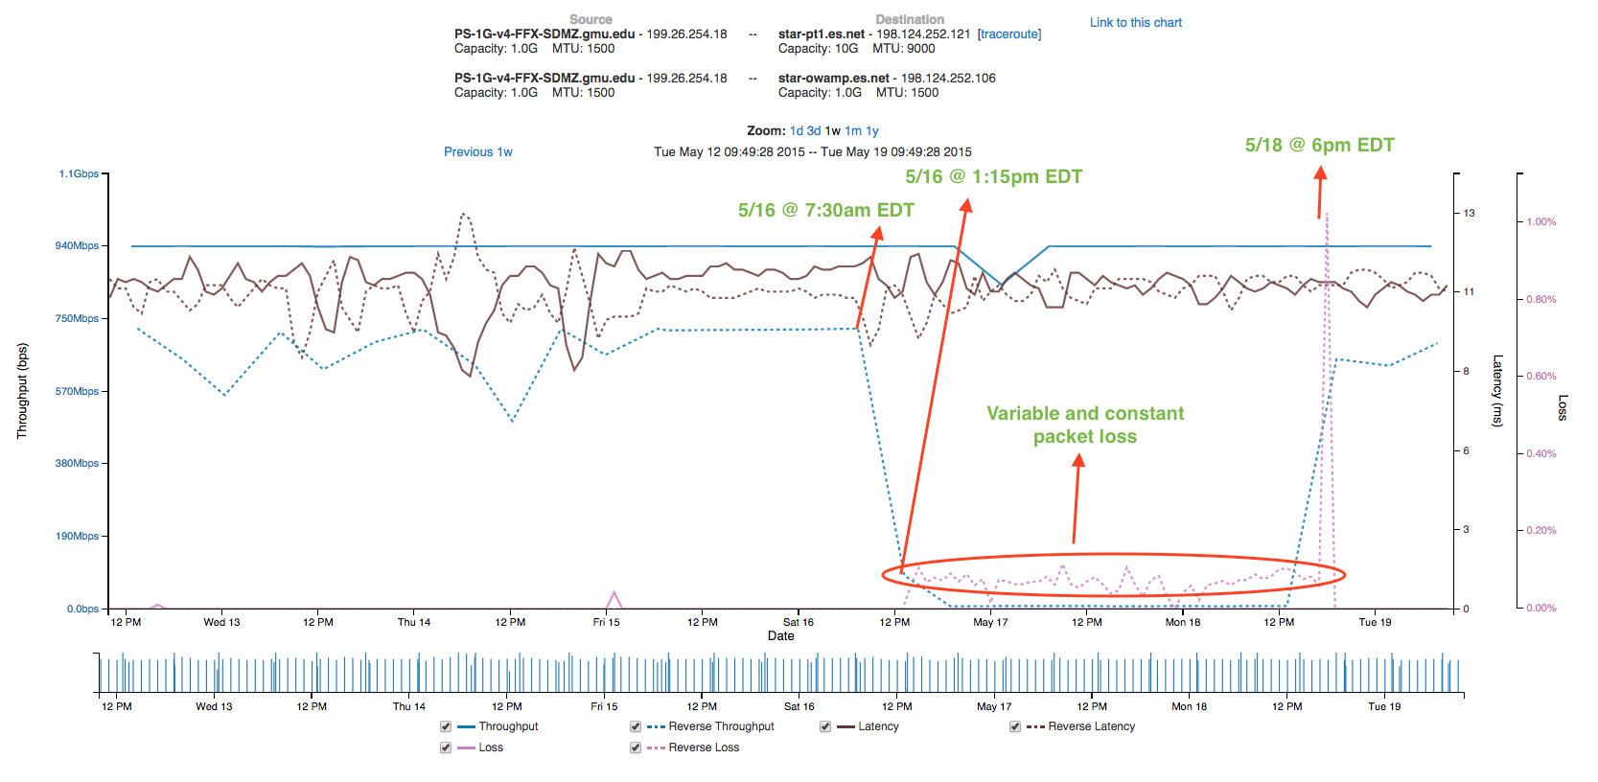
#15 George Mason Performance
Notes:
AL2S/SDN invisible (to Nagios) issue

Slide 38
#15 George Mason Performance
At the time:
Regular testing between ESnet Washington, Chicago, El-Paso, and Sacramento
Performance degredation (like previous) seen only to Chicago and New York – not to others
Lets look at paths (first to ‘good’ testers):
3 sunncr5-internet2.es.net (198.129.48.2) 10.277 ms 10.373 ms 10.439 ms 4 et-1-0-0.111.rtr.hous.net.internet2.edu (198.71.45.20) 55.655 ms 55.719 ms 55.711 ms 5 et-10-0-0.105.rtr.atla.net.internet2.edu (198.71.45.12) 70.067 ms 70.135 ms 70.128 ms 6 et-9-0-0.104.rtr.wash.net.internet2.edu (198.71.45.7) 69.869 ms 69.976 ms 69.820 ms 7 192.122.175.14 (192.122.175.14) 71.004 ms 71.088 ms 71.157 ms 8 gmu-router.v50.networkvirginia.net (192.70.138.62) 71.890 ms 71.934 ms 71.988 ms
Then to ‘bad’:
2 chiccr5-ip-a-starcr5.es.net (134.55.42.41) 0.673 ms 0.970 ms 1.300 ms 3 et-10-0-0.1235.rtr.chic.net.internet2.edu (64.57.30.0) 0.490 ms 0.559 ms 0.551 ms 4 et-7-0-0.115.rtr.wash.net.internet2.edu (198.71.45.57) 17.573 ms 17.675 ms 17.740 ms 5 192.122.175.14 (192.122.175.14) 18.803 ms 18.892 ms 18.965 ms 6 gmu-router.v50.networkvirginia.net (192.70.138.62) 19.816 ms 19.822 ms 19.891 ms
Notes:
Speedmismatch may look like a ‘problem’, but this is expected behavior unless you have deep buffers.

Slide 39
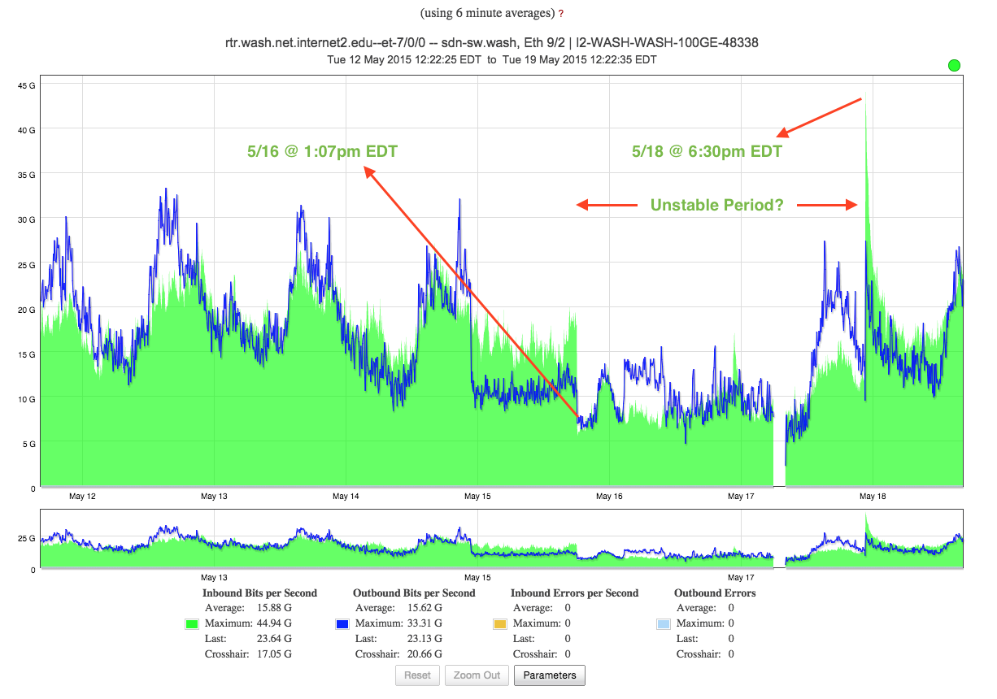
#15 George Mason Performance
Notes:
Timeline of the event

Slide 40
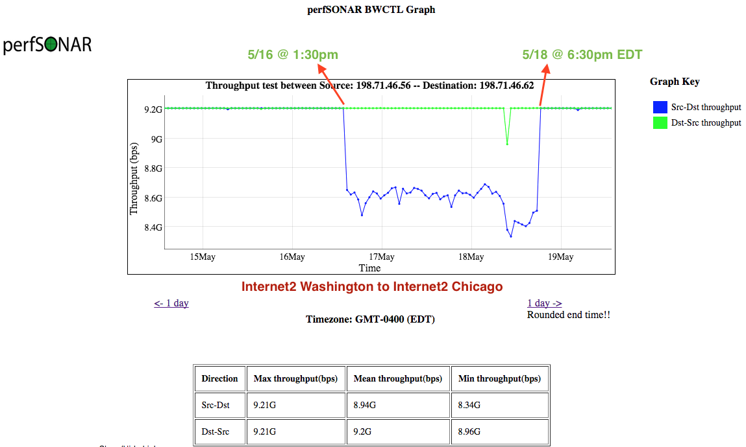
#15 George Mason Performance
Notes:
Timeline of the AL2S/SDN event

Slide 41
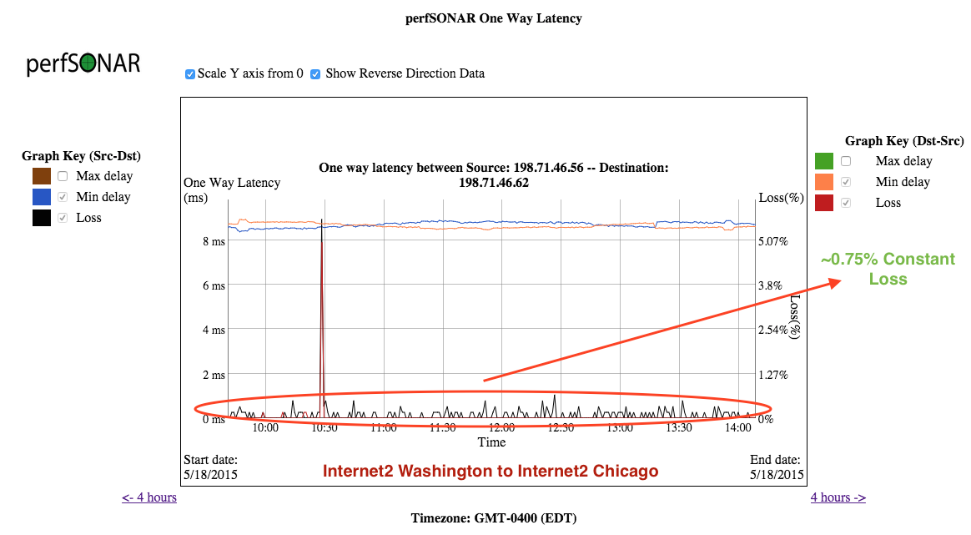
#15 George Mason Performance

Slide 42
#15 George Mason Performance
[E-LITE-Tech] Internet2 Emergency Maintenance
Date: Mon, 18 May 2015
All,
We have just been notified that Internet2 has scheduled an emergency maintenance
window to replace faulty equipment. The advertised maintenance window is for
today 5/18 16:00 (4pm) to 20:00 (8pm). During this maintenance we do not
anticipate any impact to Internet2 or AL2S connectivity, however are providing
this notification in the event that any unforeseen issues arise.
Please let me know if you have any questions or concerns.
Thanks.
Scott Daffron
Old Dominion University
Notes:
A less than clear message about what was happening?

Slide 43
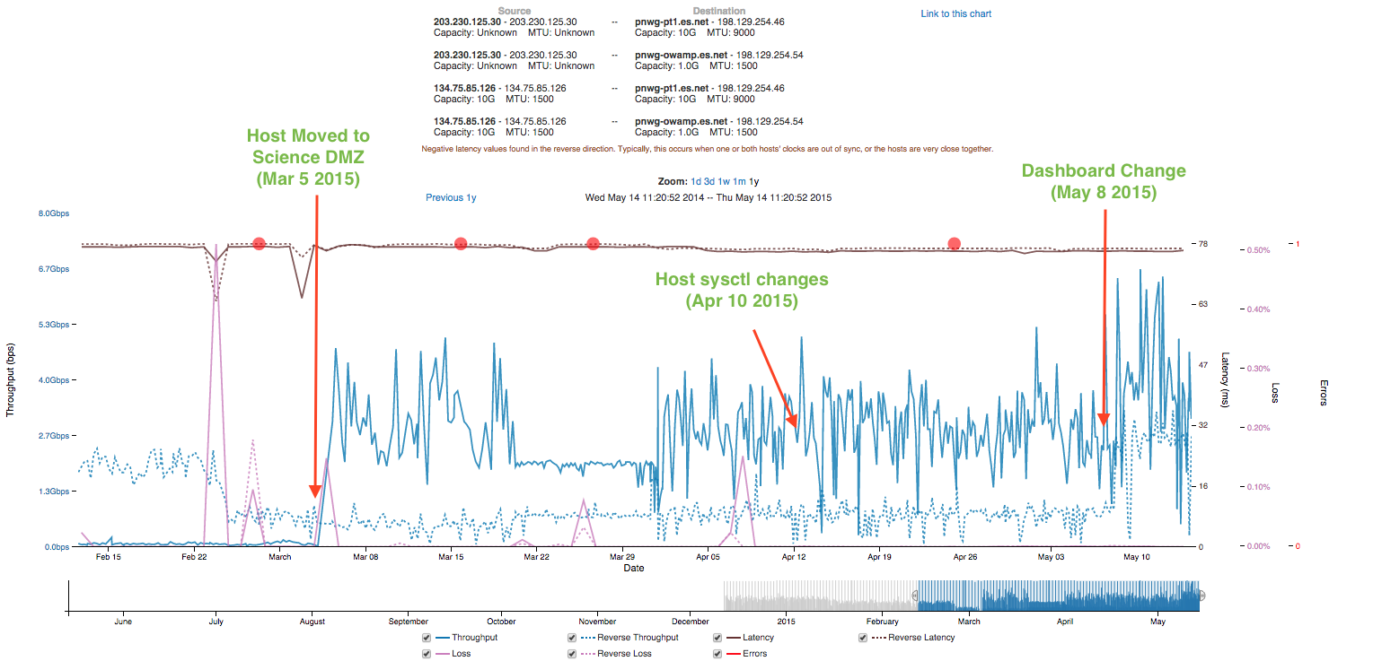
#16 KSTAR
Notes:
Science DMZ example with dashboard configuration

Slide 44
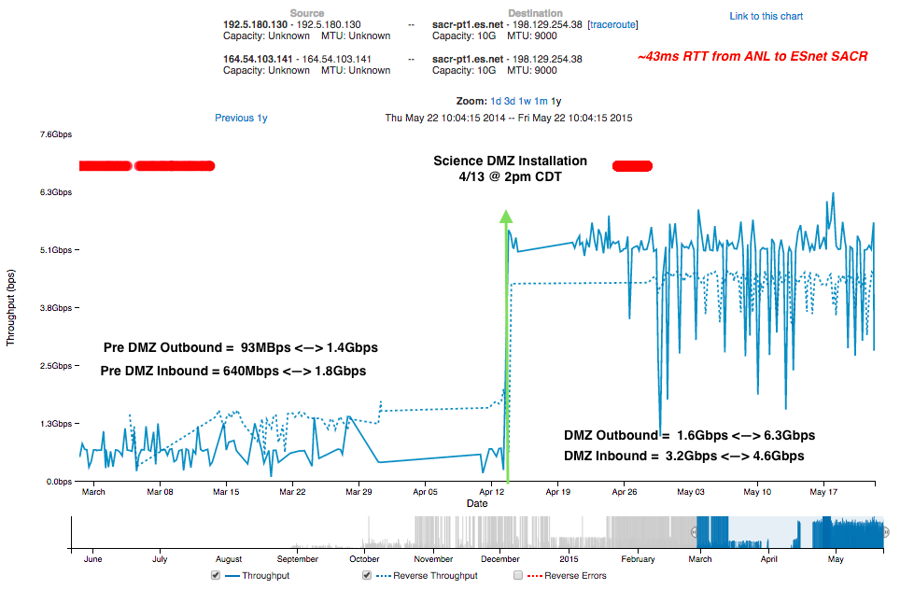
#17 APS @ ANL
Notes:
Before and After – Science DMZ installation

Slide 45
Success Stories
Key Message(s):
The monitoring infrastructure is sensitive for a reason – so that it finds the problems in all layers of the OSI stack.
End-to-end Video transmission (or just about any other use case) suffers because of a problems that may be unseen or not understood.
Understanding comes from learning to use the tools, learning to trust them, and having universal availability.
Comprehensive solutions will save time in the end – and perfSONAR is that solution

Slide 46
Use Cases & Success Stories
KENET Workshop
NSRC/IU
September 2015
This document is a result of work by the perfSONAR Project (http://www.perfsonar.net) and is licensed under CC BY-SA 4.0 (https://creativecommons.org/licenses/by-sa/4.0/).

