Slide 1
Network Debugging Strategies
KENET Workshop
NSRC/IU
September 2015
This document is a result of work by the perfSONAR Project (http://www.perfsonar.net) and is licensed under CC BY-SA 4.0 (https://creativecommons.org/licenses/by-sa/4.0/).

Slide 2
Where to Start?
perfSONAR was designed to debug end-to-end problems.
Easily deployed where it needs to be
Selection of tools that can be invoked (remotely) on demand
Ability to set up regular tests, and view a historical record
Before starting any investigation, create a plan (perhaps share this with your helpdesk/operations team too …)
As we get into this, we will be using a variation of ‘divide and conquer’, but we need to be careful:
Segment by segment analysis is not helpful – this is not a ‘many parts make a whole’ problem, TCP doesn’t work that way
We want to divide our path more intelligently, and build it/take it apart slowly. Testing every single segment from ingress to egress is a false way to diagnose an end-to-end problem

Slide 3

Developing a Plan
Suggested Flow Chart:
Problem Report
Triage
Resource Identification
1st Pass Fact Finding
Performance Testing – Step 1 (Regular Testing Setup)
Performance Testing – Step 2 (OWAMP)
Performance Testing – Step 3 (BWCTL)
Performance Testing – Step 4 (Optional – NDT or other tools)
Evaluation of Results
Hypothesis & Environmental Changes

Slide 4
Describing the Steps
Problem Report
Typically this comes in the form of a ticket, or from a user directly
Try to get as much info as you can – and remember this may goes beyond it being a ‘network’ issue (e.g. remember that hosts and applications matter too)
Problem seen from where to where?
Observed when?
Host(s) used?
Applications used?
Is it repeatable?
Prior problems for this set of circumstances?
Notes:
How do your problems show up? Tickets? Nagios? (Deploy/incorporate Nagios alerts from pS)

Slide 5
Describing the Steps
Triage
An offshoot of the previous step – weigh the items from the report and look for the low-hanging fruit. In particular:
Make sure the host(s) are tuned for the job they are trying to do, and that the application is working correctly.
Resource Identification
perfSONAR at each ‘end’ is a must. If you don’t have it, spend the 30 minutes to get a host running (placement at the border, or where the user’s resources are to start). Get it on the other end too.
Location of perfSONAR resources ‘in the middle’ comes next:
Do a quick traceroute to see the networks involved.
Use the perfSONAR directory (http://stats.es.net/ServicesDirectory/) to locate servers on those networks. We don’t need full coverage at this point, but its good to find things.
Try to get LAN maps for the ‘ends’ if you can as well. Knowing exactly what sits between the user and the border will help you later.

Slide 6
Describing the Steps
1st Pass Fact Finding
With a sheet of paper (or electronic paper), start making notes:
The traceroute and reverse traceroute between the resources. What does these look like? Are they the same, or different?
If you have the LAN maps, do you see any abnormalities? Mark locations where there are bandwidth step-downs (e.g. multiple 1Gs into a 10G, etc.).
If you are using CACTI/Cricket/MRTG/etc., look at the utilization, drops, and errors from the interfaces that make up the network path. Is congestion a factor? Are there patterns of errors/drops consistent with use, or do they look constant?
If you have access to regional/national data for the above two items – try to do the same as well. You do not need to have all the answers at this stage
As in the experimental method, make a hypothesis
Notes:
If you know already that the link is congested, than congestion is the likely suspect…

Slide 7
Describing the Steps
Performance Testing – Step 1 (Regular Testing Setup)
Using your perfSONAR Toolkit – establish some regular tests:
To the remote end having problems
To the regional that remote end connects to
To the backbone location the regional may use (e.g. Internet2 POP in some city)
To your regional
To your network demarcation (if you are testing from behind a firewall)
OWAMP tests are *very* important, we want to know packet loss
BWCTL tests are also important, we want to see throughput. Note that for ‘close’ things (your network demarcation and your regional), throughput may be ‘good’, even in the case of packet loss.
It takes a couple of days to get good data, but don’t let that stop you from continuing with the steps
Notes:
Part of the reason we install the packages prior to this talk is to be generating the data

Slide 8
Describing the Steps
Performance Testing – Step 2 (OWAMP)
‘owping’ is the tool we are going to use:
owping $HOST
Twiddle some of the options:
-c: number of packets sent, e.g. –c 1000 = 1000 packets in the session
-i: interval between packets, e.g. –i .01 = send 100 packets per second
-s: size of the packets sent, e.g. –s100 = 100 byte (pre header) size of packets
Note that twiddling the options does increase the length of time of the test, and possibly the bandwidth used. For example:
owping –c 1000 –I .01 –s 100 will send 1000 packets, of 100 bytes in size, where 100 packets are sent ever second. The entire test will take 10 seconds total.
What we want to do is tickle situations where the devices in the path may be congested on a micro scale. If we run a long enough test, we could see packet loss or out of order behavior.
Test against the opposite end, and to things in the middle. Keep good notes.

Slide 9
Describing the Steps
Performance Testing – Step 3 (BWCTL)
As in the previous case, we are going to test to the other end, and to things in the middle with BWCTL:
bwctl -T iperf3 -f m -t 20 -i 1 –c $HOST
bwctl -T iperf3 -f m -t 20 -i 1 –s $HOST
Suggestions on use:
Use iperf3 or nuttcp as the tool (avoid iperf)
Always set the ‘-f’ flag to be ‘m’ (easier to read the output)
Tests should be between 20-30 seconds, and use an interval of 1-2. This will let you see TCP behavior as it rises and falls (and gives you sufficient time to ramp up speed and window size)
Avoid parallel streams to start – see what a delicate single stream will do.
Run both directions (-c and –s) for each target. We want to see patterns, and make sure they are consistent.
Make sure we are recording things – if possible draw a map between the networks and decorate the links with these speeds

Slide 10
Describing the Steps
Performance Testing – Step 3 (BWCTL) – cont.
Our end goal is to pull out the ‘longest, cleanest’ path we can. What does that mean?
TCP dynamics tell us that throughput will be “high”, even with packet loss, when the latency is “small”. This is why testing exclusively to something on your border, or at your regional network is not useful from a throughput standpoint
If the original report is correct, and performance is ‘bad’ to the other end, we want to slowly back away away from that end until we can find where things look ‘good’.
Maybe this is to the regional network, maybe its to the backbone.
Maybe its to neither, and the problem is really on our network – this is why we need OWAMP to help with packet loss, we can’t rely on throughput alone.

Slide 11
Describing the Steps
Performance Testing – Step 3 (BWCTL) – cont.
What about UDP?
UDP testing is a double edged sword:
By default, most perfSONAR nodes disable the use of UDP for BWCTL (fear of packet cannon exposure). To use this, it has to be enabled on an as-needed basis (normally via subnet access)
UDP testing requires a lot of CPU and memory to work well. If your host doesn’t have the base hardware to support this, the results will appear limited, even if the network is fine. See this write up from ESnet for more information: https://fasterdata.es.net/network-tuning/udp-tuning/
If you are comfortable allowing UDP to be used, and know how to play with the bwctld.limits file to enable it, it can be useful for determining some things that TCP testing, and OWAMP, wouldn’t find:
The limit at which packets are dropped without a back-off mechanism (e.g. this helps determine buffer limitations, or points of congestion)
If adjusting size, burst rate, or inserting a rate limit have any impact
The takeaway: TCP tools will work off the bat, UDP is harder to work with unless you know the people involved on the path, and can negotiate for resources.

Slide 12
Describing the Steps
Performance Testing – Step 4 (Optional – NDT or other tools)
OWAMP and BWCTL can get you most of the way you need to go.
NDT is popular, and if you have this available on either site or in the middle, you can use these results.
Launching from the command line may be better:
web100clt -lll –n $HOST
This performs a bi-directional throughput test, and will spit out some analysis of the web100 variables. Can be useful for determining if there are issues with the TCP flow.
Notes:
Note that NDT relies on TCP Reno – if you turn on NDT on your testers, they will be using a different stack than production DTNs.

Slide 13
Describing the Steps
Evaluation of Results
Its important not to get ahead of yourself – do all the tests first to get a full picture based on the different metrics
Don’t perform any false diagnostics until everything is known
Go back to the regular testing after a day or two as well
Do the results that are graphed look similar to what the live testing revealed?
If not, maybe another round of live testing is in order
Update/formalize the map of what you see

Slide 14
Describing the Steps
Hypothesis & Environmental Changes
The data may start to show patterns:
Perhaps good throughput is found up to one point, and then it degrades after that
Perhaps throughput to *everything* is poor, except for a resource that is 1-5 msec away
Perhaps packet loss is seen in a very specific location
Using the map, mark off areas that are ‘clean’ versus those that warrant more attention
A section that shows higher throughput and zero packet loss doesn’t need additional scrutiny (be careful of TCP dynamics in this case)
A section that shows a drop in throughput (either or both directions) and hints of packet loss should be looked at
Notes:
Keep a network diagram with testing results during the entire process.

Slide 15
Describing the Steps
Hypothesis & Environmental Changes – cont.
Possible environmental things to examine:
Using CACTI/MRTG/Cricket (etc.), what does the utilization profile look like, and do you see a pattern of errors/discards? Remember, if you don’t see it at Layer 3, you might want to look at layer 2 or 1 …
What does the tuning of the buffers for the devices look like? Can the buffers be tuned at all? See the ESnet resources for assistance: http://fasterdata.es.net/network-tuning/router-switch-buffer-size-issues/
Is there high ‘fan in’ or ‘fan out’? This occurs when many smaller connections reach a larger or equal sized connection.
After changes, its important to re-test to verify things.
Try to test after each small change – don’t fall into the trap of fixing many things, and then re-testing (fixing a network should be like fixing a car, it is not a random walk of possibilities).

Slide 16
Putting Theory Into Practice
Lets look at a real life example using some of the steps above.
Brevity is being employed, but please ask questions if you are not making the connections.
Notes:
Have example ready for live testing if possible as well.

Slide 17
WAN Test Methodology – Problem Isolation
We said it before, but it bears repeating: segment-to-segment testing is not helpful
TCP dynamics will be different, and in this case all the pieces do not equal the whole
E.g. high throughput on a 1ms path with high packet loss vs. the same segment in a longer 20ms path
Problem links can test clean over short distances
An exception to this is hops that go thru a firewall
Run long-distance tests
Run the longest clean test you can, then look for the shortest dirty test that includes the path of the clean test
In order for this to work, the testers need to be already deployed when you start troubleshooting
ESnet has at least one perfSONAR host at each hub location.
Many (most?) R&E providers in the world have deployed at least 1
If your provider does not have perfSONAR deployed ask them why, and then ask when they will have it done
Notes:
See map on next slide

Slide 18
Network Performance Troubleshooting Example
Notes:
This is the user perspective

Slide 19
Wide Area Testing – Full Context
Notes:
This is the user perspective with full routed network context (optical transport omitted)

Slide 20
Wide Area Testing – Long Clean Test
Notes:
The long clean test identifies a portion of the infrastructure that is likely not the problem
Note that short-distance tests do not identify clean components!!!

Slide 21
Wide Area Testing – Poorly Performing Tests Illustrate Likely Problem Areas
Notes:
Test as much of the wide area path as you can – this gives the test similar TCP dynamics to the real traffic
From a single remote test host, using as much of the path as possible, run the longest clean test you can and the shortest dirty test you can that includes the path of the long clean test.

Slide 22
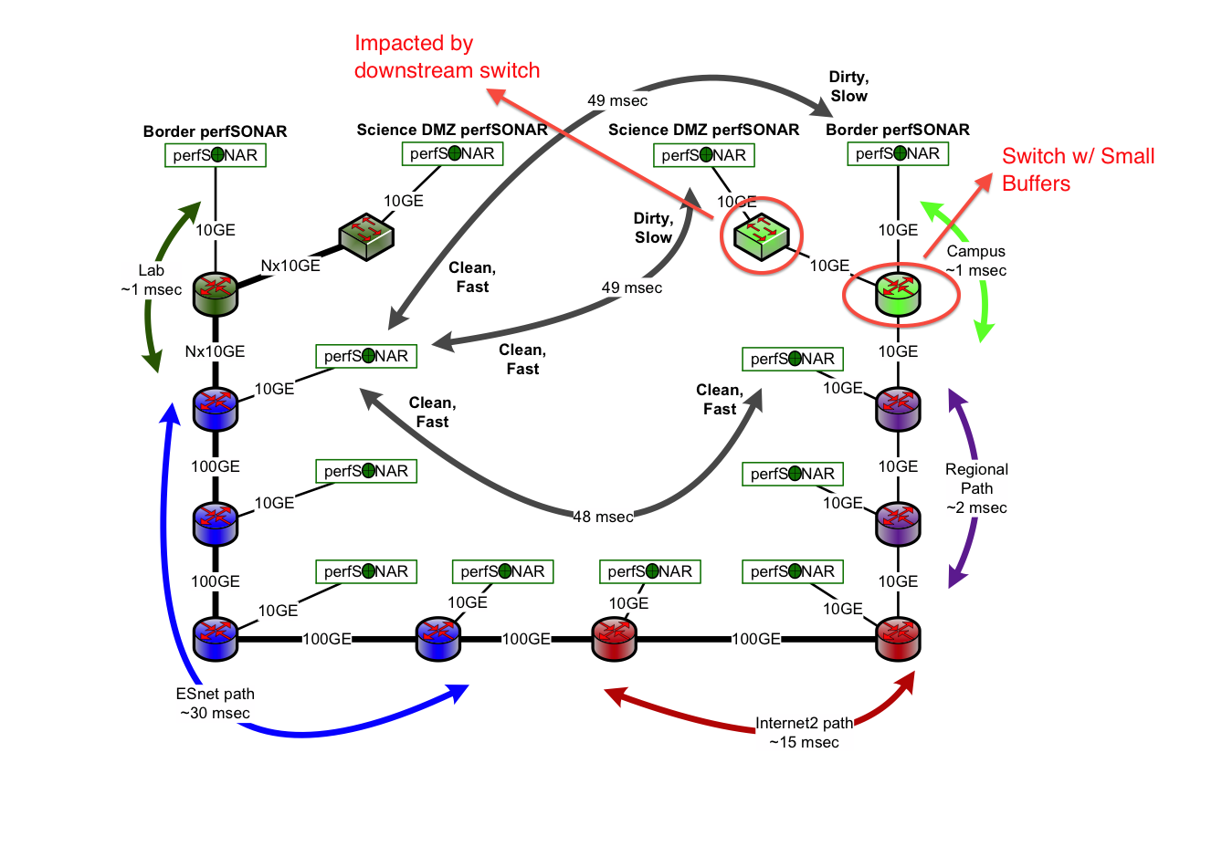
Likely Problem Area
Notes:
Test as much of the wide area path as you can – this gives the test similar TCP dynamics to the real traffic
From a single remote test host, using as much of the path as possible, run the longest clean test you can and the shortest dirty test you can that includes the path of the long clean test.

Slide 23

Lessons From This Example
This testing can be done quickly if perfSONAR is already deployed
Huge productivity
Reasonable hypothesis developed quickly
Probable administrative domain identified
Testing time can be short – an hour or so at most
Without perfSONAR cases like this are very challenging
Time to resolution measured in months
In order to be useful for data-intensive science, the network must be fixable quickly, because it will break
Notes:
Work with your providers/regional partners to deploy pS devices to make more testing to better segment the network. Become ambassadors for the community and help to answer “Why should I install a black/hacakable box in my network?”

Slide 24
BWCTL 3rd Party
bwctl –f m –t 10 –i 1 –c 172.31.5.21 –s 172.31.15.21
From a host that has a BWCTL client, I can launch a test to two “other” hosts.
Negotiation on timeslots and test parameters occurs between the 3 parties
Results are returned to the host that initiated the test
Why do we need this?
Helps to debug our problem space. I can sit on an ESnet host and launch a test from any of the above
Notes:
This is incredibly useful for doing testing.

Slide 25
Advanced Topics
The TCP protocol hides performance details from the user
Unless the Kernel is instrumented with Web100/Web10G, getting a per flow record of occurrences such as retransmissions and timeouts is not readily available
There are two methods to learn more about the TCP stream of an application:
Application Instrumentation – internal record keeping
Passive Observation – from external applications
© 2015, http://www.perfsonar.net
25

Slide 26
Advanced Topics
Goals:
Record of key metrics related to TCP
Convert into statistics about a flow (e.g. count of packet types, time spent in sending vs stalled state, etc.)
Graphical representation to illustrate performance over time
Aid in debugging end to end behaviors of a target use/application
Tools:
TCPDump
TCPTrace
XPLot
© 2015, http://www.perfsonar.net
26
Notes:
Note = this is all hard to explain, so treat it as ‘do it on your own’ if you are not comfortable with it

Slide 27
TCPDump
Application designed to capture packets (headers normally, or with certain options entire data streams)
Designed to run on a target interface, with an expression that matches a specific pattern:
E.g. capture all traffic on interface eth0 destined for subnet 192.168.1.0/24
or capture all traffic destined for port 5001
Goal is to capture all behavior
Can isolate specific flows to a src/dst pair
Can isolate specific applications if they are using specific port profiles
© 2015, http://www.perfsonar.net
27
Notes:
Note – you need root to do this

Slide 28
TCPDump
Note: Will require interface to enter ‘promiscuous’ mode.
SELinux may not like this
Firewall/IDS on machine may not like it either
Typically need to be root.
Common Options:
-A: ASCII output of packets (good if you are inspecting data contents)
-c: Exit after ‘c’ packets (rather than waiting for SIGTERM)
-I $INTERFACE: Specific interface to listen on (vs entire machine)
© 2015, http://www.perfsonar.net
28
Notes:
Note – you need root to do this

Slide 29
TCPDump
Common Options (cont.):
-n: Don’t convert addresses to names (e.g. useful if you want to see raw IPv4, IPv6 addresses, and ports)
-w $FILE: Write output to $FILE instead of STDOUT. You will want to use this option if you plan to process the packets through TCPTrace
-x: Print packet data (in HEX). Add another to see link layer header.
-X: Print packet data (in HEX and ASCII). Add another to see link layer header.
A note about high-performance packet capture
For performance debugging, you usually only need the headers
We use the snapshot length to reduce the portion of the packet we write to disk
-s 96 (or even –s 84) can be helpful (remember, perfSONAR hosts don’t usually have DTN disk subsystems!)
Make sure tcpdump says “0 packets dropped by kernel” when you are done
If for some reason your host isn’t using PF_RING (this is a linux-ism) then get a more up to date libpcap (look for this if it’s just impossible to write packet headers to disk without loss)
© 2015, http://www.perfsonar.net
29
Notes:
Note – you need root to do this

Slide 30
TCPDump
Invocation:
sudo tcpdump –i eth0 192.168.0.1
or
sudo tcpdump –i eth0 host 192.168.0.1
Capture traffic from specific host (incoming and outgoing) on target interface.
sudo tcpdump –i eth0 net 192.168.0
Capture traffic from /24 subnet (incoming and outgoing) on target interface.
sudo tcpdump –i eth0 port 5001
Capture traffic from specific port (incoming and outgoing) on target interface.
sudo tcpdump –i eth0 portrange 100-200
Capture traffic from specific ports (incoming and outgoing) on target interface.
© 2015, http://www.perfsonar.net
30
Notes:
Note – you need root to do this

Slide 31
TCPDump
Invocation (cont.):
sudo tcpdump –i eth0 src 192.168.0.1
Capture traffic where host is the src, on specific interface
sudo tcpdump –i eth0 dst net 192.168.0
Capture traffic where /24 subnet is the dst, on specific interface
sudo tcpdump –i eth0 src or dst port 5001
Capture traffic where port 5001 is the destination, on specific interface
sudo tcpdump –i eth0 tcp port 5001
Capture traffic where port 5001 is used for TCP protocol only, on specific interface
Read man pages for more information
© 2015, http://www.perfsonar.net
31
Notes:
Note – you need root to do this

Slide 32
TCPTrace
TCPDump captures packets according to specific filters, TCPTrace will analyze the gathered data
Processes entire dump file
Splits contents into specific flows (e.g. specific src/dst/port pairs based on dump contents). Multiple flows per file is possible
Outputs statistics
Produces XPlot ready graphs
Goal is to organize the haphazard nature of a dump file into specific interactions
packets arrive in pseudo-order for a given flow, multiple flows in the same file may interleave
Track individual operations (e.g. sending packets in a TCP window, tracking timers, retransmissions, duplicate ACKs, etc.)
© 2015, http://www.perfsonar.net
32

Slide 33
TCPTrace
Common Options:
-b: Brief output
-l: Long Output (suggested)
-W: Report on congestion window
-G: Output all graphs (recommended, although the TSG and TLine are the most commonly used)
© 2015, http://www.perfsonar.net
33

Slide 34
TCPTrace
Invocation:
tcptrace –lW ~/iperf.dmp
Output long analysis with congestion window information for target dump file
tcptrace –G ~/iperf.dmp
Generate all graphs for target dump file
Note there are a couple of graph types:
Time Sequence Graph (TSG)
Throughput Graph (TPUT)
RTT Graph (RTT)
Outstanding Data Graph (OWIN)
Segment Size Graph (SSIZE)
Time-Line Graph (TLINE)
http://www.tcptrace.org/manual/index.html
Read man pages for more information
© 2015, http://www.perfsonar.net
34

Slide 35
XPlot
Visualization tool for plotting complex data sets.
Supports multiple plots on a single graph
Color or mono options
Simple interface to allow click/drag zooming over interesting regions.
Invocation:
xplot graph.xpl
Display graph generated from tcptrace (‘-G option over target dumpfile’).
The TSG (Time Series Graph) is the most useful to see events over time
xplot -y ’yrange’ graph1.xpl graph2.xpl
Open 2 graphs, use a common ‘y’ axis (assists with seeing a relative slope for ‘throughput’
Read man pages for more information
© 2015, http://www.perfsonar.net
35
Notes:
Typically you do this on your host – and not the server. XPLOT installs for MacOX via macports

Slide 36
Example Use Case
Select 2 Hosts
Run “iperf” server on the first, client on the second
Run “tcpdump” on the client side or server side (its often good to do both, and compare)
Stop “tcpdump” after iperf session has completed
Run “tcptrace -G dumpfile.dmp” over the collected “tcpdump” data
Use “xplot” to view TSG (Time Series Graph) and TLine (Time Line Graph)
© 2015, http://www.perfsonar.net
36

Slide 37
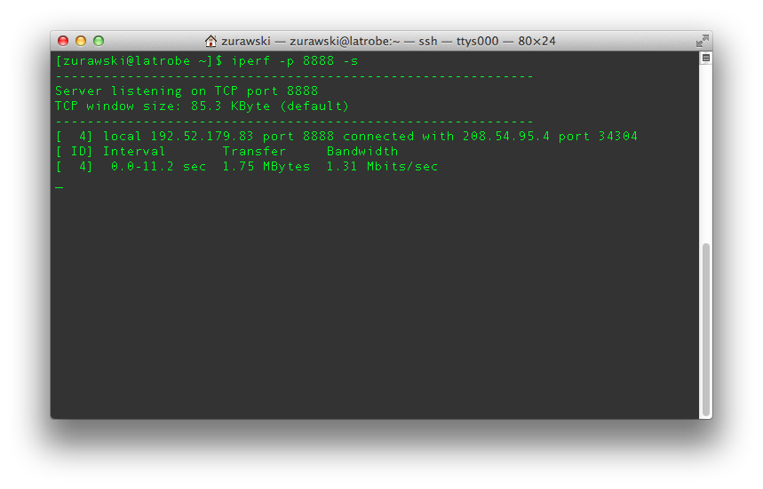
Example Use Case
© 2015, http://www.perfsonar.net
37

Slide 38
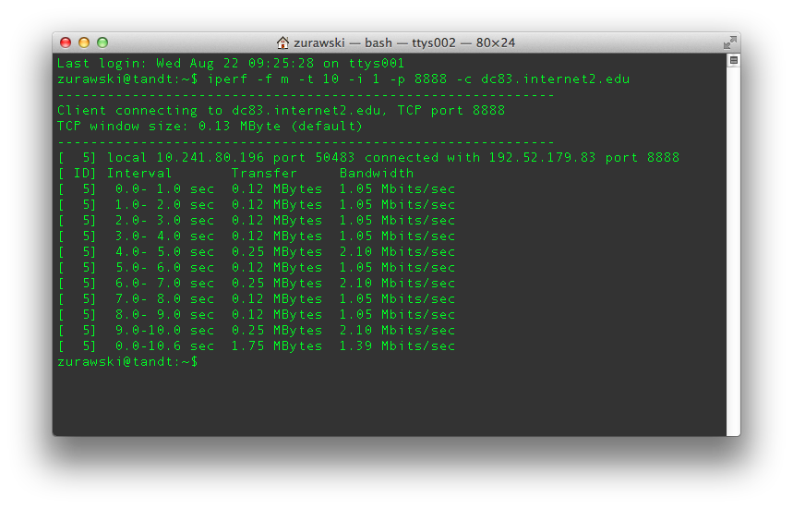
Example Use Case
© 2015, http://www.perfsonar.net
38

Slide 39
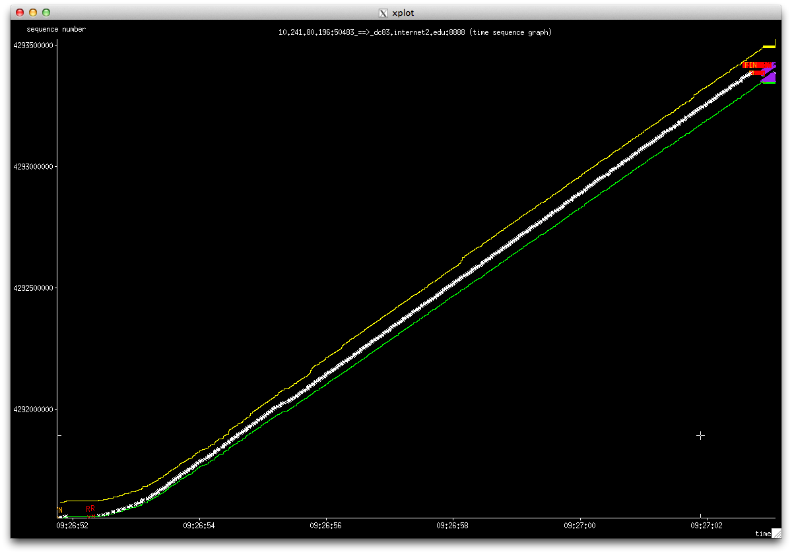
Example Use Case
© 2015, http://www.perfsonar.net
39

Slide 40
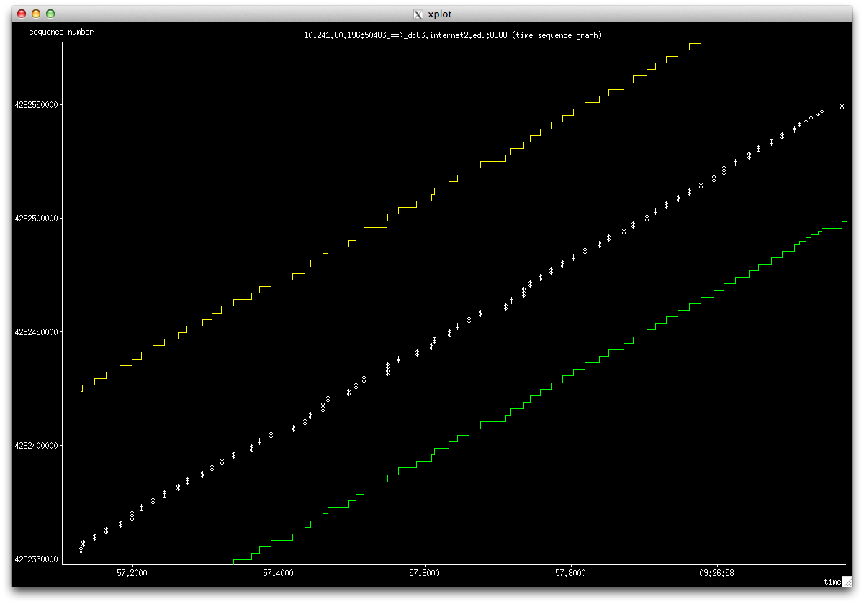
Example Use Case
© 2015, http://www.perfsonar.net
40

Slide 41
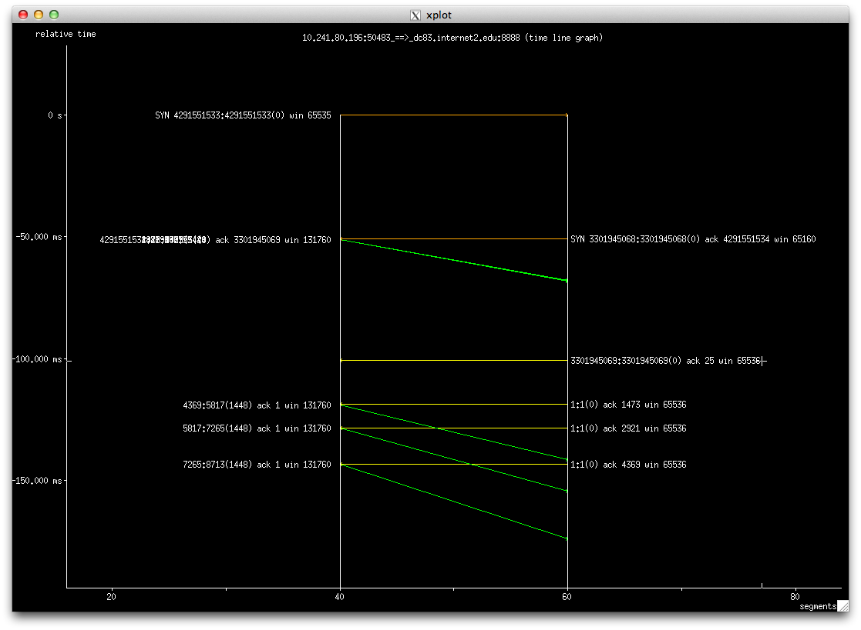
Example Use Case
© 2015, http://www.perfsonar.net
September 8, 2015
41

Slide 42
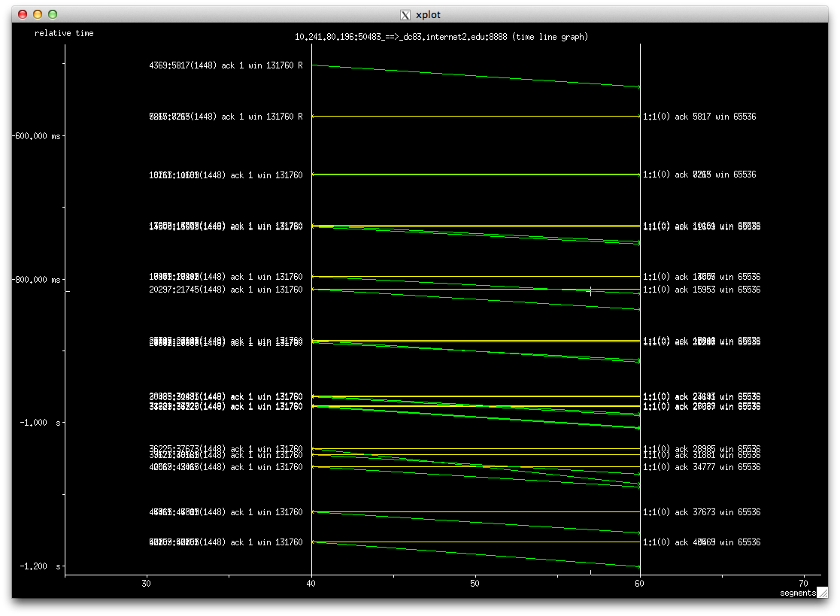
Example Use Case
© 2015, http://www.perfsonar.net
42

Slide 43
Experimentation
2 Situations to simulate:
“Outbound” Bypassing Firewall
Firewall will normally not impact traffic leaving the domain. Will pass through device, but should not be inspected
“Inbound” Through Firewall
Statefull firewall process:
Inspect packet header
If on cleared list, send to output queue for switch/router processing
If not on cleared list, inspect and make decision
If cleared, send to switch/router processing.
If rejected, drop packet and blacklist interactions as needed.
Process slows down all traffic, even those that match a white list
© 2015, http://www.perfsonar.net
43

Slide 44
Server Side (Outbound)
Run “nuttcp” server:
nuttcp -S -p 10200 --nofork
© 2015, http://www.perfsonar.net
44

Slide 45
Client Side (Outbound)
Start “tcpdump” on interface (note – isolate traffic to server’s IP Address/Port as needed):
sudo tcpdump -i eth1 -w nuttcp1.dmp net 64.57.17.66
tcpdump: listening on eth1, link-type EN10MB (Ethernet), capture size 96 bytes
Run “nuttcp” client:
nuttcp -T 10 -i 1 -p 10200 bwctl.newy.net.internet2.edu
92.3750 MB / 1.00 sec = 774.3069 Mbps 0 retrans
111.8750 MB / 1.00 sec = 938.2879 Mbps 0 retrans
111.8750 MB / 1.00 sec = 938.3019 Mbps 0 retrans
111.7500 MB / 1.00 sec = 938.1606 Mbps 0 retrans
111.8750 MB / 1.00 sec = 938.3198 Mbps 0 retrans
111.8750 MB / 1.00 sec = 938.2653 Mbps 0 retrans
111.8750 MB / 1.00 sec = 938.1931 Mbps 0 retrans
111.9375 MB / 1.00 sec = 938.4808 Mbps 0 retrans
111.6875 MB / 1.00 sec = 937.6941 Mbps 0 retrans
111.8750 MB / 1.00 sec = 938.3610 Mbps 0 retrans
1107.9867 MB / 10.13 sec = 917.2914 Mbps 13 %TX 11 %RX 0 retrans 8.38 msRTT
Complete “tcpdump”:
974685 packets captured
978481 packets received by filter
3795 packets dropped by kernel*
* Older versions of TCPdump have buffer problems, drops occur at high rates
© 2015, http://www.perfsonar.net
45

Slide 46
Analysis (Outbound)
Perform “tcptrace” analyses:
tcptrace -l nuttcp1.dmp
1 arg remaining, starting with 'nuttcp1.dmp'
Ostermann's tcptrace -- version 6.6.7 -- Thu Nov 4, 2004
974685 packets seen, 974685 TCP packets traced
elapsed wallclock time: 0:00:00.622323, 1566204 pkts/sec analyzed
trace file elapsed time: 0:00:10.215806
TCP connection info:
2 TCP connections traced:
Perform “tcptrace” graph generation:
tcptrace -G nuttcp1.dmp
1 arg remaining, starting with 'nuttcp1.dmp'
Ostermann's tcptrace -- version 6.6.7 -- Thu Nov 4, 2004
974685 packets seen, 974685 TCP packets traced
elapsed wallclock time: 0:00:33.083618, 29461 pkts/sec analyzed
trace file elapsed time: 0:00:10.215806
TCP connection info:
1: perfsonar.hep.brown.edu:47617 - nms-rthr2.newy32aoa.net.internet2.edu:5000 (a2b) 18> 17< (complete)
2: perfsonar.hep.brown.edu:60349 - nms-rthr2.newy32aoa.net.internet2.edu:10200 (c2d) 845988> 128662< (complete)
© 2015, http://www.perfsonar.net
46

Slide 47
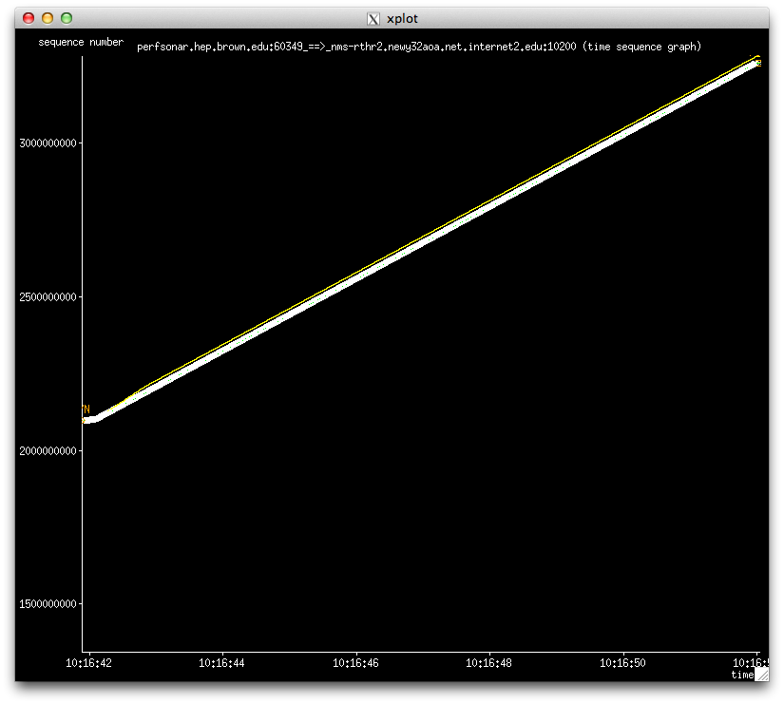
Plotting (Outbound)
© 2015, http://www.perfsonar.net
47

Slide 48
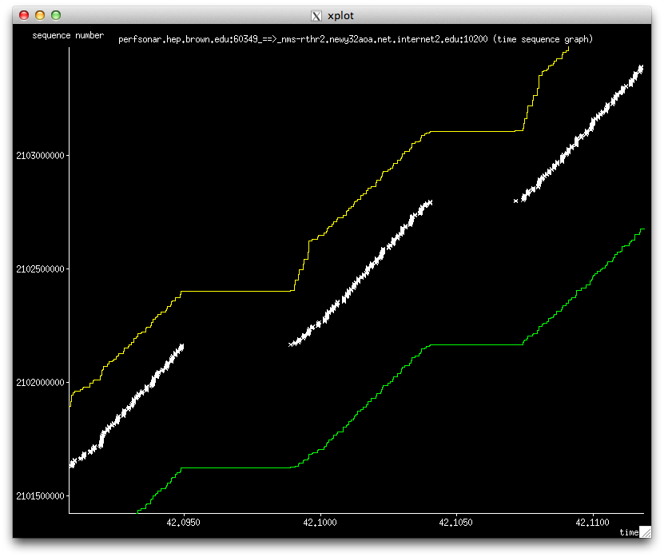
Plotting (Outbound)
© 2015, http://www.perfsonar.net
48

Slide 49
Server (Inbound)
Run “nuttcp” server:
nuttcp -S -p 10200 --nofork
© 2015, http://www.perfsonar.net
49

Slide 50
Client (Inbound)
Start “tcpdump” on interface (note – isolate traffic to server’s IP Address/Port as needed):
sudo tcpdump -i eth1 -w nuttcp2.dmp net 64.57.17.66
tcpdump: listening on eth1, link-type EN10MB (Ethernet), capture size 96 bytes
Run “nuttcp” client:
nuttcp -r -T 10 -i 1 -p 10200 bwctl.newy.net.internet2.edu
4.5625 MB / 1.00 sec = 38.1995 Mbps 13 retrans
4.8750 MB / 1.00 sec = 40.8956 Mbps 4 retrans
4.8750 MB / 1.00 sec = 40.8954 Mbps 6 retrans
6.4375 MB / 1.00 sec = 54.0024 Mbps 9 retrans
5.7500 MB / 1.00 sec = 48.2310 Mbps 8 retrans
5.8750 MB / 1.00 sec = 49.2880 Mbps 5 retrans
6.3125 MB / 1.00 sec = 52.9006 Mbps 3 retrans
5.3125 MB / 1.00 sec = 44.5653 Mbps 7 retrans
4.3125 MB / 1.00 sec = 36.2108 Mbps 7 retrans
5.1875 MB / 1.00 sec = 43.5186 Mbps 8 retrans
53.7519 MB / 10.07 sec = 44.7577 Mbps 0 %TX 1 %RX 70 retrans 8.29 msRTT
Complete “tcpdump”:
62681 packets captured
62683 packets received by filter
0 packets dropped by kernel
© 2015, http://www.perfsonar.net
50

Slide 51
Analysis (Inbound)
Perform “tcptrace” analyses:
tcptrace -l nuttcp2.dmp
1 arg remaining, starting with 'nuttcp2.dmp'
Ostermann's tcptrace -- version 6.6.7 -- Thu Nov 4, 2004
62681 packets seen, 62681 TCP packets traced
elapsed wallclock time: 0:00:00.126221, 496597 pkts/sec analyzed
trace file elapsed time: 0:00:10.188876
TCP connection info:
2 TCP connections traced:
Perform “tcptrace” graph generation:
tcptrace -G nuttcp2.dmp
1 arg remaining, starting with 'nuttcp2.dmp'
Ostermann's tcptrace -- version 6.6.7 -- Thu Nov 4, 2004
62681 packets seen, 62681 TCP packets traced
elapsed wallclock time: 0:00:02.285531, 27425 pkts/sec analyzed
trace file elapsed time: 0:00:10.188876
TCP connection info:
1: perfsonar.hep.brown.edu:50560 - nms-rthr2.newy32aoa.net.internet2.edu:5000 (a2b) 8> 7< (complete)
2: nms-rthr2.newy32aoa.net.internet2.edu:45075 - perfsonar.hep.brown.edu:10200 (c2d) 41205> 21461< (complete)
© 2015, http://www.perfsonar.net
51

Slide 52
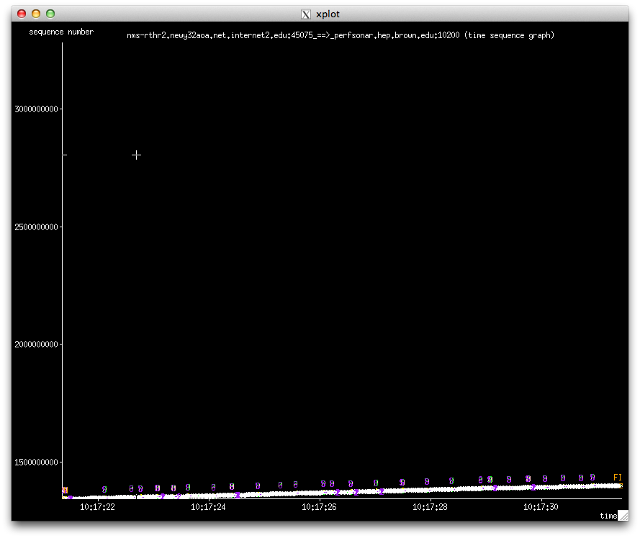
Plotting (Inbound)
© 2015, http://www.perfsonar.net
52

Slide 53
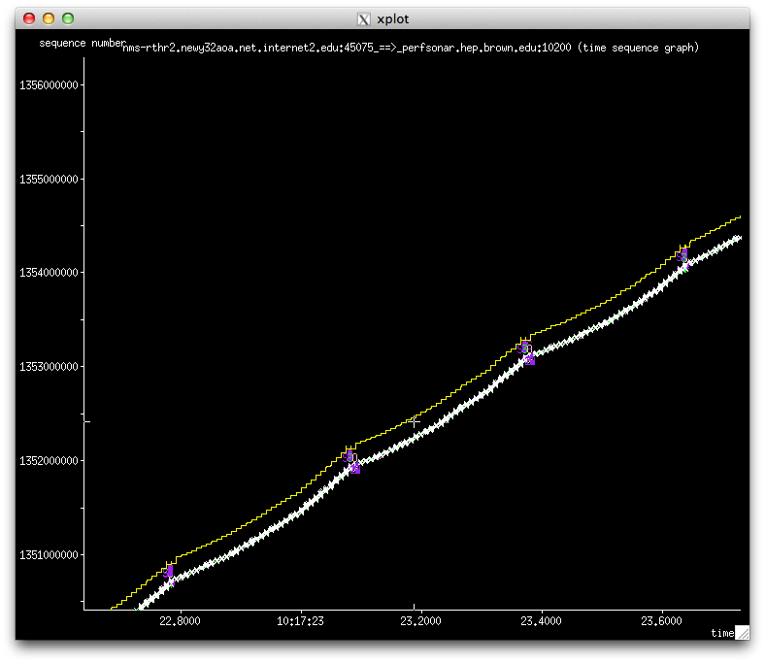
Plotting (Inbound)
© 2015, http://www.perfsonar.net
53

Slide 54
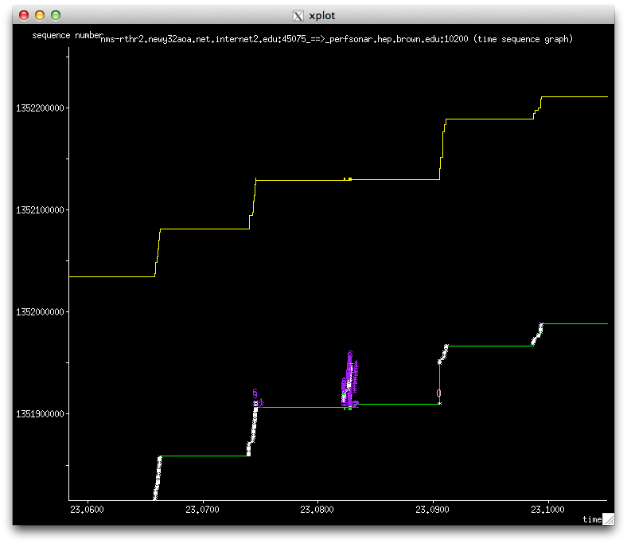
Plotting (Inbound)
© 2015, http://www.perfsonar.net
54

Slide 55
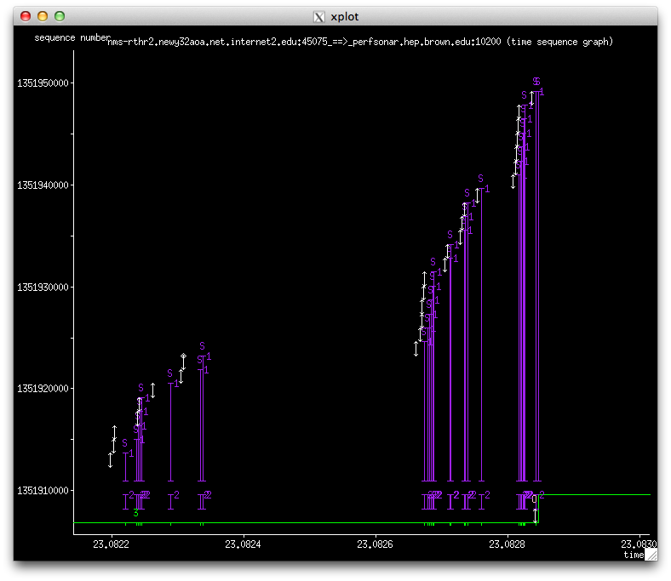
Plotting (Inbound – Zoomed)
© 2015, http://www.perfsonar.net
55

Slide 56
Slope = Throughput
© 2015, http://www.perfsonar.net
56

Slide 57
Conclusions
Lower level tools can help diagnose what the higher level tools are seeing
Low throughput is the result of all network problems when using TCP
OOP
Loss
Retransmissions/Timeouts
© 2015, http://www.perfsonar.net
57

Slide 58
Network Debugging Strategies
KENET Workshop
NSRC/IU
September 2015
This document is a result of work by the perfSONAR Project (http://www.perfsonar.net) and is licensed under CC BY-SA 4.0 (https://creativecommons.org/licenses/by-sa/4.0/).

