Slide 1
Regional Collaboration
Event
Presenter, Organization, Email
Date
This document is a result of work by the perfSONAR Project (http://www.perfsonar.net) and is licensed under CC BY-SA 4.0 (https://creativecommons.org/licenses/by-sa/4.0/).

Slide 2
Outline
Review of the CI Landscape
Good behavior cannot be localized
The role of the regional operator
Possible outcomes
Suggested Approach

Slide 3
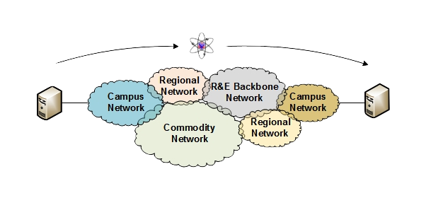
Review of the CI Landscape
The interconnections (at a high level) are well known on networks.
Campuses maintain their LAN, and connect to a regional provider, commodity provider, or perhaps to Internet2 directly
Regional networks peer with other regional networks, Internet2, ESnet, and commodity providers
National backbones peer with each other, and meet at exchange points for other connectivity options
Notes:
All of this is ‘hard’ becase we have to run across networks we don’t always control

Slide 4
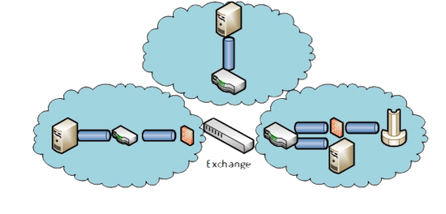
Review of the CI Landscape
There is a lot of autonomy on the details of how all these things works – conceptually its all a network.
Some may use Layer 2 primarily, others Layer 3
Some connections are bigger than others, some more numerous
Firewalls and protection devices may hide in plain sight
With everyone operating their own independent kingdom, we are all bound by protocols such as BGP and TCP to make sure it all ‘works’.
Performance is not a requirement for BGP, or TCP
Ensuring things are working is easy
Ensuring things are working well is challenging
Notes:
Everyone has a different idea of what their network looks like – and that adds to the complications

Slide 5
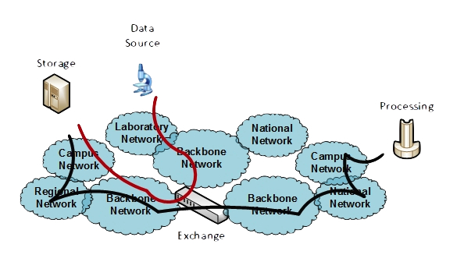
Review of the CI Landscape
It can be challenging to review every single use case for every single user.
Really, things should just plug in and work, right?
As a network engineer, do we know (or care) that the below behavior happens 100s of times per day? Sometimes successfully, sometimes not?
Notes:
Paths vary – still why we need monitoring available everywhere.

Slide 6
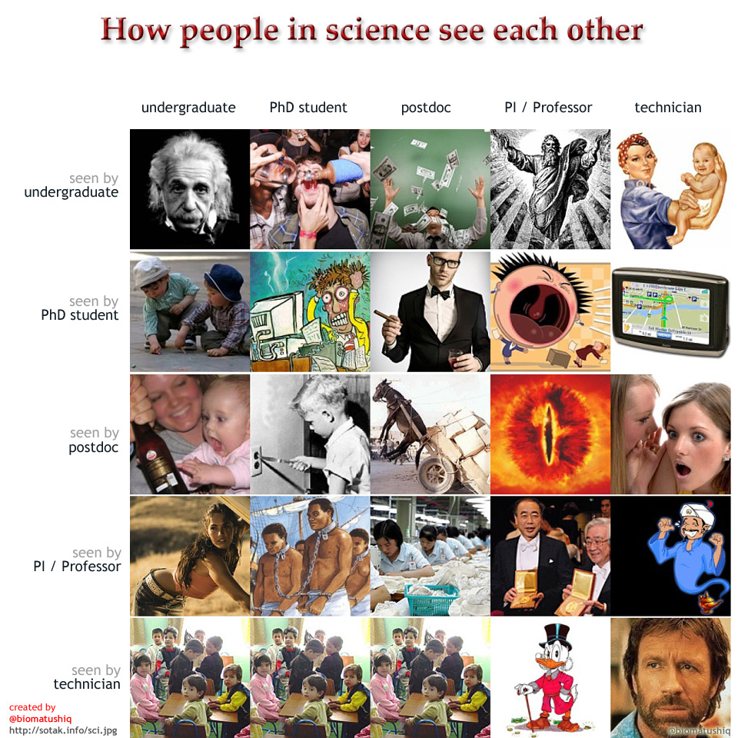
Review of the CI Landscape
The not being successful part is troubling
A campus can be viewed as a set of customers – each with a world view
We want to do right by all of them, where can we start?
First and foremost – we need a mechanism in place to debug things that go wrong.

Slide 7
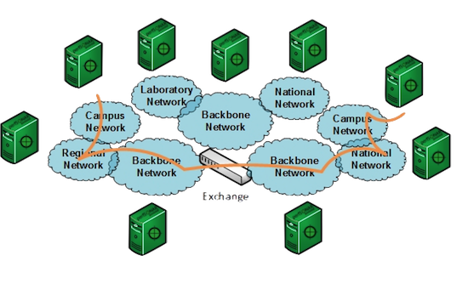
Review of the CI Landscape
To get us closer to this – its going to require the assistance of all levels
Regional networks are critical to this process – and have visibility into the last mile connectivity for universities more than a backbone can.

Slide 8
Outline
Review of the CI Landscape
Good behavior cannot be localized
The role of the regional operator
Possible outcomes
Suggested Approach

Slide 9
Good Behavior cannot be localized
Lets say that some campus spends a lot of time on their new CC-NIE grant – they design a pretty rocking network that meets the needs of all of their campus customers
What happens when a campus DTN user tries to move some data from Swampwater Tech – where her oldest and most trusted collaborator is storing 40PB of frog DNA?
Notes:
Example – you can do your network right, it doesn’t matter when you need to pull things out of something that doesn’t work right.

Slide 10
Good Behavior cannot be localized
Lets say the frog data lives here – on the Swampwater Tech campus (specifically the cluster in the lower left).
What do we think is going to happen?
1Gbps bottleneck
Local congestion
Possible firewall
Prediction:
Pain
Suffering
Use of portable media seems likely
Do we have any recourse?

Slide 11
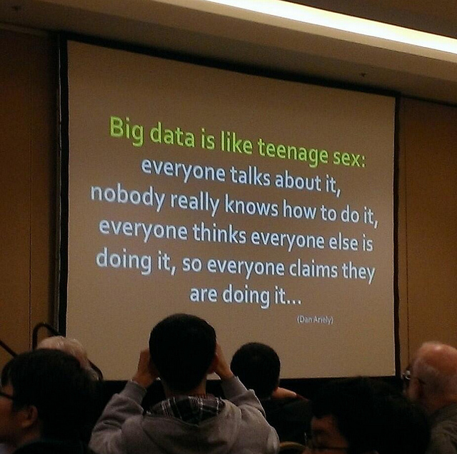
Good Behavior cannot be localized
Investments in CI technology are a good thing – no one will dispute that
The broken networks of others will harm the progress of the prepared
perfSONAR won’t fix all of these networks – but it is a way to tell (quickly) if the problem is:
Related to the network, or some other factor (app choice, host tuning)
Reproducible over time
Localized to a specific location, or a larger area
The regional networks, working with campuses, as well as national providers, are a part of this.
Deployment of perfSONAR as a service to users
Coordinating efforts to measure results a priori
Serving as the task master for making sure things can be fixed

Slide 12
Outline
Review of the CI Landscape
Good behavior cannot be localized
The role of the regional operator
Possible outcomes
Suggested Approach

Slide 13
The Role of Regionals
Lead by Example
CC-NIE encouraged the construction of a Campus CI plan. Regionals that applied were told to make a Regional CI plan. Some are stored here: https://fasterdata.es.net/campusCIplanning/
If the regional *doesn’t have one*, they should make one before their next annual meeting.
How does one do this – ask all your constituents to contribute *their* CI plans
This becomes an exercise that all are a part of, and all feel ownership of
Take charge when it comes to knowing the traffic profiles – use netflow to learn more about what is going on. See periodic flows from A to B, ask what they are doing?
Partnerships and relationships matter – someone is more likely to tell you if something is wrong if they know you, and if you are checking on them
Suffering in silence is common – break the mold
Notes:
This is all a suggestion – it may not work this way.

Slide 14
The Role of Regionals
Technology Leader
If you haven’t deployed perfSONAR, what are you waiting for? If you don’t do it, why would a campus you serve feel they need to? In the reverse direction, will a campus feel you are supporting them if you don’t have a server available to detect problems?
In addition to making perfSONAR available, be a leader when it comes to tracking status:
Set up a maddash (http://software.es.net/maddash/) instance as a service for your customers.
http://ps-dashboard.es.net
There is some initial pain – getting it set up and getting it configured. Then the pain of seeing that people are in fact suffering
A dedicated person helps with this – a ‘Regional Champion’
Notes:
This is all a suggestion – it may not work this way.

Slide 15
Outline
Review of the CI Landscape
Good behavior cannot be localized
The role of the regional operator
Possible outcomes
Suggested Approach

Slide 16
Possible Outcomes
Understanding and characterizing performance is important because it improves the network for everyone
Getting a functional dashboard makes the record of performance public and accountable
Just by setting things up, problems will be discovered and fixed
That router with small buffers
That failing optic
That congestion between the HPC facility and the border
When people can visualize what is going on, a sense of competition can develop
Making the network better – perhaps by upgrading capacity, perhaps with a Science DMZ
Science outcomes are improved across the board.
We can move the frog DNA because perfSONAR tells us the network is clean. We learn more about frogs, or cure cancer
Notes:
This is all a suggestion – it may not work this way.

Slide 17
Outline
Review of the CI Landscape
Good behavior cannot be localized
The role of the regional operator
Possible outcomes
Suggested Approach

Slide 18
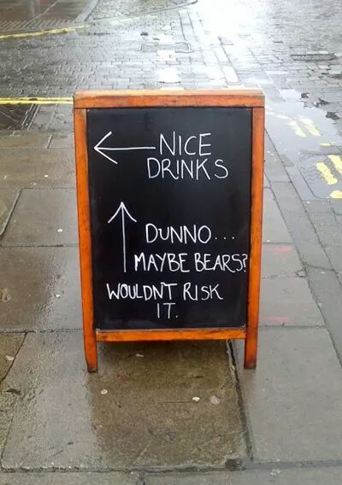
Suggested Path Forward
This is not an ordered list, but rather a list of suggestions that will get us all into the category of success:
Investment in infrastructure
Servers are not expensive, and they will be used
For those that can afford to, donate resources to those that otherwise wouldn’t or couldn’t afford the cost
Pay the initial pain tax on configuration, establish baselines
Cultivate a culture of urgency
Someone needs to ‘own’ the project, a person with a name and contact address.
Regular meetings to build relationships
Fix problems as they happen, and don’t hope they will go away
Encourage participation
Everyone in a region has ownership of a resource like a community dashboard. Let them be a part of the configuration and debugging
Force change
When problems are discovered with customers – offer constructive ways to fix
When problems are discovered further downstream, be vocal in making sure someone addresses them
Notes:
This is all a suggestion – it may not work this way.

Slide 19
Regional Collaboration
Event
Presenter, Organization, Email
Date
This document is a result of work by the perfSONAR Project (http://www.perfsonar.net) and is licensed under CC BY-SA 4.0 (https://creativecommons.org/licenses/by-sa/4.0/).

