Slide 1
perfSONAR Host Hardware
Event
Presenter, Organization, Email
Date
This document is a result of work by the perfSONAR Project (http://www.perfsonar.net) and is licensed under CC BY-SA 4.0 (https://creativecommons.org/licenses/by-sa/4.0/).

Slide 2
Outline
Introduction – What are we Measuring?
Use Cases
Hardware Selection
Virtualization
Host Configuration Successes and Failures
Inexpensive Nodes

Slide 3
Introduction
perfSONAR is a tool to measure “end-to-end” network performance. What does this imply:
End-to-end: the entire network path between perfSONAR Hosts
Applications Software
Operating System
Host Hardware
@ Each Hop: transition between OSI Layers in routing/switching devices (e.g. Transport to Network Layer, etc.), buffering, processing speed
Flow through security devices
No easy way to separate out the individual components by default – the number the tool gives has them all combined

Slide 4
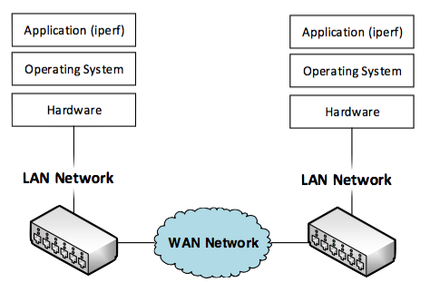
Initial End-to-End Network

Slide 5
Initial End-to-End Network
Src Host Delay:
Application writing to OS (kernel)
Kernel writing via memory to hardware
NIC writing to network
Dst Host Delay:
NIC receiving data
Kernel allocating space, sending to application
Application reading/acting on received data
Src LAN:
Buffering on ingress interface queues
Processing data for destination interface
Egress interface queuing
Transmission/Serialization to wire
Dst LAN:
Buffering on ingress interface queues
Processing data for destination interface
Egress interface queuing
Transmission/Serialization to wire
WAN:
Propagation delay for long spans
Ingress queuing/processing/egress queuing/serialization for each hop

Slide 6
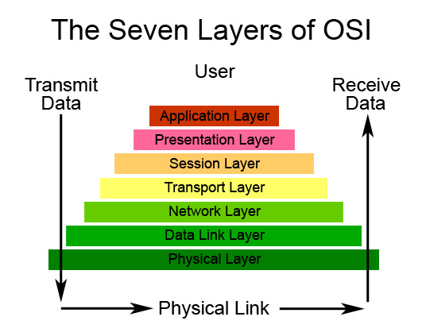
OSI Stack Reminder
The demarcation between each layer has an API (e.g. the ‘narrow waist’ of an hourglass)
Some layers are more well defined than others:
Within an application the job of presentation and session may be handled
The operating system handles TCP and IP, although these are separate libraries
Network/Data Link occur within network devices (Routers, Switches)

Slide 7
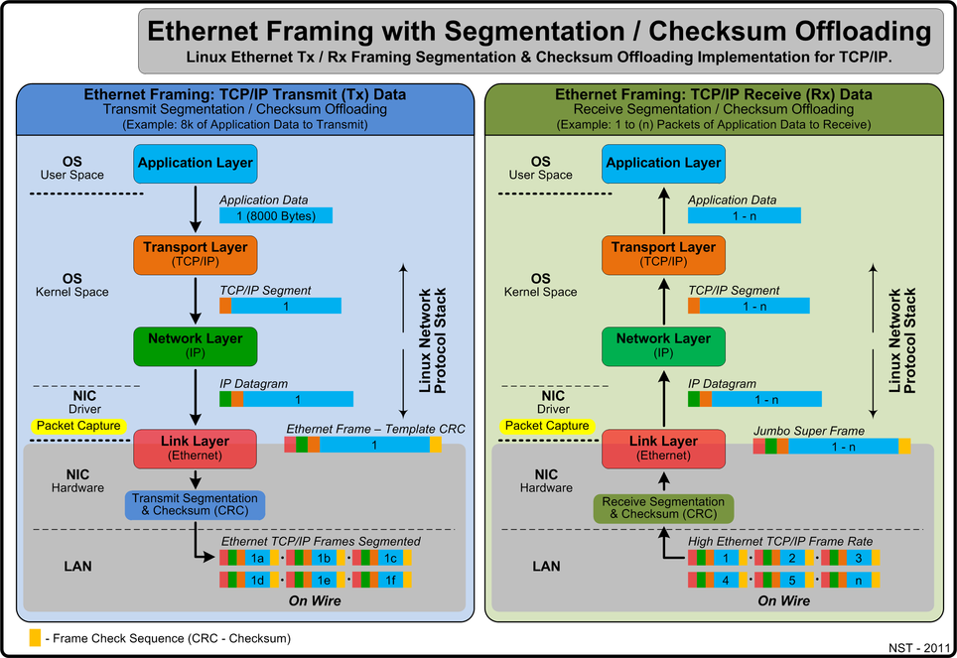
Host Breakout
Most applications are written in ‘user space’, e.g. special section of the OS that is jailed from ‘kernel space’.
Requests to use functions like the network are done by using system calls through an API (e.g. open a socket so I can communicate with a remote host)
The TCP/IP libraries are within the kernel, they receive the request and take care of the heavy lifting of converting the data from the application (e.g. a large chunk of memory) into individual packets for the network
The NIC will then encapsulate into Link layer protocol (e.g. ethernet frames) and send onto the wire for the next hop to deal with

Slide 8
Host Breakout
The receive side works similar – just in reverse
Frames come off of the network and into the NIC. The onboard processor will extract packets, and pass them to the kernel
The kernel will map the packets to the application that should be dealing with them
The application will receive the data via the API
Note – the TCP/IP libraries manage things like data control. The application only sees a socket, and knows that it will send in data, and it will make it to the other side. It is the job of the library to ensure reliable delivery

Slide 9
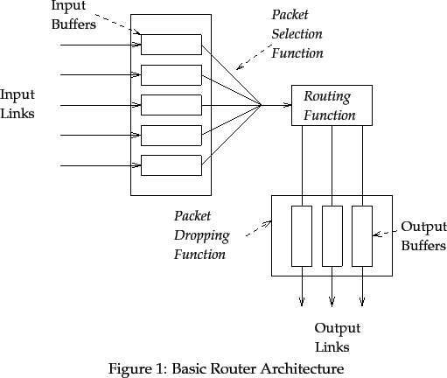
Network Device Breakout

Slide 10
Network Device Breakout
Data arrives from multiple sources
Buffers have a finite amount of memory
Some have this per interface
Others may have access to a shared memory region with other interfaces
The processing engine will:
Extract each packet/frame from the queues
Pull off header information to see where the destination should be
Move the packet/frame to the correct output queue
Additional delay is possible as the queues physically write the packet to the transport medium (e.g. optical interface, copper interface)

Slide 11
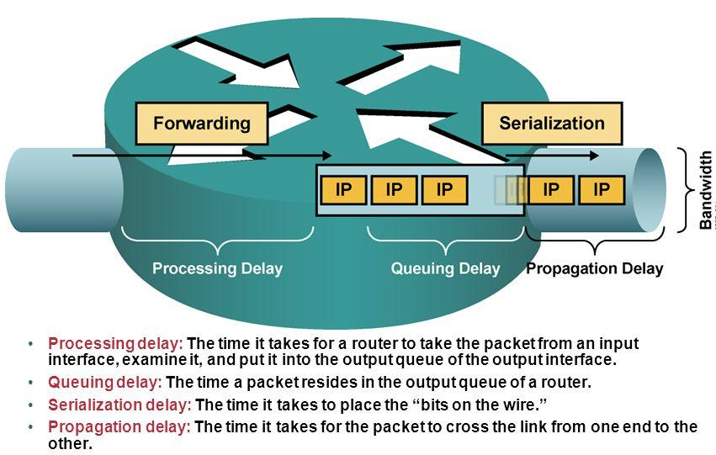
Network Device Breakout – Delays

Slide 12
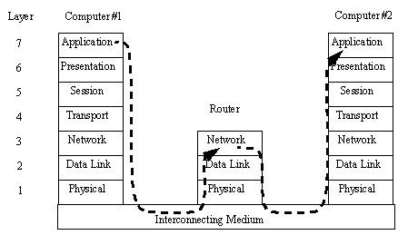
Network Devices & OSI
Not every device will care about every layer
Hosts understand them all via various libraries
Network devices only know up to a point:
‘Routers’ know up to the ‘Network Layer’. They will make the choice of sending to the next hop based on Network Layer headers. E.g. TCP information – IP addresses
‘Switches’ know up to the ‘Link Layer’. They will make the choice of sending to the next hop based on Link Layer headers. E.g. MAC addressing from the IP
Each hop has the hardware/software to pull of the encapsulated data to find what it needs

Slide 13
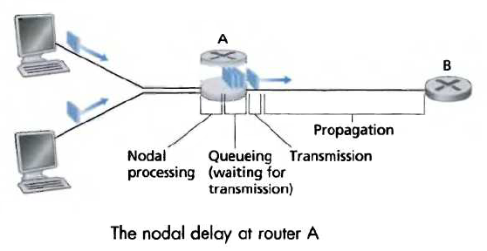
“End-to-End”
A network user interfaces with the network via a tool (data movement application, portal). They only get a single piece of feedback – how long the interaction takes
In reality – it’s a complex series of moves to get the data end to end, with limited visibility by default
Delays on the source host
Delays in the source LAN
Delays in the WAN
Delays in the destination LAN
Delays on the destination host

Slide 14
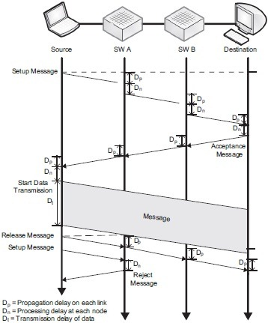
“End-to-End”
The only way to get visibility is to rely on instrumentation at the various layers:
Host level monitoring of key components (CPU, memory, network)
LAN/WAN level monitoring of individual network devices (utilization, drops/discards, errors)
End-to-end simulations
The later one is tricky – we want to ‘simulate’ what a user would see by having our own (well tuned) application tell us how it can do across the common network substrate

Slide 15
Dereferencing Individual Components
Host Performance
Software Tools – Ganglia, Host SNMP + Cacti/MRTG
Network Device Performance
SNMP/TL1 Passive Polling (e.g. interface counters, internal behavior)
Software Performance
??? This depends heavily on how well the software (e.g. operating system, application) is instrumented.
End-to-end
perfSONAR active tools (iperf, owamp, etc.)

Slide 16
Takeaways
Since we want “network” performance – we want to remove the host hardware/operating system/applications from the equation as much as possible
Things that we can do on our own, or that we get for free by using perfSONAR:
Host Hardware: Choosing hardware matters. There needs to be predictable interactions between system components (NIC, motherboard, memory, processors)
Operating System: perfSONAR features a tuned version of CentOS. This version eliminates extra software and has been modified to allow for high performance networking
Applications: perfSONAR applications are designed to make minimal system calls, and do not involve the disk subsystem. The performance they report is designed to be as low-impact on the host to achieve realistic network performance

Slide 17
Lets Talk about IPERF
Start with a definition:
network throughput is the rate of successful message delivery over a communication channel
Easier terms: how much data can I shovel into the network for some given amount of time
Things it includes: the operating system, the host hardware, and the entire netowork path
What does this tell us?
Opposite of utilization (e.g. its how much we can get at a given point in time, minus what is utilized)
Utilization and throughput added together are “capacity”
Tools that measure throughput are a simulation of a real work use case (e.g. how well could bulk data movement perform)

Slide 18
What IPERF Tells Us
Lets start by describing throughput, which is vague.
Capacity: link speed
Narrow Link: link with the lowest capacity along a path
Capacity of the end-to-end path = capacity of the narrow link
Utilized bandwidth: current traffic load
Available bandwidth: capacity – utilized bandwidth
Tight Link: link with the least available bandwidth in a path
Achievable bandwidth: includes protocol and host issues (e.g. BDP!)
All of this is “memory to memory”, e.g. we are not involving a spinning disk (more later)
45 Mbps
10 Mbps
100 Mbps
45 Mbps
source
sink
Narrow Link
(Shaded portion shows background traffic)
Tight Link
Notes:
Remember that BWCTL will only tell us the ‘results’ of the white part of the tight link – that is the constraining factor.

Slide 19
BWCTL Example (iperf3)
[zurawski@wash-pt1 ~]$ bwctl -T iperf3 -f m -t 10 -i 2 -c sunn-pt1.es.net
bwctl: 55 seconds until test results available
SENDER START
bwctl: run_tool: tester: iperf3
bwctl: run_tool: receiver: 198.129.254.58
bwctl: run_tool: sender: 198.124.238.34
bwctl: start_tool: 3598657653.219168
Test initialized
Running client
Connecting to host 198.129.254.58, port 5001
[ 17] local 198.124.238.34 port 34277 connected to 198.129.254.58 port 5001
[ ID] Interval Transfer Bandwidth Retransmits
[ 17] 0.00-2.00 sec 430 MBytes 1.80 Gbits/sec 2
[ 17] 2.00-4.00 sec 680 MBytes 2.85 Gbits/sec 0
[ 17] 4.00-6.00 sec 669 MBytes 2.80 Gbits/sec 0
[ 17] 6.00-8.00 sec 670 MBytes 2.81 Gbits/sec 0
[ 17] 8.00-10.00 sec 680 MBytes 2.85 Gbits/sec 0
[ ID] Interval Transfer Bandwidth Retransmits
Sent
[ 17] 0.00-10.00 sec 3.06 GBytes 2.62 Gbits/sec 2
Received
[ 17] 0.00-10.00 sec 3.06 GBytes 2.63 Gbits/sec
iperf Done.
bwctl: stop_tool: 3598657664.995604
SENDER END
N.B. This is what perfSONAR Graphs – the average of the complete test

Slide 20
Summary (so far)
We have established that our tools are designed to measure the network
For better or for worse the ‘network’ is also our host hardware, operating system, and application
To get the most accurate measurement, we need:
Hardware that performs well
Operating systems that perform well
Applications that perform well

Slide 21
Outline
Introduction – What are we Measuring?
Use Cases
Hardware Selection
Virtualization
Host Configuration Successes and Failures
Inexpensive Nodes

Slide 22
Use Cases
There are several deployment strategies for perfSONAR Hardware:
Bandwidth Only Testing
Latency Only Testing
Combined
Individual NIC for Bandwidth and Latency Testing
Shared NIC

Slide 23
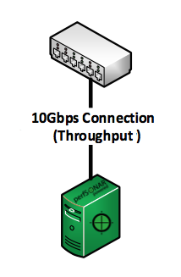
Bandwidth Use Case
The bandwidth host is designed to saturate a network to gain a measure of achievable throughout (e.g. how much information can be sent, given current end-to-end conditions)
Can test using TCP (will back off) or UDP (won’t back off) – the end result is still the same
Connectivity can be any size – typically you will want a host that matches the bottleneck of your network

Slide 24
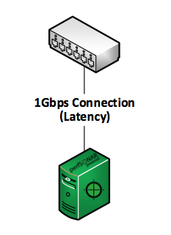
Latency Use Case
Tests are lightweight (e.g. smaller packets, less of them)
Designed to measure things like jitter (variation in arrival times of data), packet loss due to congestion, and the time it takes to travel from source to destination
Connection can be smaller – typically 100Mb or 1Gb connections will do fine. 10Gbps latency testing is not really necessary

Slide 25
Why Separate These?
Bandwidth testing is ‘heavy’ in that it is designed to fill the network as quickly as possible
E.g. the memory on the host, the queues on the NIC, the LAN, the WAN, etc.
Most throughput tests will cause loss, even if its temporal
Latency testing is ‘light’ in that it wants to know if there is something that is perturbing the network
Congestion from other sources, a failing interface, etc.

Slide 26
Why Separate These?
Because of the conflicting use case – running these at the same time is problematic
A heavy bandwidth test could cause loss in the latency testing.
This makes it challenging to figure out ‘where’ the loss is coming from; the host or the network
If operating two machines isn’t possible, it is desirable to run these on a single host. There are to ways to do this:
Dual NICs
Single NIC, with isolated testing

Slide 27
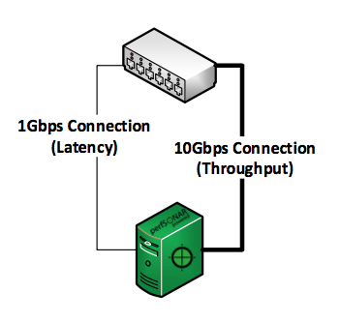
Dual NIC Testing Use Case
Newer releases of the perfSONAR software facilitate the use of two interfaces
Host-level routing manages the test traffic to each of the interfaces
Bottlenecks are still possible:
If the host has a single CPU managing both sets of test traffic
If there is a memory bottleneck
If the NICs do not have an offload engine, they both will need to rely on the CPU to manage traffic flow internally

Slide 28
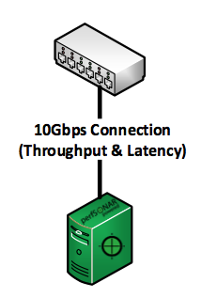
Single NIC/Dual Testing Use Case
If the host has a single NIC, tests can be configured to share access:
BWCTL and OWAMP tests will be mutually exclusive (they share a common scheduler)
This prevents OWAMP from working in the normal ‘streaming’ mode however, which will not pick up as many problems
The previous bottlenecks surrounding the NIC, CPU, and Memory are not as impactful (e.g. they will still be a problem, but impact both sets of tests equally, and one at at time)

Slide 29
Outline
Introduction – What are we Measuring?
Use Cases
Hardware Selection
Virtualization
Host Configuration Successes and Failures
Inexpensive Nodes

Slide 30
Hardware Selection
Selecting hardware to the job of measurement is not impossible
Optimize for the use case of “memory to memory” testing, e.g. we don’t care about the disk subsystem
Things that matter
CPU speed/number
Motherboard architecture
Memory availability
Peripheral interconnection
NIC card design + driver support

Slide 31
CPU/Motherboard/Memory
Motherboard/CPU
Intel Sandy Bridge or Ivy Bridge CPU architecture
Ivy Bridge is about 20% faster in practice
High clock rate better than high core count for measurement
Faster QPIC for communication between processors
Multi-processor is waste given that cores are more and more common
Motherboard/system possibilities:
SuperMicro motherboard X9DR3-F
Sample Dell Server (Poweredge r320-r720)
Sample HP Server (ProLiant DL380p gen8 High Performance model)
Memory speed – faster is better
We recommend at least 8GB of RAM for a test node (minimum to support the operating system and tools). More is better – especially for testing over larger distances and to multiple sites.

Slide 32
System Bus
PCI Gen 3 (full 40G requires PCI Gen 3, some 10G will require Gen 3 – mostly Gen 2)
PCI slots are defined by:
Slot width:
Physical card and form factor
Max number of lanes
Lane count:
Maximum bandwidth per lane
Most cards will run slower in a slower slot
Not all cards will use all lanes
Example:
10GE NICs require an 8 lane PCIe-2 slot
40G/QDR NICs require an 8 lane PCIe-3 slot
Most RAID controllers require an 8 lane PCIe-2 slot
A high-end Fusion-io card may require a 16 lane PCIe-3 slot

Slide 33
NIC
Driver support is key – if it doesn’t have a (recent) linux driver, avoid
There is a huge performance difference between cheap and expensive 10G NICs.
E.g. please don’t cheap out on the NIC or optics
If you have heard of the brand – it probably will do fine
NIC features to look for include:
support for interrupt coalescing
support for MSI-X
TCP Offload Engine (TOE)
Note that many 10G and 40G NICs come in dual ports, but that does not mean if you use both ports at the same time you get double the performance. Often the second port is meant to be used as a backup port.
Myricom 10G-PCIE2-8C2-2S
Mellanox MCX312A-XCBT

Slide 34
Outline
Introduction – What are we Measuring?
Use Cases
Hardware Selection
Virtualization
Host Configuration Successes and Failures
Inexpensive Nodes

Slide 35
Virtualization Introduction
Virtualization is the process of dividing up a physical resource into multiple logical units
Why would we want to do this?
Scale a larger server with lots of capacity to do a number of tasks
Separate functions into different logical contains (e.g. a windows server that runs one function, a linux server that runs another)
Reduce cooling/power cost by not requiring multiple servers

Slide 36
Virtualization Introduction
A Virtual Machine has two components:
Host: the physical server itself, having some number of resources (CPUs, memory, disks, network cards, etc.)
Guest: virtual “workloads” that are run by the host. These share the underlying resources
Virtualization Platform: VMware, Hyper-V, Citrix, XEN, etc.
Software abstraction between the hardware host, and the guests
Hypervisor: management/monitoring software that is used to look after the guest resources
Isolates functions
Creates a layer between the physical hardware and the guests – e.g. manages all of the interactions

Slide 37
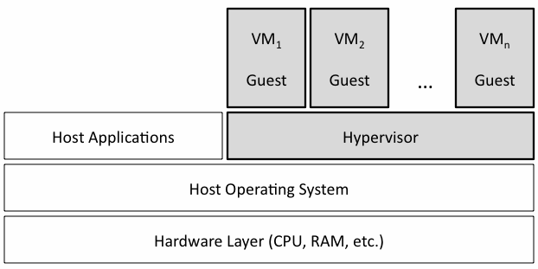
Virtualization Introduction

Slide 38
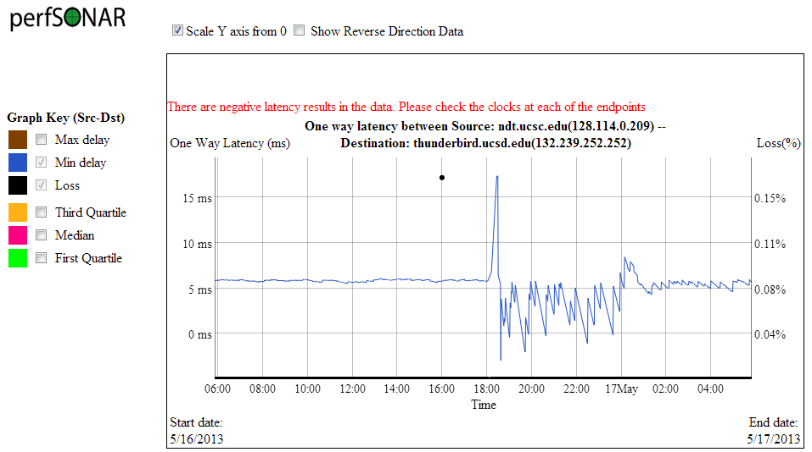
What Time is it?
Known complication: the ability to keep accurate time.
perfSONAR uses NTP (network time protocol) which is designed to keep time monotonically increasing
Slows a fast clock, skips ahead a slow clock. Never ‘reverses’ time
VM environments rely on the hypervisor to tell them what time is – this means time could skip forwards, or backwards.
IF NTP sees this, it turns off – this is normally catastrophic for measurement purposes (when do I start? When do I end?)
Picture on right – jitter observed after a hypervisor adjusted the clock.

Slide 39
Functionality Comparison
Pros:
Ability to have many ecosystems (Windows, FreeBSD, Linux, etc.) invoked through a standard management layer
Utilize resources ‘horizontally’ on the machine. E.g. most times a server sits idle if it has no task. By stacking multiple guest machines onto a single host, the probability of the resource being better utilized increases
Cons:
Limit is reached when machines require resources beyond what is available. Can ‘plan’ for this and design the system so its underutilized, or overprovision in the hopes that there will be no conflicts
Because this is a shared resource, it won’t do one job very well.

Slide 40
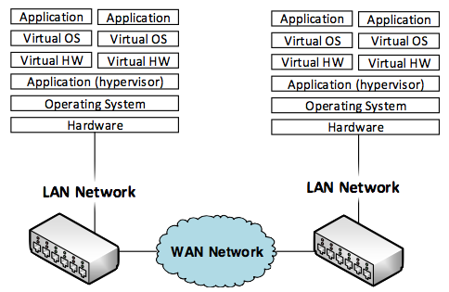
E2E Implications
By adding new layers into our original end to end drawing, we add more sources of delay:
Application delay will be the same – we would use iperf in either case
There are now 2 ‘operating’ system delays we must contend with.
Guest OS – the perfSONAR toolkit operating environment
Host OS – perhaps this is windows, perhaps its linux, etc. This is what touches the ‘real’ hardware.
There are now 2 sets of ‘hardware’
Guest Hardware – which is just an emulation of a processor, memory, and network card. The application makes calls to these, but they will get translated through the hypervisor into real system calls to the base hardware
Host hardware – same as before, but shared
We have an additional software layer (the hypervisor) that sits between the virtual and the real

Slide 41
Virtual End-to-End Network

Slide 42
Virtual End-to-End Network
VM Src Host Delay:
Application writing to VOS
VKernel writing via memory to VHardware
VNIC writing to hypervisor
VM Dst Host Delay:
VNIC receiving data from hypervisor
VKernel allocating space, sending to application
Application reading/acting on received data
Src Host Delay:
Hypervisor writing to OS
Kernel writing via memory to hardware
NIC writing to network
Dst Host Delay:
NIC receiving data
Kernel allocating space, sending to hypervisor
Hypervisor reading/acting on received data to a guest
Src LAN:
Buffering on ingress interface queues
Processing data for destination interface
Egress interface queuing
Transmission/Serialization to wire
Dst LAN:
Buffering on ingress interface queues
Processing data for destination interface
Egress interface queuing
Transmission/Serialization to wire
WAN:
Propagation delay for long spans
Ingress queuing/processing/egress queuing/serialization for each hop

Slide 43
Realities
New Sources of delay
The hypervisor is now managing traffic for a number of other hosts. Think of this as a software controlled ‘LAN’ – it is a switch (running on shared hardware) that must route traffic to the hosts, in addition to make sure none are starved for memory/compute resources
The VNIC on each guest can’t receive an entire hardware NIC to itself (unless there are many available, and allocated for private use)
The VCPU won’t receive an entire dedicated CPU unless configured to do so. If it can be bound, the handling of interrupts is still slower than on bare metal
If another guest is doing work and requesting resources at the same time as a network measurement – what happens?
Competing for a processor/core/memory – there will be a race condition and someone may get starved
The work of either machine will suffer - and this may happen a lot
Do you want your DNS server for the campus down, or the perfSONAR box? Also – you don’t usually get to make that choice, the hypervisor will.

Slide 44
Realities
Reaction of tools
Recall that iperf/owamp etc. don’t know what’s in the middle; they are designed to test, and report some numbers.
The addition of new delays (e.g. due to queuing/processing of data between the guest, hypervisor, and host operating system) is not negligible. It can be easily witnessed and this propagates into the measurements
Recourse?
Dedicating specific resources to the guests
Running less guests on a host to ensure higher levels of performance
Both of these defeat the purpose of a virtual environment of course – e.g. sharing resources

Slide 45
Outline
Introduction – What are we Measuring?
Use Cases
Hardware Selection
Virtualization
Host Configuration Successes and Failures
Inexpensive Nodes

Slide 46
Examples of Hardware Performance
The following examples will demonstrate:
The role of host tuning
Testing against hosts with different sized capacity
Hosts that are of a different hardware lineage, and the impact on performance
Comparison of virtual and real machine performance

Slide 47
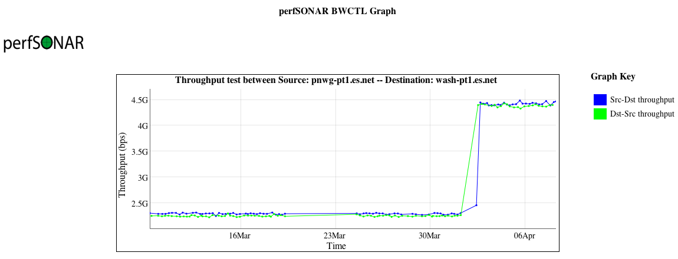
Host Tuning of TCP Settings
Long path (~70ms), single stream TCP, 10G cards, tuned hosts
Why the nearly 2x uptick? Adjusted net.ipv4.tcp_rmem/wmem maximums (used in auto tuning) to 64M instead of 16M.
As the path length/throughput expectation increases, this is a good idea. There are limits (e.g. beware of buffer bloat on short RTTs)
Notes:
Better view of increasing the max window size

Slide 48
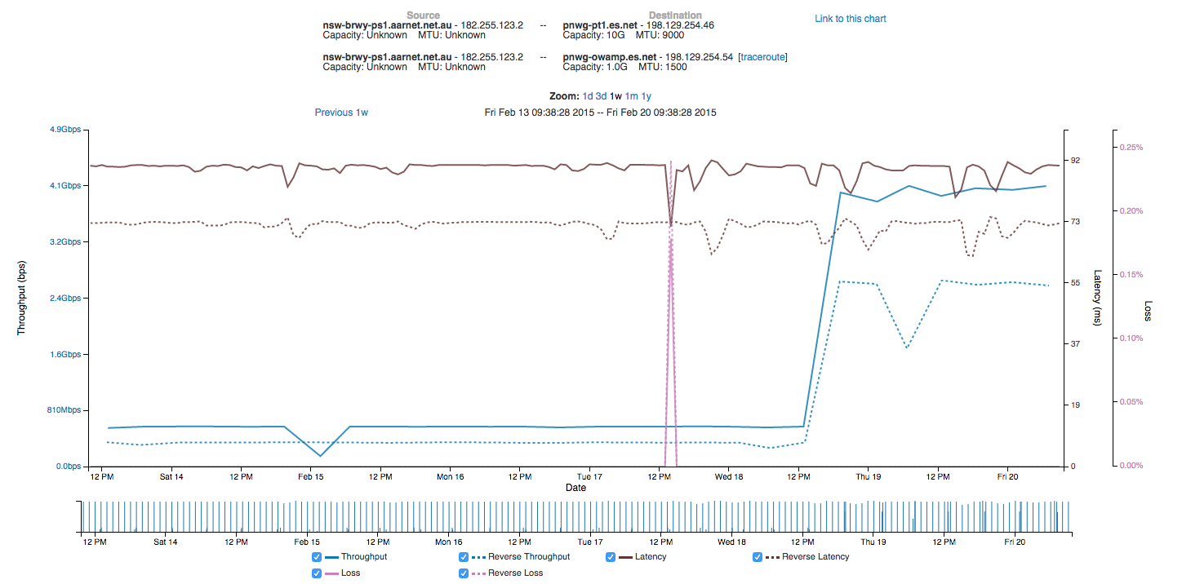
Host Tuning of TCP Settings (Long RTT)
Notes:
Normal, 9000 MTU, and increased window. This is what all science hosts need to have applied

Slide 49
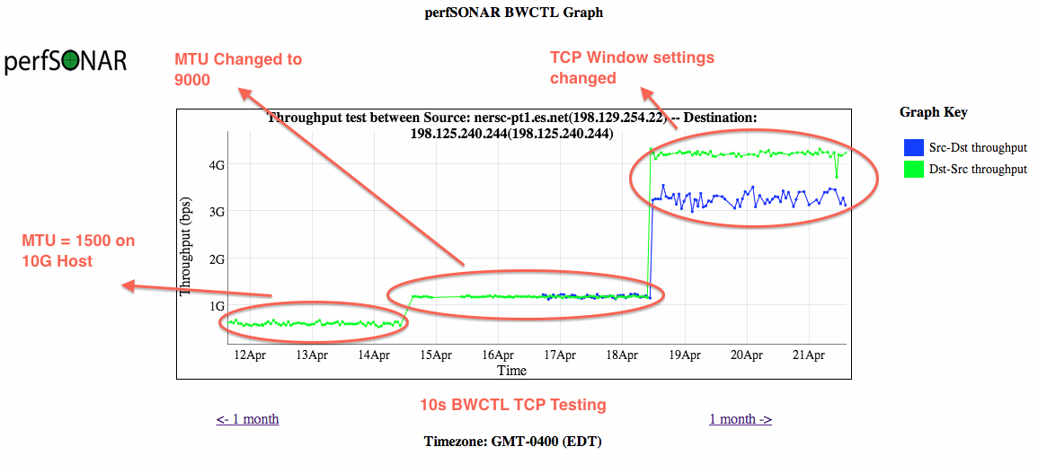
Host Tuning of TCP Settings
The role of MTUs and host tuning (e.g. ‘its all related’):
Notes:
Normal, 9000 MTU, and increased window. This is what all science hosts need to have applied

Slide 50
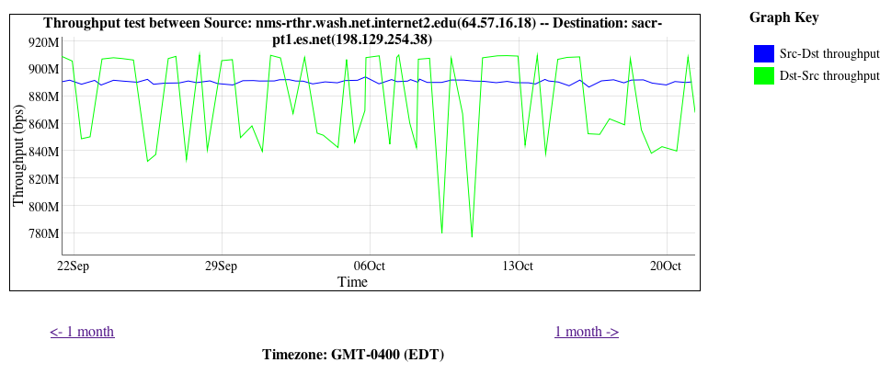
Speed Mismatch – 1G to 10G
Sometimes this happens:
Is it a “problem”? Yes and no.
Cause: this is called “overdriving” and is common. A 10G host and a 1G host are testing to each other
1G to 10G is smooth and expected (~900Mbps, Blue)
10G to 1G is choppy (variable between 900Mbps and 700Mbps, Green)
http://fasterdata.es.net/performance-testing/troubleshooting/interface-speed-mismatch/
http://fasterdata.es.net/performance-testing/evaluating-network-performance/impedence-mismatch/
Notes:
Host mismatch – 1G to 10G is ok, opposite is not true

Slide 51
Speed Mismatch – 1G to 10G
A NIC doesn’t stream packets out at some average rate - it’s a binary operation:
Send (e.g. @ max rate) vs. not send (e.g. nothing)
10G of traffic needs buffering to support it along the path. A 10G switch/router can handle it. So could another 10G host (if both are tuned of course)
A 1G NIC is designed to hold bursts of 1G. Sure, they can be tuned to expect more, but may not have enough physical memory
Ditto for switches in the path
At some point things ‘downstep’ to a slower speed, that drops packets on the ground, and TCP reacts like it were any other loss event.

Slide 52
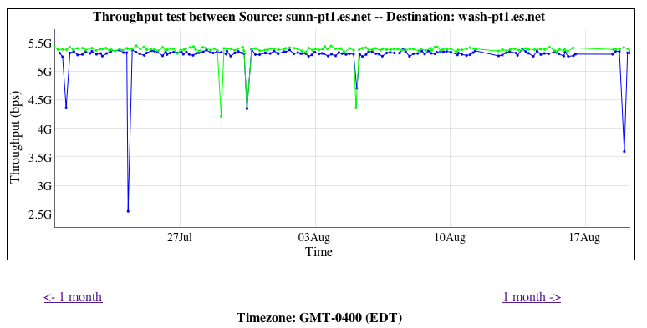
Hardware Differences Between Hosts
There have been some expectation management problems with the tools that we have seen
Some feel that if they have 10G, they will get all of it
Some may not understand the makeup of the test
Some may not know what they should be getting
Lets start with an ESnet to ESnet test, between very well tuned and recent pieces of hardware
5Gbps is “awesome” for:
A 20 second test
60ms Latency
Homogenous servers
Using fasterdata tunings
On a shared infrastructure
Notes:
Example of the differences between well tuned/well provisioned hosts. Little differences matter.

Slide 53
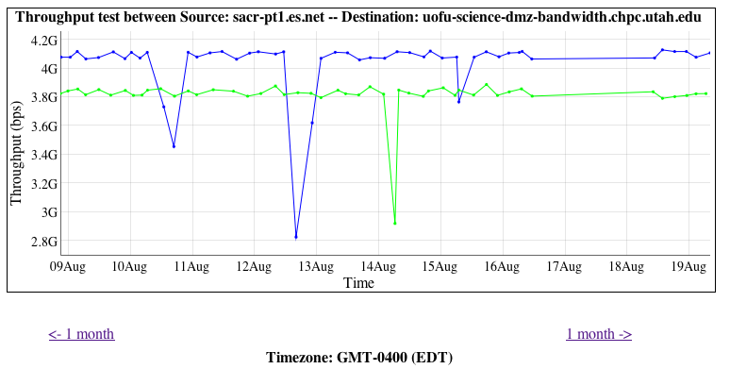
Hardware Differences Between Hosts
Another example, ESnet (Sacremento CA) to Utah, ~20ms of latency
Is it 5Gbps? No, but still outstanding given the environment:
20 second test
Heterogeneous hosts
Possibly different configurations (e.g. similar tunings of the OS, but not exact in terms of things like BIOS, NIC, etc.)
Different congestion levels on the ends
Notes:
Example of the differences between well tuned/well provisioned hosts. Little differences matter.

Slide 54
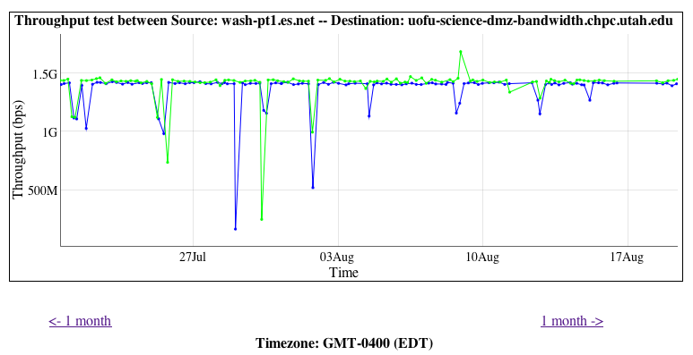
Hardware Differences Between Hosts
Similar example, ESnet (Washington DC) to Utah, ~50ms of latency
Is it 5Gbps? No. Should it be? No! Could it be higher? Sure, run a different diagnostic test.
Longer latency – still same length of test (20 sec)
Heterogeneous hosts
Possibly different configurations (e.g. similar tunings of the OS, but not exact in terms of things like BIOS, NIC, etc.)
Different congestion levels on the ends
Takeaway – you will know bad performance when you see it. This is consistent and jives with the environment.
Notes:
Example of the differences between well tuned/well provisioned hosts. Little differences matter.

Slide 55
Virtual Machine to Bare Metal Ex.
The next example compares the results of testing between domains
ESnet Pacific Northwest GigaPoP Location (Seattle WA)
Rutherford Lab (Swindon, UK)
ESnet Host = 10Gbps connected Server
RL Host 1 = 10Gbps connected Server
RL Host 2 = VM with a 1Gbps VNIC, 10Gbps NIC on host

Slide 56
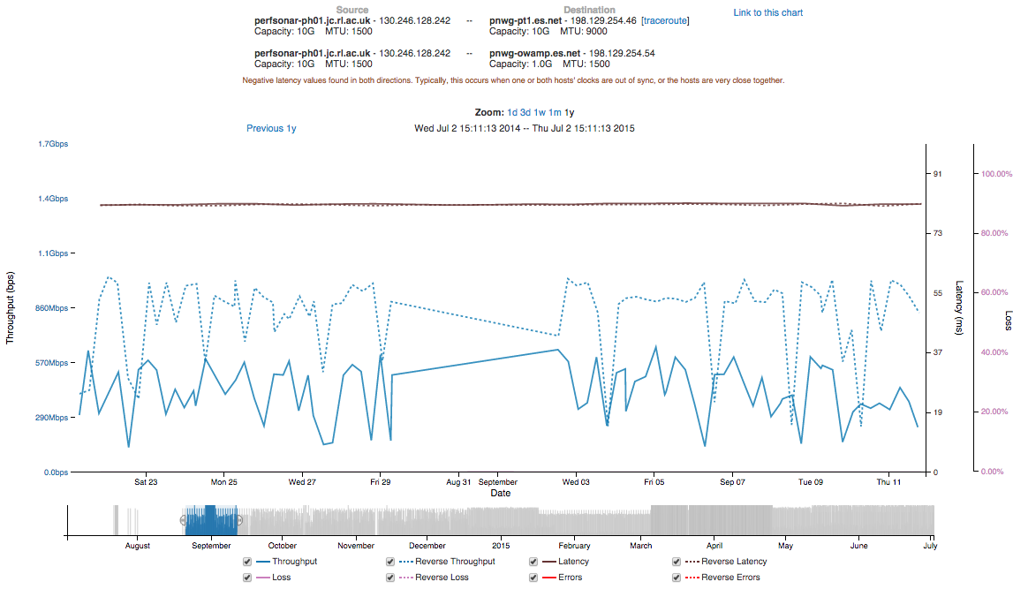
Virtual Machine to Bare Metal Ex.

Slide 57
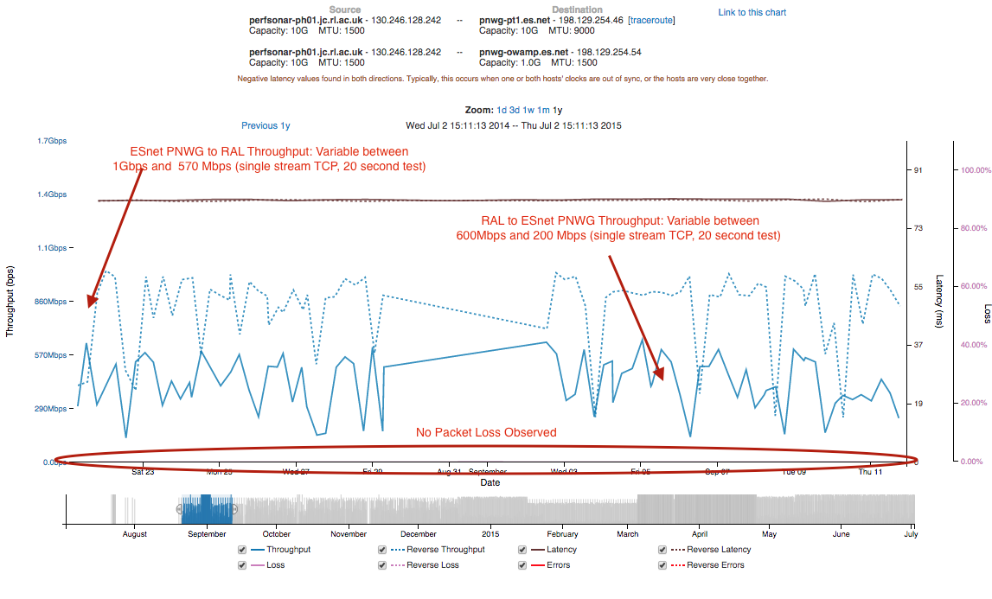
Virtual Machine to Bare Metal Ex.

Slide 58
Real Host Observations/Comments
80ms One way delay (160ms RTT). Stable over time.
RL -> ESnet is slower than ESnet -> RL
Could be differences in host hardware and TCP tuning
No packet loss observed on the network
This is good observation – if seen this could contribute to lower TCP performance

Slide 59
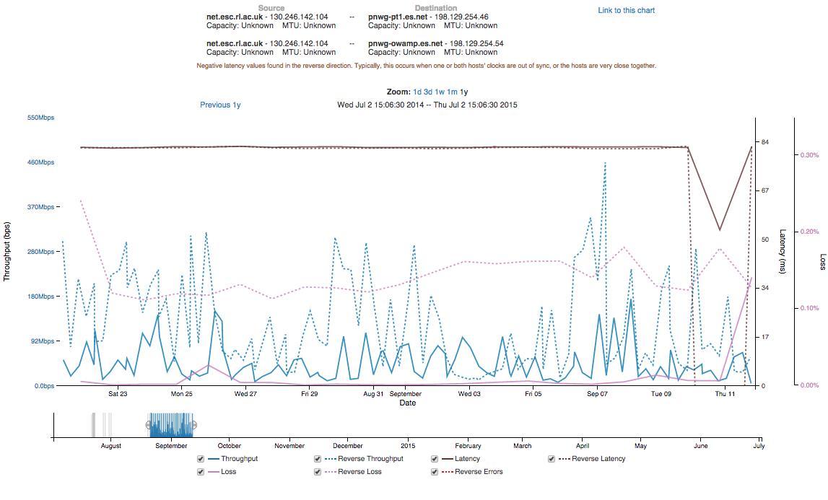
Virtual Machine to Bare Metal Ex.

Slide 60
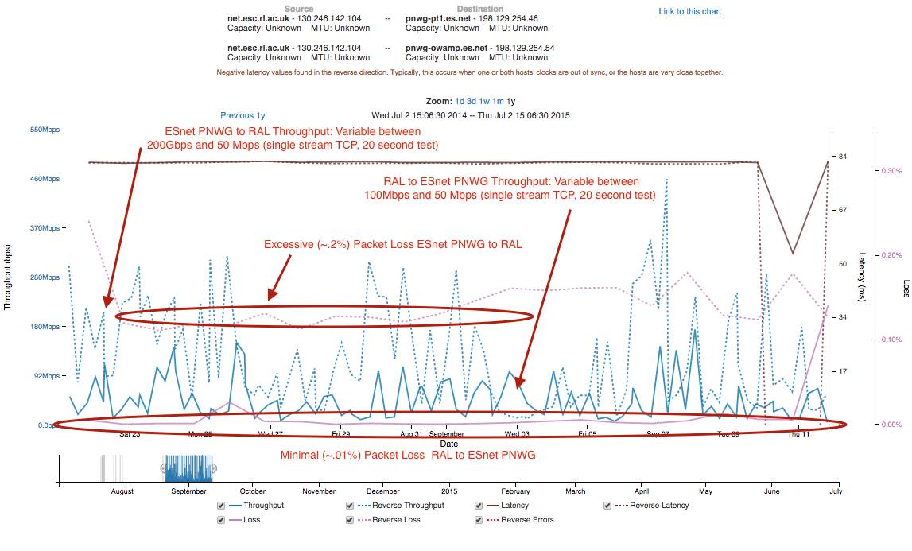
Virtual Machine to Bare Metal Ex.

Slide 61
Virtual Host Observations/Comments
80ms One way delay (160ms RTT). Mostly stable over time – period of instability on host caused latency change
RL -> ESnet is slower than ESnet -> RL
Virtual host is underpowered vs. server, has less memory, CPU, and NIC.
Packet loss observed
More severe ESnet -> RL direction. A factor of the virtual and real host at RL having problems dealing with influx of network traffic
In either case – packet loss contributes to low (and unpredictable) throughput

Slide 62
Outline
Introduction – What are we Measuring?
Use Cases
Hardware Selection
Virtualization
Host Configuration Successes and Failures
Inexpensive Nodes

Slide 63
The Beginning
Many people experimenting with and deploying perfSONAR on low cost / small form factor nodes
perfSONAR project committed to officially test/support small number of configurations as part of version 3.5 roadmap
Community survey undertaken to determine what node characteristics were most important to the community.

Slide 64
Outline
Problem statements
Limited budgets for perfSONAR deployments
Need many boxes for mobile, adhoc test-points
One possible solution: Low-cost, Small-form Nodes
Typical rack-mounted servers can cost hundreds, even thousands, per device (dollars, yen, myr)
Primary Benefits and Use Cases
Low-cost nodes for multiple, meshed testpoints
Small-form for easy transport as adhoc testers
Installation and Configuration

Slide 65
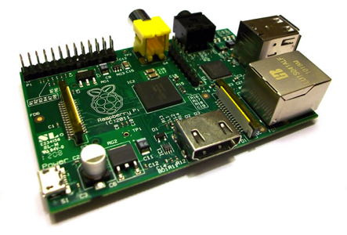
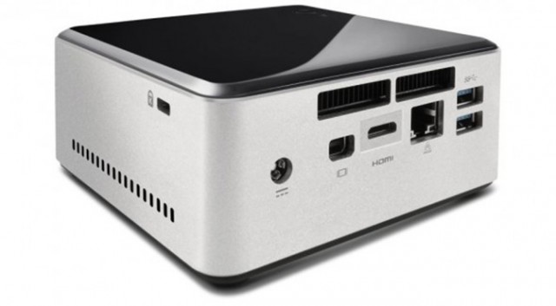
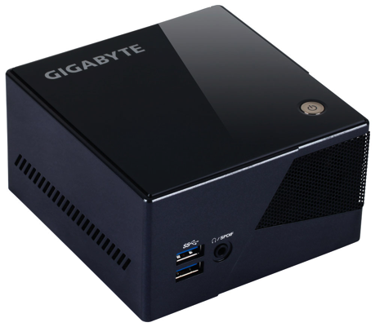
Possible Solutions
Small, Low-cost Nodes Examples include the above; NUC, Gigabyte, Pi, …
Notes:
End to end performance verification is not a typical thing that is tested for – but al science is end to end.

Slide 66
Initial Assumptions
Initially shooting for “very low price” nodes
ARM based solutions investigated
Cubox/perfCube (Brian Tierney, etc.)
Beaglebone / Raspberry Pi (Alan Whinery, etc.)
Great for some use cases
Can not support 1Gbps testing
Cost profile could allow very large deployment
Challenges in supporting ARM

Slide 67
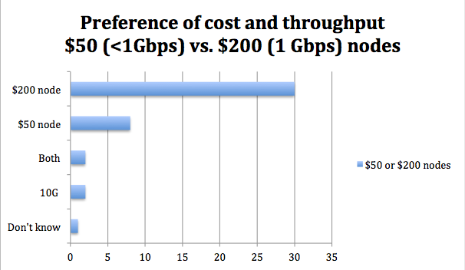
Survey Surprise
Survey respondents generally preferred slightly higher cost and the ability to test at 1Gbps

Slide 68
A Course Change
Began investigating slightly higher cost/performance nodes
Targeting around $200 per node
Capable of achieving 1Gbps BWCTL throughput
Easy to install
Intel CPUs to avoid complications with supporting ARM builds

Slide 69
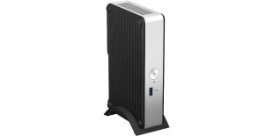
Intel Thin Canyon NUC Kit DE3815TYKHE
Not able to push 1Gbps (can push 500Mbps, receive 920Mbps)
Includes 8GB eMMC storage
$177 shipped
36W power draw
Works with Debian and CentOS
Still attractive for <1Gbps

Slide 70
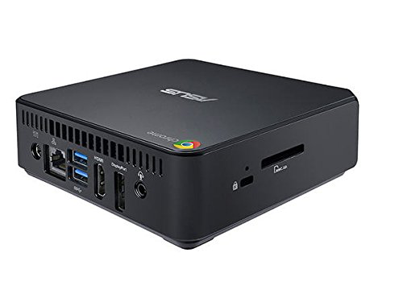
ASUS Chromebox M004U
$152
Internal 16G SSD, 2G RAM
Comes with ChromeOS
Difficult to install perfSONAR (includes using a paperclip to unlock BIOS)
Very attractive price. May be an option for “hardcore tinkerers”

Slide 71
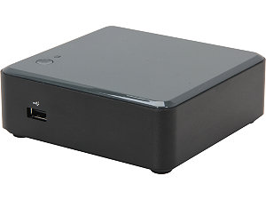
Intel NUC Kit DCCP847DYE
936Mbps in testing
$232 with SSD. $190 with microSD + USB
65W. Requires a power cable to be purchased separately, C5 cord
Missing power cable + highest cost made this less attractive than others

Slide 72
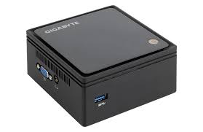
Gigabyte BRIX (GB-BXBT-2807)
937 Mbps in testing
$225 with SSD, $180 micro SD+USB
30W power
Currently preferred option. Low power, high performance.
But… see next slide!

Slide 73
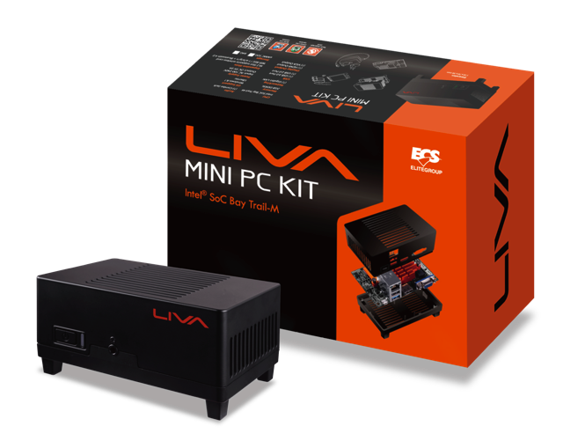
LIVA by ECS
$100-125 USD
Home: http://www.ecs.com.tw/ECSWebSite/Product/Product_LIVA.aspx?DetailID=1560&LanID=0#Overview

Slide 74
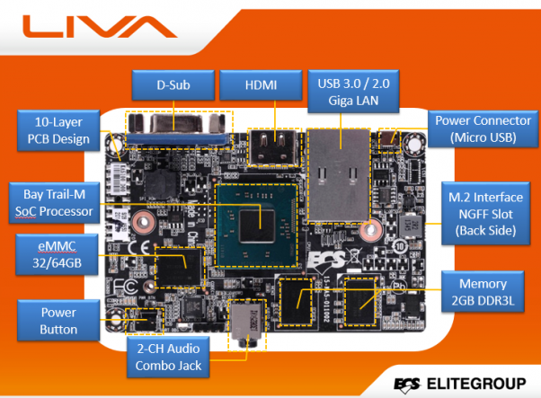
Specifications

Slide 75
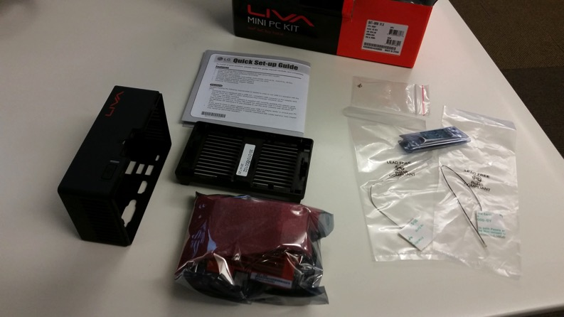
Assembly
Contents of box:
Case top and bottom
Motherboard with onboard memory, RAM, and 1GE netwok adapter
Wireless adapter card
Antennae for wireless card (1 long, black; 1 short, white)
Power Supply (US) with adapter plate (EU included)

Slide 76
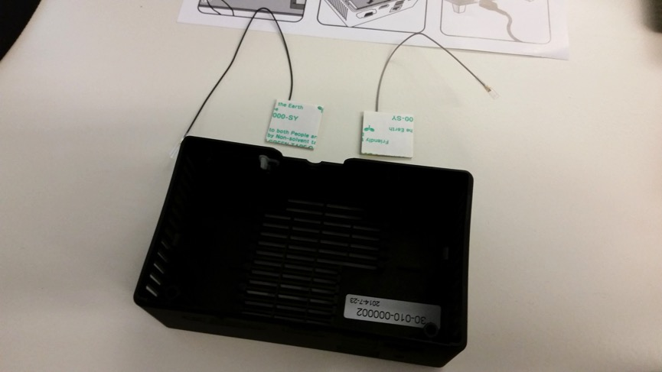
Assembly
Optional first step – Wireless card antennae
Included instructions do this in a different order
If you have needle-nose pliers or tweezers, their order is fine. For easier build…

Slide 77
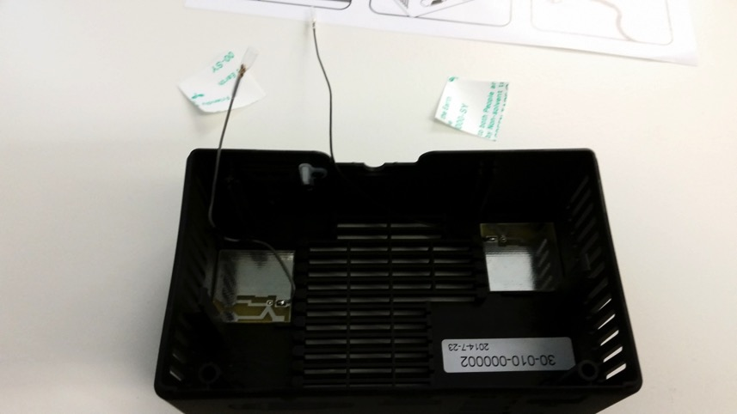
Assembly
Optional first step – Wireless card antennae
Included instructions do this in a different order
If you have needle-nose pliers or tweezers, their order is fine. For easier build…
Suggestion: Place the antennae first.

Slide 78
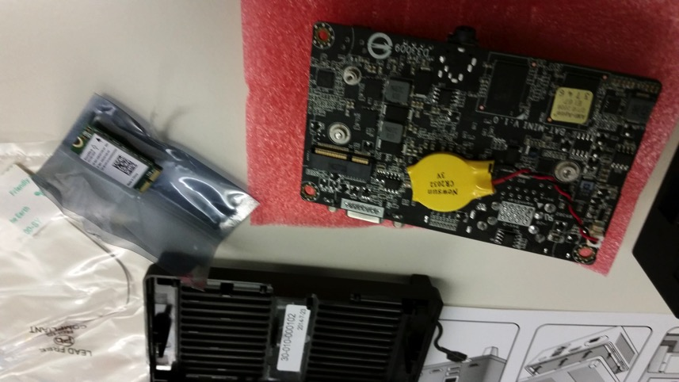
Assembly
Optional first step – Wireless card and Motherboard placement
Unpackage the small wireless card and the motherboard assembly.

Slide 79
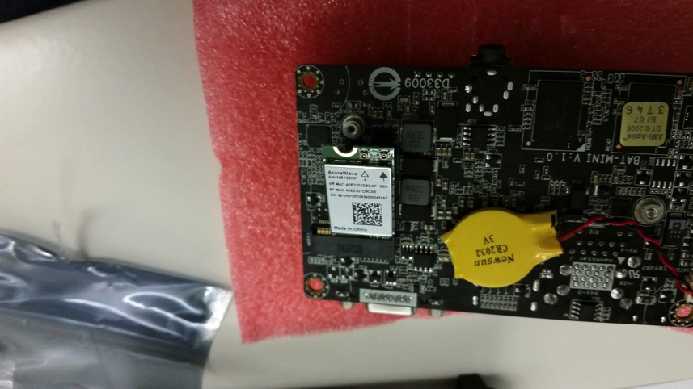
Assembly
Optional step – Wireless card and Motherboard placement
Unpackage the small wireless card and the motherboard assembly.
Socket the Wireless card.

Slide 80
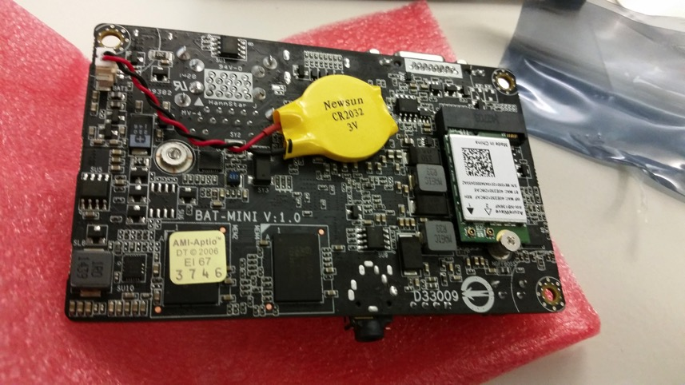
Assembly
Optional step – Wireless card and Motherboard placement
Unpackage the small wireless card and the motherboard assembly.
Socket the Wireless card.
Secure wireless card with provided screw.

Slide 81
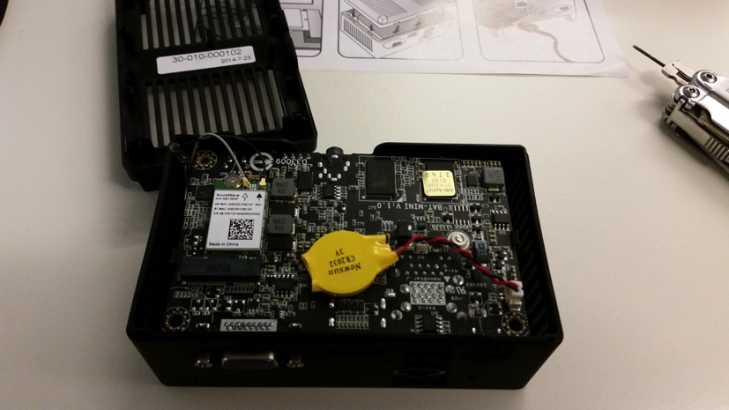
Assembly
Motherboard placement
Ensure that the antennae leads are positioned off to the side and not pinched by the motherboard.
The board is placed into the larger, top part of the case with the ports placed in first.
Snap the board downward ensuring that the ports are aligned and the front-facing audio jack is centered.

Slide 82
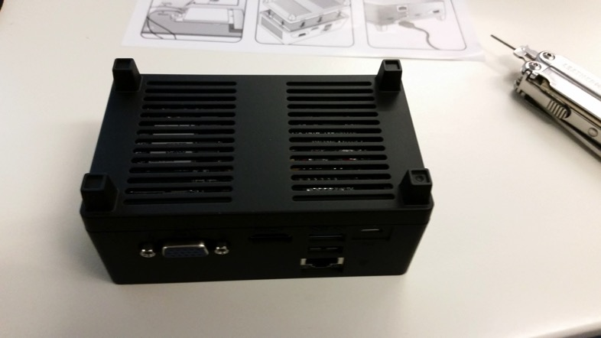
Assembly
Case bottom snaps into place; no screws required.

Slide 83
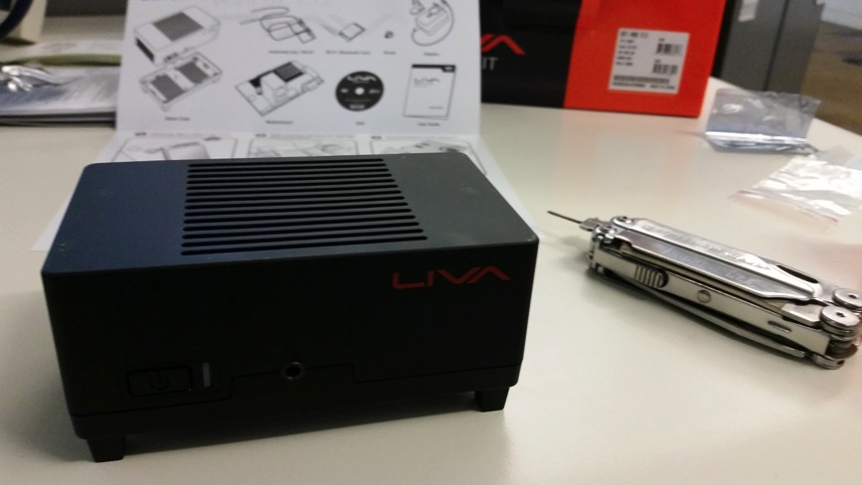
Assembly Completed

Slide 84
Strengths
Complete package with limited assembly required
32Gig of memory onboard
2Gig of RAM
True 1GE (testing over clean paths 920-980M
Only 15W power required
POE Possibilities
Small and lightweight
Comparatively Low cost to other more robust hardware/server options

Slide 85
Limitations and Eccentricities
EMMC harddrive
BIOS differences
Power button instability
USB / Keyboard instability
Passively cooled; no fans

Slide 86
EMMC Drive (Onboard)
perfSONAR’s recommended CentOS 6 does not carry driver support for the onboard storage
Using instead as a recommended build Ubuntu 12.04.5
Debian packages for perfSONAR can be found at: http://docs.perfsonar.net/install_debian#configuration

Slide 87
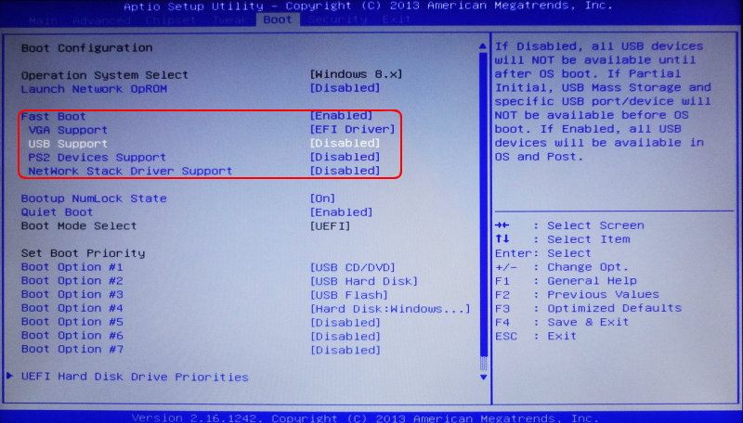
BIOS difference Issue (minor)
Rarely encountered
Some tips for uniformity
USB options: “Enable ALL”
TXE option: “Disable”
Hammer. (No. Not really.)

Slide 88

Power Button Issue (minor)
Power button instability has been found on about 1 in 10 boxes.
Easily overcome by
multiple boot attempts or;
Long-pressing the power button for a firm connection or;
Assume this is either a quirk of the manufacturing process and hope it is worked out on future models

Slide 89

USB/Wake-up Issue (minor)
USB instability has been found on about 3 in 20 boxes; independent of the power button issue
Easily overcome by
multiple connection attempts or;
Reboot

Slide 90

Passive Cooling (minor)
No fan in the box for cooling
No direct issues with this were found during testing, but it is definitely worth considering when placing in warmer spaces.

Slide 91
Installation
Ubuntu 12.04.5 Desktop
Server doesn’t have proper EMMC driver
Debian (Ubuntu) perfSONAR packages: http://docs.perfsonar.net/install_debian#configuration
Using EXAMPLE script log found at: http://download-test.odi.iu.edu/liva-ps/go http://download-test.odi.iu.edu/liva-ps/foo
And associated files on the USB drive (ntp10 and conf10)

Slide 92
What’s Next??
ECS LIVA node is the most promising
Develop flashable images
HOWTOs for setting up nodes
Scripts to make setup easier
Post results and information to perfSONAR website:
https://github.com/perfsonar/project/wiki/perfSONAR-Endpoint-Node-Project

Slide 93
Conclusions
Measurement belongs on a dedicated host
The host should be:
‘right sized’ for the application. You do not need to buy a $20000 machine, equally a $200 machine is challenging to get right.
Use recent specs for memory, CPU, NIC and it will work fine
The host should not be:
Virtualized – we want a real view of network performance

Slide 94
perfSONAR Host Hardware
Event
Presenter, Organization, Email
Date
This document is a result of work by the perfSONAR Project (http://www.perfsonar.net) and is licensed under CC BY-SA 4.0 (https://creativecommons.org/licenses/by-sa/4.0/).

