Slide 1
Day 4-1-1 anti-virus
detecting a malicious file
malware, detection,
hiding, removing

Slide 2
malware
is the generic term for computer virus, worms, spyware and other malicious software
skilled attacker can make it, fun attacker can use it.
- even there are malware build tools with GUI ☹

Slide 3

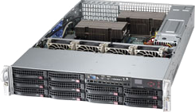
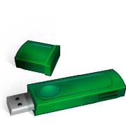
infection
attackers try to make your devices infected in many ways
- security holes, e-mail, web
- USB memory, file servers

Slide 4
causes
vulnerability
- 0-day security hole without patch
- old security holes are still used to infect
auto-execution for removal media
- USB memory, CD loading
users’ careless open
- sometimes happen to execute malwares

Slide 5
detection
signature-based detection
- blacklist of malwares
- check a file with the signatures
- update needed to detect newer malware
heuristics detection
- behavior, characteristic code

Slide 6
when?
write operations take place
- new file, file modification
new media is inserted
- USB memory, CD
periodic or manually
- scan all or important files

Slide 7
where?
final target here
web proxy
client
file server
e-mail server

Slide 8

staging for detection
Thunderbird example
otherwise, entire INBOX file will be considered as ‘suspicious’ once attached malware is stored into your inbox file

Slide 9
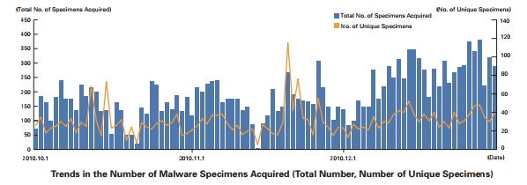
hiding
attackers modify malwares
- not to be detected by anti-virus
- they can check this locally
- up-to-date signature needed

Slide 10
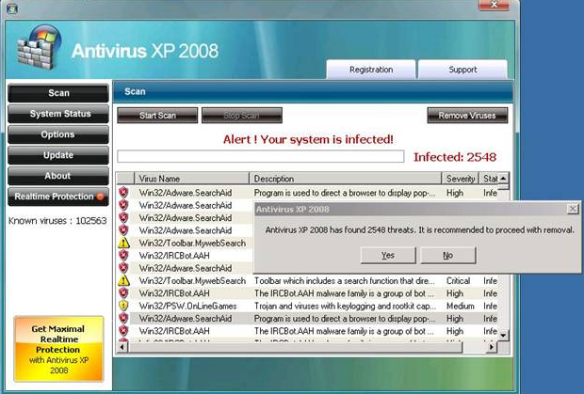
fake security software
do nothing, or is just a malware
- also known as ‘scareware’

Slide 11
summary
update system
- less security holes
update anti-virus signature
- to detect newer malware
use caution for received/downloaded file
- documents or software

