Slide 1
Layer 2 Network Design

Slide 2
Layer-2 Network Design
A good network design is modular and hierarchical, with a clear separation of functions:
Core: Resilient, few changes, few features, high bandwidth, CPU power
Distribution: Aggregation, redundancy
Access: Port density, affordability, security features, many adds, moves and changes

Slide 3
Layer-2 Network Design - Simple
ISP1
Network Border
Core
Distribution
Access

Slide 4
Layer-2 Network Design - Redundant
ISP1
ISP2
Network Border
Core
Distribution
Access

Slide 5
In-Building and Layer 2
There is usually a correspondence between building separation and subnet separation
Switching inside a building
Routing between buildings
This will depend on the size of the network
Very small networks can get by with doing switching between buildings
Very large networks might need to do routing inside buildings

Slide 6
Layer 2 Concepts
Layer 2 protocols basically control access to a shared medium (copper, fiber, electro-magnetic waves)
Ethernet is the de-facto wired-standard today
Reasons:
Simple
Cheap
Manufacturers keep making it faster
Wireless (802.11a,b,g,n) is also Layer-2 technology.

Slide 7
Ethernet Functions
Source and Destination identification
MAC addresses
Detect and avoid frame collisions
Listen and wait for channel to be available
If collision occurs, wait a random period before retrying
This is called CASMA-CD: Carrier Sense Multiple Access with Collision Detection

Slide 8
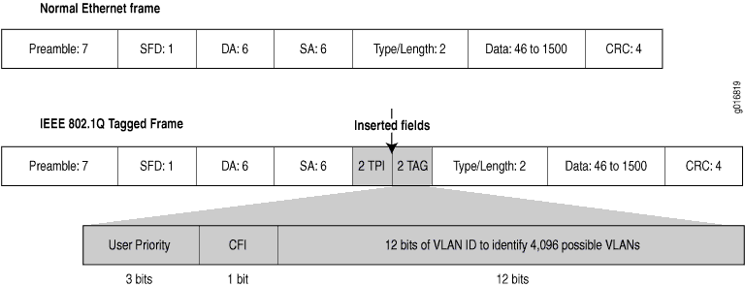
Ethernet Frame
SFD = Start of Frame Delimiter
DA = Destination Address
SA = Source Address
CRC = Cyclick Redundancy Check

Slide 9
Evolution of Ethernet Topologies
Bus
Everybody on the same coaxial cable
Star
One central device connects every other node
First with hubs (repeated traffic)
Later with switches (bridged traffic)
Structured cabling for star topologies standardized

Slide 10
Switched Star Topology Benefits
It’s modular:
Independent wires for each end node
Independent traffic in each wire
A second layer of switches can be added to build a hierarchical network that extends the same two benefits above
ALWAYS DESIGN WITH MODULARITY IN MIND

Slide 11
Hub
Receives a frame on one port and sends it out every other port, always.
Collision domain is not reduced
Traffic ends up in places where it’s not needed

Slide 12
Hub
Hub
A frame sent by one node is always sent to every other node. Hubs are also called “repeaters” because they just “repeat” what they hear.

Slide 13
Switch
Learns the location of each node by looking at the source address of each incoming frame, and builds a forwarding table
Forwards each incoming frame to the port where the destination node is
Reduces the collision domain
Makes more efficient use of the wire
Nodes don’t waste time checking frames not destined to them

Slide 14
Switch
Forwarding Table
Address | Port
AAAAAAAAAAAA | 1
BBBBBBBBBBBB | 5
Switch
B
A

Slide 15
Switches and Broadcast
A switch broadcasts some frames:
When the destination address is not found in the table
When the frame is destined to the broadcast address (FF:FF:FF:FF:FF:FF)
When the frame is destined to a multicast ethernet address
So, switches do not reduce the broadcast domain!

Slide 16
Switch vs. Router
Routers more or less do with IP packets what switches do with Ethernet frames
A router looks at the IP packet destination and checks its routing table to decide where to forward the packet
Some differences:
IP packets travel inside ethernet frames
IP networks can be logically segmented into subnets
Switches do not usually know about IP, they only deal with Ethernet frames

Slide 17
Switch vs. Router
Routers do not forward Ethernet broadcasts.
Switches reduce the collision domain
Routers reduce the broadcast domain
This becomes really important when trying to design hierarchical, scalable networks that can grow sustainably
S
R
S

Slide 18
Traffic Domains
Router
Switch
Switch
Hub
Hub
Hub
Hub
Collision Domain
Broadcast Domain

Slide 19
Traffic Domains
Try to eliminate collision domains
Get rid of hubs!
Actually hubs are very rare today.
Try to keep your broadcast domain limited to no more than 250 simultaneously connected hosts
Segment your network using routers

Slide 20
Layer 2 Network Design Guidelines
Always connect hierarchically
If there are multiple switches in a building, use an aggregation switch
Locate the aggregation switch close to the building entry point (e.g. fiber panel)
Locate edge switches close to users (e.g. one per floor)
Max length for Cat 5 is 100 meters

Slide 21
Minimize Path Between Elements
✗
✔

Slide 22
Build Incrementally
Start small
Fiber link to distribution switch
Switch
Hosts

Slide 23
Build Incrementally
As you have demand and money, grow like this:
Aggreg.
Switch
Hosts

Slide 24
Build Incrementally
And keep growing within the same hierarchy:
Aggreg.
Switch
Switch
Hosts
Hosts

Slide 25
Build Incrementally
At this point, you can also add a redundant aggregation switch:
Aggreg.
Aggreg.
Switch
Switch
Hosts

Slide 26
Do not daisy-chain
Resist the temptation of doing this:
✗

Slide 27
Connect buildings hierarchically
✔

Slide 28
Virtual LANs (VLANs)
Allow us to split switches into separate (virtual) switches
Only members of a VLAN can see that VLAN’s traffic
Inter-vlan traffic must go through a router

Slide 29
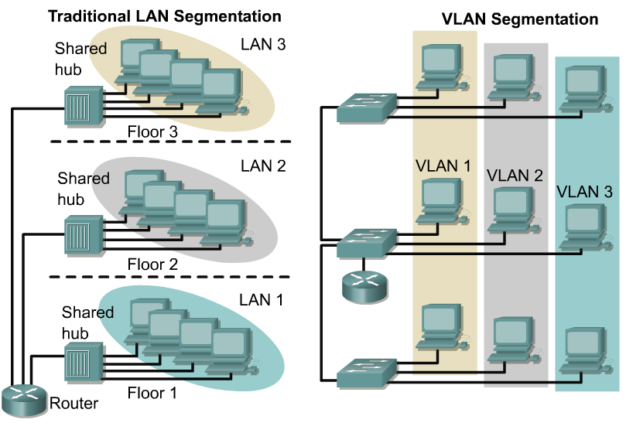
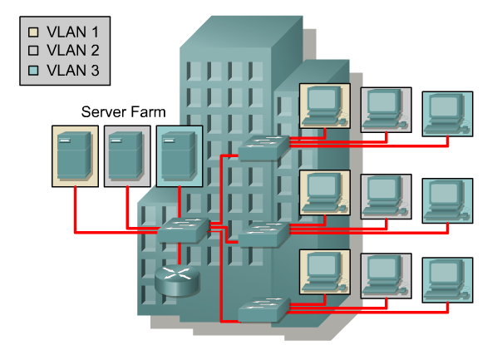
VLAN introduction
VLANs provide segmentation based on broadcast domains.
VLANs logically segment switched networks based on the functions, project teams, or applications of the organization regardless of the physical location or connections to the network.
All workstations and servers used by a particular workgroup share the same VLAN, regardless of the physical connection or location.

Slide 30
Local VLANs
2 VLANs or more within a single switch
VLANs address scalability, security, and network management. Routers in VLAN topologies provide broadcast filtering, security, and traffic flow management.
Edge ports, where end nodes are connected, are configured as members of a VLAN
The switch behaves as several virtual switches, sending traffic only within VLAN members.
Switches may not bridge any traffic between VLANs, as this would violate the integrity of the VLAN broadcast domain.
Traffic should only be routed between VLANs.

Slide 31
Local VLANs
Switch
VLAN X
VLAN Y
Edge ports
VLAN X nodes
VLAN Y nodes

Slide 32
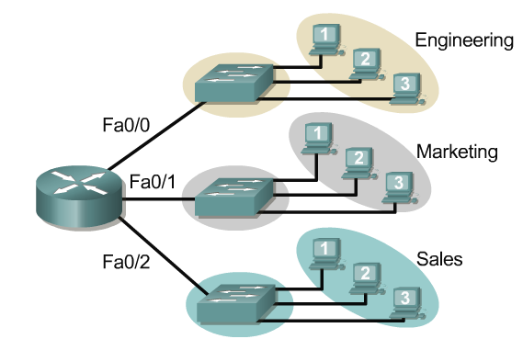
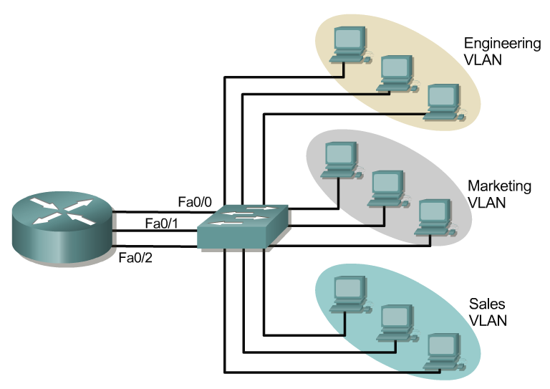
Broadcast domains with VLANs and routers
10.1.0.0/16
10.2.0.0/16
Without VLANs:
10.3.0.0/16
Without VLANs, each group is on a different IP network and on a different switch.
Using VLANs. Switch is configured with the ports on the appropriate VLAN. Still, each group on a different IP network; however, they are all on the same switch.
What are the broadcast domains in each?
One link per VLAN or a single VLAN Trunk (later)
10.1.0.0/16
With VLANs
10.2.0.0/16
10.3.0.0/16

Slide 33
VLANs
Two VLANs = Two subnets
Important notes on VLANs:
VLANs are assigned to switch ports. There is no “VLAN” assignment done on the host (usually).
In order for a host to be a part of that VLAN, it must be assigned an IP address that belongs to the proper subnet. Remember: VLAN = Subnet

Slide 34
VLANs
ARP Request
Two VLANs = Two subnets
VLANs separate broadcast domains! e.g. without VLAN the ARP would be seen on all subnets.
Assigning a host to the correct VLAN is a 2-step process:
Connect the host to the correct port on the switch.
Assign to the host the correct IP address depending on the VLAN membership

Slide 35
VLAN operation
As a device enters the network, it automatically assumes the VLAN membership of the port to which it is attached.
The default VLAN for every port in the switch is VLAN 1 and cannot be deleted. (This statement does not give the whole story. More in the lab later for interested groups…)
All other ports on the switch may be reassigned to alternate VLANs.

Slide 36
VLANs across switches
Two switches can exchange traffic from one or more VLANs
Inter-switch links are configured as trunks, carrying frames from all or a subset of a switch’s VLANs
Each frame carries a tag that identifies which VLAN it belongs to

Slide 37
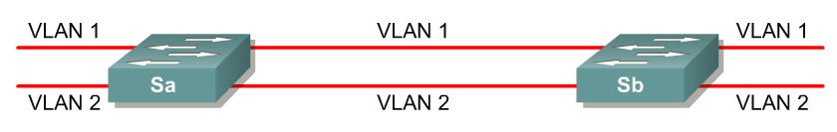
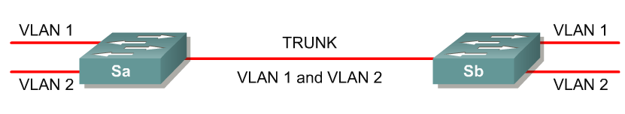
VLANs across switches
No VLAN Tagging
VLAN Tagging
VLAN tagging is used when a single link needs to carry traffic for more than one VLAN.

Slide 38
VLANs across switches
Tagged Frames
802.1Q Trunk
Trunk Port
VLAN X
VLAN Y
VLAN X
VLAN Y
Edge Ports
This is called “VLAN Trunking”

Slide 39
802.1Q
The IEEE standard that defines how ethernet frames should be tagged when moving across switch trunks
This means that switches from different vendors are able to exchange VLAN traffic.

Slide 40
802.1Q tagged frame

Slide 41
Tagged vs. Untagged
Edge ports are not tagged, they are just “members” of a VLAN
You only need to tag frames in switch-to-switch links (trunks), when transporting multiple VLANs
A trunk can transport both tagged and untagged VLANs
As long as the two switches agree on how to handle those

Slide 42
VLANS increase complexity
You can no longer “just replace” a switch
Now you have VLAN configuration to maintain
Field technicians need more skills
You have to make sure that all the switch-to-switch trunks are carrying all the necessary VLANs
Need to keep in mind when adding/removing VLANs

Slide 43
Good reasons to use VLANs
You want to segment your network into multiple subnets, but can’t buy enough switches
Hide sensitive infrastructure like IP phones, building controls, etc.
Separate control traffic from user traffic
Restrict who can access your switch management address

Slide 44
Bad reasons to use VLANs
Because you can, and you feel cool ☺
Because they will completely secure your hosts (or so you think)
Because they allow you to extend the same IP network over multiple separate buildings

Slide 45
Do not build “VLAN spaghetti”
Extending a VLAN to multiple buildings across trunk ports
Bad idea because:
Broadcast traffic is carried across all trunks from one end of the network to another
Broadcast storm can spread across the extent of the VLAN
Maintenance and troubleshooting nightmare

Slide 46
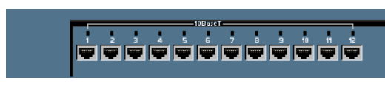
Configuring static VLANs
VLAN 1 is one of the factory-default VLANs.
Configure VLANs:
Switch#conf t
Switch(config)#interface vlan 10
Switch(config-if)#ip address x.x.x.x m.m.m.m

Slide 47
Creating VLANs
Default vlan 1
vlan 10
Default vlan 1
Create the VLAN: Switch#vlan database
Switch(vlan)#vlan vlan_number
Switch(vlan)#exit
Assign ports to the VLAN (in configuration mode):
Switch(config)#interface fastethernet 0/9
Switch(config-if)#switchport access vlan 10
access – Denotes this port as an access port and not a trunk

Slide 48
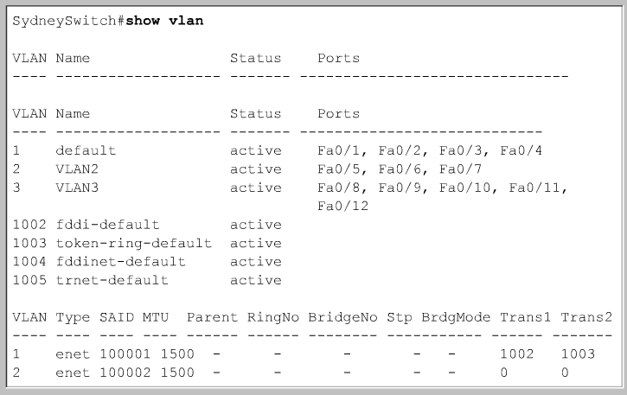
Verifying VLANs – show vlan-switch
vlan 1 default
vlan 2
vlan 3
show vlan-switch

Slide 49
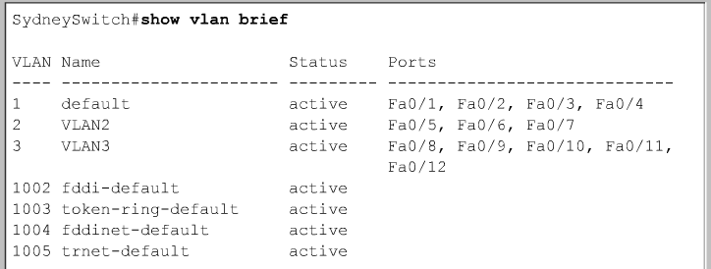
show vlan-switch brief
vlan 1 default
vlan 2
vlan 3
show vlan-switch brief

Slide 50
vlan database commands
Optional Command to add, delete, or modify VLANs.
VLAN names, numbers, and VTP (VLAN Trunking Protocol) information can be entered which “may” affect other switches besides this one. (Not part of this module)
This does not assign any VLANs to an interface.
Switch#vlan database
Switch(vlan)#?
VLAN database editing buffer manipulation commands:
abort Exit mode without applying the changes
apply Apply current changes and bump revision number
exit Apply changes, bump revision number, and exit mode
no Negate a command or set its defaults
reset Abandon current changes and reread current database
show Show database information
vlan Add, delete, or modify values associated with a single VLAN
vtp Perform VTP administrative functions.

Slide 51
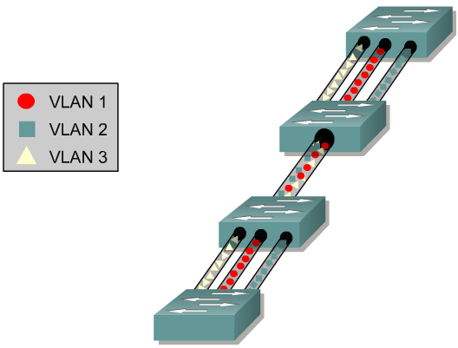
VLAN trunking
To configure 802.1q trunking switch/router, first determine which ports on the switches will be used to connect the two switches together.
Then in the Global configuration mode enter the following commands on both switches:
Switch_A(config)#interface fastethernet
interface ifnumber
Switch_A(config-if)#switchport trunk encapsulation dot1q

Slide 52
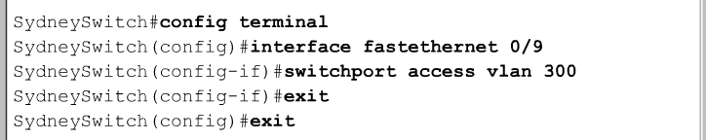
Deleting a Port VLAN Membership
Switch(config-if)#no switchport access vlan vlan_number
Deleting a VLAN
Switch#vlan database
Switch(vlan)#no vlan vlan_number
Switch(vlan)#exit

Slide 53
Link Aggregation

Slide 54
Link Aggregation
Also known as port bundling, link bundling
You can use multiple links in parallel as a single, logical link
For increased capacity
For redundancy (fault tolerance)
LACP (Link Aggregation Control Protocol) is a standardized method of negotiating these bundled links between switches

Slide 55
LACP Operation
Two switches connected via multiple links will send LACPDU packets, identifying themselves and the port capabilities
They will then automatically build the logical aggregated links, and then pass traffic.
Switch ports can be configured as active or passive

Slide 56
LACP Operation
Switches A and B are connected to each other using two sets of Fast Ethernet ports
LACP is enabled and the ports are turned on
Switches start sending LACPDUs, then negotiate how to set up the aggregation
100 Mbps
Switch A
Switch B
100 Mbps
LACPDUs

Slide 57
LACP Operation
The result is an aggregated 200 Mbps logical link
The link is also fault tolerant: If one of the member links fail, LACP will automatically take that link off the bundle, and keep sending traffic over the remaining link
100 Mbps
Switch A
Switch B
100 Mbps
200 Mbps logical link

Slide 58
Distributing Traffic in Bundled Links
Bundled links distribute frames using a hashing algorithm, based on:
Source and/or Destination MAC address
Source and/or Destination IP address
Source and/or Destination Port numbers
This can lead to unbalanced use of the links, depending on the nature of the traffic
Always choose the load-balancing method that provides the most distribution

Slide 59
Switching Loops

Slide 60
Switching Loop
When there is more than one path between two switches
What are the potential problems?
Switch A
Switch B
Swtich C

Slide 61
Switching Loop
If there is more than one path between two switches:
Forwarding tables become unstable
Source MAC addresses are repeatedly seen coming from different ports
Switches will broadcast each other’s broadcasts
All available bandwidth is utilized
Switch processors cannot handle the load

Slide 62
Switching Loop
Switch A
Switch B
Node1 sends a broadcast frame (e.g. an ARP request)
Swtich C
Node 1

Slide 63
Switching Loop
Switches A, B and C broadcast node 1’s frame out every port
Switch A
Switch B
Swtich C
Node 1

Slide 64
Switching Loop
But they receive each other’s broadcasts, which they need to forward again out every port!
The broadcasts are amplified, creating a broadcast storm…
Switch A
Switch B
Swtich C
Node 1

Slide 65
Good Switching Loops???
But you can take advantage of loops!
Redundant paths improve resilience when:
A switch fails
Wiring breaks
How to achieve redundancy without creating dangerous traffic loops?

Slide 66
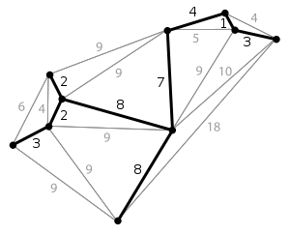
What is a Spanning Tree
“Given a connected, undirected graph, a spanning tree of that graph is a subgraph which is a tree and connects all the vertices together”.
A single graph can have many different spanning trees.

Slide 67
Spanning Tree Protocol
The purpose of the protocol is to have bridges dynamically discover a subset of the topology that is loop-free (a tree) and yet has just enough connectivity so that where physically possible, there is a path between every switch

Slide 68
Spanning Tree Protocol
Several flavors:
Traditional Spanning Tree (802.1d)
Rapid Spanning Tree or RSTP (802.1w)
Multiple Spanning Tree or MSTP (802.1s)

Slide 69
Traditional Spanning Tree (802.1d)
Switches exchange messages that allow them to compute the Spanning Tree
These messages are called BPDUs (Bridge Protocol Data Units)
Two types of BPDUs:
Configuration
Topology Change Notification (TCN)

Slide 70
Traditional Spanning Tree (802.1d)
First Step:
Decide on a point of reference: the Root Bridge
The election process is based on the Bridge ID, which is composed of:
The Bridge Priority: A two-byte value that is configurable
The MAC address: A unique, hardcoded address that cannot be changed.

Slide 71
Root Bridge Selection (802.1d)
Each switch starts by sending out BPDUs with a Root Bridge ID equal to its own Bridge ID
I am the root!
Received BPDUs are analyzed to see if a lower Root Bridge ID is being announced
If so, each switch replaces the value of the advertised Root Bridge ID with this new lower ID
Eventually, they all agree on who the Root Bridge is

Slide 72
Root Bridge Selection (802.1d)
32678.0000000000AA
Switch A
Switch B
Switch C
32678.0000000000BB
32678.0000000000CC
All switches have the same priority.
Who is the elected root bridge?

Slide 73
Root Port Selection (802.1d)
Now each switch needs to figure out where it is in relation to the Root Bridge
Each switch needs to determine its Root Port
The key is to find the port with the lowest Root Path Cost
The cumulative cost of all the links leading to the Root Bridge

Slide 74
Root Port Selection (802.1d)
Each link on a switch has a Path Cost
Inversely proportional to the link speed e.g. the faster the link, the lower the cost
Link Speed | STP Cost
10 Mbps | 100
100 Mbps | 19
1 Gbps | 4
10 Gbps | 2

Slide 75
Root Port Selection (802.1d)
Root Path Cost is the accumulation of a link’s Path Cost and the Path Costs learned from neighboring Switches.
It answers the question: How much does it cost to reach the Root Bridge through this port?

Slide 76
Root Port Selection (802.1d)
Root Bridge sends out BPDUs with a Root Path Cost value of 0
Neighbor receives BPDU and adds port’s Path Cost to Root Path Cost received
Neighbor sends out BPDUs with new cumulative value as Root Path Cost
Other neighbor’s down the line keep adding in the same fashion

Slide 77
Root Port Selection (802.1d)
On each switch, the port where the lowest Root Path Cost was received becomes the Root Port
This is the port with the best path to the Root Bridge

Slide 78
Root Port Selection (802.1d)
32678.0000000000AA
Switch A
1
2
Cost=19
Cost=19
1
1
Switch B
2
Cost=19
2
Switch C
32678.0000000000BB
32678.0000000000CC
What is the Path Cost on each Port?
What is the Root Port on each switch?

Slide 79
Root Port Selection (802.1d)
32678.0000000000AA
Switch A
1
2
Cost=19
Cost=19
Root Port
Root Port
1
1
Switch B
2
Cost=19
2
Switch C
32678.0000000000BB
32678.0000000000CC

Slide 80
Electing Designated Ports (802.1d)
OK, we now have selected root ports but we haven’t solved the loop problem yet, have we?The links are still active!
Each network segment needs to have only one switch forwarding traffic to and from that segment
Switches then need to identify one Designated Port per link
The one with the lowest cumulative Root Path Cost to the Root Bridge

Slide 81
Root Port Selection (802.1d)
32678.0000000000AA
Switch A
1
2
Cost=19
Cost=19
1
1
Switch B
2
Cost=19
2
Switch C
32678.0000000000BB
32678.0000000000CC
Which port should be the Designated Port on each segment?

Slide 82
Electing Designated Ports (802.1d)
Two or more ports in a segment having identical Root Path Costs is possible, which results in a tie condition
All STP decisions are based on the following sequence of conditions:
Lowest Root Bridge ID
Lowest Root Path Cost to Root Bridge
Lowest Sender Bridge ID
Lowest Sender Port ID

Slide 83
Root Port Selection (802.1d)
32678.0000000000AA
Designated Port
Designated Port
Switch A
1
2
Cost=19
Cost=19
1
1
Switch B
2
Cost=19
2
Switch C
32678.0000000000BB
32678.0000000000CC
Designated Port
In the B-C link, Switch B has the lowest Bridge ID, so port 2 in Switch B is the Designated Port

Slide 84
Blocking a port
Any port that is not elected as either a Root Port, nor a Designated Port is put into the Blocking State.
This step effectively breaks the loop and completes the Spanning Tree.

Slide 85
Root Port Selection (802.1d)
32678.0000000000AA
Switch A
1
2
Cost=19
Cost=19
1
1
Switch B
Cost=19
✗
2
2
Switch C
32678.0000000000BB
32678.0000000000CC
Port 2 in Switch C is put into the Blocking State, because it is neither a Root Port nor a Designated Port

Slide 86
Spanning Tree Protocol States
Disabled
Port is shut down
Blocking
Not forwarding frames
Receiving BPDUs
Listening
Not forwarding frames
Sending and receiving BPDUs

Slide 87
Spanning Tree Protocol States
Learning
Not forwarding frames
Sending and receiving BPDUs
Learning new MAC addresses
Forwarding
Forwarding frames
Sending and receiving BPDUs
Learning new MAC addresses

Slide 88
STP Topology Changes
Switches will recalculate if:
A new switch is introduced
It could be the new Root Bridge!
A switch fails
A link fails

Slide 89
Root Bridge Placement
Using default STP parameters might result in an undesired situation
Traffic will flow in non-optimal ways
An unstable or slow switch might become the root
You need to plan your assignment of bridge priorities carefully

Slide 90
Bad Root Bridge Placement
Out to router
32678.0000000000DD
Swtich D
Switch B
32678.0000000000BB
Root Bridge
32678.0000000000CC
Switch C
Switch A
32678.0000000000AA

Slide 91
Good Root Bridge Placement
Out to standby router
Out to active router
Alternative Root Bridge
Root Bridge
1.0000000000DD
Swtich D
Switch B
0.0000000000BB
32678.0000000000CC
Switch C
Switch A
32678.0000000000AA

Slide 92
Protecting the STP Topology
Some vendors have included features that protect the STP topology:
Root Guard
BPDU Guard
Loop Guard
UDLD
Etc.

Slide 93
STP Design Guidelines
Enable spanning tree even if you don’t have redundant paths
Always plan and set bridge priorities
Make the root choice deterministic
Include an alternative root bridge
If possible, do not accept BPDUs on end user ports

Slide 94
802.1d Convergence Speeds
Moving from the Blocking state to the Forwarding State takes at least 2 x Forward Delay time units (~ 30 secs.)
This can be annoying when connecting end user stations
Some vendors have added enhancements such as PortFast, which will reduce this time to a minimum for edge ports
Never use PortFast or similar in switch-to-switch links
Topology changes typically take 30 seconds too
This can be unacceptable in a production network

Slide 95
Rapid Spanning Tree (802.1w)
Convergence is much faster
Communication between switches is more interactive
Edge ports don’t participate
Edge ports transition to forwarding state immediately
If BPDUs are received on an edge port, it becomes a non-edge port to prevent loops

Slide 96
Rapid Spanning Tree (802.1w)
Defines these port roles:
Root Port (same as with 802.1d)
Alternate Port
A port with an alternate path to the root
Designated Port (same as with 802.1d)
Backup Port
A backup/redundant path to a segment where another bridge port already connects.

Slide 97
Rapid Spanning Tree (802.1w)
Synchronization process uses a handshake method
After a root is elected, the topology is built in cascade, where each switch proposes to be the designated bridge for each point-to-point link
While this happens, all the downstream switch links are blocking

Slide 98
Rapid Spanning Tree (802.1w)
DP
Root
Proposal
RP
Agreement
Switch
Switch
Switch
Switch

Slide 99
Rapid Spanning Tree (802.1w)
DP
Root
DP
Proposal
RP
RP
Agreement
Switch
Switch
Switch
Switch

Slide 100
Rapid Spanning Tree (802.1w)
DP
Root
DP
RP
RP
Switch
Switch
DP
Proposal
Agreement
RP
Switch
Switch

Slide 101
Rapid Spanning Tree (802.1w)
DP
Root
DP
RP
RP
Switch
Switch
DP
DP
Proposal
Agreement
RP
RP
Switch
Switch

Slide 102
Rapid Spanning Tree (802.1w)
Prefer RSTP over STP if you want faster convergence
Always define which ports are edge ports

Slide 103
Multiple Spanning Tree (802.1s)
Allows separate spanning trees per VLAN group
Different topologies allow for load balancing between links
Each group of VLANs are assigned to an “instance” of MST
Compatible with STP and RSTP

Slide 104
Multiple Spanning Tree (802.1s)
Root VLAN A
Root VLAN B
✕
✕
Vlan A
Vlan B

Slide 105
Multiple Spanning Tree (802.1s)
MST Region
Switches are members of a region if they have the same set of attributes:
MST configuration name
MST configuration revision
Instance-to-VLAN mapping
A digest of these attributes is sent inside the BPDUs for fast comparison by the switches
One region is usually sufficient

Slide 106
Multiple Spanning Tree (802.1s)
CST = Common Spanning Tree
In order to interoperate with other versions of Spanning Tree, MST needs a common tree that contains all the other islands, including other MST regions
IST = Internal Spanning Tree
Internal to the Region, that is
Presents the entire region as a single virtual bridge to the CST outside

Slide 107
Multiple Spanning Tree (802.1s)
MST Instances
Groups of VLANs are mapped to particular Spanning Tree instances
These instances will represent the alternative topologies, or forwarding paths
You specify a root and alternate root for each instance

Slide 108
Multiple Spanning Tree (802.1s)
CST
MST Region
MST Region
IST
IST
802.1D switch

Slide 109
Multiple Spanning Tree (802.1s)
Design Guidelines
Determine relevant forwarding paths, and distribute your VLANs equally into instances matching these topologies
Assign different root and alternate root switches to each instance
Make sure all switches match region attributes
Do not assign VLANs to instance 0, as this is used by the IST

Slide 110
Selecting Switches
Minimum features:
Standards compliance
Encrypted management (SSH/HTTPS)
VLAN trunking
Spanning Tree (RSTP at least)
SNMP
At least v2 (v3 has better security)
Traps

Slide 111
Selecting Switches
Other recommended features:
DHCP Snooping
Prevent end-users from running a rogue DHCP server
Happens a lot with little wireless routers (Netgear, Linksys, etc) plugged in backwards
Uplink ports towards the legitimate DHCP server are defined as “trusted”. If DHCPOFFERs are seen coming from any untrusted port, they are dropped.

Slide 112
Selecting Switches
Other recommended features:
Dynamic ARP inspection
A malicious host can perform a man-in-the-middle attack by sending gratuitous ARP responses, or responding to requests with bogus information
Switches can look inside ARP packets and discard gratuitous and invalid ARP packets.

Slide 113
Selecting Switches
Other recommended features:
IGMP Snooping:
Switches normally flood multicast frames out every port
Snooping on IGMP traffic, the switch can learn which stations are members of a multicast group, thus forwarding multicast frames only out necessary ports
Very important when users run Norton Ghost, for example.

Slide 114
Network Management
Enable SNMP traps and/or syslog
Collect and process in centralized log server
Spanning Tree Changes
Duplex mismatches
Wiring problems
Monitor configurations
Use RANCID to report any changes in the switch configuration

Slide 115
Network Management
Collect forwarding tables with SNMP
Allows you to find a MAC address in your network quickly
You can use simple text files + grep, or a web tool with DB backend
Enable LLDP (or CDP or similar)
Shows how switches are connected to each other and to other network devices

Slide 116
Documentation
Document where your switches are located
Name switch after building name
E.g. building1-sw1
Keep files with physical location
Floor, closet number, etc.
Document your edge port connections
Room number, jack number, server name

