Slide 1
Internet Exchange Points (IXPs)

Slide 2
Introduction to Internet Exchange Points
A bit of history
What are they?
Why use them?
Design Considerations

Slide 3
A Bit of History…
End of NSFnet – one major backbone
Move towards commercial Internet
Private companies selling their bandwidth
Need for coordination of routing exchange between providers
Traffic from ISP A needs to get to ISP B
Routing Arbiter project created to facilitate this

Slide 4
What is an Exchange Point
Network Access Points (NAPs) established at end of NSFnet
The original “exchange points”
Major providers connect their networks and exchange traffic
High-speed network or ethernet switch
Simple concept – any place where providers come together to exchange traffic

Slide 5
Conceptual Diagram of an IXP
Exchange Point Medium
ISP Router
ISP Router
ISP Router

Slide 6
Internet Exchange Point Why peer?
Consider a region with one ISP
They provide internet connectivity to their customers
They have one or two international connections
Internet grows, another ISP sets up in competition
They provide internet connectivity to their customers
They have one or two international connections
How does traffic from customer of one ISP get to customer of the other ISP?
Via the international connections

Slide 7
Internet Exchange Point Why peer?
Yes, International Connections…
If satellite, RTT is around 550ms per hop
So local traffic takes over 1s round trip
International bandwidth…
Costs order of magnitude or two more than domestic bandwidth
Becomes congested with local traffic
Wastes money, harms performance

Slide 8
Internet Exchange Point Why peer?
Multiple service providers
Each with Internet connectivity
Internet
B
A

Slide 9
Why IXPs?
Is not cost effective
Backhaul issue causes cost to both parties
Internet
B
A

Slide 10
Internet Exchange Point Why peer?
Solution:
Two competing ISPs peer with each other
Result:
Both save money
Local traffic stays local
Better network performance, better QoS,…
More international bandwidth for expensive international traffic
Everyone is happy

Slide 11
Why IXPs?
Domestic Interconnection
Internet
B
A

Slide 12
Internet Exchange Point Why peer?
A third ISP enters the equation
Becomes a significant player in the region
Local and international traffic goes over their international connections
They agree to peer with the two other ISPs
To save money
To keep local traffic local
To improve network performance, QoS,…

Slide 13
Why IXPs?
A third ISP enters the equation
Internet
C
B
A

Slide 14
Internet Exchange Point Why peer?
Peering means that the three ISPs have to buy circuits between each other
Works for three ISPs, but adding a fourth or a fifth means this does not scale
Solution:
Internet Exchange Point

Slide 15
Internet Exchange Point
Every participant has to buy just one whole circuit
From their premises to the IXP
Rather than N-1 half circuits to connect to the N-1 other ISPs
5 ISPs have to buy 4 half circuits = 2 whole circuits → already twice the cost of the IXP connection

Slide 16
Internet Exchange Point
Solution
Every ISP participates in the IXP
Cost is minimal – one local circuit covers all domestic traffic
International circuits are used for just international traffic – and backing up domestic links in case the IXP fails
Result:
Local traffic stays local
QoS considerations for local traffic is not an issue
RTTs are typically sub 10ms
Customers enjoy the Internet experience
Local Internet economy grows rapidly

Slide 17
Internet Exchange Point
Ethernet switch in the middle

Slide 18
Why use an IXP?
PEERING
Shared medium vs. point-to-point
Shared
can exchange traffic with multiple peers at one location via one interface
Point-to-Point
for high volumes of traffic

Slide 19
Why use an IXP?
KEEP LOCAL TRAFFIC LOCAL!!!
ISPs within a region peer with each other at the local exchange
No need to have traffic go overseas only to come back
Much reduced latency and increased performance

Slide 20
Why use an IXP?
SAVES MONEY!!!
Traffic going overseas means transit charges paid to your upstream ISP
Money stays in local economy
Used to provide better local infrastructure and services for customers
Customers pay less for Internet access
Therefore more customers sign up
ISP has more customers, better business

Slide 21
Why use an IXP?
VASTLY IMPROVES PERFORMANCE!!!
Network RTTs between organisations in the local economy is measured in milliseconds, not seconds
Packet loss becomes virtually non-existent
Customers use the Internet for more products, services, and activities

Slide 22




Exchange Point Design
ISP 6
ISP 5
ISP 4
IXP Services:
TLD DNS,
Routing Registry
Looking Glass,
news, etc
IXP
Management
Network
Ethernet Switch
ISP 1
ISP 2
ISP 3

Slide 23
Exchange Point Design
ISP 6
ISP 5
ISP 4
IXP Services:
TLD DNS,
Routing Registry
Looking Glass,
news, etc
IXP
Management
Network
Ethernet Switches
ISP 1
ISP 2
ISP 3

Slide 24
Peering at an IXP
Each participant needs to run BGP
They need their own AS number
Each participant configures external BGP with the other participants in the IXP
Peering with all participants
or
Peering with a subset of participants

Slide 25
IP Address Space
Some IXPs use private addresses for the IXP LAN
Public address space means the IXP network can be leaked to the Internet, which could be undesirable
Filtering RFC1918 address space by ISPs is Best Practice; this avoids leakage
Some IXPs use public addresses for the IXP LAN
Address space is available from the RIRs for IXPs
IXP terms of participation usually forbid carrying the IXP LAN addressing in the ISP backbone

Slide 26
Exchange Point examples
LINX in London, UK
Ethernet switches
AMS-IX in Amsterdam, NL
Ethernet switches
SIX in Seattle, US
Ethernet switches
JPNAP in Tokyo, Japan
Ethernet switches

Slide 27
DHCP

Slide 28
DHCP: Dynamic Host Configuration Protocol
Goal: allow host to dynamically obtain its IP address from network server when it joins network
Can renew its lease on address in use
Allows reuse of addresses (only hold address while connected an “on”
Support for mobile users who want to join network (more shortly)
DHCP overview:
host broadcasts “DHCP discover” msg
DHCP server responds with “DHCP offer” msg
host requests IP address: “DHCP request” msg
DHCP server sends address: “DHCP ack” msg
Notes:
DHCP: Dynamic Host Configuration Protocol
4.4.6

Slide 29
DHCP client-server scenario
223.1.1.4
DHCP
223.1.2.9
server
223.1.1.2
223.1.1.1
223.1.2.1
223.1.2.2
arriving DHCP
client needs
address in this
network
223.1.1.3
223.1.3.1
223.1.3.27
223.1.3.2
Notes:
DHCP client-server scenario
4.4.6, Fig 4.26
Diagram: Diagram: Consider host A on a LAN connected to two other LANs via a gateway. The address of A is 223.1.1.1, the address of the gateway interface with A’s LAN is 223.1.1.4, and the network portion of the addresses on the other two LANs are 223.1.2 and 223.1.3. Host B is on the same LAN as A and has address 223.1.1.3. Host E is on a different LAN to A and has address 223.1.2.2. E’s LAN has a DHCP server. A DHCP client arrives in E’s LAN.

Slide 30
DHCP client-server scenario
DHCP server: 223.1.2.5
arriving
client
DHCP discover
src : 0.0.0.0, 68
dest.: 255.255.255.255,67
yiaddr: 0.0.0.0
transaction ID: 654
DHCP offer
src: 223.1.2.5, 67
dest: 255.255.255.255, 68
yiaddrr: 223.1.2.4
transaction ID: 654
Lifetime: 3600 secs
DHCP request
src: 0.0.0.0, 68
dest:: 255.255.255.255, 67
yiaddrr: 223.1.2.4
transaction ID: 655
Lifetime: 3600 secs
time
DHCP ACK
src: 223.1.2.5, 67
dest: 255.255.255.255, 68
yiaddrr: 223.1.2.4
transaction ID: 655
Lifetime: 3600 secs
Notes:
DHCP client-server scenario
4.4.6
Diagram: Consider an arriving client negotiating an address lease with DHCP server 223.1.2.5.
Client broadcasts DHCP Discover:
Source: 0.0.0.0, port 68.
Destination: 255.255.255.255, port 67
Via Address: 0.0.0.0
Transaction ID: 654
Server receives broadcast and responds with a DCHP Offer
Source 223.1.2.5, Port 67
Destination: 255.255.255.255, port 68
Via Address: 223.1.2.4
Transaction ID: 654
Lifetime: 3600 seconds
Client receives Offer and sends DHCP Request
Source: 0.0.0.0, port 68
Destination 255.255.255.255, port 67
Via Address: 223.1.2.4
Transaction ID: 655
Lifetime 3600 seconds
Server accepts request and sends DHCP ACK
Source: 223.1.2.5, port 67
Destination: 255.255.255.255, port 68
Via Address: 223.1.2.4
Transaction ID: 655
Lifetime: 3600 seconds

Slide 31
Domain Name System
(DNS)

Slide 32
Computers use IP addresses. Why do we need names?
Names are easier for people to remember
Computers may be moved between networks, in which case their IP address will change.

Slide 33
The old solution: HOSTS.TXT
A centrally-maintained file, distributed to all hosts on the Internet
SPARKY 128.4.13.9
UCB-MAILGATE 4.98.133.7
FTPHOST 200.10.194.33
... etc
This feature still exists:
/etc/hosts (UNIX)
c:\windows\hosts
Notes:
Really Basic Lists (the quick & dirty way)
Addressbook
This is where most mailing lists start - a single user enters a list of addresses into their favorite mail client in order to send messages to a group of friends without typing all the addresses each time they want to send a message:
nus Us - NANOG (hak@darkwing.uoregon.edu, hugi@oregon.uoregon.edu, jad@ns.uoregon.edu, joelja@darkwing.uoregon.edu)
Advantages
quick to implement
requires no interaction with any outside agent (listmaster, MLM software, etc.)
Disadvantages
It can quickly become a pain to keep updated
If the full list is displayed in headers, users replying to a message may end up talking to many more people than they intended to.
Individual members have no control over their participation, so they must depend on the address book owner to remove them or update their address if it changes.
Does not scale well.

Slide 34
hosts.txt does not scale
Huge file (traffic and load)
Name collisions (name uniqueness)
Consistency
Always out of date
Single point of Administration
Did not scale well

Slide 35
The Domain Name System was born
DNS is a distributed database for holding name to IP address (and other) information
Distributed:
Shares the Administration
Shares the Load
Robustness and improved performance achieved through
replication
and caching
Employs a client-server architecture
A critical piece of the Internet's infrastructure

Slide 36
DNS is Hierarchical
.(root)
/ (root)
uk
com
org
etc
bin
usr
/etc/hosts
usr/local
usr/sbin
ac.uk
google.com
ba.com
unesco.org
usr/local/src
lboro.ac.uk
maps.google.com
DNS Database
Unix Filesystem
Forms a tree structure

Slide 37
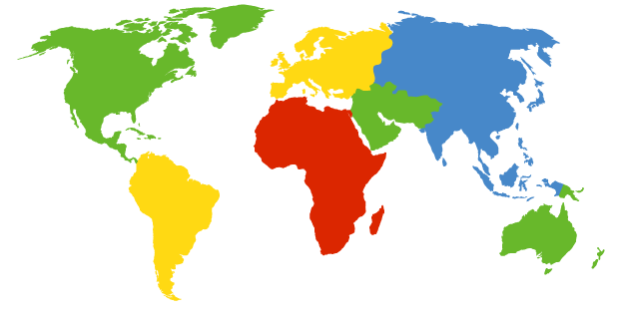
DNS: Root name servers
contacted by local name server that can not resolve name
root name server:
contacts authoritative name server if name mapping not known
returns mapping to top-level name server
a NSI Herndon, VA
c PSInet Herndon, VA
d U Maryland College Park, MD
g DISA Vienna, VA
h ARL Aberdeen, MD
j NSI (TBD) Herndon, VA
k RIPE London
i NORDUnet Stockholm
m WIDE Tokyo
e NASA Mt View, CA
f Internet Software C. Palo Alto, CA
b USC-ISI Marina del Rey, CA
l ICANN Marina del Rey, CA
Notes:
DNS: Root name servers
2.5.2
Diagram: There are 13 root name servers worldwide, named ‘a’ – ‘m’. Aside from ones in London, Tokyo and Stockholm, all other root name servers are in North America.

Slide 38
DNS: iterated queries
root name server
recursive query:
puts burden of name resolution on contacted name server
heavy load?
iterated query:
contacted server replies with name of server to contact
“I don’t know this name, but ask this server”
2
iterated query
3
4
7
local name server
agate.lut.ac.uk.
intermediate name server
B.GTLD-SERVERS.NET.
5
6
1
8
authoritative name server
ns3.google.com
requesting host
maps.google.com
maps.google.com
Notes:
DNS: iterated queries
2.5.2

Slide 39
DNS is Hierarchical (contd.)
Globally unique names
Administered in zones (parts of the tree)
You can give away ("delegate") control of part of the tree underneath you
Example:
google.com on one set of nameservers
maps.google.com on a different set
www.maps.google.com on another set

Slide 40
Domain Names are (almost) unlimited
Max 255 characters total length
Max 63 characters in each part
RFC 1034, RFC 1035
If a domain name is being used as a host name, you should abide by some restrictions
RFC 952 (old!)
a-z 0-9 and minus (-) only
No underscores ( _ )

Slide 41
Using the DNS
A Domain Name (like www.lut.ac.uk) is the KEY to look up information
The result is one or more RESOURCE RECORDS (RRs)
There are different RRs for different types of information
You can ask for the specific type you want, or ask for "any" RRs associated with the domain name

Slide 42
Commonly seen Resource Records (RRs)
A (address): map hostname to IPv4 address
AAAA (quad A): map a hostname to IPv6 address
PTR (pointer): map IP address to hostname
MX (mail exchanger): where to deliver mail for user@domain
CNAME (canonical name): map alternative hostname to real hostname
TXT (text): any descriptive text
NS (name server), SOA (start of authority): used for delegation and management of the DNS itself

Slide 43
A Simple Example
Query: www.lut.ac.uk.
Query type: A
Result:
www.lut.ac.uk. 22725 IN A 158.125.1.208
In this case a single RR is found, but in general, multiple RRs may be returned.
(IN is the "class" for INTERNET use of the DNS)

Slide 44
Possible results from a Query
POSITIVE
one or more RRs found
NEGATIVE
definitely no RRs match the query
SERVER FAIL
cannot find the answer
REFUSED
not allowed to query the server

Slide 45
How do you use an IP address as the key for a DNS query
Convert the IP address to dotted-quad
Reverse the four parts
Add ".in-addr.arpa." to the end; special domain reserved for this purpose
e.g. to find name for 158.125.1.208
Domain name: 208.1.125.158.in-addr.arpa.
Query Type: PTR
Result: www.lut.ac.uk.
Known as a "reverse DNS lookup" (because we are looking up the name for an IP address, rather than the IP address for a name)

Slide 46
DNS is a Client-Server application
(Of course - it runs across a network)
Requests and responses are normally sent in UDP packets, port 53
Occasionally uses TCP, port 53
for very large requests (larger than 512-bytes) e.g. zone transfer from master to slave or an IPv6 AAAA (quad A) record.

Slide 47
There are three roles involved in DNS
e.g. web
browser
Application
Resolver
Caching
Nameserver
Authoritative
Nameserver

Slide 48
Three roles in DNS
RESOLVER
Takes request from application, formats it into UDP packet, sends to cache
CACHING NAMESERVER
Returns the answer if already known
Otherwise searches for an authoritative server which has the information
Caches the result for future queries
Also known as RECURSIVE nameserver
AUTHORITATIVE NAMESERVER
Contains the actual information put into the DNS by the domain owner

Slide 49
Three roles in DNS
The SAME protocol is used for resolver <-> cache and cache <-> auth NS communication
It is possible to configure a single name server as both caching and authoritative
But it still performs only one role for each incoming query
Common but NOT RECOMMENDED to configure in this way (we will see why later).

Slide 50
ROLE 1: THE RESOLVER
A piece of software which formats a DNS request into a UDP packet, sends it to a cache, and decodes the answer
Usually a shared library (e.g. libresolv.so under Unix) because so many applications need it
EVERY host needs a resolver - e.g. every Windows workstation has one

Slide 51
How does the resolver find a caching nameserver?
It has to be explicitly configured (statically, or via DHCP etc)
Must be configured with the IP ADDRESS of a cache (why not name?)
Good idea to configure more than one cache, in case the first one fails

Slide 52
How do you choose which cache(s) to configure?
Must have PERMISSION to use it
e.g. cache at your ISP, or your own
Prefer a nearby cache
Minimises round-trip time and packet loss
Can reduce traffic on your external link, since often the cache can answer without contacting other servers
Prefer a reliable cache
Perhaps your own?

Slide 53
Resolver can be configured with default domain(s)
If "foo.bar" fails, then retry query as "foo.bar.mydomain.com"
Can save typing but adds confusion
May generate extra unnecessary traffic
Usually best avoided

Slide 54
Example: Unix resolver configuration
/etc/resolv.conf
domain lboro.ac.uk
nameserver 158.125.1.100
nameserver 131.231.16.7
That's all you need to configure a resolver

Slide 55
Testing DNS with "dig"
"dig" is a program which just makes DNS queries and displays the results
Better than "nslookup", "host" because it shows the raw information in full
dig lboro.ac.uk.
-- defaults to query type "A"
dig lboro.ac.uk. mx
-- specified query type
dig @8.8.8.8 lboro.ac.uk. mx
-- send to particular cache (overrides
/etc/resolv.conf)

Slide 56
The trailing dot
# dig lboro.ac.uk.
Prevents any default domain being appended
Get into the habit of using it always when testing DNS
only on domain names, not IP addresses or e-mail addresses

Slide 57
dig lboro.ac.uk.
; <<>> DiG 9.6.0-APPLE-P2 <<>> lboro.ac.uk.
;; global options: +cmd
;; Got answer:
;; ->>HEADER<<- opcode: QUERY, status: NOERROR, id: 26566
;; flags: qr aa rd ra; QUERY: 1, ANSWER: 1, AUTHORITY: 4, ADDITIONAL: 7
;; QUESTION SECTION:
;lboro.ac.uk. IN A
;; ANSWER SECTION:
lboro.ac.uk. 86400 IN A 158.125.1.208
;; AUTHORITY SECTION:
lboro.ac.uk. 86400 IN NS cgate.lut.ac.uk.
lboro.ac.uk. 86400 IN NS agate.lut.ac.uk.
lboro.ac.uk. 86400 IN NS bgate.lut.ac.uk.
lboro.ac.uk. 86400 IN NS ns3.ja.net.
;; ADDITIONAL SECTION:
agate.lut.ac.uk. 86400 IN A 158.125.1.100
bgate.lut.ac.uk. 86400 IN A 131.231.16.7
bgate.lut.ac.uk. 86400 IN AAAA 2001:630:301:4605::b53
cgate.lut.ac.uk. 86400 IN A 131.231.16.16
cgate.lut.ac.uk. 86400 IN AAAA 2001:630:301:2905::c53
ns3.ja.net. 21325 IN A 193.63.106.103
ns3.ja.net. 39250 IN AAAA 2001:630:0:46::67
;; Query time: 30 msec
;; SERVER: 158.125.1.100#53(158.125.1.100)
;; WHEN: Sun Dec 6 15:51:52 2009
;; MSG SIZE rcvd: 281

Slide 58
Understanding output from dig
STATUS
NOERROR: 0 or more RRs returned
NXDOMAIN: non-existent domain
SERVFAIL: cache could not locate answer
REFUSED: query not available on cache server
FLAGS
AA: Authoritative answer (not from cache)
You can ignore the others
QR: Query/Response (1 = Response)
RD: Recursion Desired
RA: Recursion Available
ANSWER: number of RRs in answer

Slide 59
Understanding output from dig
Answer section (RRs requested)
Each record has a Time To Live (TTL)
Says how long the cache will keep it
Authority section
Which nameservers are authoritative for this domain
Additional section
More RRs (typically IP addresses for the authoritative nameservers)
Total query time
Check which server gave the response!
If you make a typing error, the query may go to a default server

Slide 60
DNS records
DNS: distributed db storing resource records (RR)
RR format: (name, value, type,ttl)
Type=A
name is hostname
value is IP address
Type=CNAME
name is alias name for some “cannonical” (the real) name
www.lboro.ac.uk is really
www.lut.ac.uk.
value is cannonical name
Type=NS
name is domain (e.g. foo.com)
value is IP address of authoritative name server for this domain
Type=MX
value is name of mailserver associated with name
Notes:
DNS records
2.5.3

Slide 61
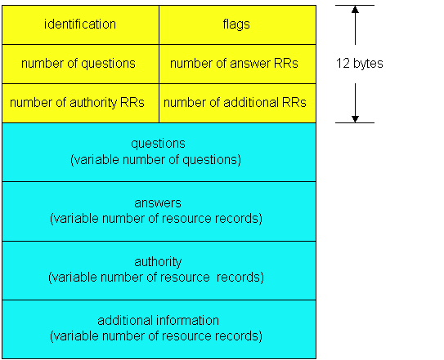
DNS protocol, messages
DNS protocol : query and reply messages, both with same message format
msg header
identification: 16 bit # for query, reply to query uses same #
flags:
query or reply
recursion desired
recursion available
reply is authoritative
Notes:
DNS protocol, messages
2.5.4
Diagram: A DNS message consists of a 16-bit identification number, several flags (indicating the nature of the message), the number of questions (each consisting of a Name and Type field), the number of answer Resource Records (RRs) (giving a response to the query) , the number of authority RRs (showing which servers answered the query), and the number of additional RRs (any other ‘useful’ information).

Slide 62
DNS protocol, messages
Name, type fields
for a query
RRs in reponse
to query
records for
authoritative servers
additional “helpful”
info that may be used
Notes:
DNS protocol, messages
2.5.4

Slide 63
HTTP
(Hypertext Transfer Protocol)

Slide 64
HTTP overview
HTTP: hypertext transfer protocol
Web’s application layer protocol
client/server model
client: browser that requests, receives, “displays” Web objects
server: Web server sends objects in response to requests
HTTP 1.0: RFC 1945
HTTP 1.1: RFC 2068
PC running
Explorer
HTTP request
HTTP response
HTTP request
Server
running
Apache Web
server
HTTP response
Mac running
Safari
Notes:
HTTP overview
2.2.1
Diagram: Typical HTTP software clients include Explorer on PCs and Navigator on Macs. Typical HTTP servers include Apache.

Slide 65
HTTP overview (continued)
Uses TCP:
client initiates TCP connection (creates socket) to server, port 80
server accepts TCP connection from client
HTTP messages (application-layer protocol messages) exchanged between browser (HTTP client) and Web server (HTTP server)
TCP connection closed
HTTP is “stateless”
server maintains no information about past client requests
aside
Protocols that maintain “state” are complex!
past history (state) must be maintained
if server/client crashes, their views of “state” may be inconsistent, must be reconciled
Notes:
HTTP overview (continued)
2.2.1

Slide 66
HTTP connections
Nonpersistent HTTP
At most one object is sent over a TCP connection.
HTTP/1.0 uses nonpersistent HTTP
Persistent HTTP
Multiple objects can be sent over single TCP connection between client and server.
HTTP/1.1 uses persistent connections in default mode
Notes:
HTTP overview (continued)
2.2.2

Slide 67
Nonpersistent HTTP
(contains text,
references to 10
jpeg images)
Suppose user enters URL:
http://www.someSchool.edu/someDepartment/home.index
1a. HTTP client initiates TCP connection to HTTP server (process) at www.someSchool.edu on port 80
1b. HTTP server at host www.someSchool.edu waiting for TCP connection at port 80. “accepts” connection, notifying client
2. HTTP client sends HTTP request message (containing URL) into TCP connection socket. Message indicates that client wants object someDepartment/home.index
3. HTTP server receives request message, forms response message containing requested object, and sends message into its socket
time
Notes:
Nonpersistent HTTP
2.2.2 – Nonpersistent Connections
Diagram: Consider the URL www.someSchool.edu/someDept/home.index, and assume that home.index file contains text and references to 10 images.
The communication is as follows:
1a – HTTP Client initiates TCP connection to HTTP server (which is a process on a host) at www.someSchool.edu, on port 80.
1b – HTTP Server at host accepts the connection on port 80, and notifies the client.
2 – HTTP client sets HTTP Request Message (containing URL) into the TCP connection socket. Message indicates that the client wants someDept/home.index
3 – HTTP server receives Request Message and forms a Response Message, containing the requested file, and sends the message into its socket.
4 – The Server closes the connection with the Client.
5 – The Client processes the HTML file received and discovers the links to the images.
6 – Steps 1 to 5 are carried out again, for each image.

Slide 68
Nonpersistent HTTP (cont.)
5. HTTP client receives response message containing html file, displays html. Parsing html file, finds 10 referenced jpeg objects
4. HTTP server closes TCP connection.
time
6. Steps 1-5 repeated for each of 10 jpeg objects
Notes:
Nonpersistent HTTP (cont.)
2.2.2 – Nonpersistent Connections

Slide 69
Response time modeling
Definition of RTT: time to send a small packet to travel from client to server and back.
Response time:
one RTT to initiate TCP connection
one RTT for HTTP request and first few bytes of HTTP response to return
file transmission time
total = 2RTT+transmit time
initiate TCP
connection
RTT
request
file
time to
transmit
file
RTT
file
received
time
time
Notes:
Response time modeling
2.2.2 – Nonpersistent Connections

Slide 70
Persistent HTTP
Nonpersistent HTTP issues:
requires 2 RTTs per object
OS must work and allocate host resources for each TCP connection
but browsers often open parallel TCP connections to fetch referenced objects
Persistent HTTP
server leaves connection open after sending response
subsequent HTTP messages between same client/server are sent over connection
Persistent without pipelining:
client issues new request only when previous response has been received
one RTT for each referenced object
Persistent with pipelining:
default in HTTP/1.1
client sends requests as soon as it encounters a referenced object
as little as one RTT for all the referenced objects
Notes:
Persistent HTTP
2.2.2 – Persistent Connections

Slide 71
HTTP request message
two types of HTTP messages: request, response
HTTP request message:
ASCII (human-readable format)
request line
(GET, POST,
HEAD commands)
GET /somedir/page.html HTTP/1.1
Host: www.someschool.edu
User-agent: Mozilla/4.0
Connection: close
Accept-language:en
(extra carriage return, line feed)
header
lines
Carriage return,
line feed
indicates end
of message
Notes:
HTTP request message
2.2.3 – HTTP Request Message

Slide 72
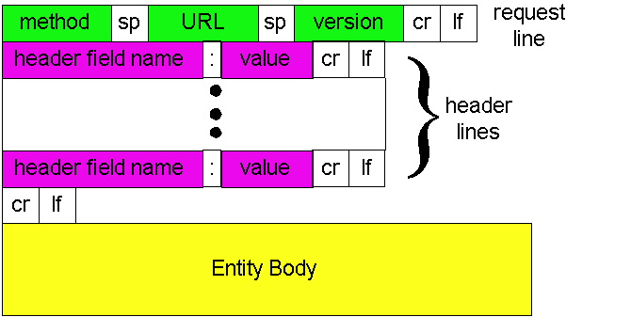
HTTP request message: general format
Notes:
HTTP request message: general format
2.2.3 – HTTP Request Message
Diagram: The HTTP Request Message is split into 3 sections:
Request Line:
This consists of a Method (e.g. GET or POST), then a space then the URL then a space then the Version then a Carriage Return and Line Feed.
Header Lines:
These are zero or more lines specifying extra information. Each line consists of a Header Field Name (e.g. User-Agent, Connection) then a colon then a value (e.g. Mozilla 4.0, Close) then a Carriage Return and Line Feed.
After the final header, even if there are zero headers, an extra Carriage Return and Line Feed is sent.
Entity Body:
Contains the rest of the request, for example uploaded files, etc.

Slide 73
Uploading form input
Post method:
Web page often includes form input
Input is uploaded to server in entity body
URL method:
Uses GET method
Input is uploaded in URL field of request line:
www.somesite.com/animalsearch?monkeys&banana
Notes:
Uploading form input
2.2.3 – HTTP Request Message

Slide 74
Method types
HTTP/1.0
GET
POST
HEAD
asks server to leave requested object out of response
HTTP/1.1
GET, POST, HEAD
PUT
uploads file in entity body to path specified in URL field
DELETE
deletes file specified in the URL field
Notes:
Method types
2.2.3 – HTTP Request Message

Slide 75
Conditional GET: client-side caching
client
server
Goal: don’t send object if client has up-to-date cached version
client: specify date of cached copy in HTTP request
If-modified-since: <date>
server: response contains no object if cached copy is up-to-date:
HTTP/1.0 304 Not Modified
HTTP request msg
If-modified-since: <date>
object
not
modified
HTTP response
HTTP/1.0
304 Not Modified
HTTP request msg
If-modified-since: <date>
object
modified
HTTP response
HTTP/1.0 200 OK
<data>
Notes:
Conditional GET: client-side caching
2.2.5

Slide 76
HTTP response message
status line
(protocol
status code
status phrase)
HTTP/1.1 200 OK
Connection close
Date: Sun, 06 Dec 2009 12:00:15 GMT
Server: Apache/1.3.0 (Unix)
Last-Modified: Fri, 04 Dec 2009...
Content-Length: 6821
Content-Type: text/html
data data data data data ...
header
lines
data, e.g.,
requested
HTML file
Notes:
HTTP response message
2.2.3 – HTTP Response Message

Slide 77
HTTP response status codes
In first line in server->client response message.
A few sample codes:
200 OK
request succeeded, requested object later in this message
301 Moved Permanently
requested object moved, new location specified later in this message (Location:)
400 Bad Request
request message not understood by server
404 Not Found
requested document not found on this server
505 HTTP Version Not Supported
Notes:
HTTP response status codes
2.2.3 – HTTP Response Message

Slide 78
Trying out HTTP (client side) for yourself
1. Telnet to your favorite Web server:
telnet www.lboro.ac.uk 80
Opens TCP connection to port 80
(default HTTP server port).
Anything typed in sent
to port 80 at www.lut.ac.uk.
2. Type in a GET HTTP request:
GET /index.html HTTP/1.0
By typing this in (hit carriage
return twice), you send
this minimal (but complete)
GET request to HTTP server
3. Look at response message sent by HTTP server!
Notes:
Trying out HTTP (client side) for yourself

Slide 79
Cookies: keeping “state”
Many major Web sites use cookies
Four components:
1) cookie header line in the HTTP response message
2) cookie header line in HTTP request message
3) cookie file kept on user’s host and managed by user’s browser
4) back-end database at Web site
Example:
Susan access Internet always from same PC
She visits a specific e-commerce site for first time
When initial HTTP requests arrives at site, site creates a unique ID and creates an entry in backend database for ID
Notes:
Cookies: keeping “state”
2.2.4 - Cookies

Slide 80
Cookies: keeping “state” (cont.)
client
server
Cookie file
usual http request msg
server
creates ID
1678 for user
ebay: 8734
usual http response +
Set-cookie: 1678
entry in backend
database
Cookie file
usual http request msg
cookie: 1678
amazon: 1678
ebay: 8734
cookie-
specific
action
access
usual http response msg
one week later:
access
Cookie file
usual http request msg
cookie: 1678
cookie-
spectific
action
amazon: 1678
ebay: 8734
usual http response msg
Notes:
Cookies: keeping “state” (cont.)
2.2.4 – Cookies
Diagram: Consider a client and server interacting using cookies.
Client sends HTTP request to server.
Server creates ID 1678 for user and enters it into a back-end database.
Server sends a usual response along with Set-Cookie: 1678 (a header line)
Client stores this cookie in the HTTP browser.
Client sends HTTP request to server and includes Cookie: 1678
Server looks up ID 1678 in its database and acts accordingly
Server sends a usual response.
-- one week later –
Client sends HTTP request to server and cookie
Server looks up ID 1678 in its database and acts accordingly
Server sends a usual response.

Slide 81
Cookies (continued)
What cookies can bring:
authorization
shopping carts
recommendations
user session state (Web e-mail)
aside
Cookies and privacy:
cookies permit sites to learn a lot about you
you may supply name and e-mail to sites
search engines use redirection & cookies to learn yet more
advertising companies obtain info across sites
Notes:
Cookies (continued)
2.2.4 - Cookies

Slide 82
User-server interaction: authorization
client
server
Authorization: control access to server content
authorization credentials: typically name, password
stateless: client must present authorization in each request
authorization: header line in each request
if no authorization: header, server refuses access, sends
WWW authenticate:
header line in response
usual http request msg
401: authorization req.
WWW authenticate:
usual http request msg
+ Authorization: <cred>
usual http response msg
usual http request msg
+ Authorization: <cred>
usual http response msg
time
Notes:
User-server interaction: authorization
2.2.4 – Authorization
Diagram: Consider a client connecting to a server requiring authorisation, to obtain 2 files.
Client sends usual HTTP request message
Server sends 401: Authorisation Required (WWW Authenticate:)
Client sends usual HTTP request message with authentication information (obtained from user)
Server sends usual response message
Client sends usual request message with authentication information
Server sends usual response message.

Slide 83
CDNs
(Content Distribution Networks)

Slide 84
Web caches (proxy server)
Goal: satisfy client request without involving origin server
user sets browser: Web accesses via cache
browser sends all HTTP requests to cache
object in cache: cache returns object
else cache requests object from origin server, then returns object to client
origin
server
Proxy
server
HTTP request
HTTP request
client
HTTP response
HTTP response
HTTP request
HTTP response
client
Notes:
Web caches (proxy server)
2.9.1
Diagram: A proxy server sits between clients and a server. It intercepts all requests and if it can answer them then it replies on behalf of the origin server. If it cannot answer the request then it sends it on to the origin server and passes the reply back. It may cache the reply in case the same request comes through again later.

Slide 85
More about Web caching
Cache acts as both client and server
Cache can do up-to-date check using If-modified-since HTTP header
Issue: should cache take risk and deliver cached object without checking?
Heuristics are used.
Typically cache is installed by ISP (university, company, residential ISP)
Why Web caching?
Reduce response time for client request.
Reduce traffic on an institution’s access link.
Internet dense with caches enables “poor” content providers to effectively deliver content
Notes:
More about Web caching
2.9.1

Slide 86
Content distribution networks (CDNs)
The content providers are the CDN customers.
Content replication
CDN company installs hundreds of CDN servers throughout Internet
in lower-tier ISPs, close to users
CDN replicates its customers’ content in CDN servers. When provider updates content, CDN updates servers
origin server
in North America
CDN distribution node
CDN server
in S. America
CDN server
in Asia
CDN server
in Europe
Notes:
Content distribution networks (CDNs)
2.9.2

Slide 87
CDN example
HTTP request for
http://www.foo.com/sports/sports.html
1
Origin server
2
DNS query for www.cdn.com
3
CDNs authoritative DNS server
HTTP request for
http://www.cdn.com/www.foo.com/sports/ruth.gif
Nearby CDN server
origin server
www.foo.com
distributes HTML
Replaces:
http://www.foo.com/sports.ruth.gif
with http://www.cdn.com/www.foo.com/sports/ruth.gif
CDN company
cdn.com
distributes gif files
uses its authoritative DNS server to route redirect requests
Notes:
CDN example
2.9.2

Slide 88
FTP
(File Transfer Protocol)

Slide 89

FTP: the file transfer protocol
file transfer
FTP user
interface
FTP
client
FTP
server
user
at host
local file
system
remote file
system
transfer file to/from remote host
client/server model
client: side that initiates transfer (either to/from remote)
server: remote host
ftp: RFC 959
ftp server: port 21
Notes:
FTP: the file transfer protocol
2.3

Slide 90
FTP: separate control, data connections
FTP client contacts FTP server at port 21, specifying TCP as transport protocol
Client obtains authorization over control connection
Client browses remote directory by sending commands over control connection.
When server receives a command for a file transfer, the server opens a TCP data connection to client
After transferring one file, server closes connection.
TCP control connection
port 21
TCP data connection
port 20
FTP
client
FTP
server
Server opens a second TCP data connection to transfer another file.
Control connection: “out of band”
FTP server maintains “state”: current directory, earlier authentication
Notes:
FTP: separate control, data connections
2.3
Diagram: FTP uses TCP port 21 to send commands (Control Connection), and TCP port 20 to move data (Data Connection)

Slide 91
FTP commands, responses
Sample commands:
sent as ASCII text over control channel
USER username
PASS password
LIST return list of file in current directory
RETR filename retrieves (gets) file
STOR filename stores (puts) file onto remote host
Sample return codes
status code and phrase (as in HTTP)
331 Username OK, password required
125 data connection already open; transfer starting
425 Can’t open data connection
452 Error writing file
Notes:
FTP commands, responses
2.3.1

Slide 92
E-Mail
(SMTP, POP, IMAP)

Slide 93
Electronic Mail
Three major components:
user agents
mail servers
simple mail transfer protocol: SMTP
User Agent
a.k.a. “mail reader”
composing, editing, reading mail messages
e.g., Eudora, Outlook, mutt, Apple Mail
outgoing, incoming messages stored on server
user
agent
user
agent
SMTP
user
agent
SMTP
user
agent
SMTP
user
agent
user
agent
Notes:
Electronic Mail
2.4
Diagram: Mail servers have outgoing message queues and mail boxes for each of their users’ incoming mail.
Mail servers communicate with each other using SMTP, user agents (I.e. user mail reading software) do not use SMTP to retrieve email.

Slide 94
Electronic Mail
Mail Servers
mailbox contains incoming messages for user
message queue of outgoing (to be sent) mail messages
SMTP protocol between mail servers to send email messages
client: sending mail server
“server”: receiving mail server
user
agent
user
agent
SMTP
user
agent
SMTP
user
agent
SMTP
user
agent
user
agent
Notes:
Electronic Mail
2.4
Diagram: Mail servers have outgoing message queues and mail boxes for each of their users’ incoming mail.
Mail servers communicate with each other using SMTP, user agents (I.e. user mail reading software) do not use SMTP to retrieve email.

Slide 95
Electronic Mail: SMTP [RFC 2821]
uses TCP to reliably transfer email message from client to server, port 25
direct transfer: sending server to receiving server
three phases of transfer
handshaking (greeting)
transfer of messages
closure
command/response interaction
commands: ASCII text
response: status code and phrase
messages must be in 7-bit ASCII
Notes:
Electronic Mail: SMTP [RFC 2821]
2.4.1

Slide 96

Scenario: Alice sends message to Bob
1) Alice composes a message “to” bob@someschool.edu
2) Alice’s user agent sends message to her mail server; message placed in message queue
3) Client side of SMTP opens TCP connection with Bob’s mail server
4) SMTP client sends Alice’s message over the TCP connection
5) Bob’s mail server places the message in Bob’s mailbox
6) Bob invokes his user agent to read message
1
2
3
6
user
agent
user
agent
4
5
Notes:
Scenario: Alice sends message to Bob
2.4.1
Diagram: Consider a message sent from Alice to Bob. It will travel from Alices User Agent to a mail server then to Bob’s mail server, and is retrieved by Bob’s User Agent.

Slide 97
Sample SMTP interaction
S: 220 hamburger.edu
C: HELO crepes.fr
S: 250 Hello crepes.fr, pleased to meet you
C: MAIL FROM: <alice@crepes.fr>
S: 250 alice@crepes.fr... Sender ok
C: RCPT TO: <bob@hamburger.edu>
S: 250 bob@hamburger.edu ... Recipient ok
C: DATA
S: 354 Enter mail, end with "." on a line by itself
C: Do you like ketchup?
C: How about pickles?
C: .
S: 250 Message accepted for delivery
C: QUIT
S: 221 hamburger.edu closing connection
Notes:
Sample SMTP interaction
2.4.1

Slide 98
Try SMTP interaction for yourself:
telnet servername 25
see 220 reply from server
enter HELO, MAIL FROM, RCPT TO, DATA, QUIT commands
above lets you send email without using email client (reader)
Notes:
Try SMTP interaction for yourself:

Slide 99
SMTP: final words
SMTP uses persistent connections
SMTP requires message (header & body) to be in 7-bit ASCII
Comparison with HTTP:
HTTP: pull
SMTP: push
both have ASCII command/response interaction, status codes
HTTP: each object encapsulated in its own response msg
SMTP: multiple objects sent in multipart msg
Notes:
SMTP: final words
2.4.1, 2.4.2

Slide 100
Mail message format
SMTP: protocol for exchanging email msgs
RFC 822: standard for text message format:
header lines, e.g.,
To:
From:
Subject:
different from SMTP commands!
body
the “message”, ASCII characters only
header
blank
line
body
Notes:
Mail message format
2.4.3
Diagram: SMTP messages have a header similar to HTTP headers (To:, From:, Subject:) then a blank line like HTTP and the message body.

Slide 101
Message format: multimedia extensions
MIME: multimedia mail extension, RFC 2045, 2056
additional lines in msg header declare MIME content type
From: alice@crepes.fr
To: bob@hamburger.edu
Subject: Picture of yummy crepe.
MIME-Version: 1.0
Content-Transfer-Encoding: base64
Content-Type: image/jpeg
base64 encoded data .....
.........................
......base64 encoded data
MIME version
method used
to encode data
multimedia data
type, subtype,
param. declaration
encoded data
Notes:
Message format: multimedia extensions
2.4.3 – The MIME Extension for Non-ASCII Data
Diagram: MIME messages add an extra few headers – MIME-Version:, Content-Transfer-Encoding and Content-Type.
The encoded data is sent as part of the body.

Slide 102
MIME types Content-Type: type/subtype; parameters
Text
example subtypes: plain, html
Image
example subtypes: jpeg, gif
Audio
example subtypes: basic (8-bit mu-law encoded), 32kadpcm (32 kbps coding)
Video
example subtypes: mpeg, quicktime
Application
other data that must be processed by reader before “viewable”
example subtypes: msword, octet-stream
Notes:
MIME types
2.4.3 – The MIME Extension for Non-ASCII Data

Slide 103
Multipart Type
From: alice@crepes.fr
To: bob@hamburger.edu
Subject: Picture of yummy crepe.
MIME-Version: 1.0
Content-Type: multipart/mixed; boundary=StartOfNextPart
--StartOfNextPart
Dear Bob, Please find a picture of a crepe.
--StartOfNextPart
Content-Transfer-Encoding: base64
Content-Type: image/jpeg
base64 encoded data .....
.........................
......base64 encoded data
--StartOfNextPart
Do you want the recipe?
Notes:
Multipart Type
2.4.3 – The MIME Extension for Non-ASCII Data, 2.4.3 – The Received Message

Slide 104
POP3
Short for Post Office Protocol, a protocol used to retrieve e-mail from a mail server.
Still most e-mail applications use the POP protocol, although some can use the newer IMAP (Internet Message Access Protocol).
There are two versions of POP. The first, called POP2, became a standard in the mid-80's and requires SMTP to send messages. The newer version, POP3, can be used with or without SMTP. POP3 uses TCP/IP port 110.

Slide 105
POP3 protocol
S: +OK POP3 server ready
C: user bob
S: +OK
C: pass hungry
S: +OK user successfully logged on
authorization phase
client commands:
user: declare username
pass: password
server responses
+OK
-ERR
transaction phase, client:
list: list message numbers
retr: retrieve message by number
dele: delete
quit
C: list
S: 1 498
S: 2 912
S: .
C: retr 1
S: <message 1 contents>
S: .
C: dele 1
C: retr 2
S: <message 1 contents>
S: .
C: dele 2
C: quit
S: +OK POP3 server signing off
Notes:
POP3 protocol
2.4.4 – POP3
Diagram: The POP3 protocol consists of an authorisation phase to log on, then a transaction phase to interact with email.

Slide 106
POP3 (more) and IMAP
More about POP3
Previous example uses “download and delete” mode.
Bob cannot re-read e-mail if he changes client
“Download-and-keep”: copies of messages on different clients
POP3 is stateless across sessions
IMAP
Keep all messages in one place: the server
Allows user to organize messages in folders
IMAP keeps user state across sessions:
names of folders and mappings between message IDs and folder name
Notes:
POP3 (more) and IMAP
2.4.4 – POP3, 2.4.4 – IMAP

Slide 107
IMAP
IMAP is an Internet Message Access Protocol. It is a method of accessing electronic mail messages that are kept on a possibly shared mail server. In other words, it permits a "client" email program to access remote message stores as if they were local. For example, email stored on an IMAP server can be manipulated from a desktop computer at home, a workstation at the office, and a notebook computer while travelling, without the need to transfer messages or files back and forth between these computers.
IMAP uses TCP/IP port 143.

Slide 108
POP3 vs IMAP
With IMAP, all your mail stays on the server in multiple folders, some of which you have created. This enables you to connect to any computer and see all your mail and mail folders. In general, IMAP is great if you have a dedicated connection to the Internet or you like to check your mail from various locations.
With POP3 you only have one folder, the Inbox folder. When you open your mailbox, new mail is moved from the host server and saved on your computer. If you want to be able to see your old mail messages, you have to go back to the computer where you last opened your mail.
With POP3 "leave mail on server" only your email messages are on the server, but with IMAP your email folders are also on the server.

Slide 109
Test POP3 and IMAP …..
# telnet localhost 143
Connected to staff-mail.lboro.ac.uk.
Escape character is '^]'.
* OK [CAPABILITY IMAP4rev1 UIDPLUS CHILDREN NAMESPACE THREAD=ORDEREDSUBJECT
THREAD=REFERENCES SORT QUOTA IDLE ACL ACL2=UNION STARTTLS] Courier-IMAP ready.
Copyright 1998-2005 Double Precision, Inc. See COPYING for distribution information.
a login username password
a OK LOGIN Ok.
a examine inbox
* FLAGS (\Answered \Flagged \Deleted \Seen \Recent)
* OK [PERMANENTFLAGS ()] No permanent flags permitted
* 26 EXISTS
* 0 RECENT
* OK [UIDVALIDITY 989061119] Ok
* OK [READ-ONLY] Ok
a logout
* BYE Courier-IMAP server shutting down
a OK LOGOUT completed
Connection closed by foreign host.

Slide 110
Exim
Exim is an open source mail transfer agent (MTA), which is a program responsible for receiving, routing, and delivering e-mail messages (this type of program is sometimes referred to as an Internet mailer, or a mail server program). MTAs receive e-mail messages and recipient addresses from local users and remote hosts, perform alias creation and forwarding functions, and deliver the messages to their destinations. Exim was developed at the University of Cambridge for the use of Unix systems connected over the Internet. The software can be installed in place of sendmail, the most common MTA for UNIX and Linux systems. In comparison to sendmail, Exim is said to feature more straightforward configuration and task management.

Slide 111
Network Address Translation
(NAT)

Slide 112
NAT: Network Address Translation
Motivation: local network uses just one IP address as far as outside word is concerned:
no need to be allocated range of addresses from ISP: just one IP address is used for all devices
can change addresses of devices in local network without notifying outside world
can change ISP without changing addresses of devices in local network
devices inside local net not explicitly addressable, visible by outside world (a security plus).
Notes:
NAT: Network Address Translation
4.4.7

Slide 113
Private Network
Private IP network is an IP network that is not directly connected to the Internet
IP addresses in a private network can be assigned arbitrarily.
Not registered and not guaranteed to be globally unique
Generally, private networks use addresses from the following experimental address ranges (non-routable addresses):
10.0.0.0 – 10.255.255.255
172.16.0.0 – 172.31.255.255
192.168.0.0 – 192.168.255.255

Slide 114
Private Addresses

Slide 115
NAT: Network Address Translation
rest of
Internet
local network
(e.g., home network)
10.0.0/24
10.0.0.1
10.0.0.4
10.0.0.2
138.76.29.7
10.0.0.3
All datagrams leaving local
network have same single source NAT IP address: 138.76.29.7,
different source port numbers
Datagrams with source or
destination in this network
have 10.0.0/24 address for
source, destination (as usual)
Notes:
NAT: Network Address Translation
4.4.7
Diagram: Network Address Translation (NAT) Gateways join LANs to WANs (e.g. Internet). No matter what the address of the sending computer on the LAN, all packets leaving the NAT Gateway have the WAN address of the gateway, but with differing source port numbers. Datagrams within the network are unchanged.

Slide 116
NAT: Network Address Translation
Implementation: NAT router must:
outgoing datagrams: replace (source IP address, port #) of every outgoing datagram to (NAT IP address, new port #)
. . . remote clients/servers will respond using (NAT IP address, new port #) as destination addr.
remember (in NAT translation table) every (source IP address, port #) to (NAT IP address, new port #) translation pair
incoming datagrams: replace (NAT IP address, new port #) in dest fields of every incoming datagram with corresponding (source IP address, port #) stored in NAT table
Notes:
NAT: Network Address Translation
4.4.7

Slide 117
NAT: Network Address Translation
NAT translation table
WAN side addr LAN side addr
1: host 10.0.0.4
sends datagram to
128.119.40, 80
2: NAT gw changes datagram source addr from 10.0.0.4, 3345 to 138.76.29.7, 5001,
updates table
138.76.29.7, 5001 10.0.0.4, 3345
…… ……
S: 10.0.0.4, 3345
D: 128.119.40.186, 80
10.0.0.4
1
2
S: 138.76.29.7, 5001
D: 128.119.40.186, 80
10.0.0.1
10.0.0.2
138.76.29.7
S: 128.119.40.186, 80
D: 10.0.0.1, 3345
4
S: 128.119.40.186, 80
D: 138.76.29.7, 5001
3
4: NAT router
changes datagram
dest addr from
138.76.29.7, 5001 to 10.0.0.4, 3345
10.0.0.3
3: Reply arrives
dest. address:
138.76.29.7, 5001
Notes:
NAT: Network Address Translation
4.4.7, fig 4.28
Diagram: Consider host 10.0.0.1 on a LAN with a NAT gateway with internal address 10.0.0.4 and external address 138.76.29.7
Host 10.0.0.1 sends datagram to 128.119.40, port 80.
NAT router changes datagram source address from 10.0.0.1, port 3345, to 138.76.29.7, port 5001 and updates the NAT table, storing the WAN side address of the datagram and the LAN side address.
Reply arrives with destination address 138.76.29.7, port 5001.
NAT router looks up destination address and changes reply datagram destination address to 10.0.0.1, port 3345

Slide 118
NAT: Network Address Translation
16-bit port-number field:
60,000 simultaneous connections with a single LAN-side address!
NAT is controversial:
violates end-to-end argument
NAT possibility must be taken into account by app designers, eg, P2P applications
address shortage should instead be solved by IPv6
Notes:
NAT: Network Address Translation
4.4.7

Slide 119
Simple NAT
(Public IP addresses)
(Private IP
addresses)
NAT
Main
Internet
(Public IP addresses)

Slide 120
Provider NATs? Considered Harmful
156.148.70.32
Main
Internet
ISP
NAT
(Public IP addresses)
ISP
network
192.168.2.12
192.168.2.99
Home
NAT
(Private IP adresses)
Home
network
10.0.0.12

Slide 121
NAT traversal: relay
Main
Internet
1
Relay S
2
NAT
NAT
Local
network
Local
network
10.0.0.12
192.168.2.99
host B
host A
Notes:
Relaying is the simplest way to traverse a NAT and probably the only solution when both host A and host B are behind a NAT/Firewall.
This solution assumes that hosts can initiate a connection (UDP or TCP) to a public relay server.
Some system admin can disable all outgoing traffic except HTTP to port 80 and in some cases hosts are only allowed to browse the web connecting to a HTTP proxy.
Host A establishes a TCP connection to relay S
2. Host B establishes a TCP connection to relay S
Now A and B can exchange traffic because relay S can bounce data back and forth. This solution is robust and fully functional but has the big disadvantage of involving S. In case of large data transfer between A and B the server S has a large workload.

Slide 122
TURN protocol
Protocol for UDP/TCP relaying behind NAT
Data is bounced to a public TURN server
No hole punching
TURN works even behind symmetric NAT

Slide 123
Hole punching
Technique to allow traffic from/to a host behind a firewall/NAT without collaboration of the NAT itself
UDP: simple☺
TCP:
Berkeley sockets allows TCP socket to initiate an outgoing or listen for an incoming connections but not both
Solution: bind multiple sockets to same local endpoint

Slide 124
STUN (RFC 3489)
Defines operations and message formats to understand type of NAT
Discovers presence and type of NAT and firewalls between them and Internet
Allows applications to determine their public NAT IP address
Notes:
A support to hole punching is given by the STUN protocol.
STUN is “a lightweight protocol that allows applications to discover the presence and types of Network Address Translators and firewalls between them and the public Internet. It also provides the ability for applications to determine the public IP addresses allocated to them by the NAT. STUN works with many existing NATs, and does not require any special behavior from them. As a result, it allows a wide variety of applications to work through existing NAT infrastructure.”
From http://www.networksorcery.com/enp/protocol/stun.htm

Slide 125
STUNT
Simple Traversal of UDP Through NATs and TCP too (STUNT)
Extends STUN to include TCP functionality
Notes:
From http://nutss.gforge.cis.cornell.edu/stunt.php

Slide 126
Configuring NAT in Linux
Linux uses the Netfilter/iptable package to add filtering rules to the IP module

Slide 127
Configuring NAT with iptable
First example: iptables –t nat –A POSTROUTING –s 10.0.1.2 –j SNAT --to-source 128.143.71.21
Pooling of IP addresses: iptables –t nat –A POSTROUTING –s 10.0.1.0/24 –j SNAT --to-source 128.128.71.0–128.143.71.30
ISP migration:
iptables –t nat –R POSTROUTING –s 10.0.1.0/24 –j SNAT --to-source 128.195.4.0–128.195.4.254
IP masquerading:
iptables –t nat –A POSTROUTING –s 10.0.1.0/24 –o eth1 –j MASQUERADE
Load balancing:
iptables -t nat -A PREROUTING -i eth1 -j DNAT --to-destination 10.0.1.2-10.0.1.4

Slide 128
Multimedia Networking

Slide 129


Multimedia, Quality of Service (QoS): What is it?
Multimedia applications: Network audio and video
(“continuous media”)
QoS
Network provides application with level of performance needed for application to function.

Slide 130
Goals
Principles
Classify multimedia applications
Identify the network services the apps need
Making the best of best effort service
Protocols and architectures
Specific protocols for best-effort
Architectures for QoS

Slide 131
MM networking applications
Classes of MM applications:
1) Streaming stored audio and video
2) Streaming live audio and video
3) Real-time interactive audio and video
Fundamental characteristics:
Typically delay sensitive
End-to-end delay
Delay jitter
But loss tolerant: infrequent losses cause minor glitches
Antithesis of data, which are loss intolerant but delay tolerant.
Jitter is the variability
of packet delays within
the same packet stream

Slide 132
Streaming stored multimedia
Streaming:
Media stored at source
Transmitted to client
Streaming: client playout begins before all data has arrived
Timing constraint for still-to-be transmitted data: in time for playout

Slide 133
Streaming stored multimedia: What is it?
Cumulative data
2. video
sent
1. video
recorded
3. video received,
played out at client
network
delay
time
Streaming: at this time, client
playing out early part of video,
while server still sending later
part of video

Slide 134
Streaming live multimedia
Examples:
Internet radio talk show
Live sporting event
Streaming
Playback buffer
Playback can lag tens of seconds after transmission
Still have timing constraint
Interactivity
Fast forward impossible
Rewind, pause possible!

Slide 135
Interactive, real-time multimedia
Applications: IP telephony, video conference, distributed interactive worlds
End-end delay requirements:
Audio: < 150 msec good, < 400 msec OK
Includes application-level (packetization) and network delays
Higher delays noticeable, impair interactivity
Session initialization
How does callee advertise its IP address, port number, encoding algorithms?

Slide 136
A few words about audio compression
Analog signal sampled at constant rate
Telephone: 8,000 samples/sec
CD music: 44,100 samples/sec
Each sample quantized, i.e., rounded
E.g., 2⁸=256 possible quantized values
Each quantized value represented by bits
8 bits for 256 values
Example: 8,000 samples/sec, 256 quantized values --> 64,000 bps
Receiver converts it back to analog signal:
Some quality reduction
Example rates
CD: 1.411 Mbps
MP3: 96, 128, 160 kbps
Internet telephony: 5.3 - 13 kbps

Slide 137
Streaming multimedia: Client buffering
constant bit
rate video
transmission
client video
reception
constant bit
rate video
playout at client
Cumulative data
variable
network
delay
buffered
video
client playout
delay
time
Client-side buffering, playout delay compensate for network-added delay, delay jitter

Slide 138
Packet loss and delay
Network loss: IP datagram lost due to network congestion (router buffer overflow)
Delay loss: IP datagram arrives too late for playout at receiver
Delays: processing, queuing in network; end-system (sender, receiver) delays
Typical maximum tolerable delay: 400 ms
Loss tolerance: depending on voice encoding, losses concealed, packet loss rates between 1% and 10% can be tolerated.

Slide 139
Multimedia over today’s Internet
TCP/UDP/IP: “best-effort service” no “QoS”
No guarantees on delay, loss
?
?
?
?
?
?
But you said multimedia apps requires
QoS and level of performance to be
effective!
?
?
?
?
?
Today’s Internet multimedia applications
use application-level techniques to mitigate
(as best possible) effects of delay, loss

Slide 140
How should the Internet evolve to better support multimedia?
Integrated services philosophy:
Fundamental changes in Internet so that apps can reserve end-to-end resources including bandwidth
Requires new, complex software in hosts & routers
Laissez-faire:
No major changes
More bandwidth when needed
Content distribution, application-layer multicast
Application layer
Differentiated services philosophy:
Fewer changes to Internet infrastructure, yet provide 1st and 2nd class service

Slide 141
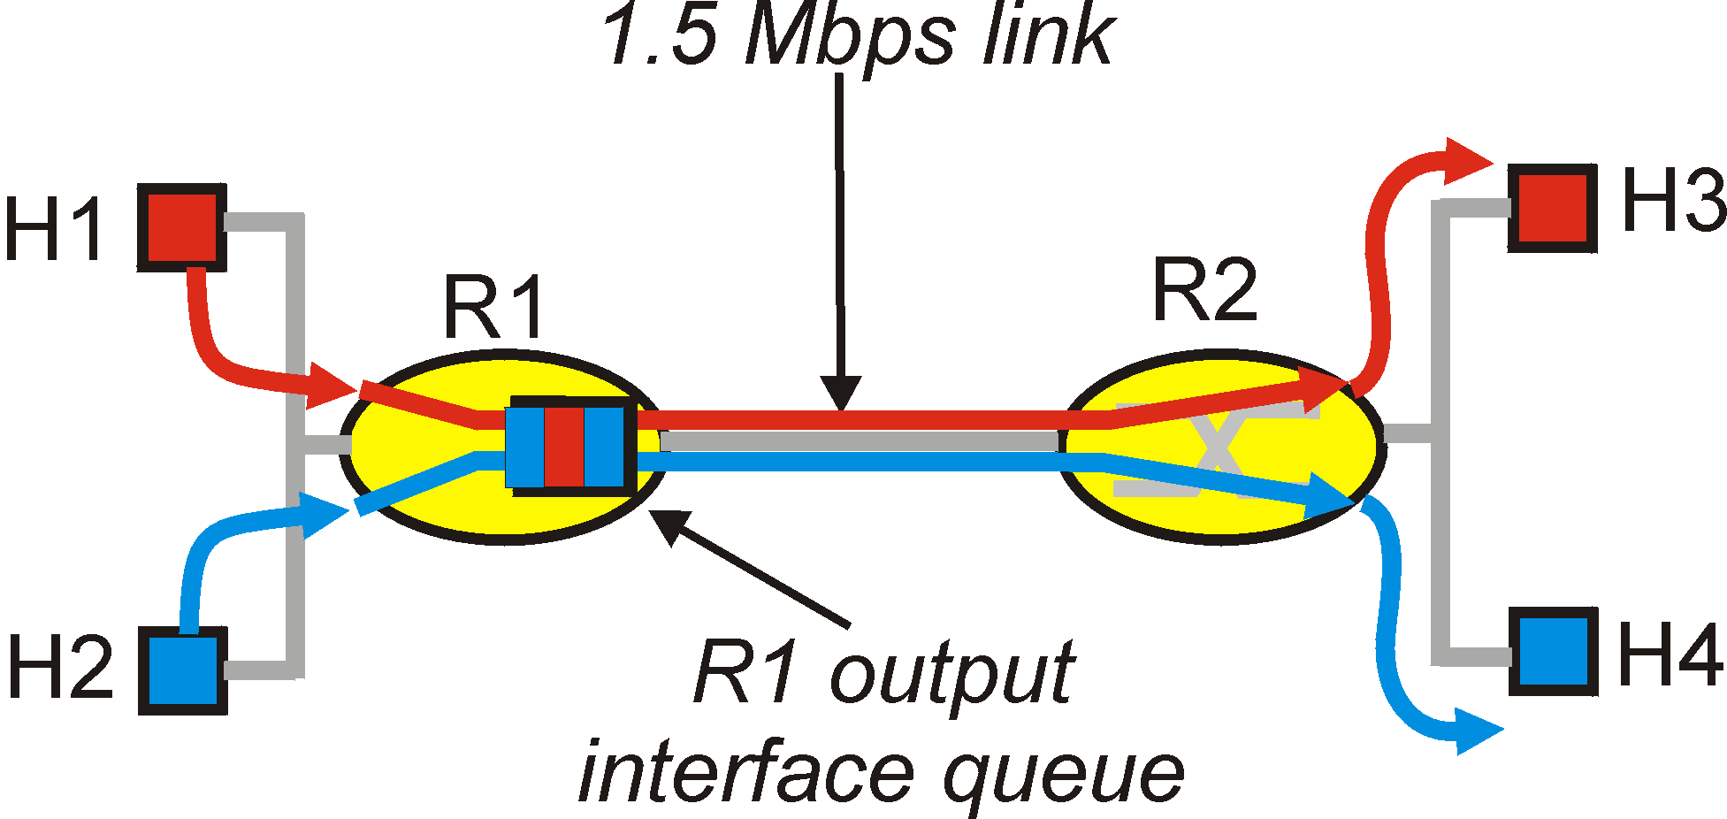
Improving QOS in IP Networks
Thus far: “making the best of best effort”
Future: next generation Internet with QoS guarantees
RSVP: signaling for resource reservations
Differentiated Services: differential guarantees
Integrated Services: firm guarantees
simple model for sharing and congestion studies:

Slide 142
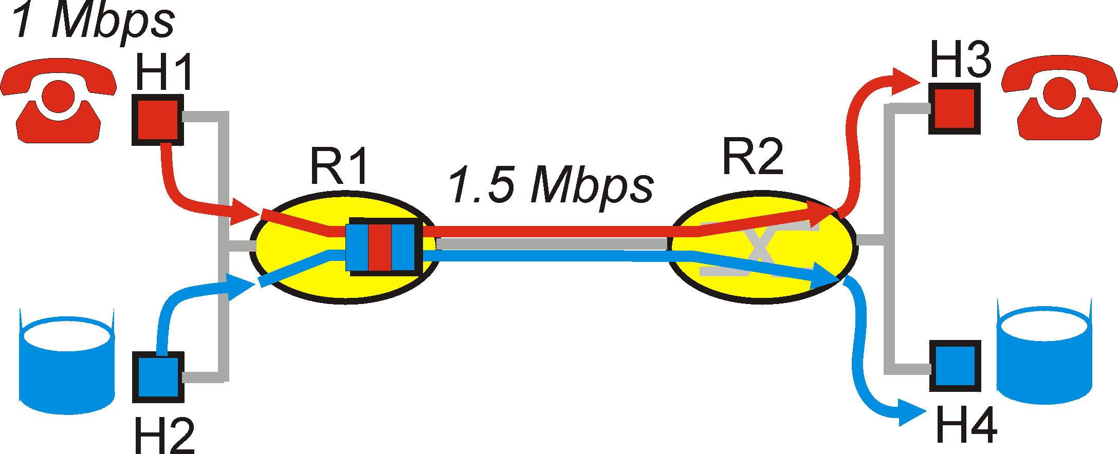
Principles for QOS Guarantees
Example: 1Mbps IP phones and FTP/p2p share 1.5 Mbps link.
bursts of FTP can congest router, cause audio loss
want to give priority to audio over FTP
Principle 1
packet marking needed for router to distinguish between different classes; and new router policy to treat packets accordingly

Slide 143
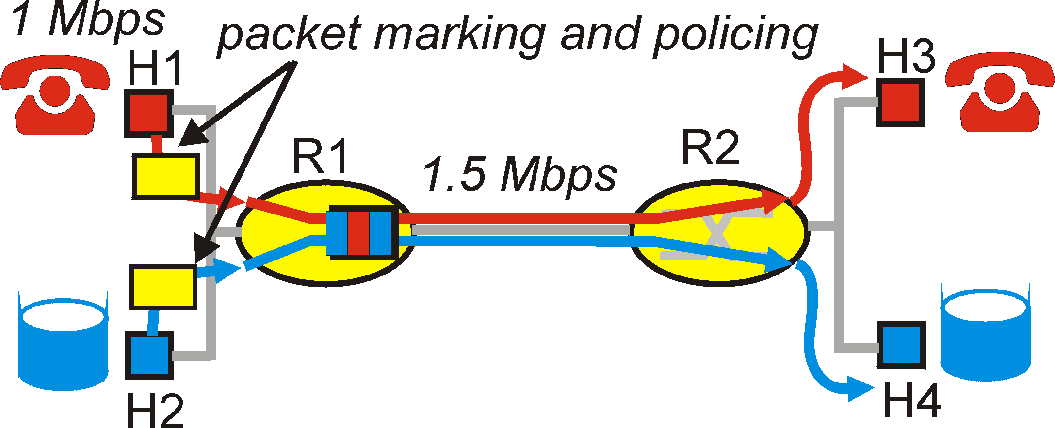
Principles for QOS Guarantees
what if applications misbehave (audio sends higher than declared rate)
policing: force source adherence to bandwidth allocations
marking and policing at network edge:
similar to ATM UNI (User Network Interface)
Principle 2
provide protection (isolation) for one class from others

Slide 144
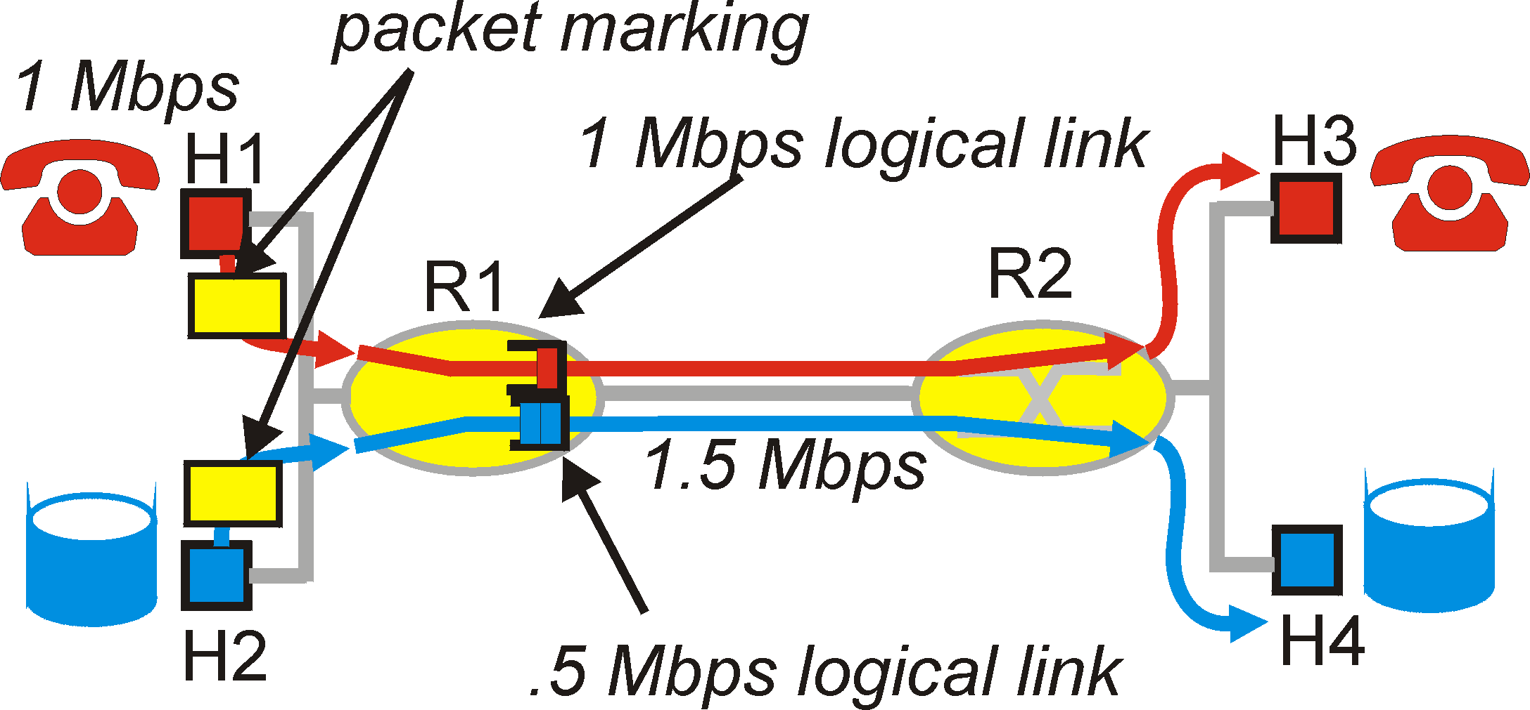
Principles for QOS Guarantees
Allocating fixed (non-sharable) bandwidth to flow: inefficient use of bandwidth if flows doesn’t use its allocation
Principle 3
While providing isolation, it is desirable to use resources as efficiently as possible

Slide 145
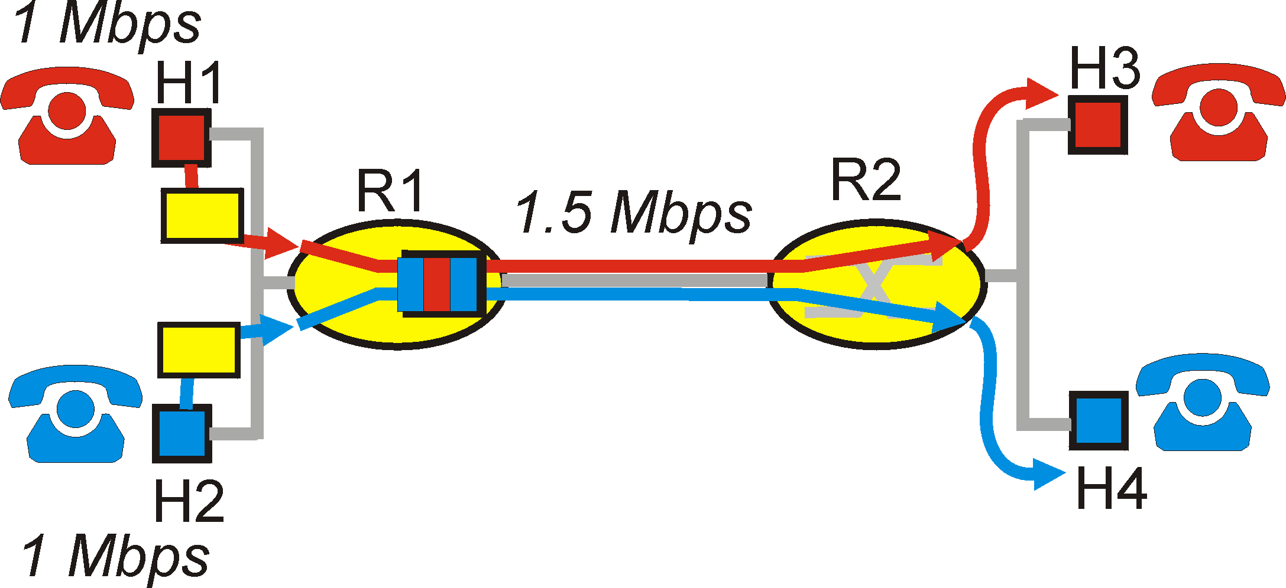
Principles for QOS Guarantees
Basic fact of life: can not support traffic demands beyond link capacity
Principle 4
Call Admission: flow declares its needs, network may
block call (e.g., busy signal) if it cannot meet needs

Slide 146
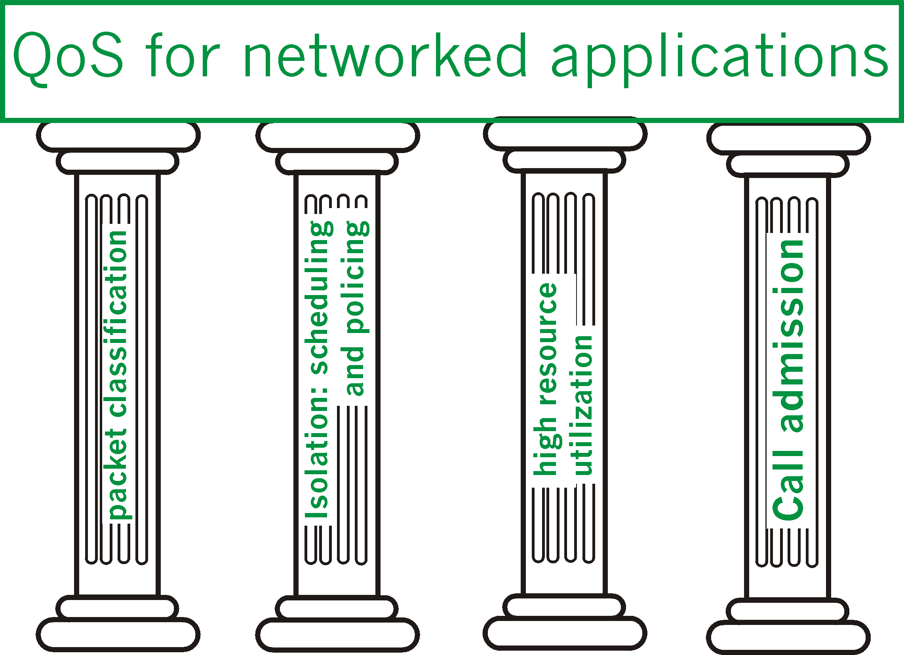
Summary of QoS Principles

Slide 147
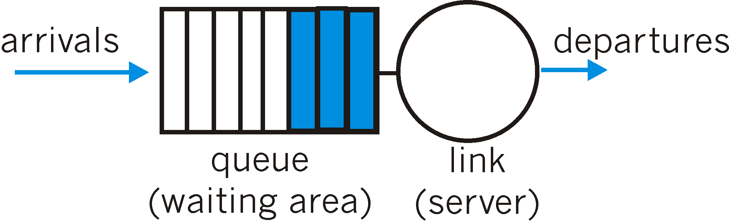
Scheduling And Policing Mechanisms
scheduling: choose next packet to send on link
FIFO (first in first out) scheduling: send in order of arrival to queue
discard policy: if packet arrives to full queue: who to discard?
Tail drop: drop arriving packet
priority: drop/remove on priority basis
random: drop/remove randomly

Slide 148
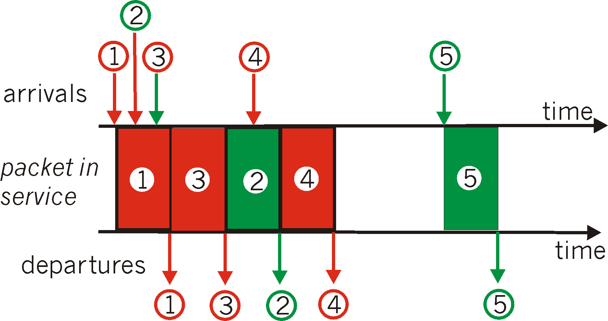
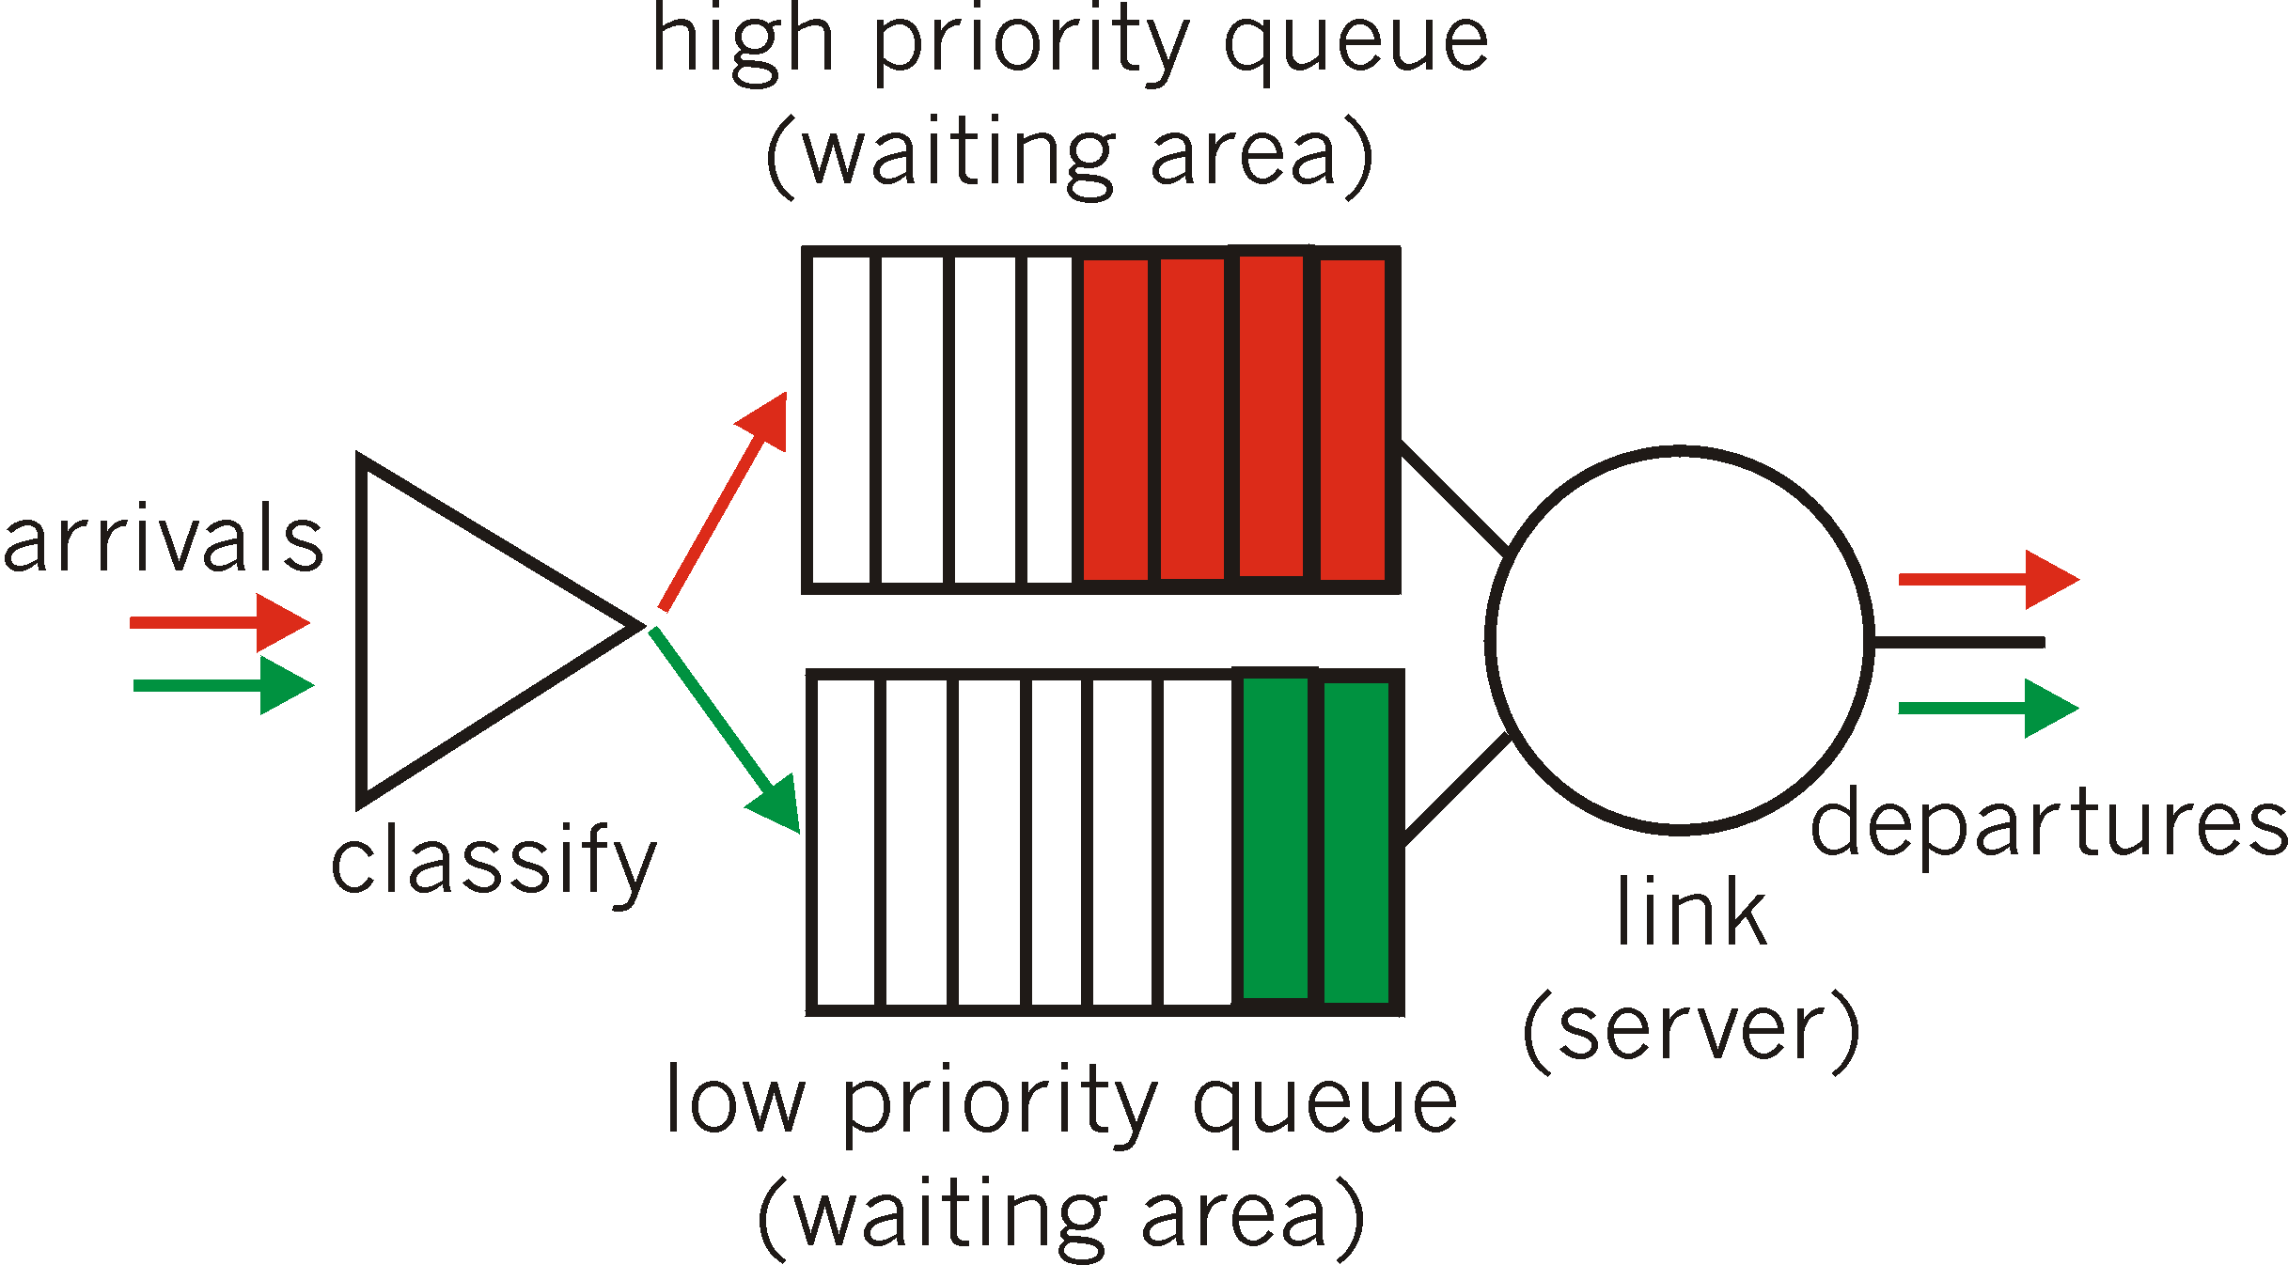
Scheduling Policies: more
Priority scheduling: transmit highest priority queued packet
multiple classes, with different priorities
class may depend on marking or other header info, e.g. IP source/dest, port numbers, etc..

Slide 149
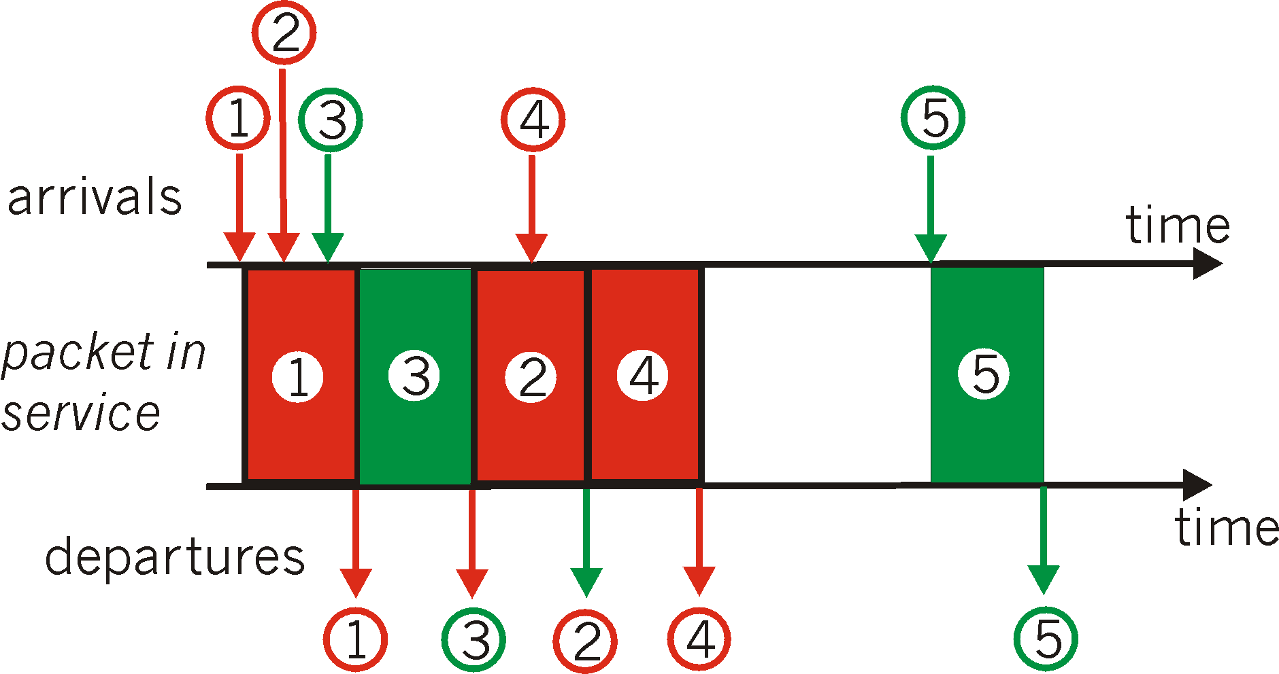
Scheduling Policies: still more
round robin scheduling:
multiple classes
cyclically scan class queues, serving one from each class (if available)

Slide 150
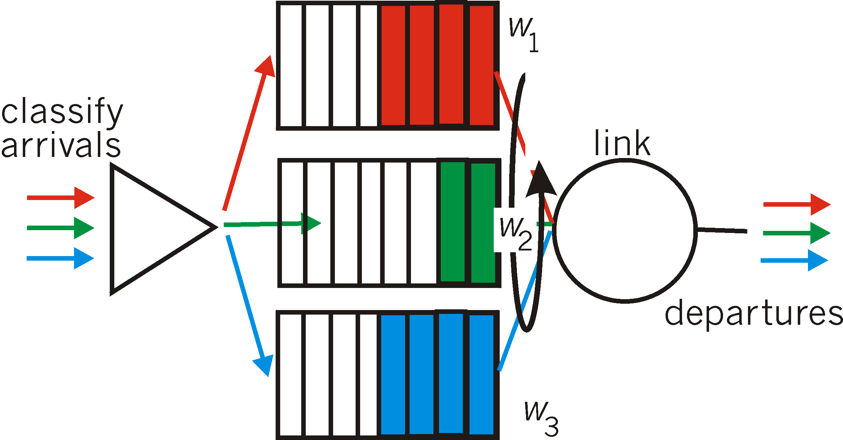
Scheduling Policies: still more
Weighted Fair Queuing:
generalized Round Robin
each class gets weighted amount of service in each cycle

Slide 151
IETF Differentiated Services
Diffserv approach:
simple functions in network core, relatively complex functions at edge routers (or hosts)
Do’t define define service classes, provide functional components to build service classes

Slide 152

Diffserv Architecture
scheduling
.
.
Edge router:
per-flow traffic management
marks packets as in-profile and out-profile
.
Core router:
per class traffic management
buffering and scheduling based on marking at edge
preference given to in-profile packets
Assured Forwarding
marking

Slide 153
Edge router pckt marking
profile: pre-negotiated rate A, bucket size B
packet marking at edge based on per-flow profile
Rate A
B
User packets
Possible usage of marking:
class-based marking: packets of different classes marked differently
intra-class marking: conforming portion of flow marked differently than non-conforming one

Slide 154
Classification and Conditioning
Packet is marked in the Type of Service (TOS) in IPv4, and Traffic Class in IPv6
6 bits used for Differentiated Service Code Point (DSCP) and determine PHB that the packet will receive
2 bits are currently unused

Slide 155
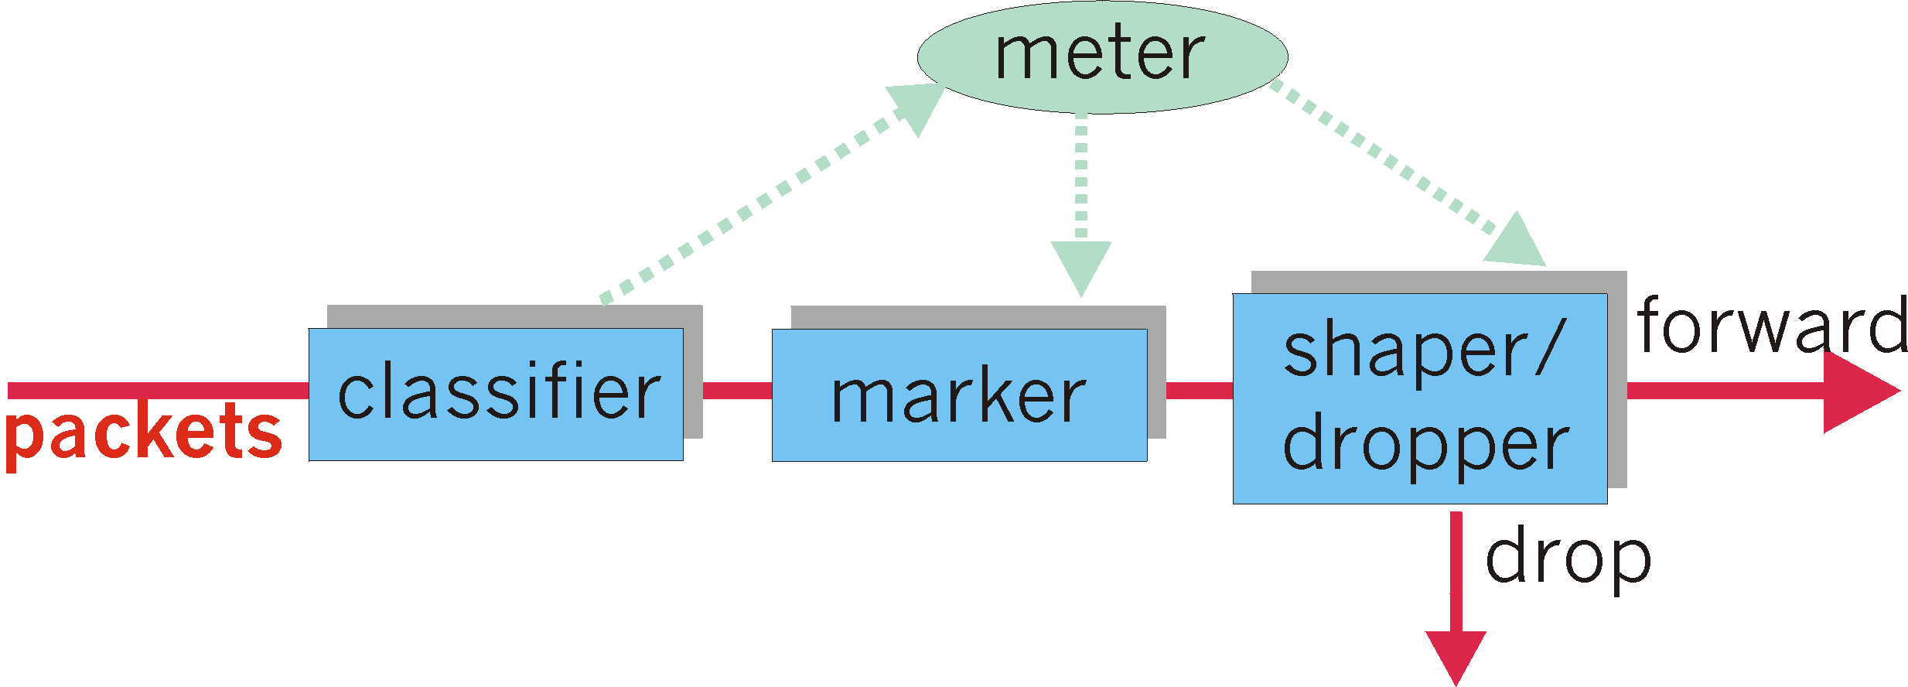
Classification and Conditioning
may be desirable to limit traffic injection rate of some class:
user declares traffic profile (e.g., rate, burst size)
traffic metered, shaped if non-conforming

Slide 156
Firewalls

Slide 157
Firewalls
By conventional definition, a firewall is a partition made
of fireproof material designed to prevent the spread
of fire from one part of a building to another.
firewall
isolates organization’s internal net from larger Internet, allowing some packets to pass, blocking others.
privately administered
Internet
222.22/16

Slide 158
Firewall goals
All traffic from outside to inside and vice-versa passes through the firewall.
Only authorized traffic, as defined by local security policy, will be allowed to pass.
The firewall itself is immune to penetration.

Slide 159
Firewalls: taxonomy
Traditional packet filters
filters often combined with router, creating a firewall
Stateful filters
Application gateways
Major firewall vendors:
Checkpoint
Cisco PIX

Slide 160
Traditional packet filters
Analyzes each datagram going through it; makes drop decision based on:
source IP address
destination IP address
source port
destination port
TCP flag bits
SYN bit set: datagram for connection initiation
ACK bit set: part of established connection
TCP or UDP or ICMP
Firewalls often configured to block all UDP
direction
Is the datagram leaving or entering the internal network?
router interface
decisions can be different for different interfaces

Slide 161
Filtering Rules - Examples
Policy | Firewall Setting
No outside Web access. | Drop all outgoing packets to any IP address, port 80
Outside connections to public Web server only. | Drop all incoming TCP SYN packets to any IP except 130.207.244.203, port 80
Prevent Web-radios from eating up the available bandwidth. | Drop all incoming UDP packets - except DNS and router broadcasts.
Prevent your network from being used for a Smuft DoS attack. | Drop all ICMP packets going to a “broadcast” address (eg 130.207.255.255).
Prevent your network from being tracerouted | Drop all incoming ICMP

Slide 162
Access control lists
Apply rules from top to bottom:
action | source address | dest address | protocol | source port | dest port | flag bit
allow | 222.22/16 | outside of 222.22/16 | TCP | > 1023 | 80 | any
allow | outside of 222.22/16 | 222.22/16 | TCP | 80 | > 1023 | ACK
allow | 222.22/16 | outside of 222.22/16 | UDP | > 1023 | 53 | ---
allow | outside of 222.22/16 | 222.22/16 | UDP | 53 | > 1023 | ----
deny | all | all | all | all | all | all

Slide 163
Access control lists
Each router/firewall interface can have its own ACL
Most firewall vendors provide both command-line and graphical configuration interface

Slide 164
Advantages and disadvantages of traditional packet filters
Advantages
One screening router can protect entire network
Can be efficient if filtering rules are kept simple
Widely available. Almost any router, even Linux boxes
Disadvantages
Can be penetrated
Cannot enforce some policies. For example, permit certain users.
Rules can get complicated and difficult to test

Slide 165
Firewall Lab: iptables
Converts linux box into a packet filter.
Part of most linux distributions today.
linux
host
linux
host w/
iptables
student
network
your job:
configure

Slide 166
Firewall lab: iptables
iptables
Provides firewall capability to a linux host
Comes installed with linux Fedora
With other versions of Linux, may need to install RPM

Slide 167
Chain types
Internet
linux
host w/
iptables
protected
network
INPUT
chain
Internet
linux
host w/
iptables
protected
network
OUTPUT
chain
Internet
linux
host w/
iptables
protected
network
FORWARD
chain

Slide 168
iptables: Example command
iptables –A INPUT –i eth0 –s 232.16.4.0/24 –j ACCEPT
Sets a rule
Accepts packets that enter from interface eth0 and have source address in 232.16.4/24
Kernel applies the rules in order.
The first rule that matches packet determines the action for that packet
Append: -A
Adds rule to bottom of list of existing rules

Slide 169
iptables: More examples
iptables –L
list current rules
iptables –F
flush all rules
iptables – D INPUT 2
deletes 2nd rule in INPUT chain
iptables –I INPUT 1 –p tcp –tcp-flags SYN –s 232.16.4.0/24 –d 0/0:22 –j ACCEPT
-I INPUT 1, put rule at top
Accept TCP SYNs to port 22 (ssh) from 232.16.4.0/24

Slide 170
iptables Options
-p protocol type (tcp, udp, icmp)
-s source IP address & port number
-d dest IP address & port number
-i interface name (lo, ppp0, eth0)
-j target (ACCEPT, DENY)
-l log this packet
--sport source port
--dport dest port
--icmp-type

Slide 171
Firewall Lab: Part A
Rules for outgoing traffic:
Your local machine should be able to communicate with the student network without any restrictions.
Rules for incoming traffic:
All incoming connection requests should be rejected, with the following exception:
Your machine should respond to Ping from network 10.0.0/24
Your machine should accept all incoming SSH, HTTP, FTP requests from Network 10.0/16
Your machine should accept all incoming telnet connections from the machine 10.0.0.1 and 10.0.0.110.
All multicast traffic should be allowed
OSPF traffic should be allowed

Slide 172
Firewall Lab: Part B
Rules for outgoing traffic from internal node:
Outgoing SSH, and ICMP traffic should be allowed
All multicast traffic should be allowed
OSPF traffic should be allowed
All other traffic should be blocked
Rules for incoming traffic to protected server:
All incoming SSH, http, SMTP, Ping, and anonymous ftp should be permitted
All multicast traffic should be allowed
OSPF traffic should be allowed
All other incoming traffic should be blocked

Slide 173
Stateful Filters
In previous example, any packet with ACK=1 and source port 80 gets in.
Attacker could, for example, attempt a malformed packet attack by sending ACK=1 segments
Stateful filter: Adds more intelligence to the filter decision-making process
Stateful = remember past packets
Memory implemented in a very dynamic state table

Slide 174
Stateful filters: example
Log each TCP connection initiated through firewall: SYN segment
Timeout entries which see no activity for, say, 60 seconds
source address | dest address | source port | dest port
222.22.1.7 | 37.96.87.123 | 12699 | 80
222.22.93.2 | 199.1.205.23 | 37654 | 80
222.22.65.143 | 203.77.240.43 | 48712 | 80
If rule table indicates that stateful table must be checked:
check to see if there is already a connection in stateful table
Stateful filters can also remember outgoing UDP segments

Slide 175
Stateful example
Packet arrives from outside: SA=37.96.87.123, SP=80, DA=222.22.1.7, DP=12699, SYN=0, ACK=1
Check filter table ➜ check stateful table
action | source address | dest address | proto | source port | dest port | flag bit | check conxion
allow | 222.22/16 | outside of 222.22/16 | TCP | > 1023 | 80 | any
allow | outside of 222.22/16 | 222.22/16 | TCP | 80 | > 1023 | ACK | x
allow | 222.22/16 | outside of 222.22/16 | UDP | > 1023 | 53 | ---
allow | outside of 222.22/16 | 222.22/16 | UDP | 53 | > 1023 | ---- | x
deny | all | all | all | all | all | all
3) Connection is listed in connection table ➜ let packet through

Slide 176
Demarcation Zone (DMZ)
application
gateway
firewall
Internet
Internal
network
Web
server
DNS
server
FTP
server
Demilitarized zone

